Slide 1
RESTful APIs
By Larry Ohaka
4/28/2021
WEB420

Slide 2

WHAT ARE RESTful APIs?
APIs , which stand for Application Programming Interface, is an application programming interface that follow the architectural layout of REST-- which in turn allows for interaction with RESTful web services

Slide 3

APIs
You can think of an API as a mediator between the users or clients and the resources or web services they want to get. It’s also a way for an organization to share resources and information while maintaining security, control, and authentication—determining who gets access to what.

Slide 4

HOW ARE THEY USED
RESTful APIs are used when they break down incoming transactions to create smaller packaged modules.
By doing this it provides developers with more flexibility-- although this can be challenging for developers to design their APIs from scratch.
RESTful APIs use different commands to obtain resources. The four most common being :
GET
POST
PUT
DELETE

Slide 5
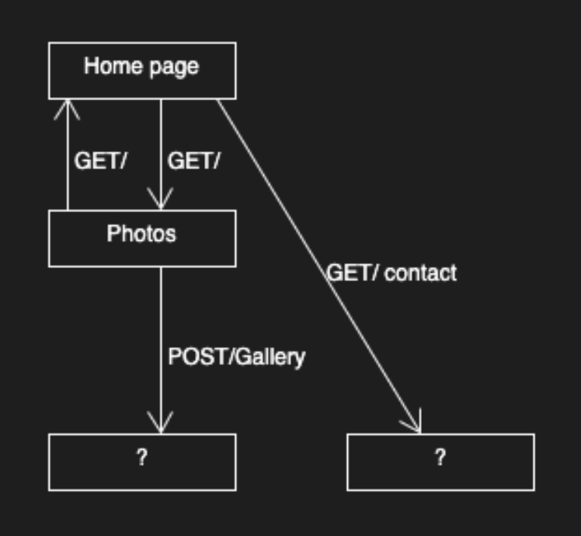
WEBSITE COMMUNICATIONS
There are ways for API clients to directly interact with chosen APIs; to do this, one must send different types of HTTP messages. There are eight different types of these methods but only four of them are used commonly. Methods such as GET, DELETE, POST, and PUT are the most commonly used-- the remaining are HEAD, OPTIONS, CONNECT, and TRACE.

Slide 6

ADVANTAGE OF RESTFUL APIS: scalability
There is little to no difficulty for developmental teams to scale the product because of the separation between clients and servers.
The server end of REST is stateless, meaning the server doesn't have to store anything across requests
There doesn't have to be (much) communication between servers, making it horizontally scalable.

Slide 7

ADVANTAGE OF RESTFUL APIS: flexibility and portability
It is possible for front and back to be hosted on different servers giving the advantage to management. RESTful can handle multiple types of calls because of it not being tied to resources or methods.

Slide 8

ADVANTAGE OF RESTFUL APIS: independence
Another advantage of the separation of client and server is for projects to be developed in separate places
Adaption to simultaneous work on the same project follows updates to both the syntax and platform edits

Slide 9

DISADVANTAGE OF RESTFUL APIS: lack of state
The maintaining of the state of something like the amount of items selected for purchase in a e-commerce website for example-- this burden lies on the client.

Slide 10

DISADVANTAGE OF RESTFUL APIS: lack of security
There isn't much security RST imposes, unlike SOAP
WIth this lack of security because of its public URLs, confidential data between the server and the client is not existent .

Slide 11
DIFFERENCE BETWEEN URI AND URL
Though most of the time URI and URL are used interchangeably. They aren't the same
URI identifies specific resources (example: a document or a picture file)
URL does the same thing however it identifies in which way you will access it (example: HTTPS, FTP, etc)

Slide 12
REFERENCES
“What is a REST API?”.https://www.redhat.com/en/topics/api/what-is-a-rest-api
“WHAT ARE THE ADVANTAGES OF A REST API?”https://www.chakray.com/advantages-of-rest-api/
“Advantages and Disadvantages of REST API”https://krify.co/advantages-and-disadvantages-of-rest-api/
Gillis, Alexander S. “REST API (RESTful API)”https://searchapparchitecture.techtarget.com/definition/RESTful-API#:~:text=A%20RESTful%20API%20is%20an,deleting%20of%20operations%20concerning%20resources.

