Slide 1
Stochastic optimal control
Part 3: Positive definitesness preserving Lyapunov discretisation

Slide 2
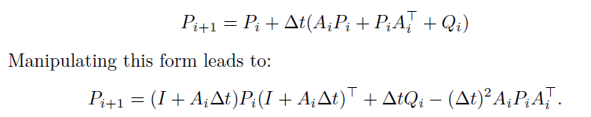
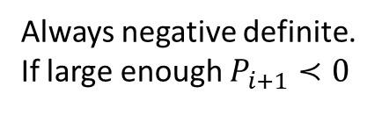
Problem: Integration error can result in negative definite covariance matrix
Always negative definite.
If large enough $P_{i+1}≺0$
Negative definite covariance → negative variances, which is impossible
Optimization algorithm could then ‘misuse’/optimize the integration error to get negative uncertainty and minimize the objective

Slide 3
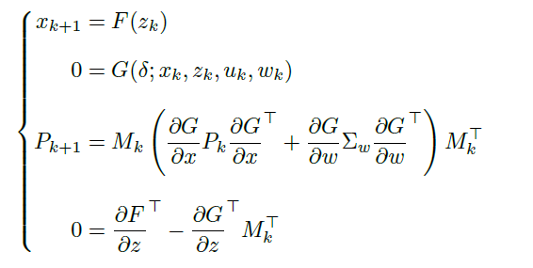

Thesis Joris Gillis: positive definiteness preserving Lyapunov discretisation
Helper variables for implicit integration (e.g. collocation points)
Implicit formulation of integration scheme
$M_{k}$ helper variable to avoid inversion

Slide 4




Example: foward Euler
${x_{k+1}=z}_{k}$
$0=G\left(x_{k},u_{k},w_{k}\right)=z_{k}−(x_{k}+δ∙f(x_{k},$ $u_{k},w_{k}))$
$\frac{∂G}{∂x}=−I−δ$ $∙A$
$\frac{∂G}{∂w}=−δ$ $∙C$
$\frac{∂G}{∂z}=I$
$\frac{∂F}{∂z}=I$
Remember:
$$A\left(t\right)=\frac{∂f\left(x\left(t\right),u\left(t\right),w\left(t\right)\right)}{∂x}$$
$$C\left(t\right)=\frac{∂f\left(x\left(t\right),u\left(t\right),w\left(t\right)\right)}{∂w}$$
$$⇒M_{k}=I$$
$P_{k+1}=(I+δ ∙A)P_{k}$ ${\left(I+δ ∙A\right)}^{′}+δ^{2}CΣ_{w}^{′}C′$
Compare to original integration → the negative definit term is added (always overestimate $P_{k+1}$)

Slide 5


Example: trapezoidal integration
${x_{k+1}=z}_{k}$
$0=G\left(x_{k},u_{k},w_{k}\right)=z_{k}−(x_{k}+\frac{δ}{2}∙(f(x_{k},$ $u_{k},w_{k})+f(z_{k}, u_{k+1},w_{k+1})))$
$\frac{∂G}{∂x}=−I−\frac{δ}{2}∙A_{k}$
$\frac{∂G}{∂w}=−\frac{δ}{2}∙C_{k}−$ $\frac{δ}{2}∙C_{k+1}$
$\frac{∂G}{∂z}=I−\frac{δ}{2}∙A_{k+1}$
$\frac{∂F}{∂z}=I$
$$C_{k}=C_{k+1}$$
$P_{k+1}=a bit more complex$ ☺
Always use a trapezoidal scheme! (last part of the supplementary of my paper)

Slide 6
Revisit the pendulum swing-up problem
Check the propagation of P
We can take large time steps without risking to get negative definite P; useful to do testruns of stochastic OCPs

