Slide 1
Stochastic optimal control
Part 3: Different formulations for the approximate SOC framework

Slide 2
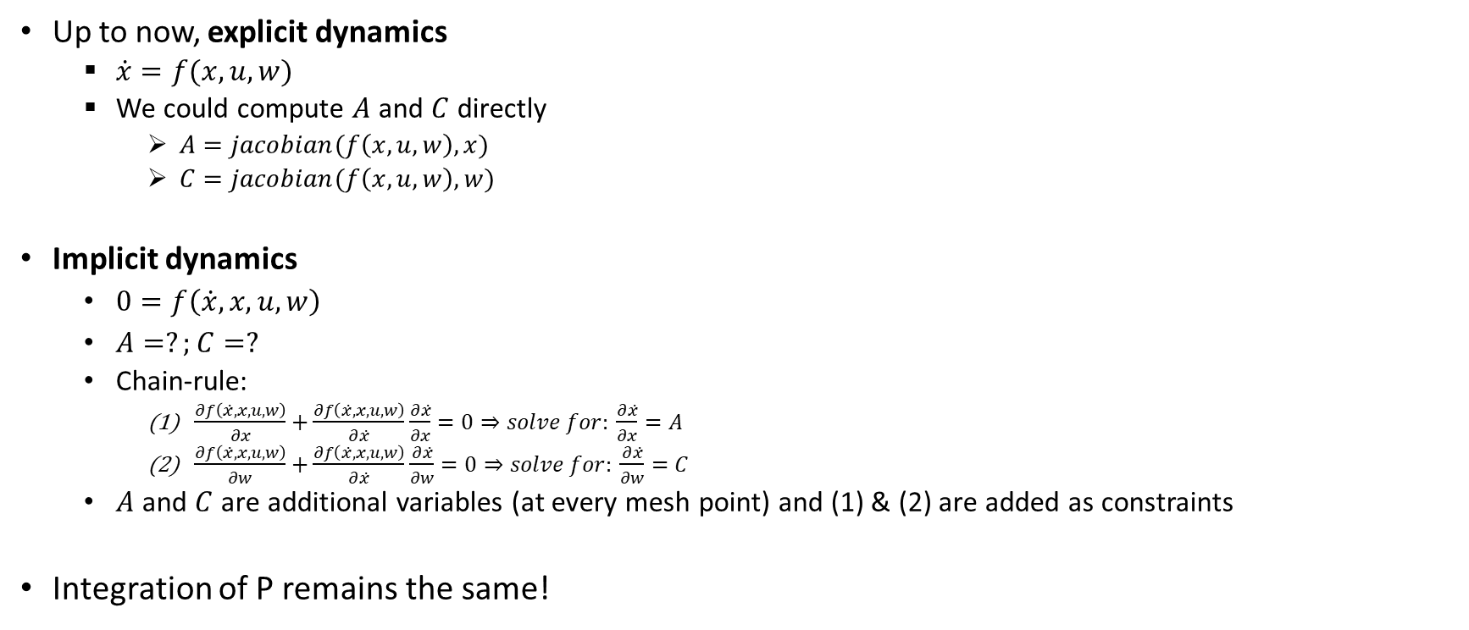
Explicit & implicit system dynamics
Up to now, explicit dynamics
$\dot{x}=f(x,u,w)$
We could compute $A$ and $C$ directly
$A=jacobian(f\left(x,u,w\right),x)$
$C=jacobian(f\left(x,u,w\right),w)$
Implicit dynamics
$0=f\left(\dot{x},x,u,w\right)$
$A=?;C=?$
Chain-rule:
$\frac{∂f\left(\dot{x},x,u,w\right)}{∂x}+$ $\frac{∂f\left(\dot{x},x,u,w\right)}{∂\dot{x}}$ $\frac{∂\dot{x}}{∂x}=0⇒solve for: \frac{∂\dot{x}}{∂x}=A$
$\frac{∂f\left(\dot{x},x,u,w\right)}{∂w}+$ $\frac{∂f\left(\dot{x},x,u,w\right)}{∂\dot{x}}$ $\frac{∂\dot{x}}{∂w}=0⇒solve for: \frac{∂\dot{x}}{∂w}=C$
$A$ and $C$ are additional variables (at every mesh point) and (1) & (2) are added as constraints
Integration of P remains the same!

Slide 3
Explicit & implicit system dynamics
Note that now also the integration of the mean state is different (as we are used to)
Introduce ‘slack’ variables for the derivatives of the state
Add constraints to determine these slack variables
Integration of the mean state by use of these slack variables
Try to re-write the pendulum swing-up problem with implicit dynamics
Make a comparison for number of variables; non-zeros in the jacobian etc. (start from example 4_1)

Slide 4
Shooting or ‘collocating’ P
Assumption is that we always use collocation for the mean state
Mean state at every mesh point is a variable (as in our examples)
In examples of session 2 and 3, shooting is used to propagate P
There is a variable P (Pvar), discretized at every time point.
This is just to extract P easily from the solution and plot it; we can remove it directly!
P at the end thus depends on all previous P’s and all previous x_mean’s.
Example 4_2 is a collocation version. Decouple P from previous P’s and x_mean’s

Slide 5
Some things you can do to improve convergence when collocating P.
A problem when collocating P is that it can be negative definite throughout iterations (this can’t happen when shooting). This is bad for convergence!!
If you have P collocation, impose that diagonal elements are positive
opti.subject_to( P(1,1,:) > 1e-8)
This avoids solve trying to make those values negative to minimize the objective
Another way to avoid this is to decompose P
P = L*L’; with L a lower triangular matrix. This guarantees P to be positive definite
L are the variables instead of P. Compute P at each meshpoint from L.
Re-write example 4_2 with decomposition of P.

