Slide 1
Stochastic optimal control
Part 2: Simulation of a non-linear stochastic system

Slide 2
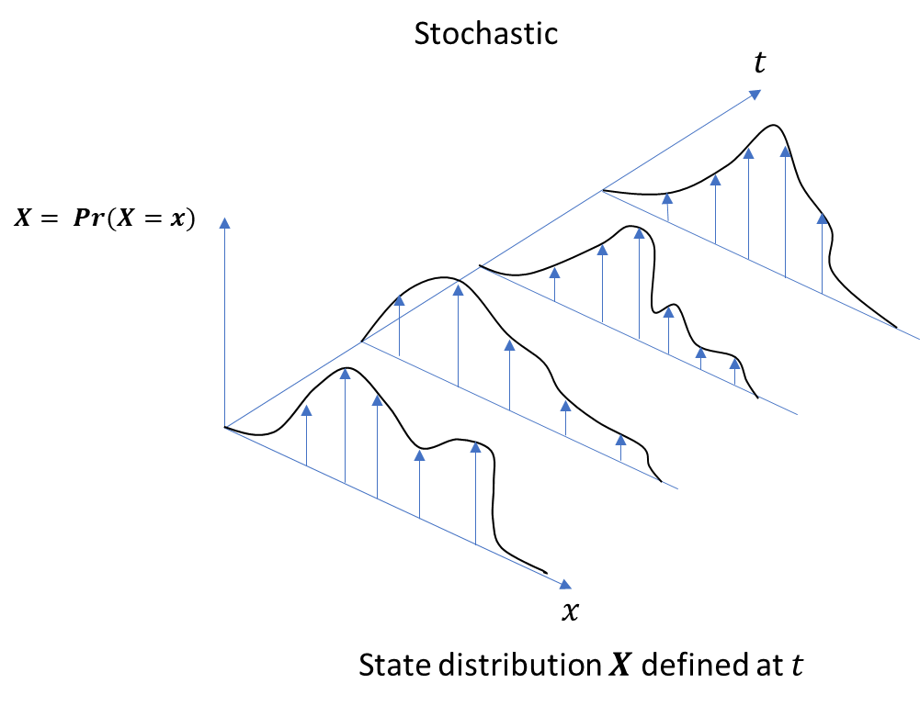




Revision: Simulation of linear stochastic dynamic system
= simulation of a state probability distribution rather than state vector
We assume state distribution to be Gaussian: mean + covariance
$$x_{m}$$
$$P$$
First-order SDE (stochastic differential equation) – state space representation
$$\dot{X}=AX+Bu+Cw$$
$${\dot{x}}_{m}=Ax_{m}+Bu$$
→ Lyapunov equation
$$\dot{P}\text{=}\text{A}∙P+P∙A^{′}+CΣ_{w}C′$$
propagation
injection
$Σ_{w}$ - spectral density of noise sources

Slide 3




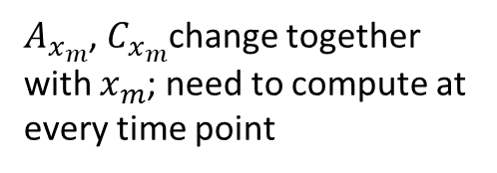


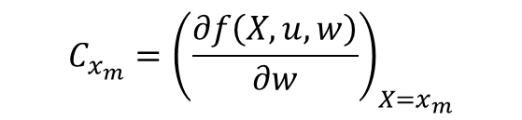

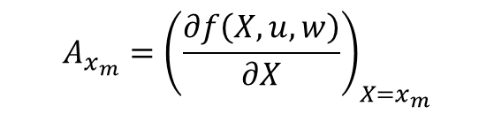

Simulation of non-linear stochastic dynamic system
Non-linear stochastic dynamics
$$\dot{X}=f\left(X,u,w\right)$$
$${\dot{x}}_{m}=f\left(x_{m},u,w=0\right)$$
➔ deterministic non-linear dynamics; business as usual
$\dot{P}$ = ?
Before, we had: $\dot{P}\text{=}\text{A}∙P+P∙A^{′}+CΣ_{w}C′$
based on :: $\dot{X}=AX+Bu+Cw$
we can linearize
$$\dot{X}=f\left(X,u,w\right)$$
with respect to $x_{m}$ to achieve the same form
$${\dot{X}}_{x_{m}}=A_{x_{m}}X+B_{x_{m}}u+C_{x_{m}}w$$
$\text{A}∙P$ $+ P∙A^{′}$
“to what extent does the derivative of our state vector change when the state is varying around the mean state vector”, “multiplied with the variability around that mean state vector”
$$A_{x_{m}}={\left(\frac{∂f\left(X,u,w\right)}{∂X}\right)}_{X=x_{m}}$$
$A_{x_{m}}$, $C_{x_{m}}$change together with $x_{m}$; need to compute at every time point
$$CΣ_{w}C′$$
$$C_{x_{m}}={\left(\frac{∂f\left(X,u,w\right)}{∂w}\right)}_{X=x_{m}}$$
“to what extent does the derivative of our state vector change when the intensity of noise is changing ”, “multiplied with the intensity of the noise source”

Slide 4
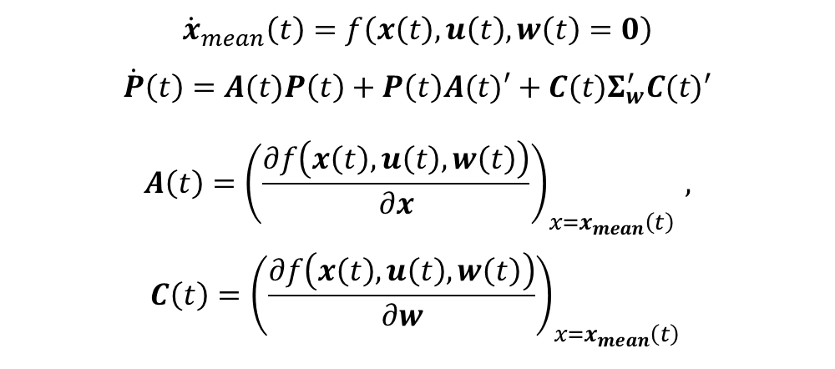
Simulation of non-linear stochastic dynamic system
$$\dot{X}=f\left(X,u,w\right)$$
$${\dot{x}}_{mean}\left(t\right)=f\left(x\left(t\right),u\left(t\right),w\left(t\right)=0\right)$$
$$\dot{P}\left(t\right)=A(t)P\left(t\right)+P\left(t\right)A(t)′+C(t)Σ_{w}^{′}{C(t)}^{′}$$
$$A\left(t\right)={\left(\frac{∂f\left(x\left(t\right),u\left(t\right),w\left(t\right)\right)}{∂x}\right)}_{x=x_{mean}\left(t\right) },$$
$$C\left(t\right)={\left(\frac{∂f\left(x\left(t\right),u\left(t\right),w\left(t\right)\right)}{∂w}\right)}_{x=x_{mean}\left(t\right) }$$
Note how in the case of a linear system A and C are constant in time and we get previous equations again.

Slide 5

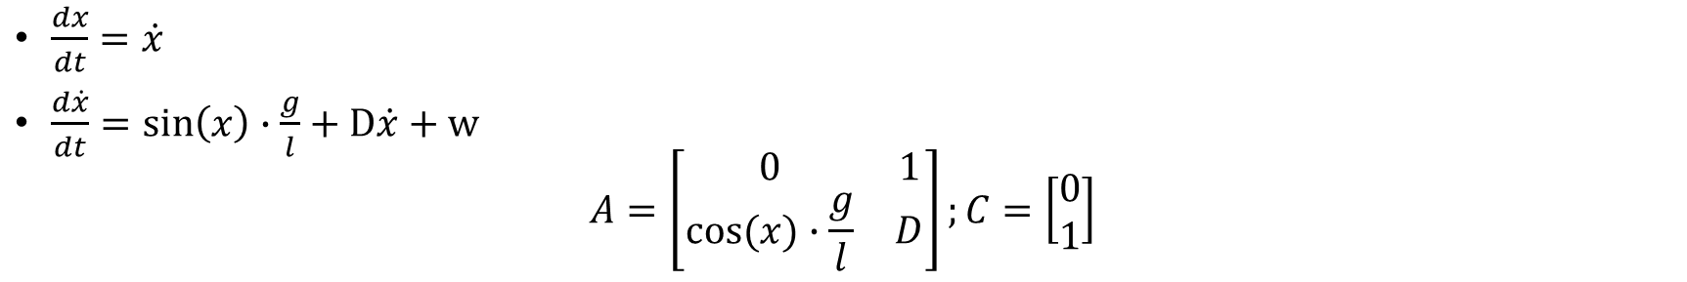
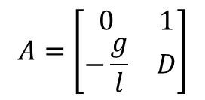

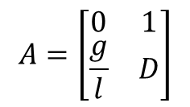
Example damped inverted pendulum
$\frac{dx}{dt}=\dot{x}$
$\frac{d\dot{x}}{dt}=\sin\left(x\right)∙\frac{g}{l}+D\dot{x}+w$
$$A=\left[\begin{matrix}0 & 1 \\ cos⁡(x)∙\frac{g}{l} & D\end{matrix}\right];C=\left[\begin{matrix}0 \\ 1\end{matrix}\right]$$
Note how $A$ drastically changes depending on $x$
Unstable/stable, growing uncertainty at rate of noise injection for velocity, superlinear growth for position.
Very unstable, exponentially growing uncertainty
Stable, uncertainty stabilizes at some fixed point (dependent on amount of noise injection)
$$A=\left[\begin{matrix}0 & 1 \\ \frac{g}{l} & D\end{matrix}\right]$$
$$A=\left[\begin{matrix}0 & 1 \\ −\frac{g}{l} & D\end{matrix}\right]$$
$$A=\left[\begin{matrix}0 & 1 \\ 0 & D\end{matrix}\right]$$

Slide 6
Example 1_1
Forward simulation of a pendulum sway around upright and around downward position
Pendulum is perturbed by stochastic torque
Interpret how uncertainty develops over time for the downward and upright position

Slide 7
Example 1_2
First stochastic optimal control problem!
Pendulum swing-up with minimal effort vs minimal uncertainty (endpoint position)
Only feedforward control – additive motor noise
Increasing noise, what happens to the trajectory?
What if we add feedback? (change constraints on feedback gain)
Compensating for noise (through feedback) is more expensive in upright position…

