Slide 1
Adapting example2_2 code
Lars D’Hondt

Slide 2
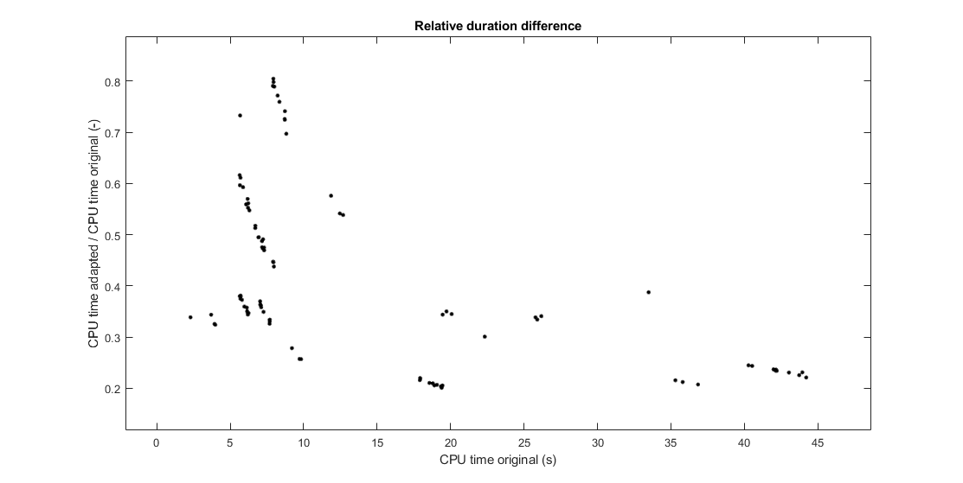

Slide 3
Changes
Creating dynamics casadi function:
use SX instead of MX
Create new opti instance for every noise factor:
create parametrised opti instance once
Loop over mesh intervals to integrate states:
Define casadi function to integrate states over k^{th} interval, with k^{th} and (k+1)^{th} as input. (using SX symbolic variables)
Map this function to N mesh intervals

Slide 4
Test 1
Run and time original code for noise factor 1 to 7 (example2_2.m)
Run and time adapted code for noise factor 1 to 7 (example2_2b.m)
Repeat 10 times to avoid influence of background programs (= 10 trials)
solver: mumps
feedback variables (K, D) constrained = 0

Slide 5
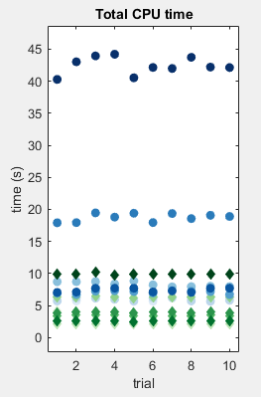
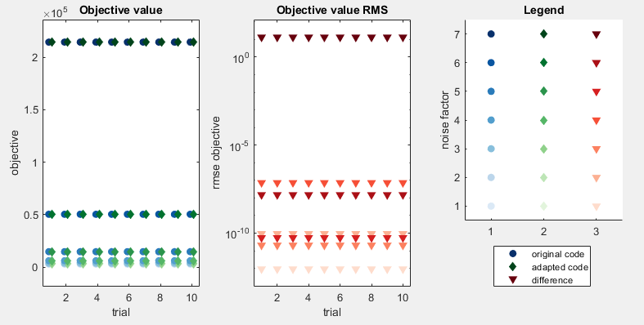
Duration and results are consistent between trials

Slide 6
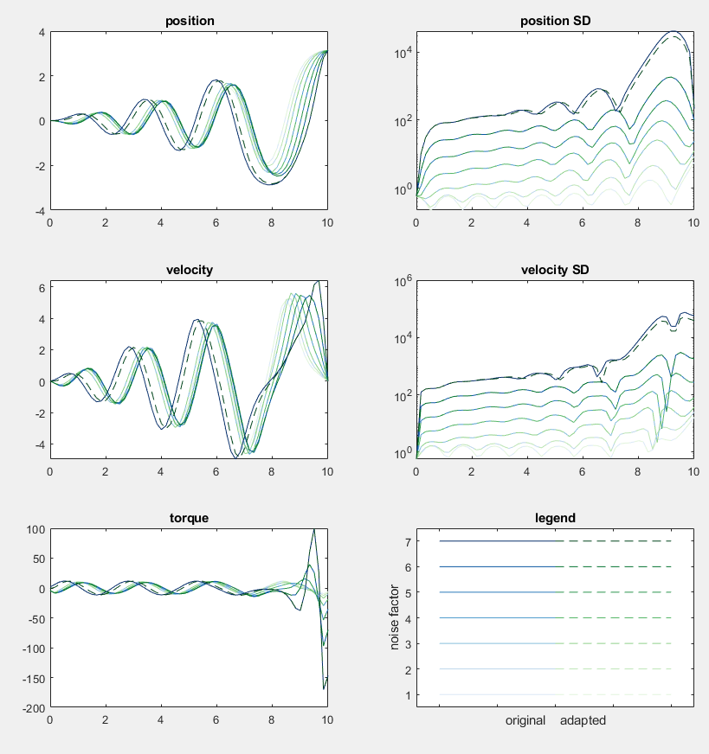
Adaptations give different results for higher noise
… but objective values are close

Slide 7
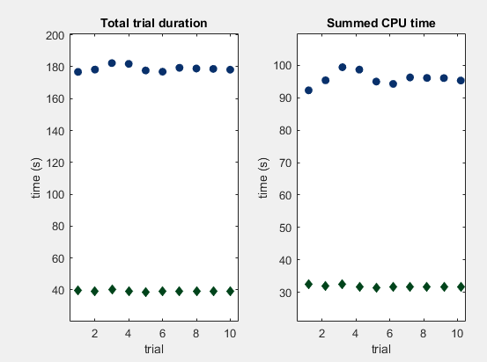
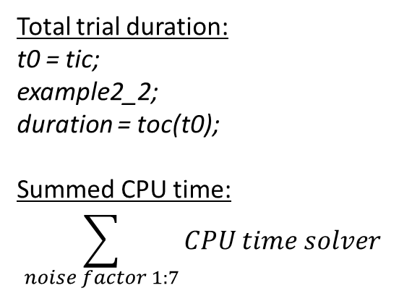
Original code spends more time not solving OCP’s
Mainly caused by parametrising opti
Total trial duration:
t0 = tic;
example2_2;
duration = toc(t0);
Summed CPU time:
$$\sum_{noise factor 1:7}{CPU time solver}$$

Slide 8
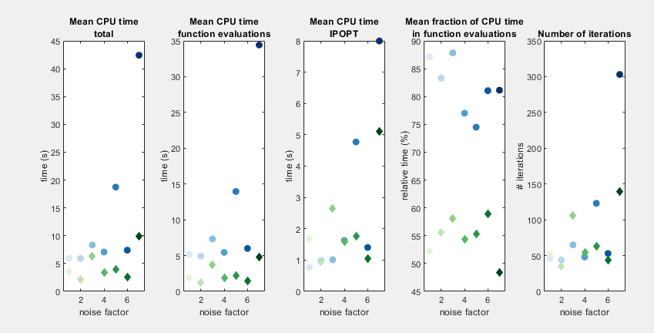
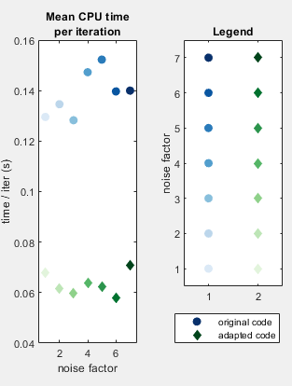
Adapted code solves OCP’s much faster
Iterations are faster (expression graph is more efficient?)
Less iterations needed (why?)
Difference increases with growing noise levels

Slide 9
Conclusion test 1
Avoid for-loops
Use SX to create functions
Solve OCP much faster
Functions defined by SX expressions have a much lower overhead per operation making it much faster for operations that are naturally written as a sequence of scalar operations. The SX expressions are thus intended to be used for low level operations.
The MX expressions act as a glue and enables the formulation of e.g. the constraint function of an NLP (which might contain calls to ODE/DAE integrators, or might simply be too large to expand as one big expression).
from: https://web.casadi.org/docs/#mixing-sx-and-mx

Slide 10
Test 2
Run and time original code for noise factor 1 to 6 (example2_2.m)
Run and time adapted code for noise factor 1 to 6 (example2_2b.m)
Repeat 3 times to avoid influence of background programs (= 3 trials)
solver: mumps
feedback variables (K, D) free, but constant in time

Slide 11
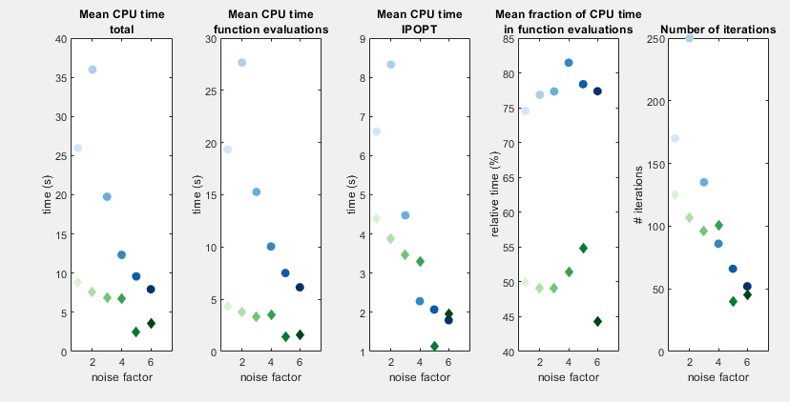
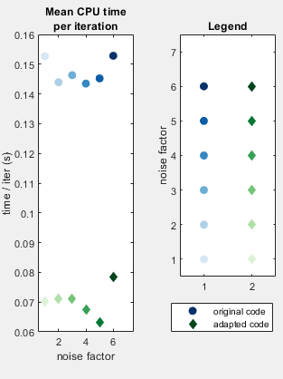
Adapted code solves OCP’s much faster
Iterations are faster (expression graph is more efficient?)
Less iterations needed (why?)
Difference decreases with growing noise levels

Slide 12
Test 3
Run and time original code for noise factor 2(example2_2.m)
Run and time adapted code for noise factor 2 (example2_2b.m)
Repeat 4 times different time step
solver: mumps
feedback variables (K, D) constrained = 0
final time unchanged -> vary N

Slide 13
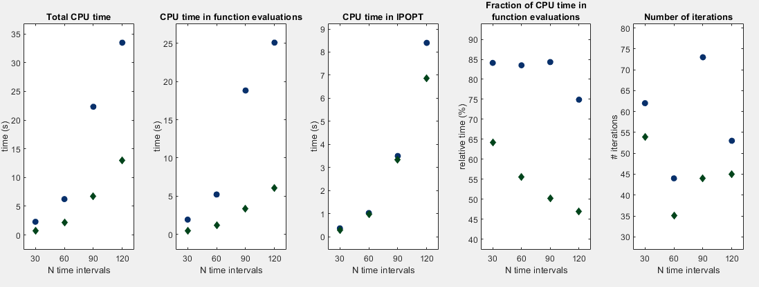
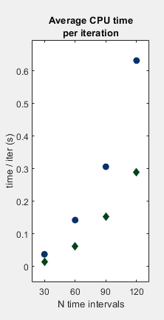
Adapted code scales better with mesh refinement

