Slide 1
Stochastic optimal control
Part 1: Simulation of a linear stochastic system

Slide 2






Deterministic vs stochastic variable
deterministic variable
Stochastic/random variable
$$x$$
$$X$$
is exactly determined
has a probability distribution
$$Pr(x=x)$$
$$X= Pr(X=x)$$
100%
$$x$$
$$x$$
- Coordinates of point-mass are exactly determined
- Coordinates of point-mass are described by a probability function

Slide 3







Deterministic and stochastic variables over time
1D case
(example of 1D system: point-mass moving on a straight line)
Deterministic
Stochastic
$$t$$
$$x$$
$$X= Pr(X=x)$$
$$t$$
State vector $x$ defined at $t$
$$x$$
State distribution $X$ defined at $t$

Slide 4
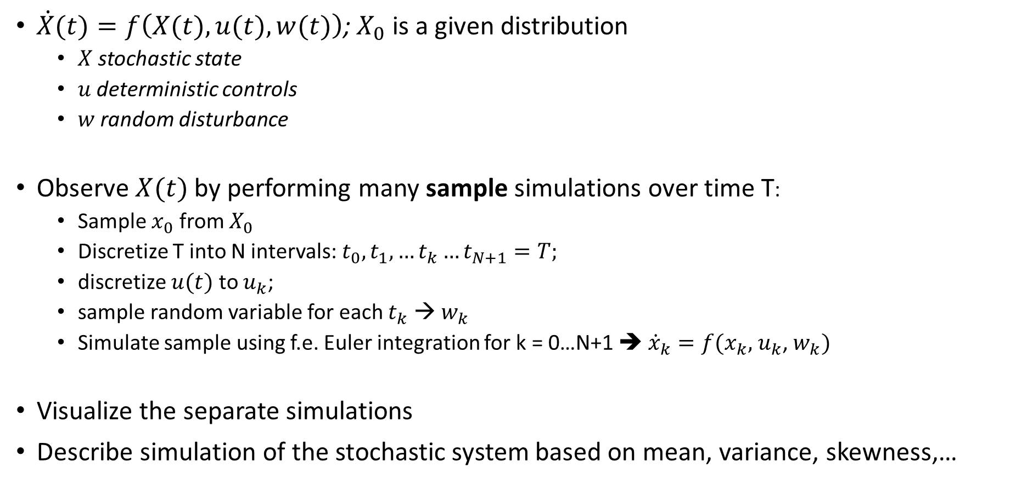
Monte Carlo approach to simulate stochastic system (1)
$\dot{X}(t)=f\left(X(t),u(t),w(t)\right)$; $X_{0}$ is a given distribution
$X$ stochastic state
$u$ deterministic controls
$w$ random disturbance
Observe $X(t)$ by performing many sample simulations over time T:
Sample $x_{0}$ from $X_{0}$
Discretize T into N intervals: $t_{0},t_{1},…t_{k}…t_{N+1}=T;$
discretize $u(t)$ to $u_{k}$;
sample random variable for each $t_{k}$ → $w_{k}$
Simulate sample using f.e. Euler integration for k = 0…N+1 ➔ ${\dot{x}}_{k}=f(x_{k},$ $u_{k}$, $w_{k})$
Visualize the separate simulations
Describe simulation of the stochastic system based on mean, variance, skewness,…

Slide 5
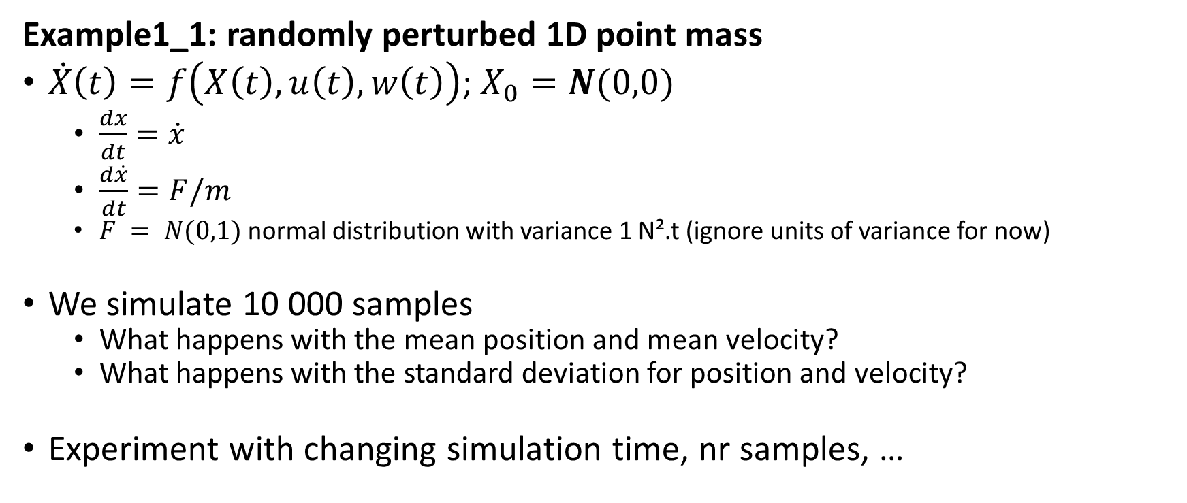
Monte Carlo approach to simulate stochastic system (2)
Example1_1: randomly perturbed 1D point mass
$\dot{X}\left(t\right)=f\left(X\left(t\right),u\left(t\right),w\left(t\right)\right)$; $X_{0}=N(0,0)$
$\frac{dx}{dt}=\dot{x}$
$\frac{d\dot{x}}{dt}=F/m$
$F = N(0,1)$normal distribution with variance 1 N².t (ignore units of variance for now)
We simulate 10 000 samples
What happens with the mean position and mean velocity?
What happens with the standard deviation for position and velocity?
Experiment with changing simulation time, nr samples, …

Slide 6
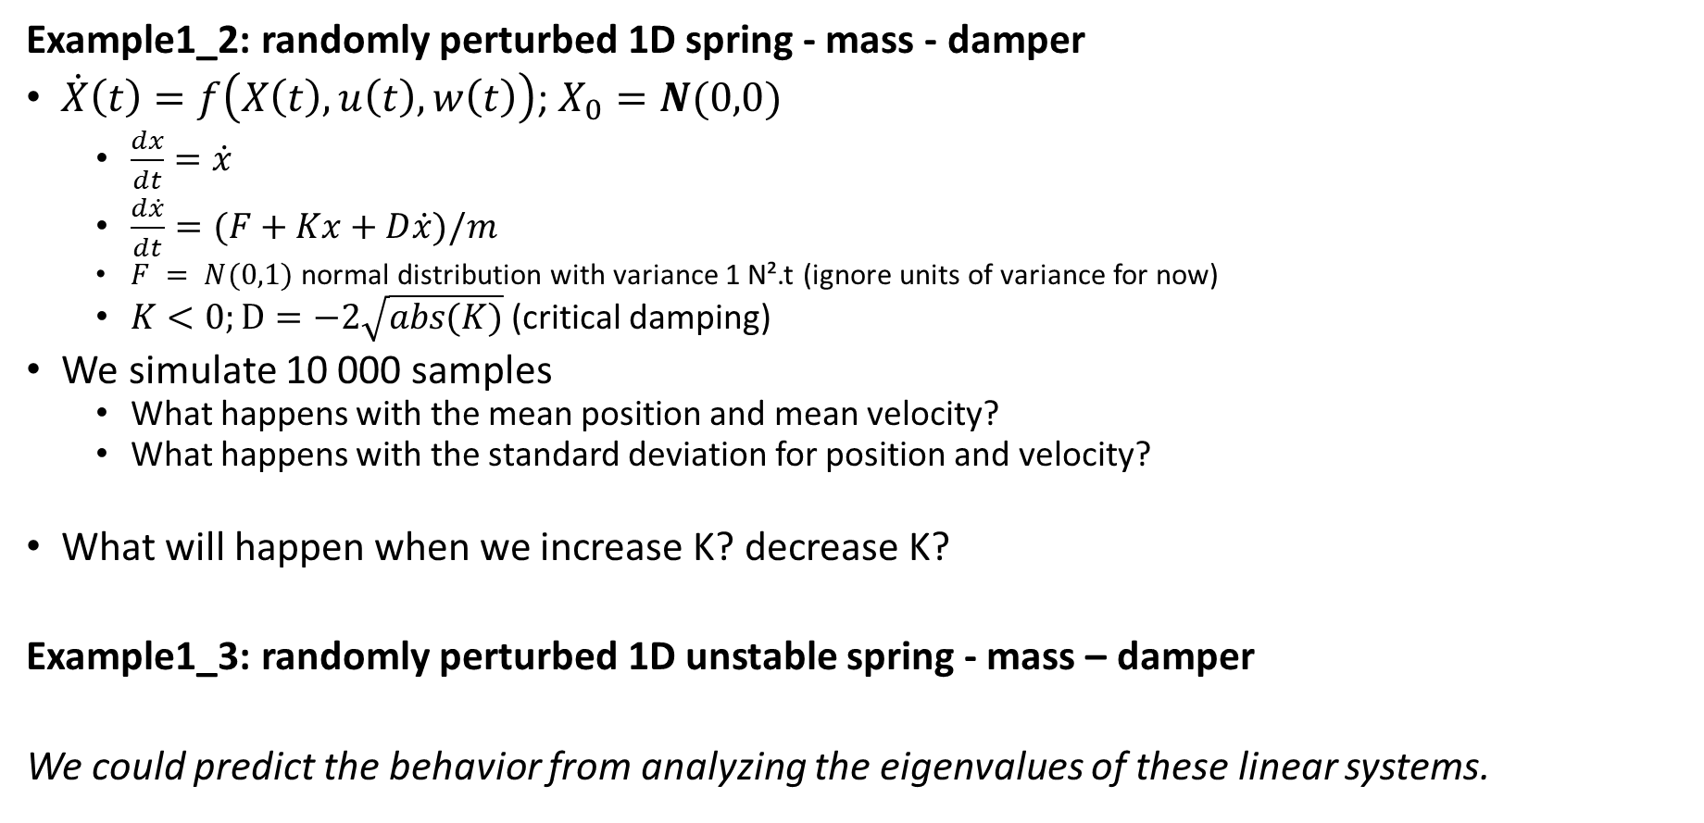
Monte Carlo approach to simulate stochastic system (3)
Example1_2: randomly perturbed 1D spring - mass - damper
$\dot{X}\left(t\right)=f\left(X\left(t\right),u\left(t\right),w\left(t\right)\right)$; $X_{0}=N(0,0)$
$\frac{dx}{dt}=\dot{x}$
$\frac{d\dot{x}}{dt}=(F+Kx+D\dot{x})/m$
$F = N(0,1)$normal distribution with variance 1 N².t (ignore units of variance for now)
$K<0;D=−2\sqrt{abs(K)}$ (critical damping)
We simulate 10 000 samples
What happens with the mean position and mean velocity?
What happens with the standard deviation for position and velocity?
What will happen when we increase K? decrease K?
Example1_3: randomly perturbed 1D unstable spring - mass – damper
We could predict the behavior from analyzing the eigenvalues of these linear systems.

Slide 7
Approximating the simulation of a stochastic system
For high-dimensional systems, Monte Carlo simulations are not practical.
How many are necessary?
Computational effort
We can approximate the evolution of a stochastic system by computing how the mean and covariance evolve over time
Today: we only look at linear systems; no approximation necessary. Just evolving the mean and covariance over time is exact!

Slide 8




Gaussian assumption for stochastic variable
For the performed simulations the mean and variance described the distributions exactly. Why?
→ Linear system, perturbed by Gaussian disturbance, Gaussian initial distribution
If any of these conditions are violated, mean and variance are not exact anymore.
Nevertheless we can do as if they are.
$$Pr(X=x)$$
This is a huge assumption when considering a complex, non-linear system such as the musculoskeletal system!
$$\sqrt{P}$$
$$x$$
$$x_{mean}$$
…but it is the only way to make computations tractable
[We could think about approximating the state distribution $X$ by a multimodal distribution (f.e. sum of Gaussians).]

Slide 9





Simulation of linear dynamic system
First-order ODE (ordinary differential equation)
Numerical integrator (problem/simulation discretized)
+
$$\dot{x}=f(x,u)$$
e.g.: $x_{t+δt}=x_{t}+δt∙f(x_{t},u_{t})$
Linear dynamics:
$$\dot{x}=f\left(x,u\right)↔\dot{x}=Ax+Bu$$
$$x_{t+δt}=x_{t}+δt∙(Ax_{t}+Bu_{t})$$
function linear in x
$$x_{t+δt}=(1+A∙δt)x_{t}+B∙δtu_{t}$$

Slide 10







Simulation of linear stochastic dynamic system
First-order ODE (ordinary differential equation)
Linear dynamics:
$$\dot{X}=f(X,u)$$
$$\dot{X}=f\left(X,u\right)↔\dot{X}=AX+Bu$$
No random disturbance
$X$ is described by a Gaussian distribution ($x_{m}$, $P$)
By definition
$${\dot{x}}_{m}=\frac{d}{dt}E\left[X\right]=Ε\left[\dot{X}\right]=E\left[AX+Bu\right]=A∙E\left[X\right]+Bu↔{\dot{x}}_{m}=Ax_{m}+Bu$$
$x_{m}=Ε[X$]
$$P=Ε[(X−x_{m}\text{)(}X−x_{m}\text{)′]}$$
$$\dot{P}=\frac{d}{dt}Ε[(X−x_{m}\text{)(}X−x_{m}\text{)′]}$$
$$\frac{d}{dt}\left(X−x_{m}\text{)(}X−x_{m}\text{)′=(}\dot{X}{−\dot{x}}_{m}\right)\left(X−x_{m}\right)′+(X−x_{m})(\dot{X}{−\dot{x}}_{m})′$$
$\dot{X}{−\dot{x}}_{m}=$ $AX+Bu−\left(Ax_{m}+Bu\right)=A\left(X−x_{m}\right)$
…
$$\dot{P}\text{=}\text{A}∙P+P∙A′$$

Slide 11

Simulation of linear stochastic dynamic system with input noise
First-order SDE (stochastic differential equation)
$$\dot{X}=AX+Bu+Cw$$
$${\dot{x}}_{m}=Ε\left[\dot{X}\right]=E\left[AX+Bu+w\right]=A∙E\left[X\right]+Bu+E\left[w\right]↔{\dot{x}}_{m}=Ax_{m}+Bu$$
→ Lyapunov equation
$$\dot{P}\text{=}\text{A}∙P+P∙A^{′}+CΣ_{w}C′$$
propagation
injection
$Σ_{w}$ - spectral density of noise sources

Slide 12





Simulation of linear stochastic dynamic system
First-order SDE (stochastic differential equation)
Numerical integrator (problem/simulation discretized)
+
$$\dot{X}=AX+Bu+Cw$$
$${\dot{x}}_{m}=Ax_{m}+Bu$$
$$x_{m,t+δt}=(1+A∙δt)x_{m,t}+B∙δtu_{t}$$
$\dot{P}\text{=}\text{A}∙P+P∙A′$ $+CΣ_{w}C′$
$$P_{t+δt}=P_{t}+{\dot{P}}_{t}∙δt$$
Example2_1: randomly perturbed 1D spring - mass – damper
Compare Lyapunov equations to Monte Carlo simulations!
What about the correlation between position and velocity?

Slide 13
Application: Identify the feedback gains that generate some observed behavior
A 1D particle is in some kind of visco-elastic environment (Kelvin-Voigt: spring-damper in parallel).
We want to identify the properties of this environment
We observed a particle in 1D for a very long time and took measurements of its position and velocity while perturbing by a Gaussian force with spectral density of 7.2 N².t
The particle seems to present some constant/stable behavior
From our measurements we computed a covariance matrix that seems to remain constant in time
P =[ 0.2651 0.0000
0.0000 1.6514]
Identify K,D?
A = [0 1;
K/m D/m];
C = [0; 1/m];
$$\dot{P}\text{=}\text{A}∙P+P∙A^{′}+CΣ_{w}C′$$

Slide 14
Stochastic optimal control
Part 2: Simulation of a non-linear stochastic system

