Slide 1
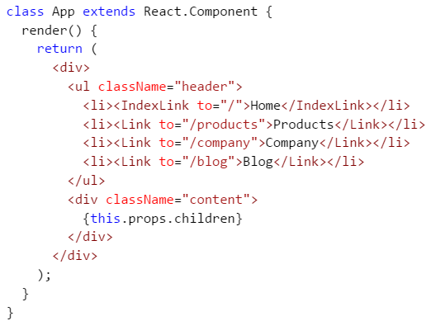
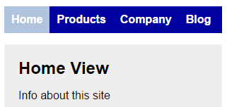

Slide 2
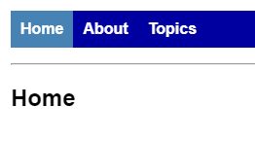
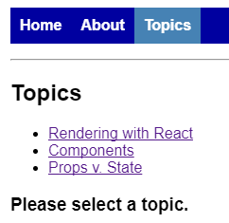
const BasicExample = () =>( <HashRouter> <div> <ul className="header"> <li><NavLink exact to="/">Home</NavLink></li> <li><NavLink to="/about">About</NavLink></li> <li><NavLink to="/topics">Topics</NavLink></li> </ul>
<hr/> <Route exact path="/" component={Home}/> <Route path="/about" component={About}/> <Route path="/topics" component={Topics}/> </div> </HashRouter> )
Const Home = () => ( <div> <h2>Home</h2> </div> )
const BasicExample = () =>( <HashRouter> <div> <ul className="header"> <li><NavLink exact to="/">Home</NavLink></li> <li><NavLink to="/about">About</NavLink></li> <li><NavLink to="/topics">Topics</NavLink></li> </ul> <hr/> <Route exact path="/" component={Home}/> <Route path="/about" component={About}/> <Route path="/topics" component={Topics}/> </div> </HashRouter> )

Slide 3
const BasicExample = () =>( <HashRouter> <div> <ul className="header"> <li><NavLink exact to="/">Home</NavLink></li> <li><NavLink to="/about">About</NavLink></li> <li><NavLink to="/topics">Topics</NavLink></li> </ul> <hr/> <Route exact path="/" component={Home}/> <Route path="/about" component={About}/> <Route path="/topics" component={Topics}/> </div> </HashRouter> )
const Topics = ({ match }) => (
...
...
)

Slide 4
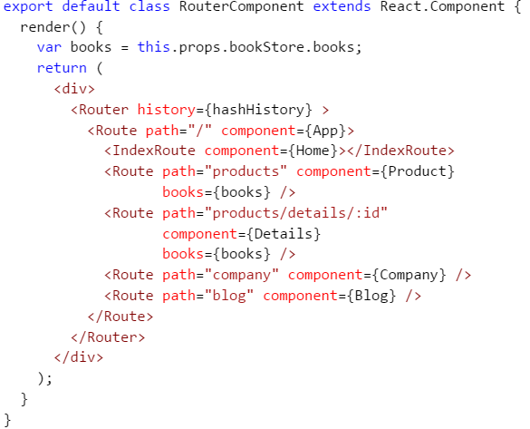

Slide 5
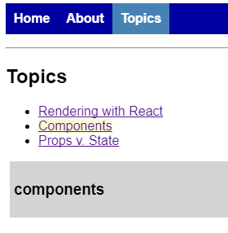
const Topics = ({ match }) => ( <div> <h2>Topics</h2> <ul> <li> <NavLink to={`${match.url}/rendering`}> Rendering with React </NavLink> </li> <li> <NavLink to={`${match.url}/components`}> Components </NavLink> </li> <li> <NavLink to={`${match.url}/props-v-state`}> Props v. State </NavLink> </li> </ul> <Route path={`${match.url}/:topicId`} component={Topic}/> <Route exact path={match.url} render={() => ( <h3>Please select a topic.</h3> )}/> </div> )
Outer Router was matched, to get us here
const Topic = ({ match }) => ( <div className="topic"> <h3>{match.params.topicId}</h3> </div> )

Slide 6


let Home = () => ( <div> <h2>Home</h2> </div> ) let About = () => ( <div> <h2>About</h2> </div> ) let Topic = ({ match }) => ( <div className="topic"> <h3>{match.params.topicId}</h3> </div> ) let Topics = ({ match }) => ( <div> <h2>Topics</h2> <ul> <li> <NavLink activeClassName="activeV2" to={`${match.url}/rendering`}> Rendering with React </NavLink> </li> <li> <NavLink activeClassName="activeV2" to={`${match.url}/components`}> Components </NavLink> </li> <li> <NavLink activeClassName="activeV2" to={`${match.url}/props-v-state`}> Props v. State </NavLink> </li> </ul> <Route path={`${match.url}/:topicId`} component={Topic}/> <Route exact path={match.url} render={() => ( <h3>Please select a topic.</h3> )}/> </div> ) let BasicExample = () =>( <HashRouter> <div> <ul className="header"> <li><NavLink exact to="/">Home</NavLink></li> <li><NavLink to="/about">About</NavLink></li> <li><NavLink to="/topics">Topics</NavLink></li> </ul> <hr/> <Route exact path="/" component={Home}/> <Route path="/about" component={About}/> <Route path="/topics" component={Topics}/> </div> </HashRouter> )

Slide 7
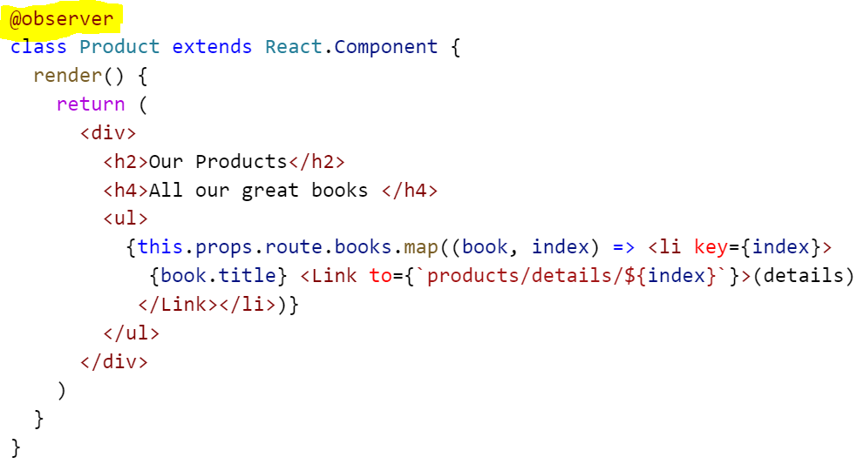
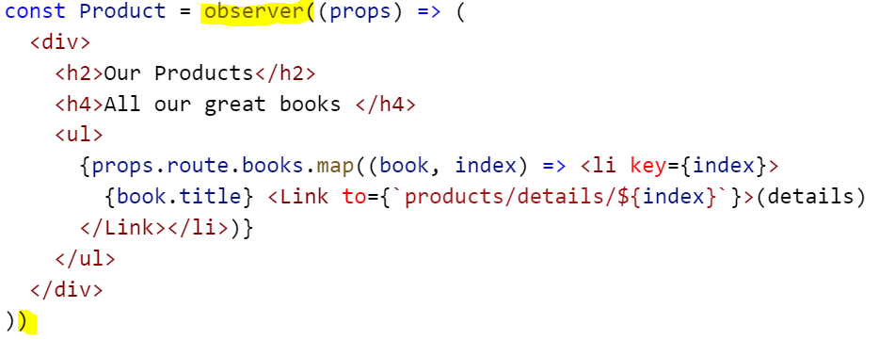
Mark as class as an observer
Mark a functional component as an observer

