Slide 1

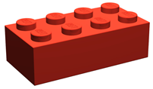
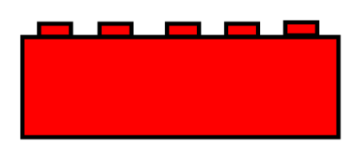



React
Welcome Brick
Sara
React Native
Lucas
Sara
Lucas
Emma
Emma

