Slide 1
Example powerpoint a
Has slides with mistakes

Slide 2
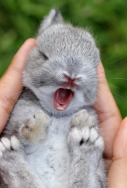
A correct slide
A cute image

Slide 3
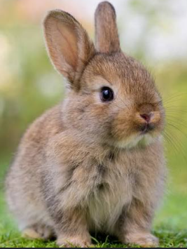
A duplicated slide
A pretty Bun image

Slide 4
A duplicated slide
A pretty Bun image

Slide 5
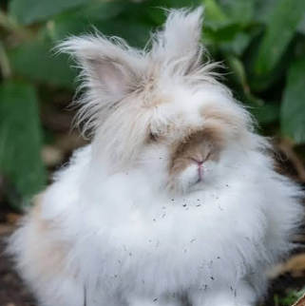
Bad slide
No alt text on image slide

Slide 6
Bad slide, no title

Slide 8
Bad slide no text

Slide 9
Double bad slide
Super small text
Super small invincible text

Slide 10
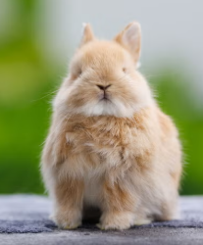
Bad slide
Text going over image

Slide 11
Bad ordered slide
2, two before first is not logical
5, next is worse
1, makes no sence

Slide 12
Correct table slide
one | two | three | four | five
e |  |  |  | d
 | e |  |  | d
 |  | e |  | d
 |  |  | e

Slide 13
Bad table no headers or alt text

Slide 14
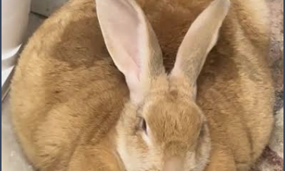

Slide 15
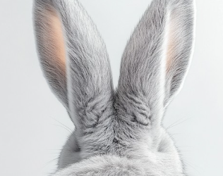
END

