Slide 1


Team 6
Roes, Naimi, Shaiza, Lars

Slide 2
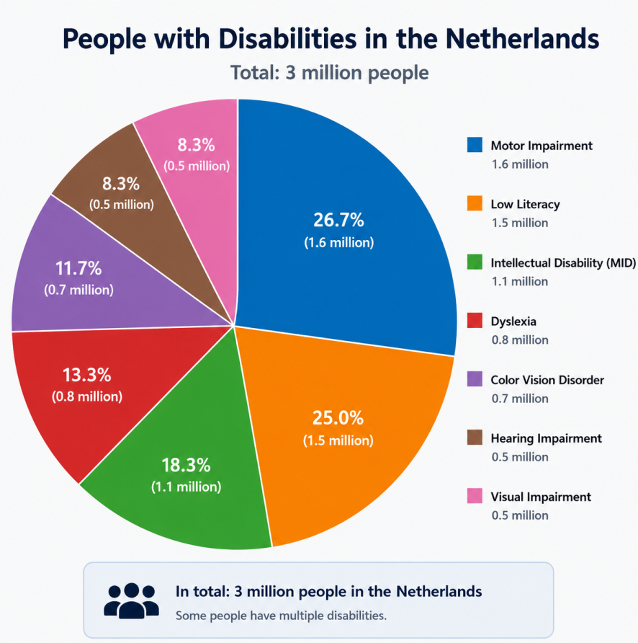
Our problem
3 million people in the Netherlands live with a disability
Many more face dyslexia or low literacy challenges
Accessibility issues often go unnoticed
Organizations need an easy way to find and fix them

Slide 3
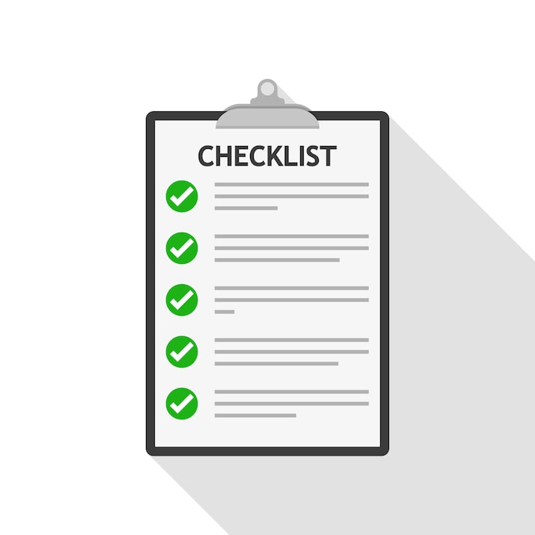
Our amazing solution
An accessibility checker
Direct feedback
Easy to understand

Slide 4
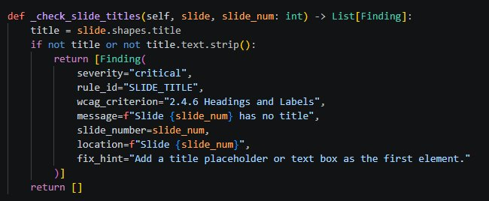
The project progress
Website with two fully functional checkers
13 accessibility rules for ppt
6 core rules for pdf

Slide 5
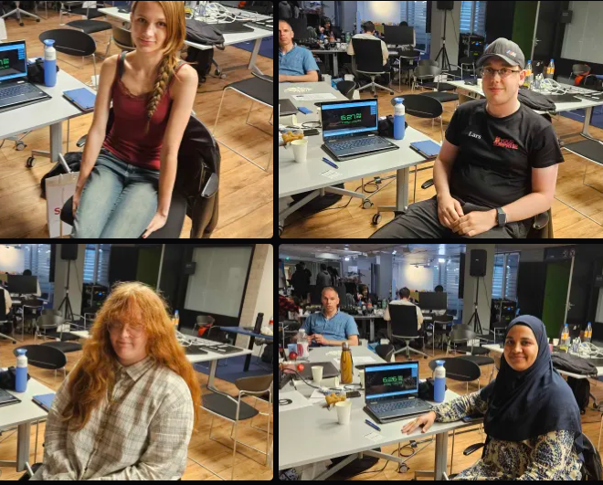
But, who are we?
Very small Team
Majority Women
All second years
Positive

Slide 6
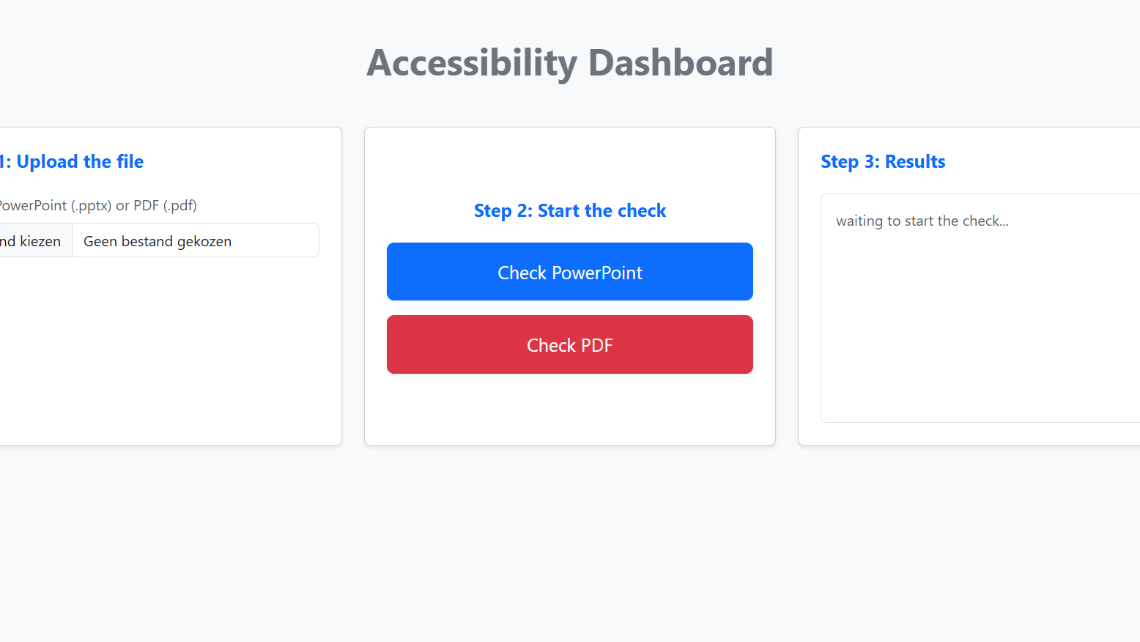
The best part!
Now we will see our application in action...
Notes:
We thank you very much for listening to our pitch, right now I would like to take a few more important seconds of your time and show the amazing web application we developed in the past 24 hours

