Slide 1
Rest Calls

Slide 2
Original
@Test public void shouldGetCustomerFromService() { // given accountType = CustomerAccountTypeInfo.builder().account(ACCOUNT_ID).accountType(”PERSONAL").subscription(”MONTHLY").build(); when(responseEntity.getBody()).thenReturn(accountType); // when CustomerAccount result = customerService.retrieveAccount(ACCOUNT_ID); // then CustomerAccount expectedCustomerAccount = new CustomerAccount(ACCOUNT_ID, CustomerPaymentType.MONTHLY, "PERSONAL"); assertThat(result, is(expectedCustomerAccount)); verify(restTemplate, times(1)).exchange(calledUrlCaptor.capture(), eq(HttpMethod.GET), sentHttpEntityCaptor.capture(), any(Class.class)); verifyHeadersAreValid(sentHttpEntityCaptor.getValue().getHeaders()); }

Slide 3
Approval Text
Recorded call to : Conversation Details API
REQUEST
--------------------------------------------------------------------------------
Method : GET
Called Url: /api/v1.2/message/id/500
Headers :
{
"Authorization" : [ "Basic fake" ],
"Cache-Control" : [ "no-cache" ]
}
Body :
null
EXAMPLE RESPONSE
--------------------------------------------------------------------------------
{
"data": [
{
"displayNumber": "500",
"encodedCaseDisposition": 27,
"uuid": "uuid-1",
"createDate": 0,
"responsePortalLink": "/portal/message/500",
"primaryMessage": {
"conversationDisplayId": "500",
"network": "twitter",
"networkInstance": "twitter",
"receiveDate": 0,
"publishDate": 0,
"tags": [
],
"private": true
},
"messages": [
{
"conversationDisplayId": "500",
"network": "twitter",
"networkInstance": "twitter",
"receiveDate": 0,
"publishDate": 0,
"tags": [
],
"private": true
}
],
"tags": [
{
"creator": {
"type": "BOT"
},
"tagId": "34",
"uuid": "uuid2"
}
],
"priority": 4,
"lswPermalink": "/console/bot/500",
"totalResponses": 2,
"hasResponse": false,
"status": "IN_PROGRESS"
}
]
}

Slide 4
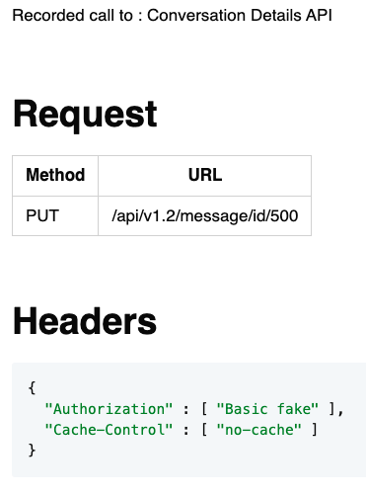
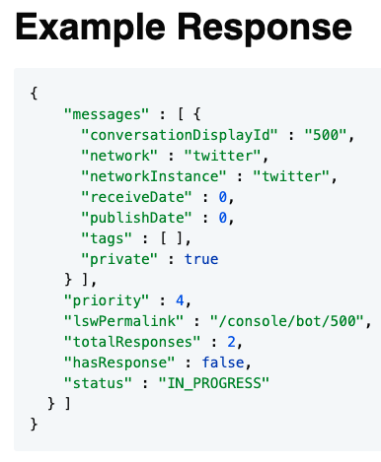
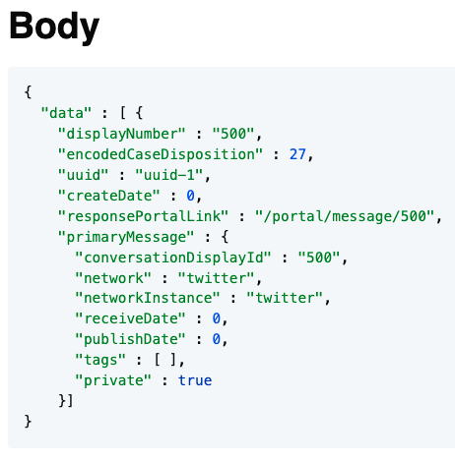
Approval Markdown

