Slide 1
Machine Learning & Energy - Exercises 0. Installation and Introduction to Python
Tim Janke, Allan Santos

Slide 2
Installing Python and creating virtual environment
We recommend to install Python using miniconda:
Download miniconda using the following link: https://docs.conda.io/en/latest/miniconda.html (Python 3.8)
Install miniconda using the default options
Download the exercise folder from Moodle and unzip it
Open the Anaconda Prompt (just type “Anaconda” in the search bar and double-click on it) and run the command “conda env create –f environment.yml” (give the full path to environment.yml, e.g. “C:\Users\username\Downloads\environment.yml”)
If you enter the command “conda env list” you should see an environment called MLE

Slide 3
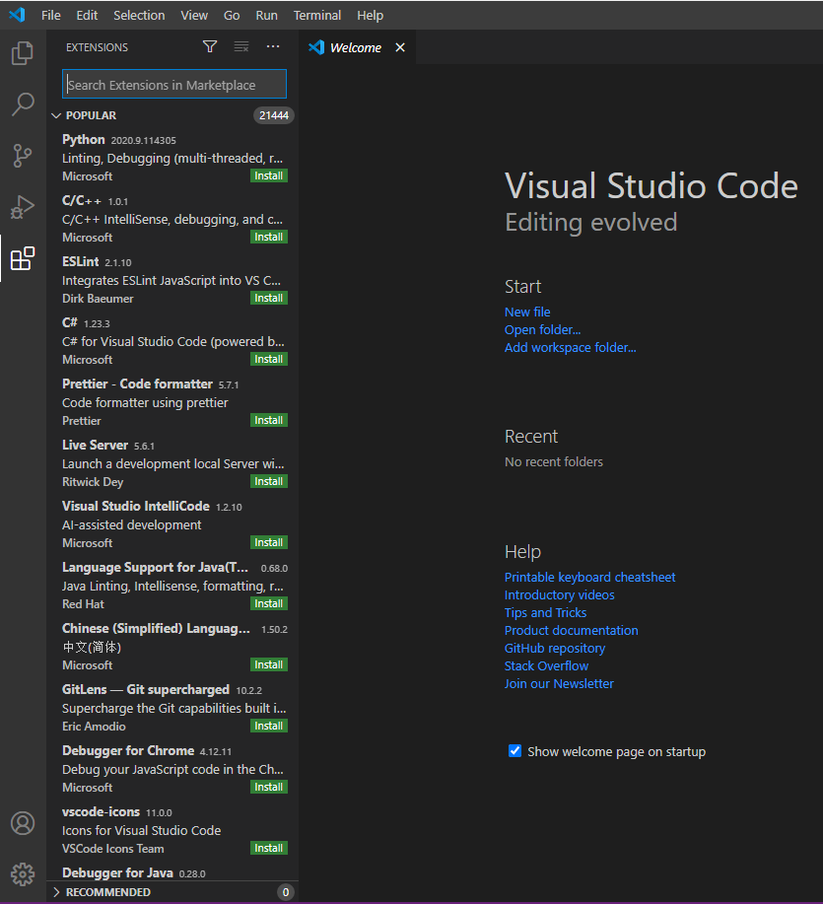
Installing VS Code and Python extension
We recommend using VS Code as text editor:
Download VS Code using the following link: https://code.visualstudio.com/download
Install VS Code using the default options
Launch VS Code and in the extensions menu search for Python and install it

Slide 4
Installing VS Code and Python extension
Click in the bottom-left corner text of the main window. Select the option “Enter interpreter path…”, then “Find…”. Your interpreter should be in “C:Users/username/miniconda3/envs/MLE/python.exe”
Open the .ipynb file from the exercise folder
In the upper right corner, select the kernel MLE

Slide 5
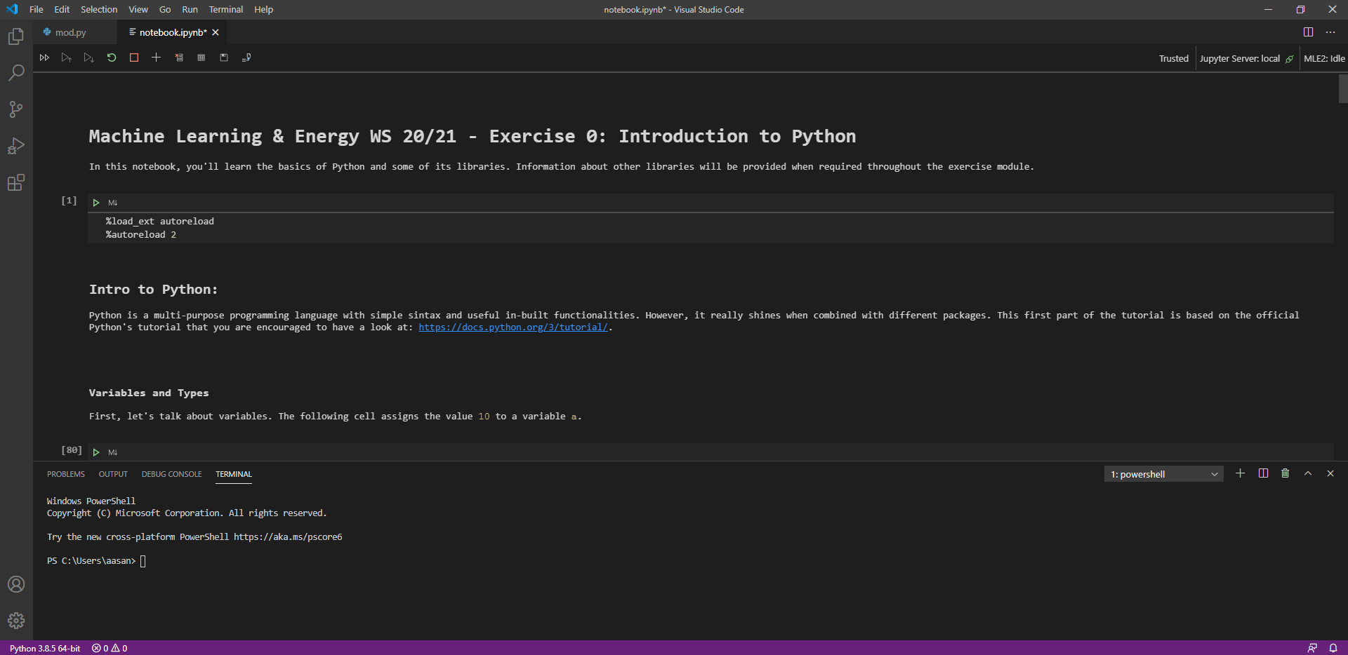
Installing VS Code and Python extension

Slide 6
Basic usage of notebooks
You can run cells by selecting them and pressing SHIFT+ENTER
Cells can contain either code or Markdown text
Follow the tutorial and have fun!

