Slide 1
Quality Momentum Univ Part I 4bn MktCap / 100k Liq
Analysis Date: 28/01/2026
Total Stocks: 3,158 | Total Market Cap: $2,984,782.08M

Slide 2
Universe Summary Statistics
Total Number of Stocks: 3,158
Total Market Cap: $2,984,782.08M
Average Market Cap: $945.15M
Median Market Cap: $431.30M
Number of Sectors: 12

Slide 3
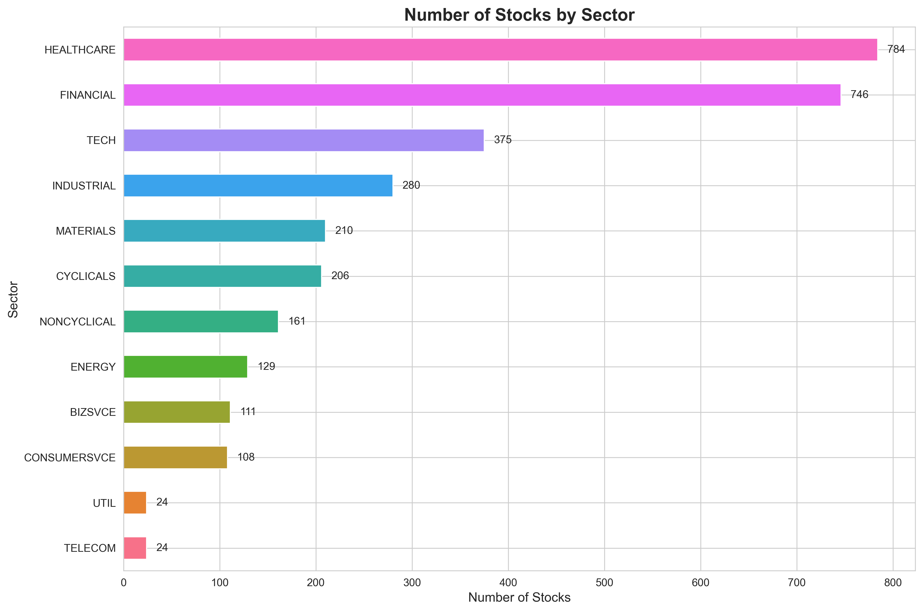
Stock Count by Sector

Slide 4
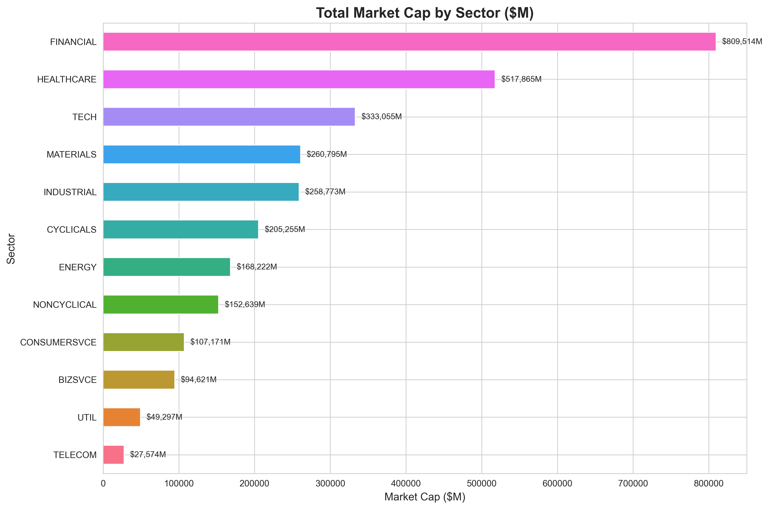
Total Market Cap by Sector

Slide 5
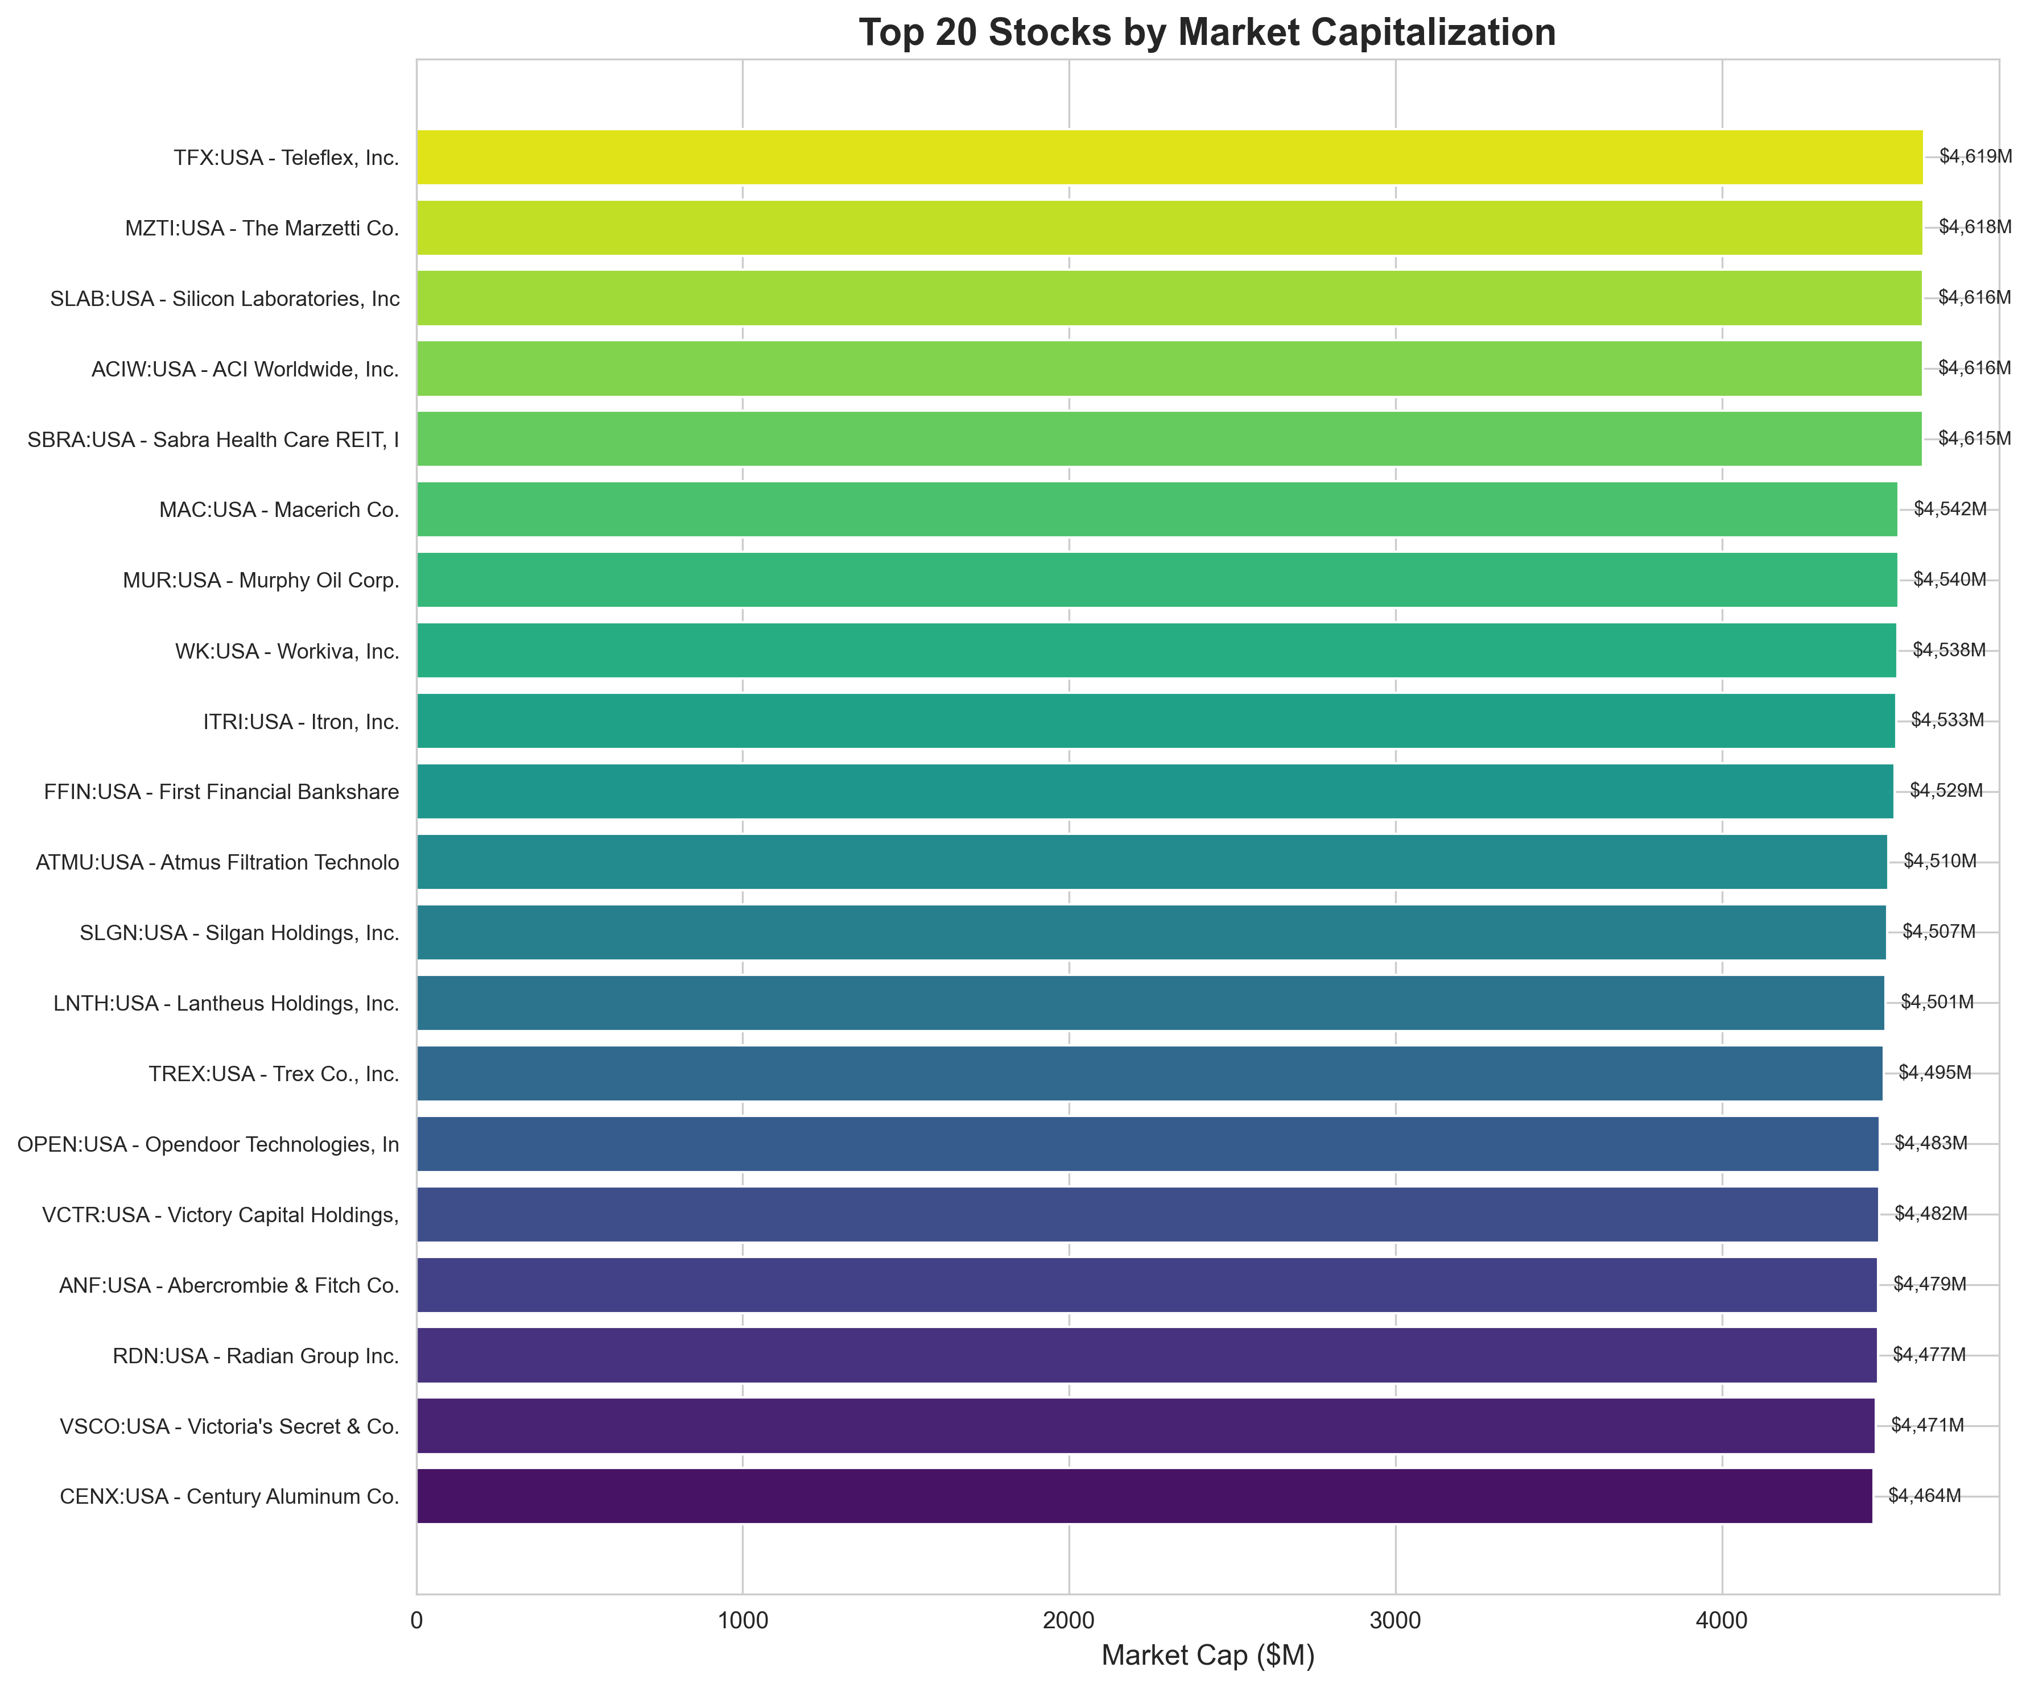
Top 20 Stocks by Market Capitalization

Slide 6
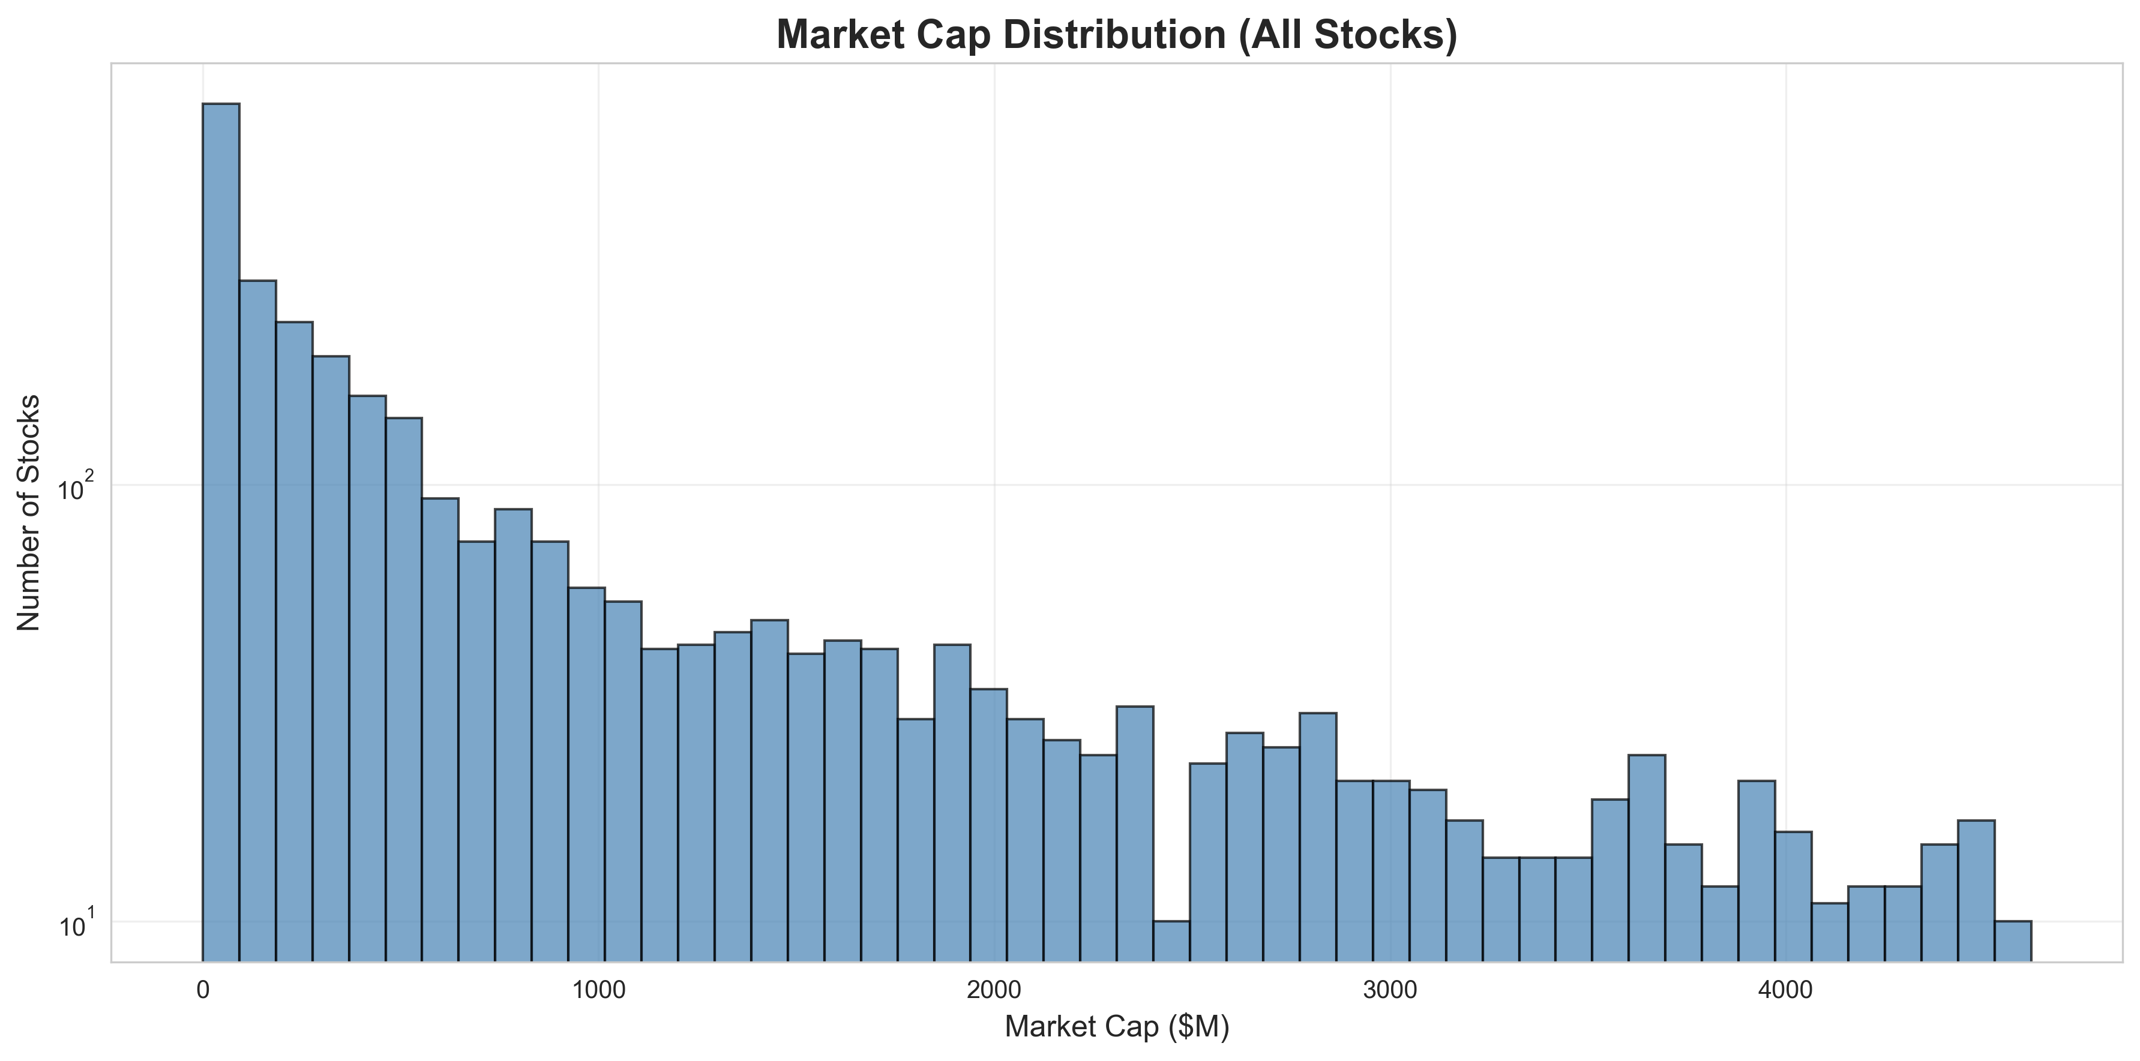
Market Cap Distribution

Slide 7
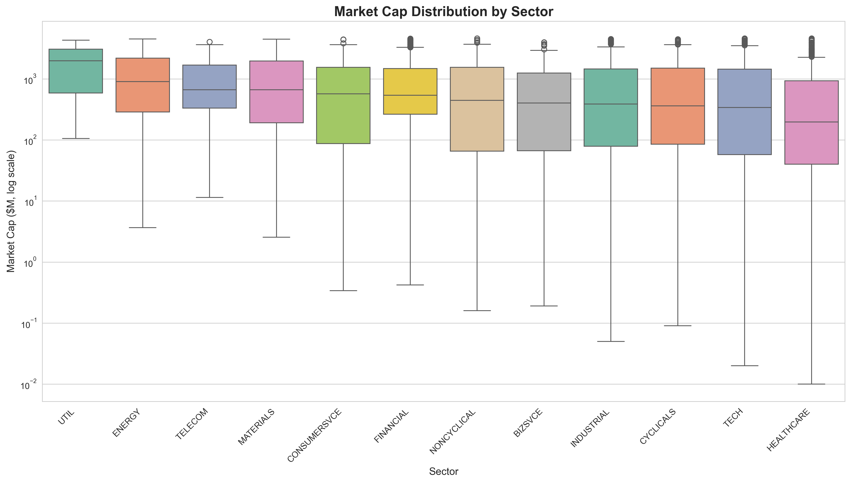
Market Cap Distribution by Sector

Slide 8
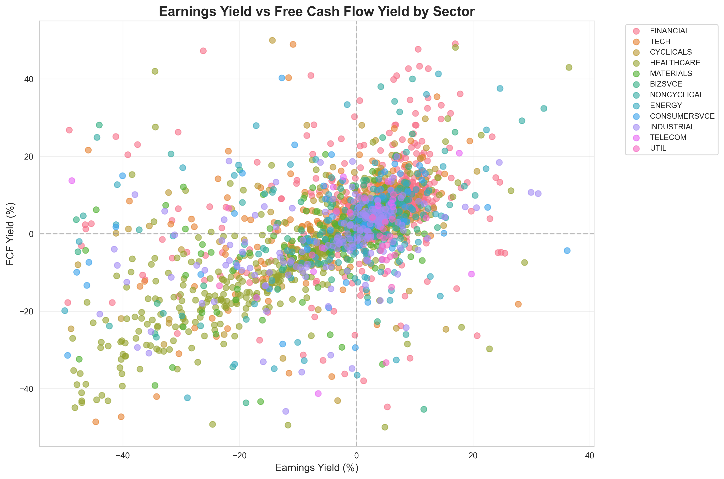
Earnings Yield vs Free Cash Flow Yield

