Slide 1
AINI → Returns: Rejection Rates (both-method)

Slide 2
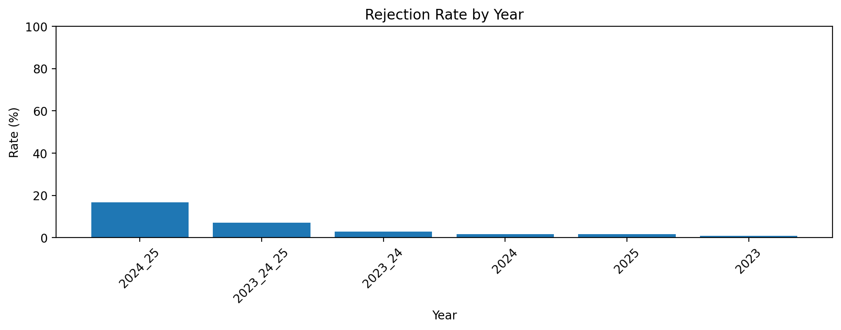
Rejection Rate by Year (both-method)
Year | sum | count | rate
2024_25 | 40 | 240 | 16.67%
2023_24_25 | 17 | 240 | 7.08%
2023_24 | 7 | 240 | 2.92%
2024 | 4 | 240 | 1.67%
2025 | 4 | 240 | 1.67%
2023 | 2 | 240 | 0.83%

Slide 3
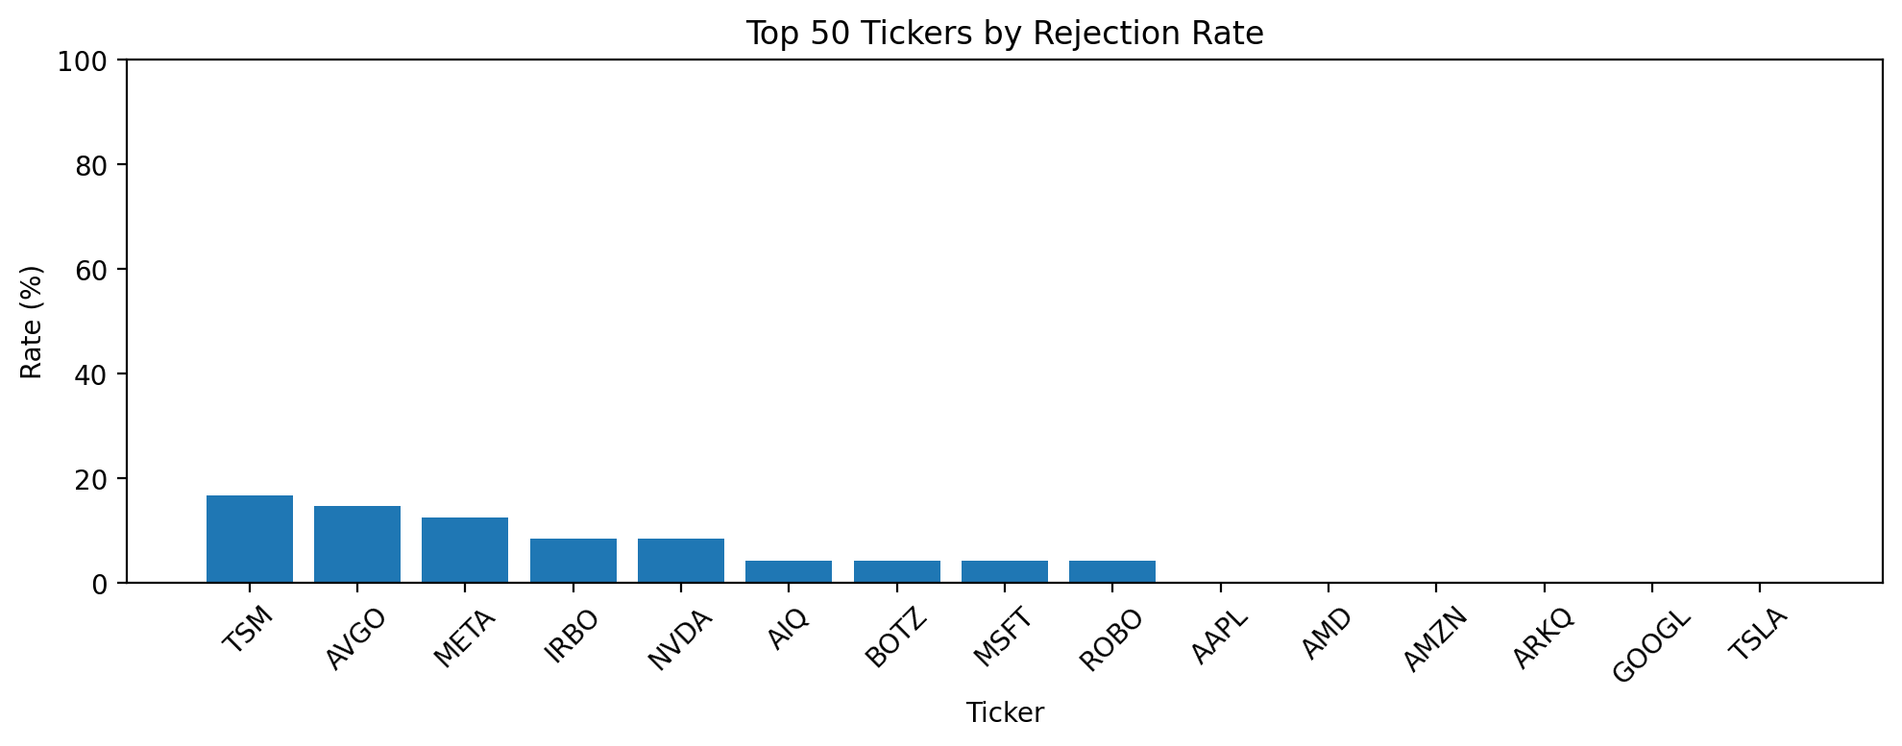
Rejection Rate by Ticker (Top 50, both-method)
Ticker | sum | count | rate
TSM | 16 | 96 | 16.67%
AVGO | 14 | 96 | 14.58%
META | 12 | 96 | 12.50%
IRBO | 8 | 96 | 8.33%
NVDA | 8 | 96 | 8.33%
AIQ | 4 | 96 | 4.17%
BOTZ | 4 | 96 | 4.17%
MSFT | 4 | 96 | 4.17%
ROBO | 4 | 96 | 4.17%
AAPL | 0 | 96 | 0.00%
AMD | 0 | 96 | 0.00%
AMZN | 0 | 96 | 0.00%
ARKQ | 0 | 96 | 0.00%
GOOGL | 0 | 96 | 0.00%
TSLA | 0 | 96 | 0.00%

