Slide 1
An introduction to distributed event streaming using Apache Kafka
Wednesday Evening Training
Hans van Rijs Carl in ‘t Veld Sina Wahed Lars Mudde

Slide 2
Indeling
Kafka
01
History
Use Cases
Kafka in perspective
Architecture
02
In te vullen door Hans
Demo
03
Code review
Demo
DIY Kafka

Slide 3
Kafka
History
Use cases
Kafka in perspective

Slide 4
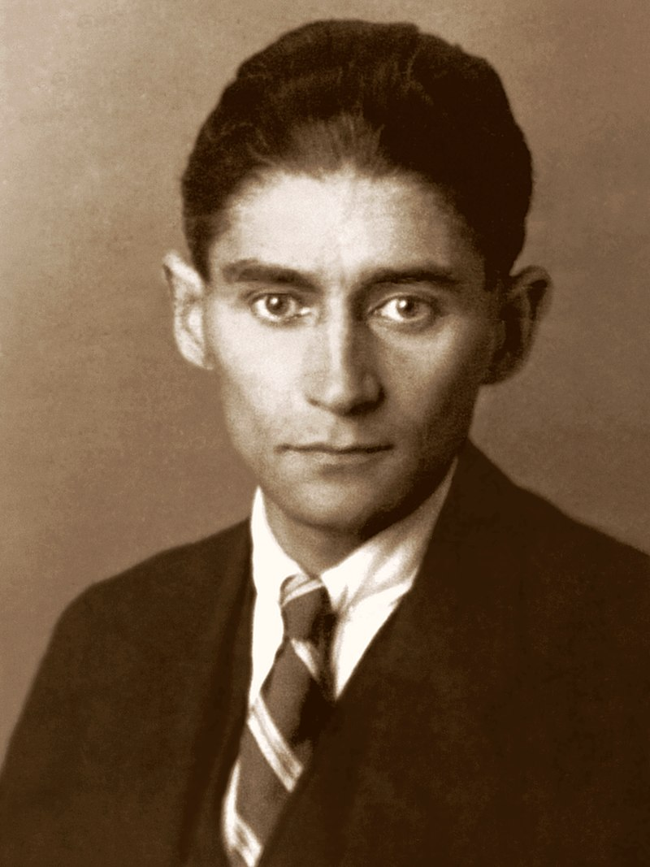
History
LinkedIn
Written in Scala & Java
High troughput, low-latency platform for handling real-time data feeds
“Massively scalable pub/sub message queue designed as a distributed transaction log.”
Apache Incubator (2011)
Confluent (2014)
Franz Kafka (1923) Source: Wikipedia

Slide 5
Use Cases of Apache Kafka
Messaging
Event Sourcing
Stream processing
Companies that use Kafka
Linkedin (activity stream)
Netflix (event-processing)
Spotify (log delivery)
Uber
PayPal
AirBNB
Coursera
CloudFlare

Slide 6
Kafka in perspective
Kafka
ActiveMQ
RabbitMQ
Horizontal Scaling
Distributed streaming platform
Process and re-process
High troughput
Big data, small messages
Most efficient storage format
Pull based
General-purpose message broker
Supports multiple protocols
Supports both broker and P2P topologies
Push based
General-purpose message broker
Supports multiple protocols
Leading implementation of AMQP
Broker architecture
Push based

Slide 7
Architecture
Indeling hier

Slide 8
Demo
Code review
Demo
DIY Kafka

Slide 9
Demo
Scenario Subscription
Kafka Package
Publishers and Consumers
Hosted Service
Demo
DIY Expansion
https://github.com/LarsMudde/kafka-wet

