Slide 1


An introduction to
Lars Mudde Hans van Rijs Carl in ‘t Veld Sina Wahed
v0.9

Slide 2
Contents
Kafka introduction:
History
Use Cases
Kafka in perspective
Architecture: the relevant patterns
Kafka in practice:
Code review
Demo
DIY Kafka

Slide 3
Kafka introduction
History
Use cases
Kafka in perspective

Slide 4
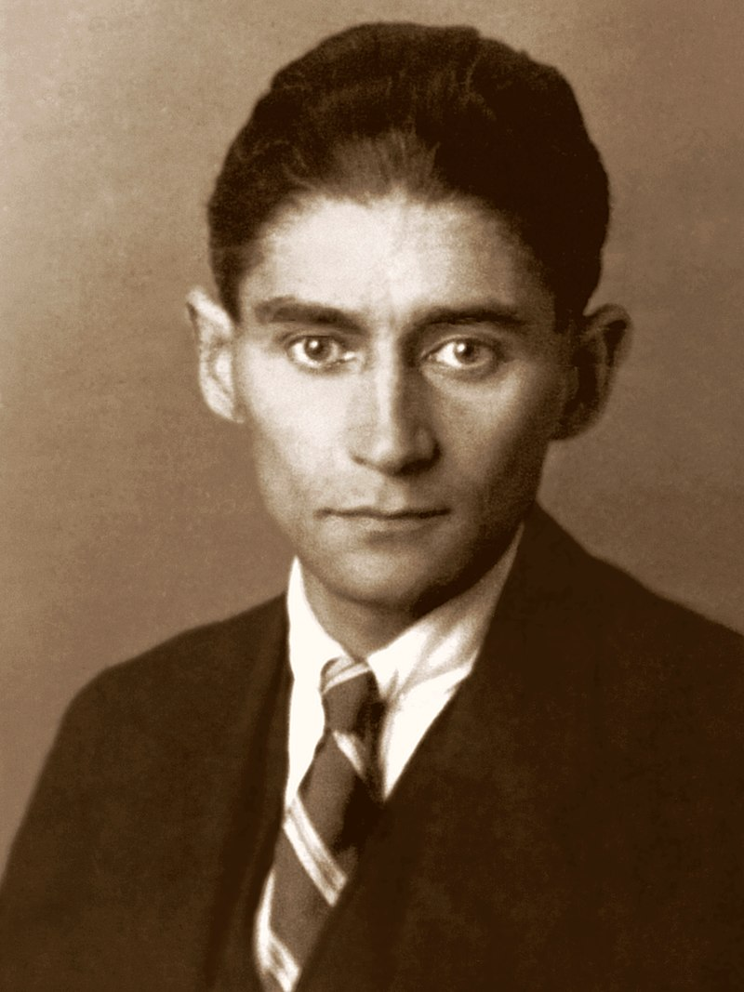
History
LinkedIn
Written in Scala & Java
High troughput, low-latency platform for handling real-time data feeds
“Massively scalable pub/sub message queue designed as a distributed transaction log.”
Apache Incubator (2011)
Confluent (2014)
Franz Kafka (1923) Source: Wikipedia

Slide 5
Use Cases
Messaging
Event Sourcing
Stream processing
Companies that use Kafka:
Linkedin (activity stream)
Netflix (event-processing)
Spotify (log delivery)
Uber
PayPal
AirBNB
Coursera
CloudFlare

Slide 6
Kafka in perspective
Kafka
Active MQ
Rabbit MQ
Horizontal Scaling
Distributed streaming platform
Process and re-process
High troughput
Big data, small messages
Most efficient storage format
Pull based
General-purpose message broker
Supports multiple protocols
Supports both broker and P2P topologies
Push based
General-purpose message broker
Supports multiple protocols
Leading implementation of AMQP
Broker architecture
Push based

Slide 7
Architecture
Relevant patterns

Slide 8
Kafka: relevant architecture terms & patterns
Context is a distributed (microservices?) architecture. What does that mean?
Everything is asynchronous
Dynamic ecosystem of services
Weak consistency: Eventually consistent
Replication (with Leader election)

Slide 9
Eventually consistent?
Specific form of weak consistency
Storage system guarantees that if no new updates are made to the object, eventually all accesses will return the last updated value
If no failures occur, the maximum size of the inconsistency window can be determined based on factors such as communication delays, the load on the system, and the number of replicas involved in the replication scheme.
Example: DNS (Domain Name System)

Slide 10
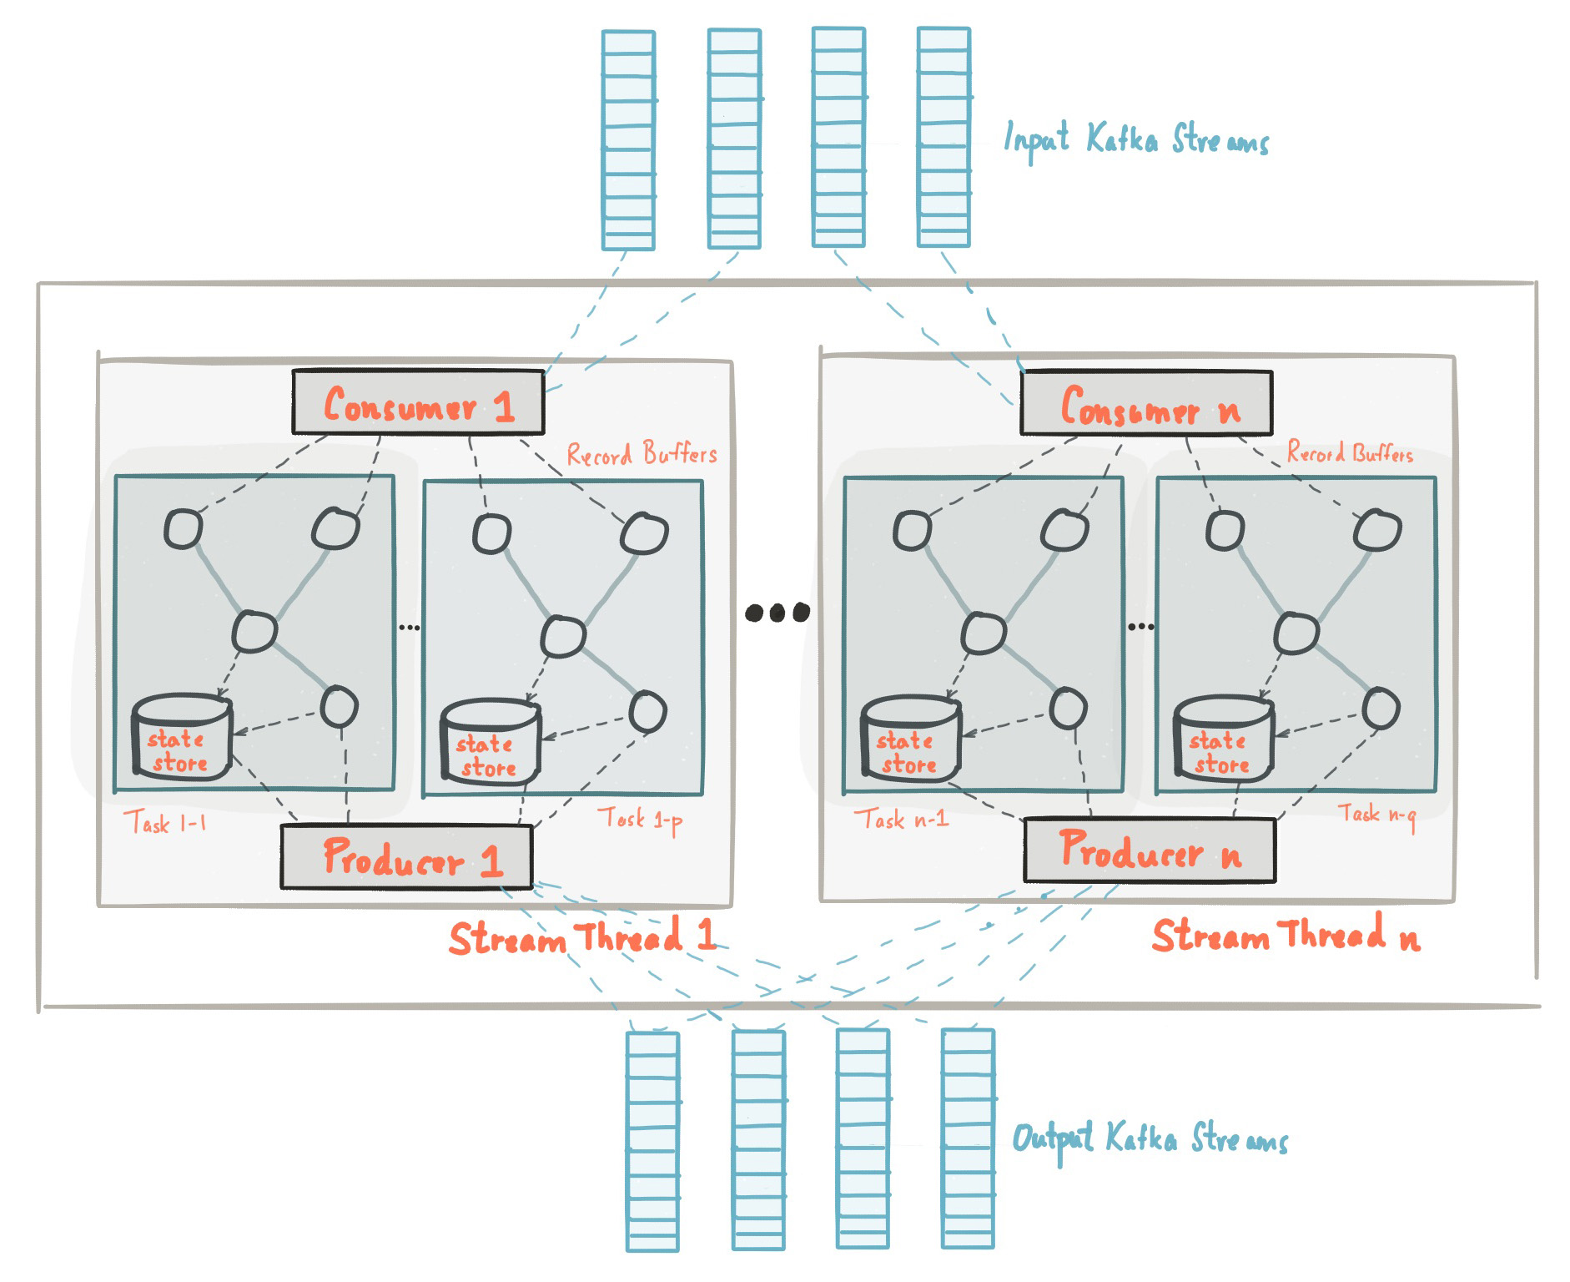
(Very) high level Kafka architecture

Slide 11
Kafka architecture: relevant terms & patterns
CQRS
Event Sourcing
Pub-Sub vs Push-Pull

Slide 12
Event sourcing…
Specific procedure for storing data. Do not persist the current state of a record, but store the individual changes as a series of deltas (just like a DBMS does ☺) in an Event Store.
Enables traceability of changes, enables audit logs without any additional effort.
Makes it possible to reinterpret the past. Replay (learn from history), analysed and interpreted on the basis of new findings or questions.
Reduces the conflict potential of simultaneously occurring changes.
Enables easy versioning of business logic.
Even different bounded context or even another domain. Microservices architecture are used in multiple domains/contexts, events need to make the difference.
Is also suitable for integration with other systems.

Slide 13
What’s in an Event?
“Events”: Domain-related facts that contain certain semantics.
In software, an event is essentially made of two things:
An action (or label, name, code…) used to clearly identify what happened. For example, 'user_created' or 'email_processed'.
Context that provide all needed details (context) and fully determines the event. For example, the first and last name of a newly created user, or the ID of a processed email.
The consequence of an event is a State change of the Event receiver. So what about “Events” that are just passed from the Receiver to underlying Services?
So: IMHO: Event Store = Message Store, Event = Interpretation of a message in some specific Domain(s).

Slide 14
Event sourcing: some challenges…
Can lead to tightly coupled distributed system…
Using a Global Event Store, Domain Events are your Bounded Context's public API.
You have to discuss each particular Domain Event with exactly one other partner in your relationship
Do not publish lower level events publicly, do it in local event store which only accessible from this Bounded Context
Time travelling, only if:
Events are enriched by semantics and intention
All applications in the network support this, otherwise you end up with an inconsistent (Global) State
Getting slow with lots of events…
Snapshots (replay from …) could help
When updating Data stores, there are some extra challenges...

Slide 15
CQRS (Command Query Responsibility Segregation)
Different model to update information than the model you use to read information.
Read: get key(s) + data + sufficient context to write. Write: use keys, data and context
Between Read & Write stream you can analyze and “learn” from the past (that is: history stored in the CQRS store)
Having the same conceptual model for commands and queries leads to a more complex model that does neither well.
Quality of Service: data (that is relied upon) takes time to be processed (relay). Is it still relevant / valuable then or stale?
Create is fine, but what about Update and Delete? And Transactions?
E.g. popping a stack (read & delete top stack item) is a good example of a query that modifies state.

Slide 16
Pub-Sub vs Push-Pull vs Request-Reply
Pub socket sends the same message to all Subscribers
Push: does a round-robin amongst all its connected Pull sockets
Request-Reply: specific (server) instance requests data from specific (client) instance
The pub/sub pattern is used for wide message distribution according to topics.
Push-Pullpattern is really a pipelining mechanism.

Slide 17
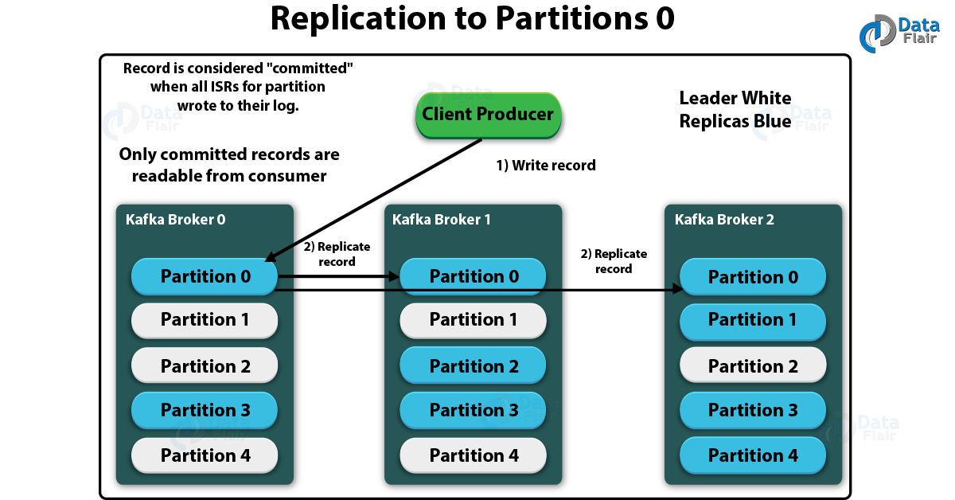
Replication (with Leader election)

Slide 18
Replication (with Leader election)
Leader: the replica that is responsible for coordination among all replicas
Start with “Leader Election Set”. One wins and becomes leader. Leader continually “heartbeats“ to renew it’s position, others challenge. If leader fails, it’s quickly replaced
Leader election implemented in ZooKeeper:
Zookeeper maintains active connection with its clients (heartbeat mechanism)
When a client disconnects for more than a specified timeout, session expires.
All participants of the election process create an ephemeral(kortlevend)-sequential node on the same election path.
Node with the smallest sequence number is the leader.
Each “follower” node listens to the node with the (smaller) next lower sequence number to prevent a herding effect when the leader goes away (creates a linked list of nodes).
When a leader dies, follower finds a smaller node or become the leader if it has the lowest sequence number.

Slide 19
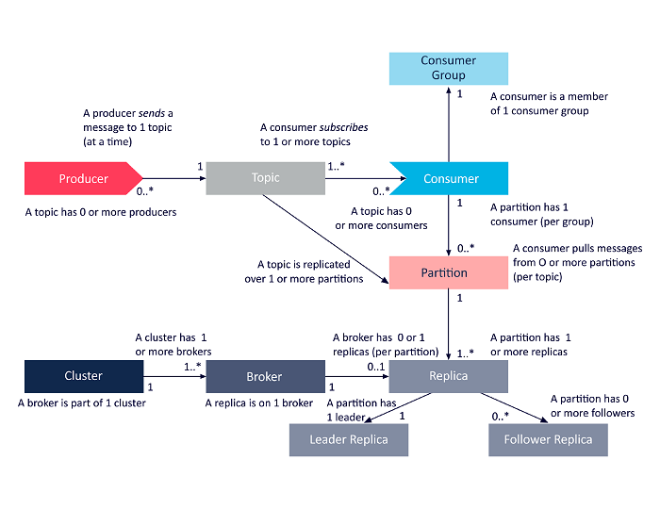
Kafka object type relations

Slide 20
Kafka in practice
Code review
Demo
DIY Kafka

Slide 21
Demo
Scenarion subscription
Kafka Package
Publishers and Consumers
Hosted Service
Demo
DIY Expansion
https://github.com/LarsMudde/kafka-wet

Slide 22
Follow us on LinkedIn: https://www.linkedin.com/feed/hashtag/wednesdayeveningtraining

Slide 23
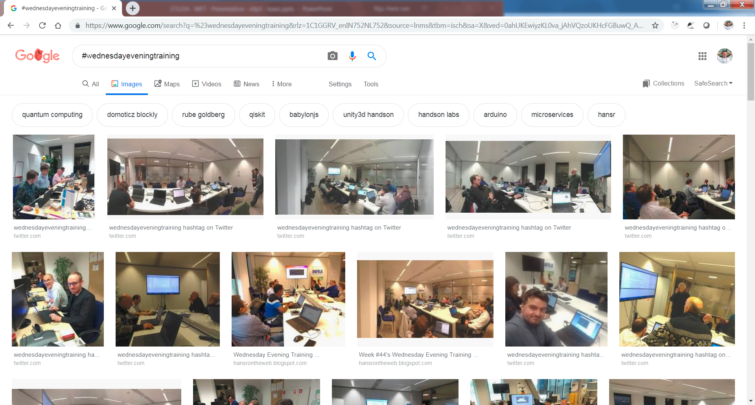
find us on internet

