Slide 1
Interacting with SPFx Web Parts in Modern Pages

Slide 2

Interacting with SPFx Web Parts in Modern Pages
Adding client-side web parts to modern pages
Introducing the new reactive property pane
Validating local SPFx development environment

Slide 3
SharePoint client-side web parts
Configurable, reusable, purpose-built components
Add functionality to SharePoint experiences
Web Parts
Framework for connecting related components
Context aware parts
Notes:
Main point: Keep light on vision, more on outline for today and why we are investing in our innovation areas influenced by where we are seeing the most usage (outside circle), consistently influenced by our productivity pillars (inside circle)

Slide 4
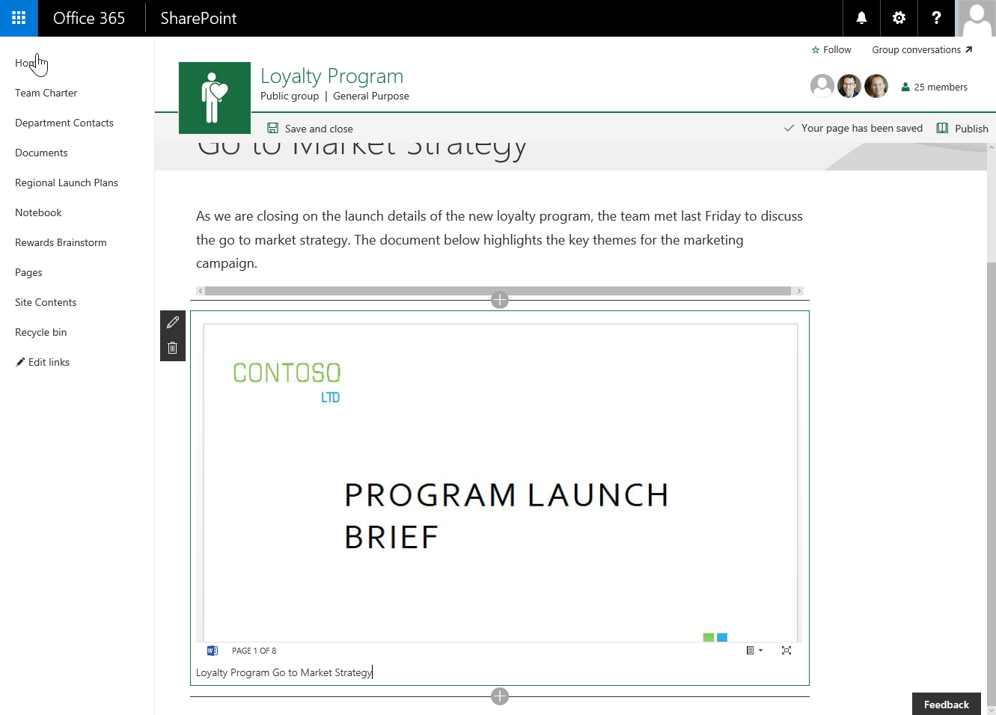
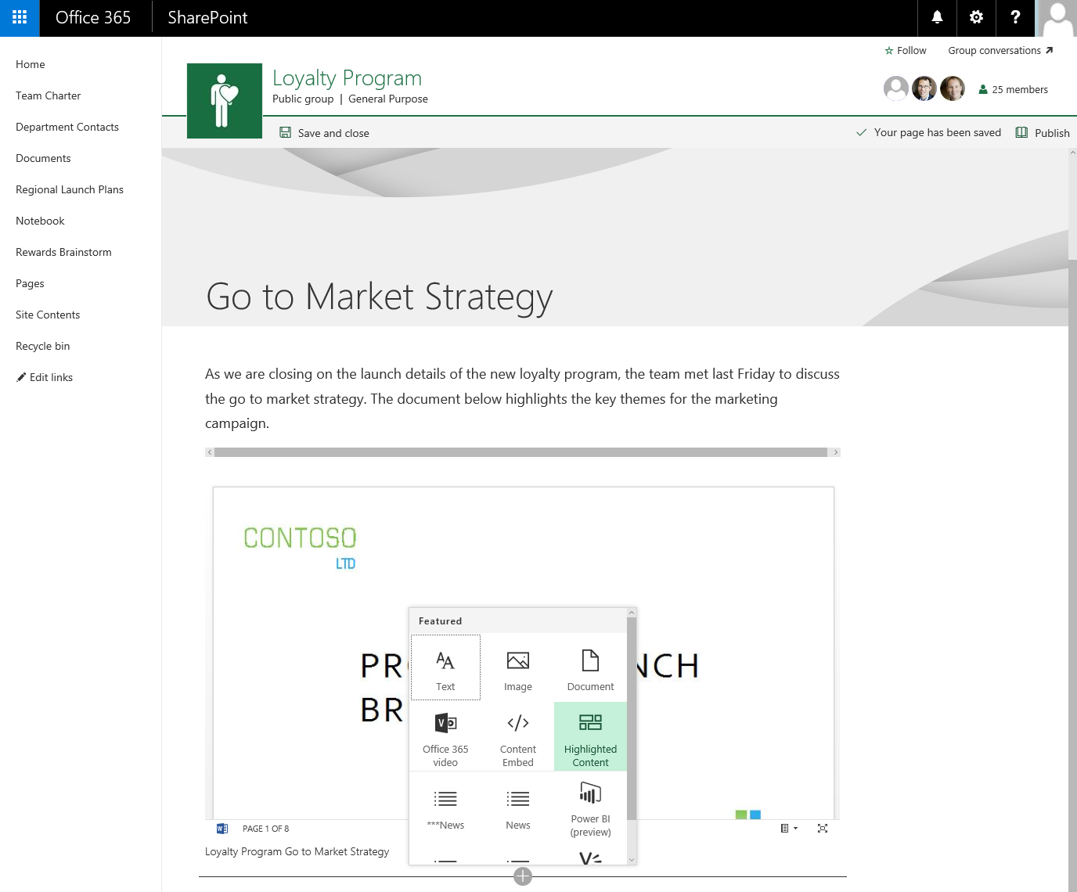
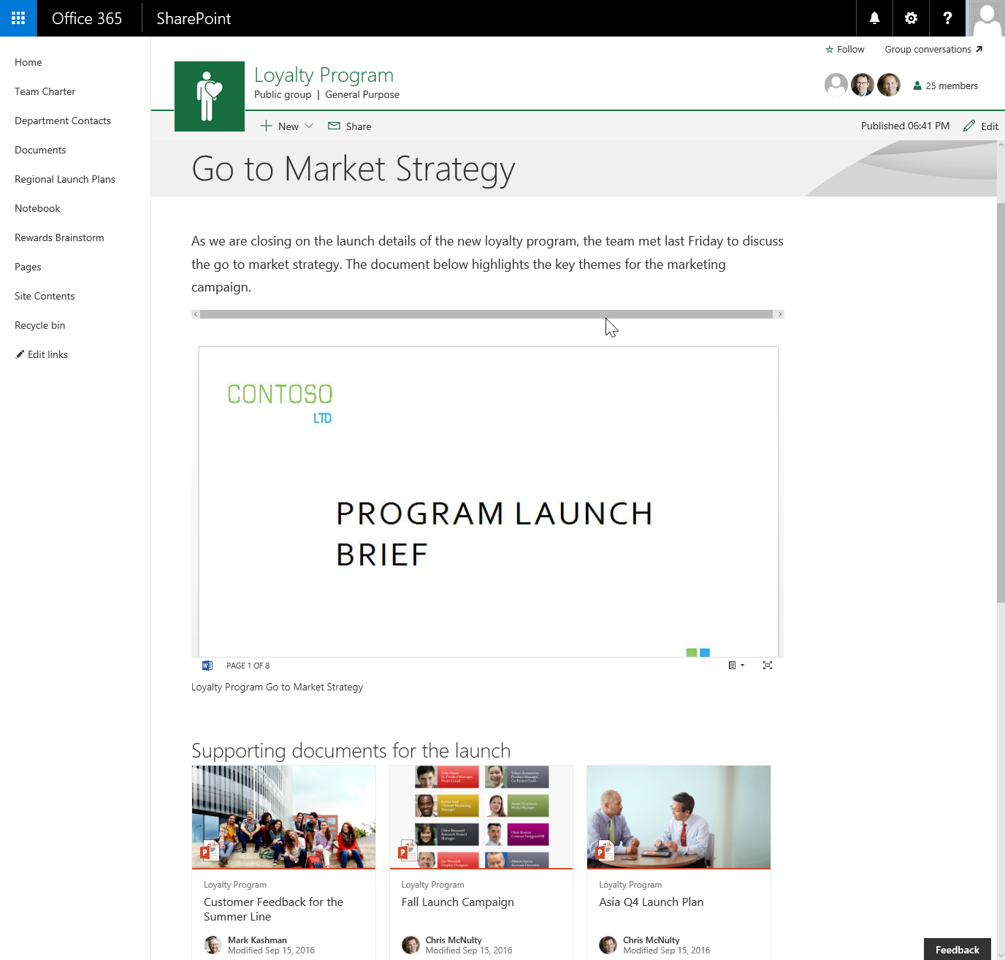

Client-side web parts
They are still web parts!
Built for the modern, JavaScript-driven web
Runs directly inside a SharePoint Page

Slide 5
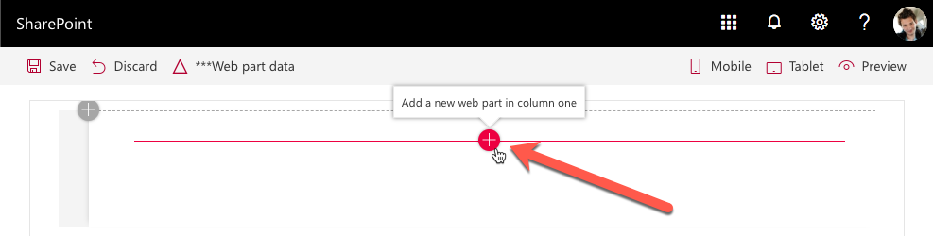
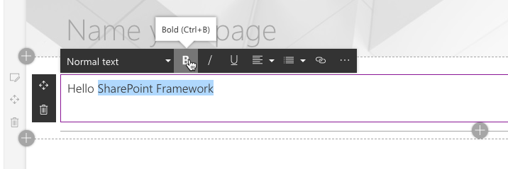
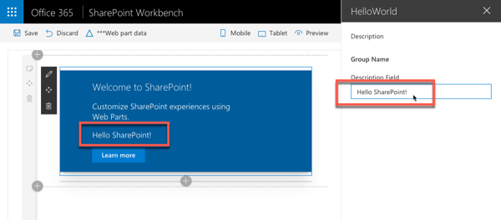
Adding SPFx web parts to pages
Once a page is in edit mode, add via web part toolbox
Select a web part and edit inline / property pane

Slide 6
Demo Interact with SPFx Client-Side Web Parts in Modern Sites

Slide 7
Validate local SPFx development configuration
Install required runtimes & tools:
Node.js & NPM (included with Node.js)
Yeoman, SPFx Yeoman generator
Gulp
Create first project with Yeoman & SPFx generator
Build & run web part in the local workbench
yo @microsoft/sharepoint
gulp serve

Slide 8
Demo Creating & Running Your First SPFx Project

Slide 9

Summary
Adding client-side web parts to modern pages
Introducing the new reactive property pane
Validating local SPFx development environment

Slide 10
Thank you.

