Slide 1

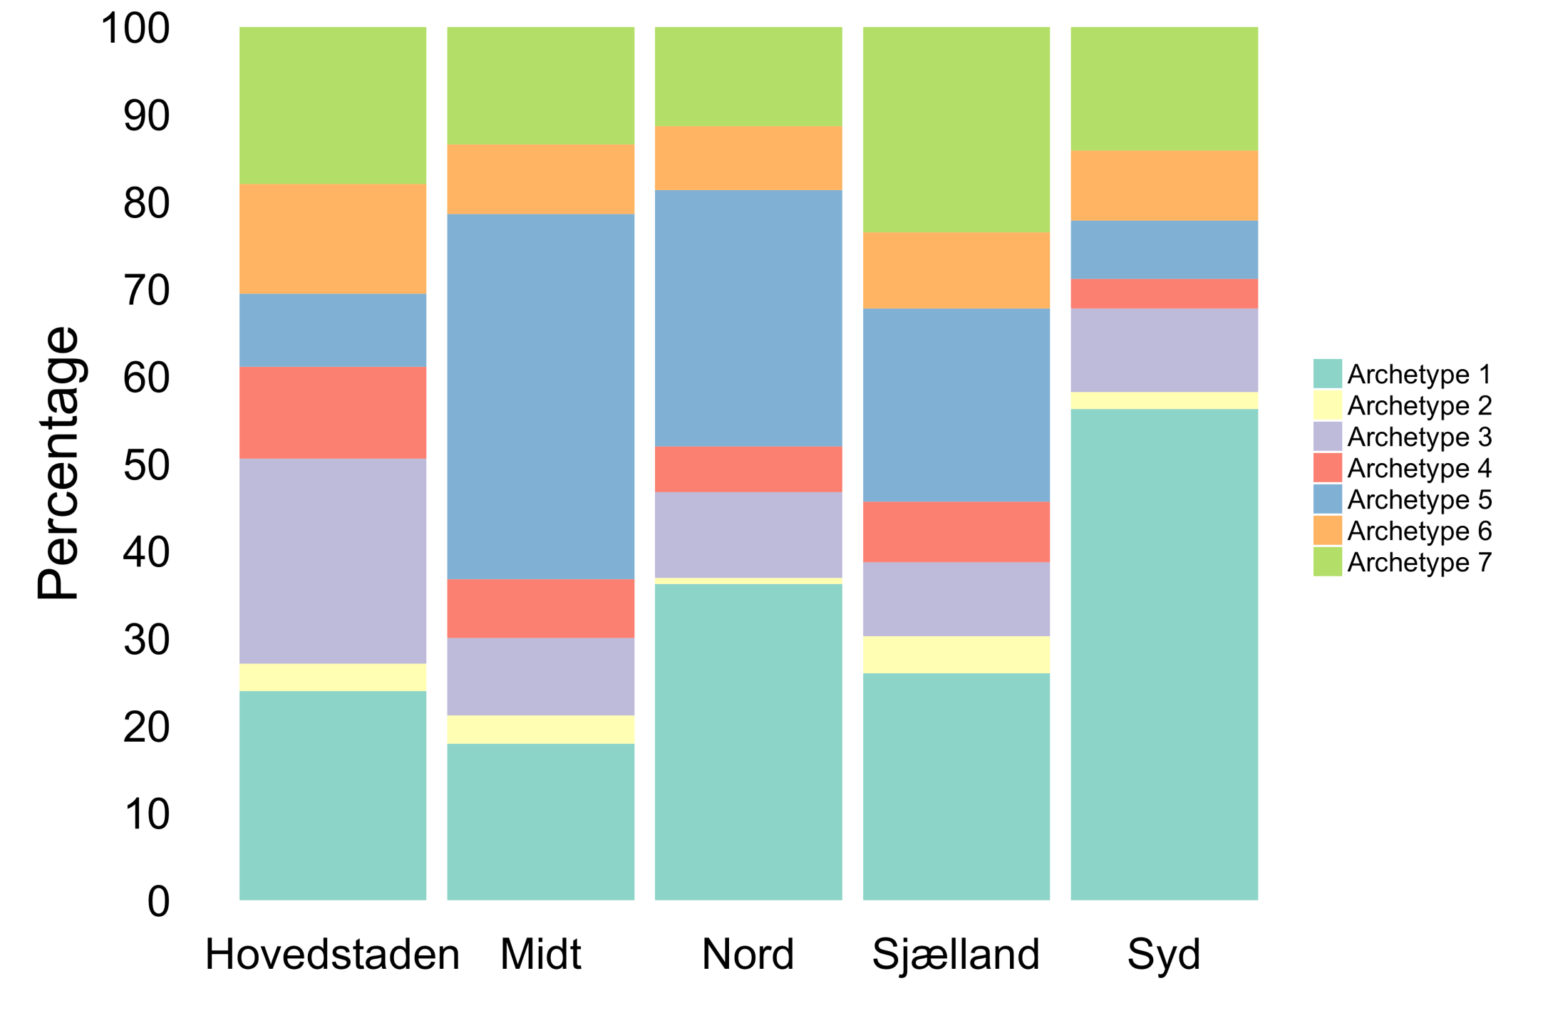
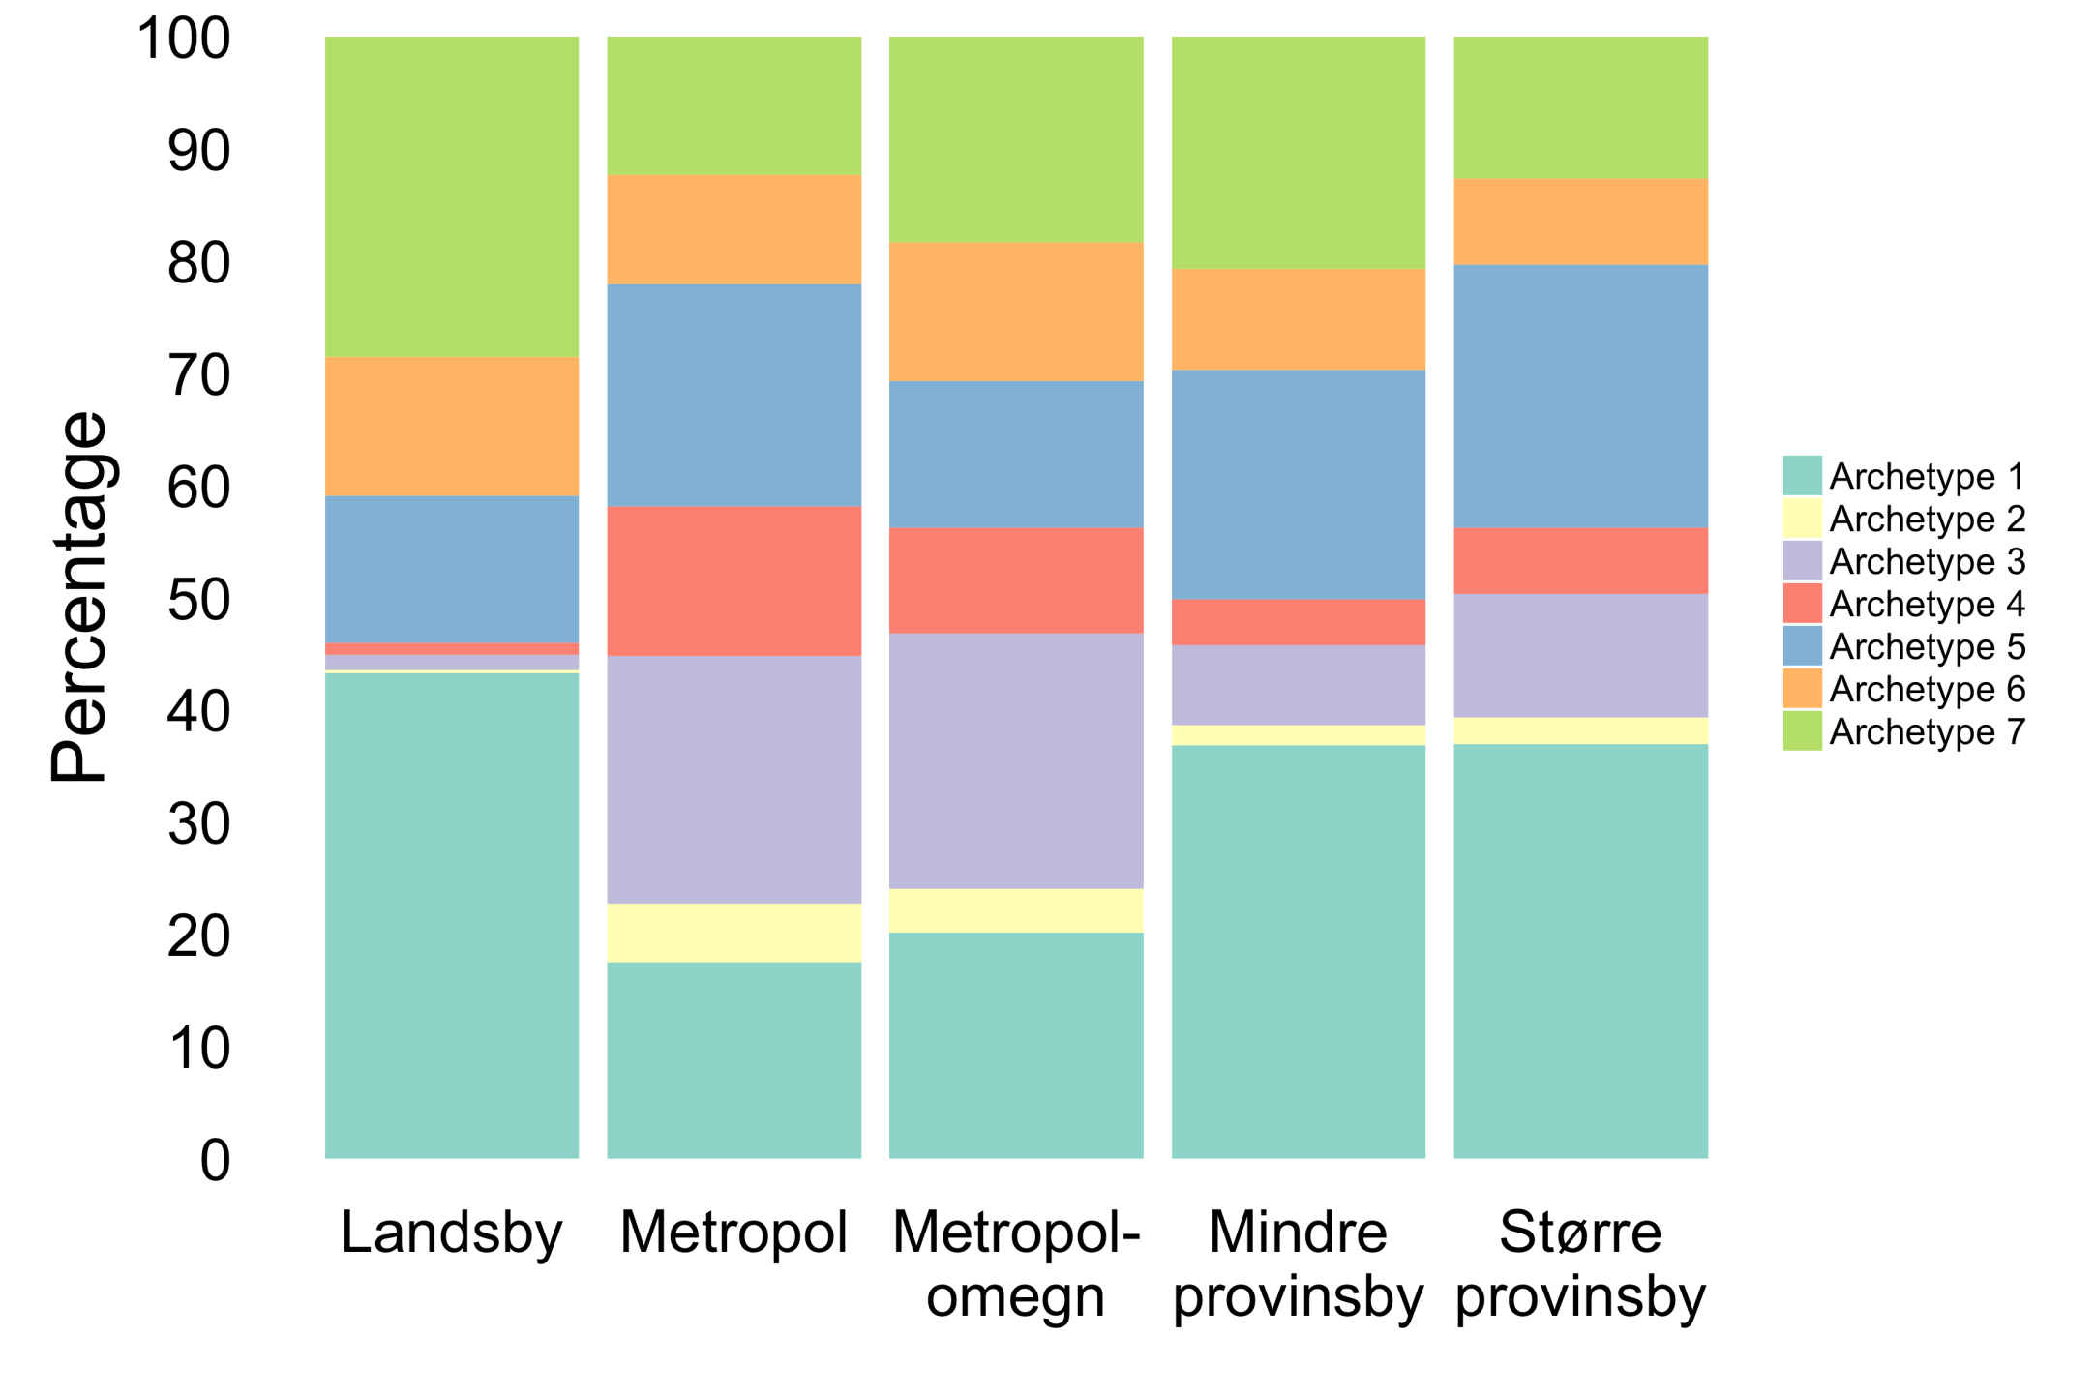
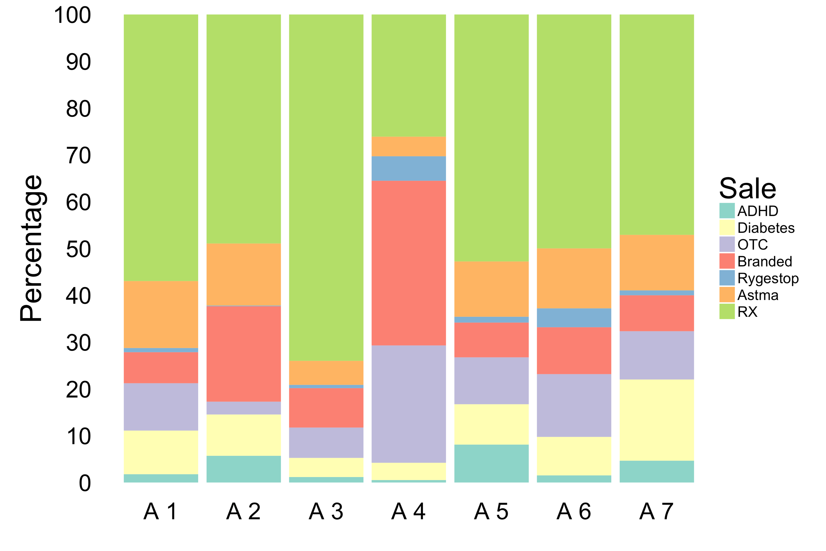
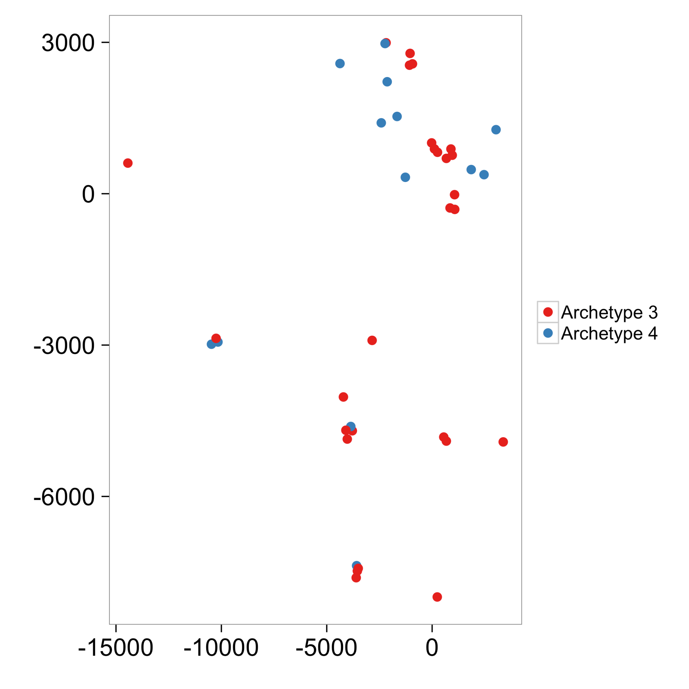
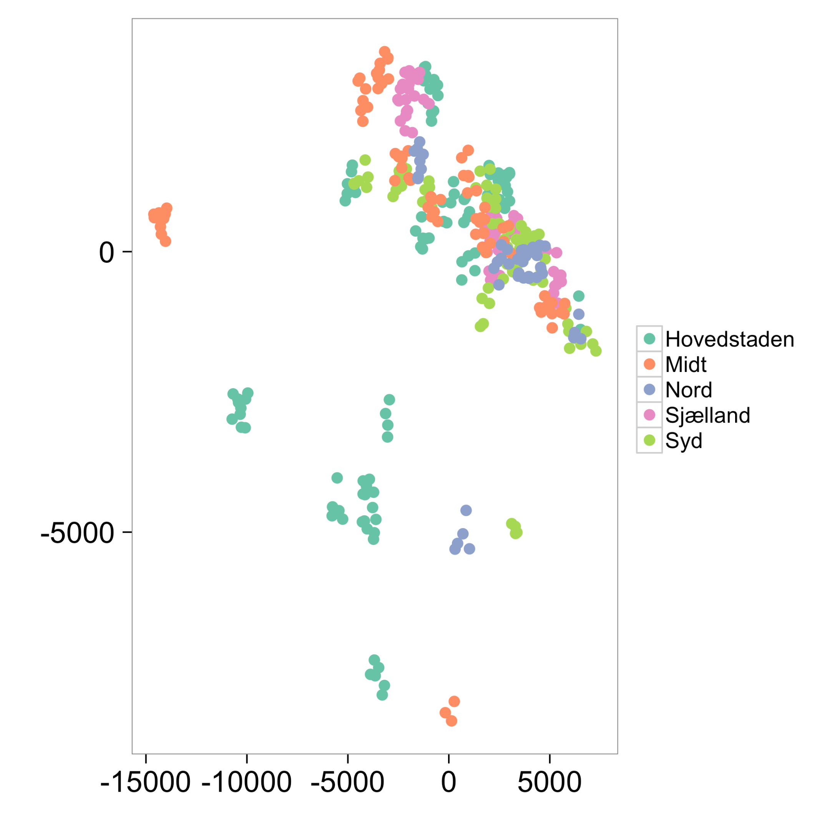
Revenue based segmentation of Danish pharmacies
Kasper Juul Jensen, Lars Roed Ingerslev, Maya Katrin Gussmann
Introduction
Pharmacies in Denmark sell different kinds of products, prescription drugs (RX), over the counter (OTC) drugs and branded products. While prescription drugs bring the highest revenue, their sales depend on the population and cannot really be influenced. OTC drugs and branded products sales, however, can be increased. We will show that there are a number of pharmacies that have managed to increase the proportion of sold OTC drugs and branded products.
Figure 2a and 2b. Archetype 3 and 4 can be found in all regions, but mostly in or near metropols. Both archetypes are nearly non-existent in the countryside.
Figure 1. Sales of the archetypes. Among the seven archetypes, archetypes 3 and 4 seem to stand out.
Data and Methods
We removed one pharmacy from the data set, as the prescription drugs revenue RX went below zero, when splitting it up into categories. Then, we performed an archetypal analysis on the pharmacy revenues. On the basis of a screeplot, seven was chosen as the appropiate number of archetypes.
Finally, we performed a PLS on demographic data to explore whether demographics can explain the archetype distribution.
Figure 3a and 3b. PLS analysis revealed that to some extent archetype 3 seems to be related to younger adults and archetype 4 to children between 8 and 18 and adults over 50. However, the separation is not perfect and it is not immediately clear what causes the separation.
Conclusions
We found two archetypes representing extremes in prescription drug sales. These can appear in the same region, module and demographic structure, suggesting that there are other factors separating them.
We recommend to further examine pharmacies representing these archetypes in order to determine if different marketing or training strategies could explain the differences in revenue composition.
Results
Archetype 3 sells a lot of prescription drugs, but not so much OTC drugs and branded products, while archetype 4 sells a lot more OTC drugs and branded products.
02582 Computational Data Analysis F16
Case 2 - The pharmacies revenue; links between sale, geography and demography
Notes:
Tekst og Streger i 100% farve – Baggrund i 90% Transparent.

