Slide 1
AskSuMa Presentation

Slide 2
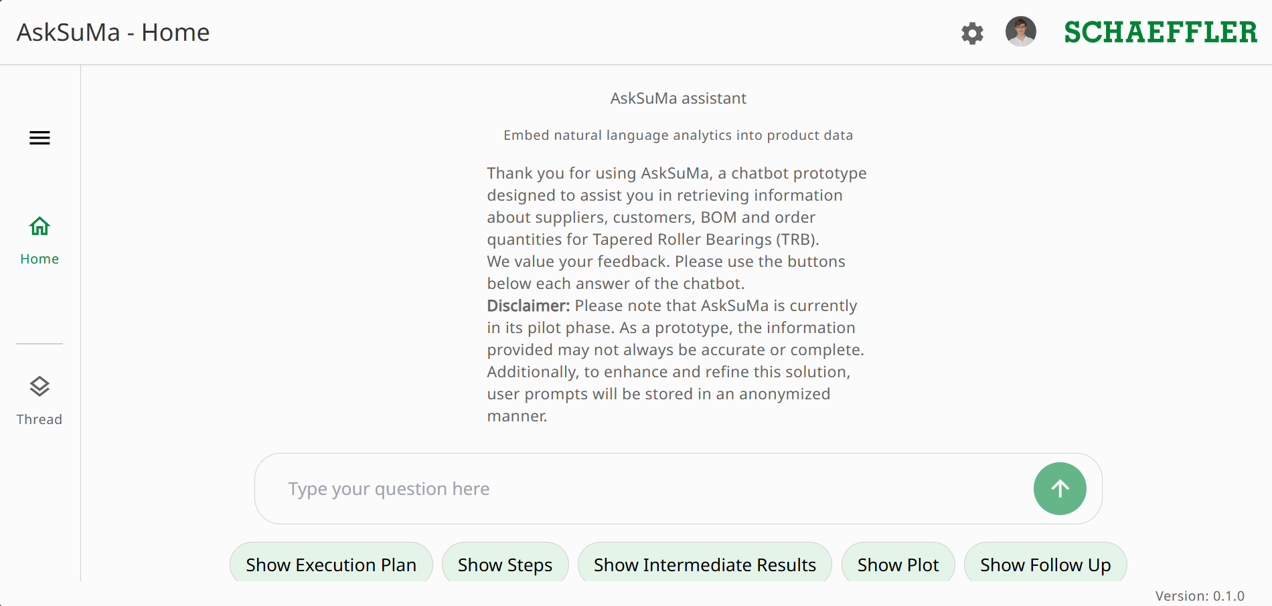
Notes:
Startseite
Erscheint wenn der User die Website aufruft
Anmeldung wird automatisch durchgeführt
Interaktion über Chatbar unten

Slide 3
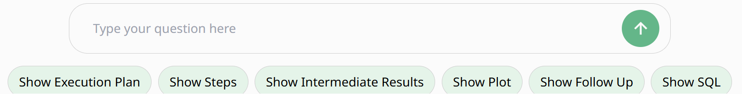
Hier kann die Frage eingegeben werden
Einstellmöglichkeiten für die Antwort vom Chatbot

Slide 4
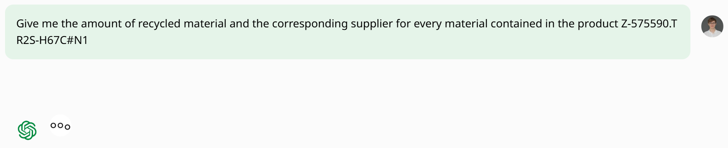
Notes:
Thats what It looks like when you submit a query
Time to first response so 10-20s

Slide 5

Notes:
Execution Plan
Hier wird angezeigt welche Schritte der Chatbot unternimmt.
Dargestellt in einem Flowchart für einfaches Verständnis
An/Ausschaltbar über „Show Execution Plan“
Kann ein und ausgeblendet werden mittels des Augen-Symbols

Slide 6

Notes:
Shows a Step description for each step it currently is executing

Slide 7
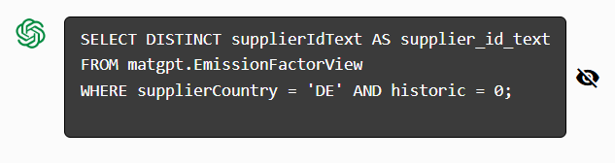
Notes:
For the technically interested Users the SQL-Query can be displayed in a CodeBlock
Hideable using the eye
NOTE: CodeBlock styling still buggy and experimental

Slide 8
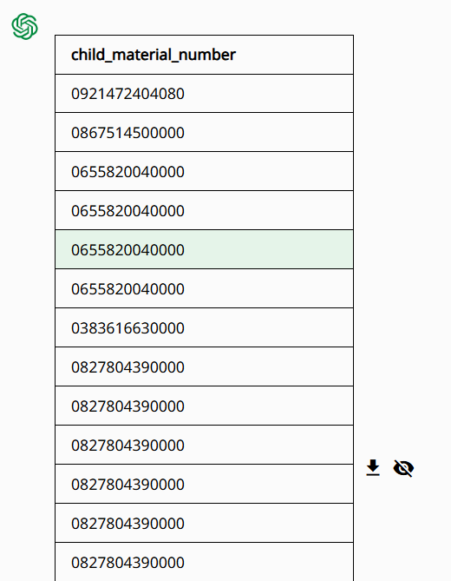
Notes:
Intermediate Results
Shows a List of the intermediate Results the chatbot uses for further requests
Downloadable as excel using the download button
Hideable using the eye icon
Limited to 20 Rows and 5 Columns if Results exceed that threshold download as excel for full results

Slide 9
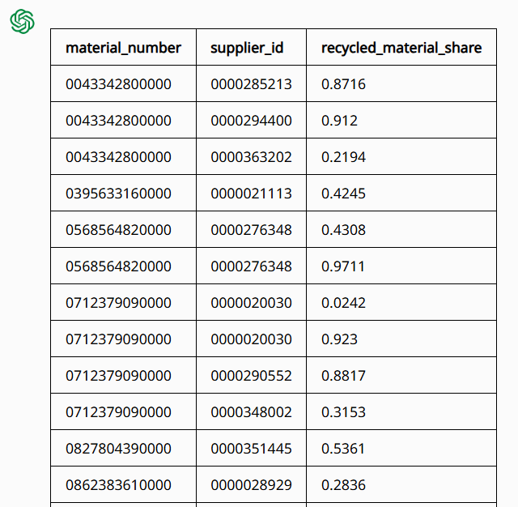
Notes:
Final Result
Returns the Final Result in the Same Format as the intermediate Result.
Same Features/Limitations as the intermediate Result

Slide 10
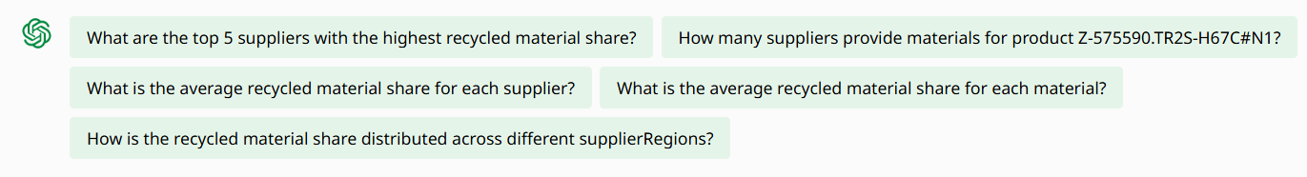
Notes:
After Request has been completed a set of followUp Questions which could be interesting for the user are displayed

Slide 11
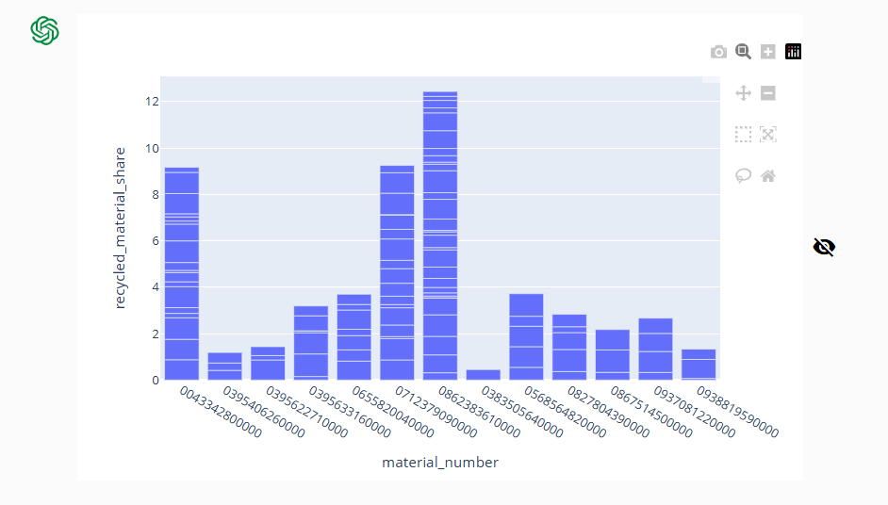
Notes:
If the result of the Data is suitable and the option is turned on, a plot of the data is being created
Interactive Plot: supports zooming paning and also downloadable as a picture
Also hideable using the eye
Note: for this plot duplicate values for the same material number are being stacked on top of each other.
PLOTS ARE STILL WIP AND NOT REALLY READY TO SHOW

Slide 12
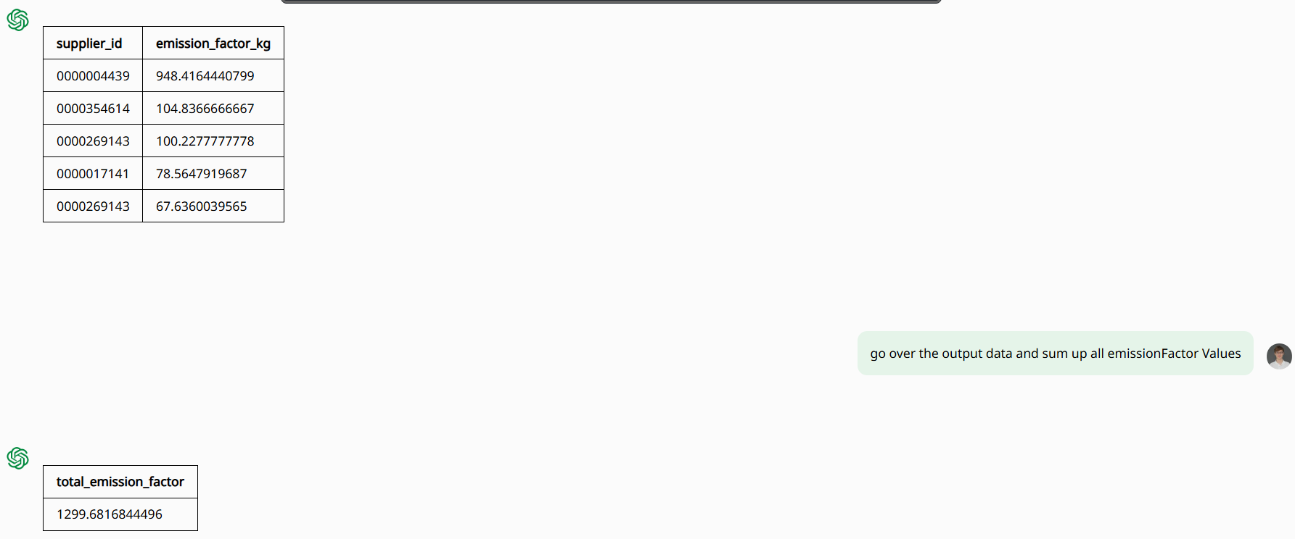
Notes:
Analysis of Results
Question was: What are the top 5 suppliers with the highest emission factors? Use the Kg values
Chatbot delivered Result on the top left
User then asked to sum up all the emission Factor Values
Chatbot returned the requested sum

