Slide 1
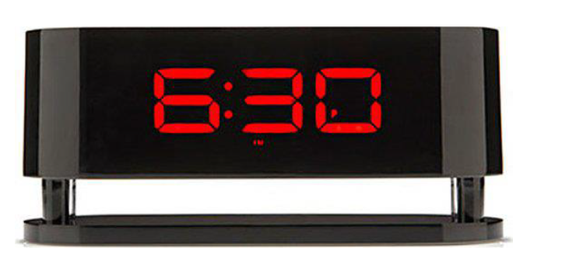
<Assignment 3>
<Andreas Carlsen>
<Mohamed GOmaa>
<Lars Saalbrink>
A digital clock
Show clock format hh:mm on LCD display
Single press will decrease or
increments timer minute
Double press will change the direction
of the single press
Long press will go to normal running
clock
When clock is running the colon ( : )
will blink every second

Slide 2
Task diagram

Slide 3
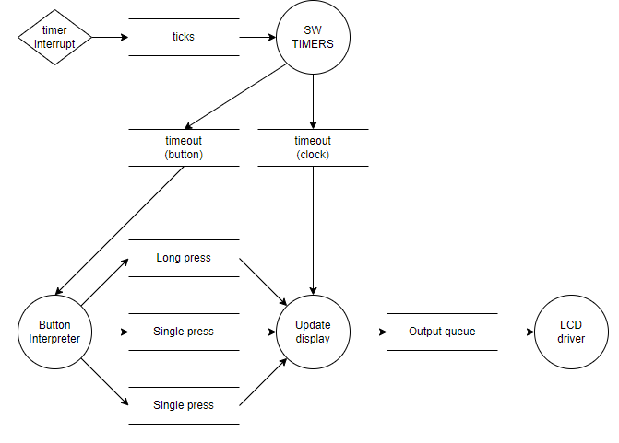

Slide 4
Machine state diagrams

Slide 5
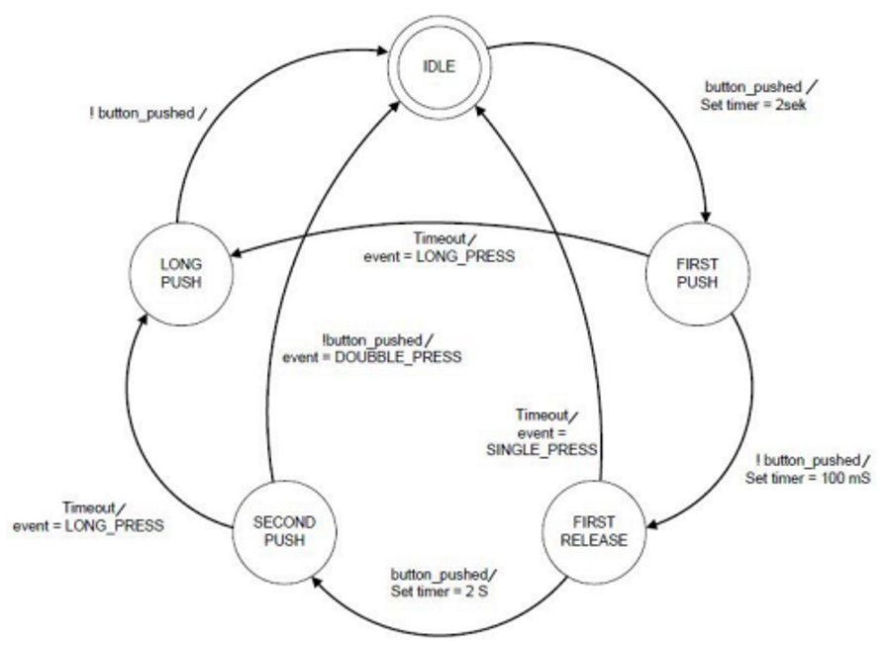
Button Interpreter

Slide 6
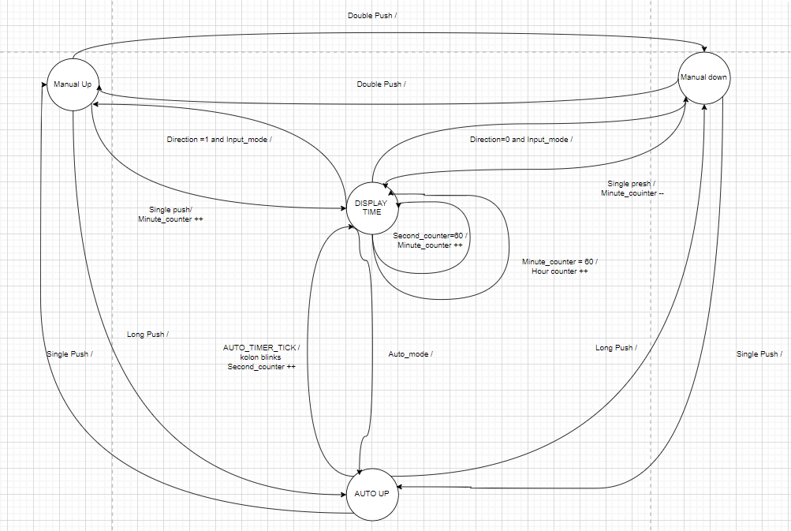
Update Display

Slide 7
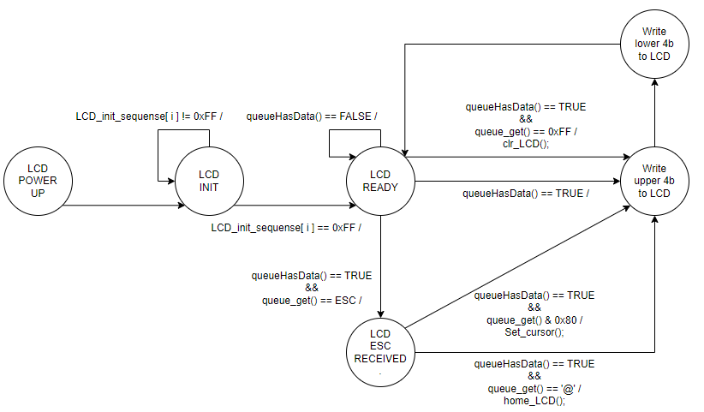
LCD driver

Slide 8
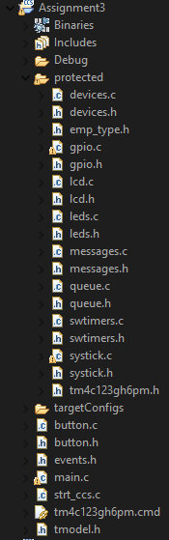
SW modules

Slide 9
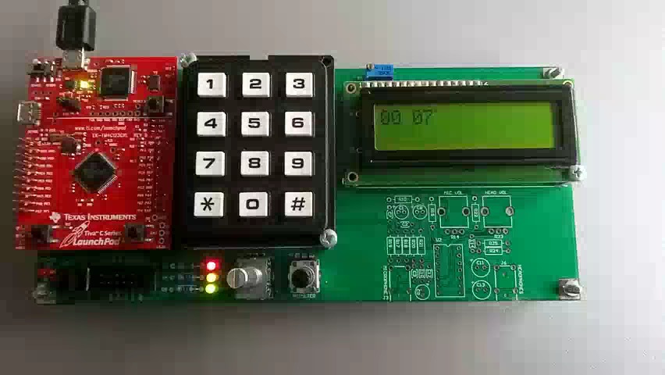
Demo video

