Slide 1
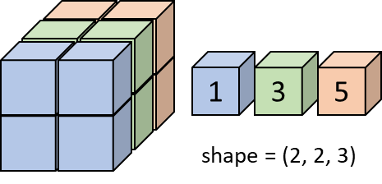
array[:,:,0]
array[:,1,:]
array[0,:,:]
array[0,1,:]
array[0,1,0]
1
1
shape = (2, 2, 3)
1
1
1
1
1
1
1
1
1
1
1
1
1
1
1
1
1
1
1
1
1
1
1
1
1
3
5
1
1
1
1
1
1
1
1
1
1
1
1
1
1
1
1
1
1
1
1
1
1
axis 0
axis 2
axis 1

Slide 2
1
2
3
3
6
9
.
3
=
4
5
6
12
15
18
3
3
3
3
3
3

Slide 3



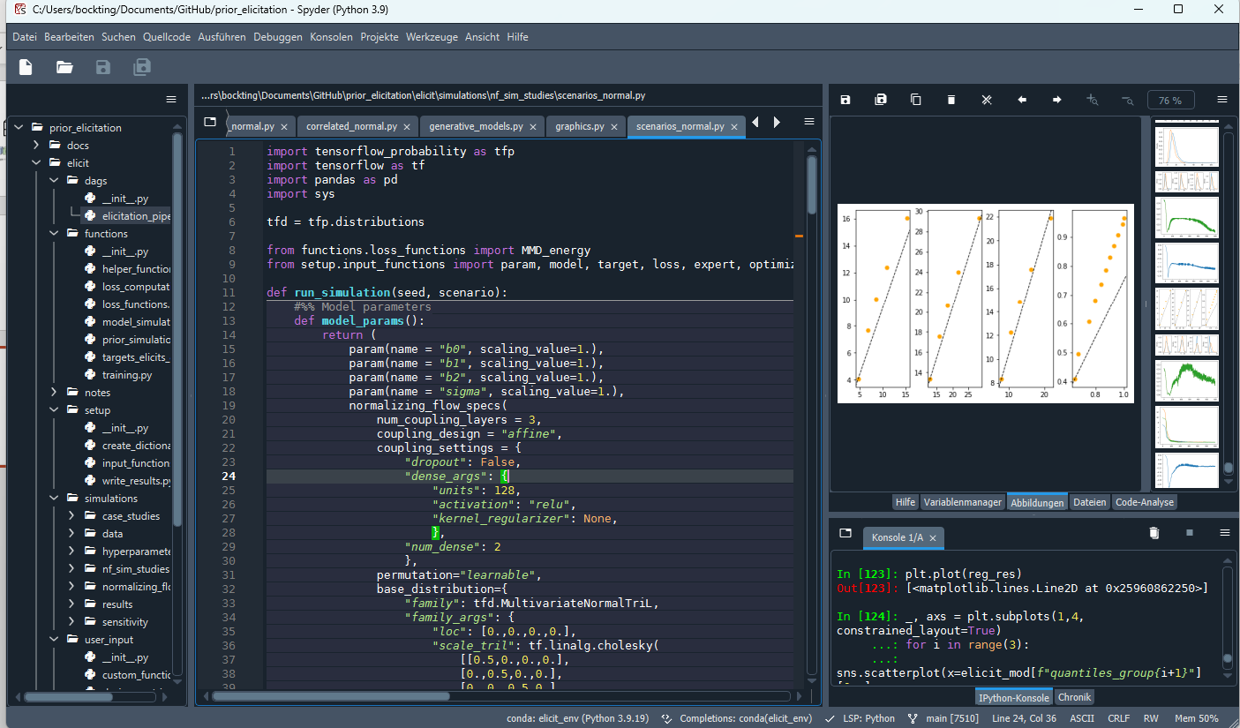
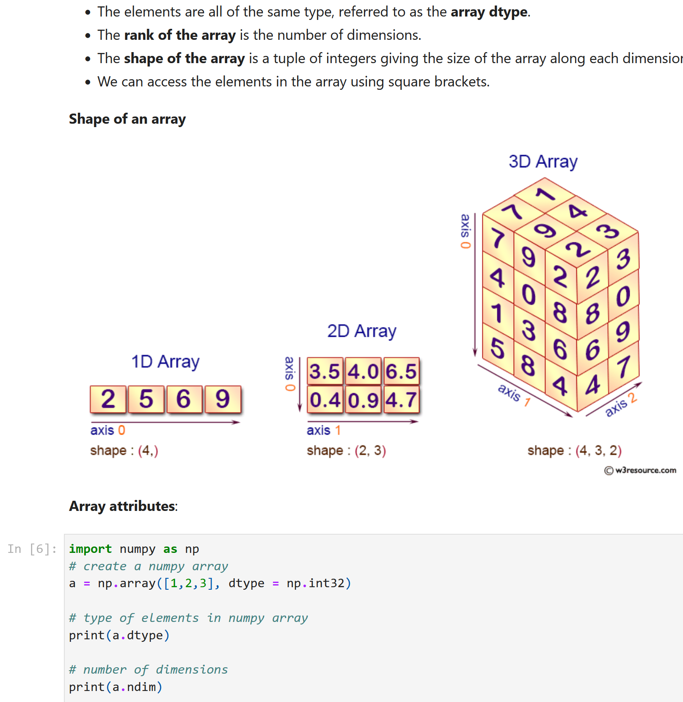





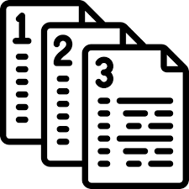


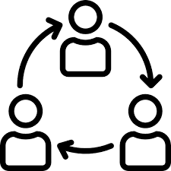



Environment (Anaconda)
Python (3.9.)
modules/packages
Spyder IDE
JupyterLab
Numpy (1.23.)
Pandas (2.2.)
Tensorflow (2.14.)
…
Install new packages using pip or conda
file directory
GitHub
data_wrangling.py
plotting.py
…
documentation.ipynb
exercises.ipynb
save work in online repository
Collaborative work
Share work with community
Easy integration of version control
version control using git
(if Windows: via Git Bash )
GiHub Desktop

Slide 4
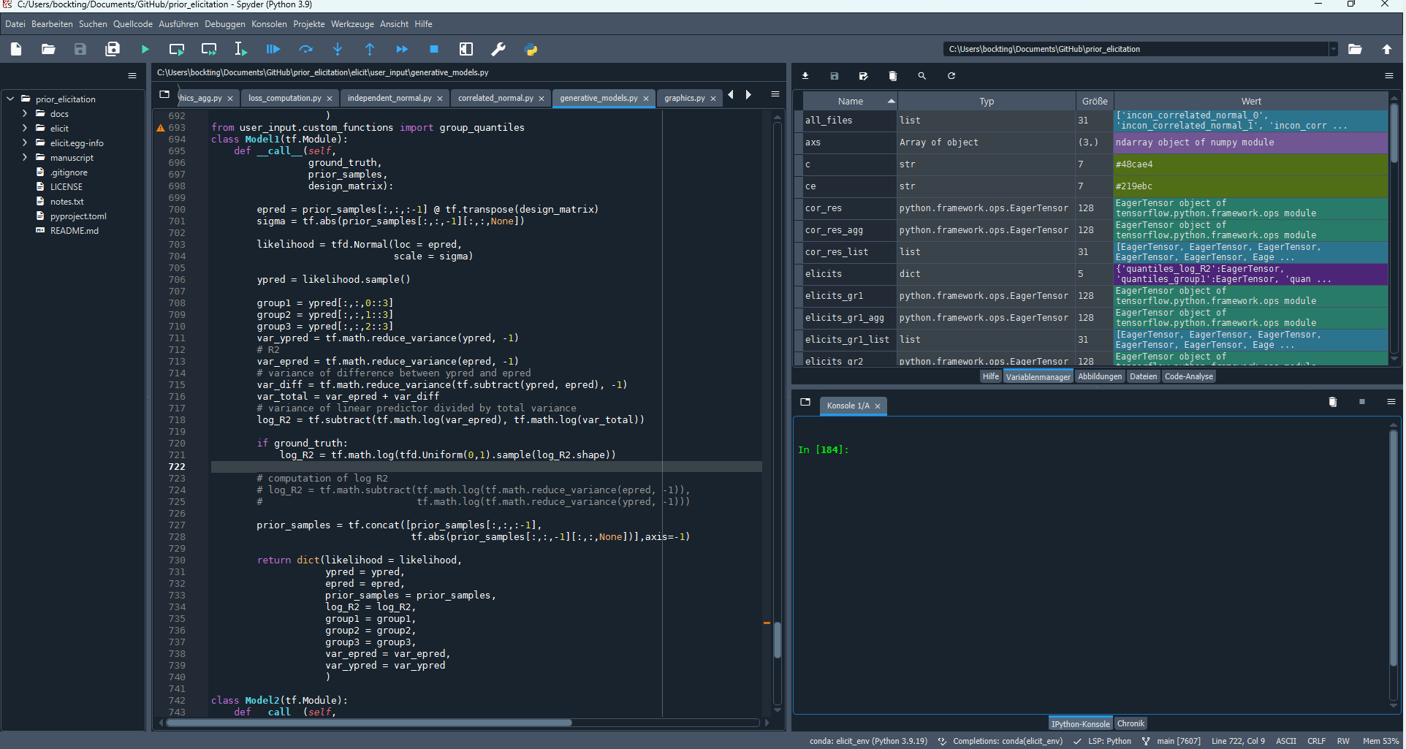
Help / Variable Explorer
File
directory
Editor
IPython Console
Files
Running

