Slide 1




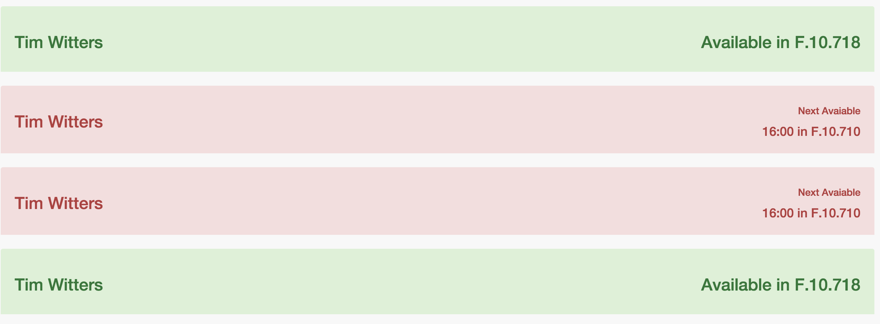
Zaterdag 27 december 2014 - 14:15
0 Show availabilities
1 Show map
2 Search member
Filter:
3 Show all
4 Only directors
5 Only post-doctoral researchers
6 Only PhD Students
Sort by:
7 Lastname
8 Firstname
9 Position

Slide 2
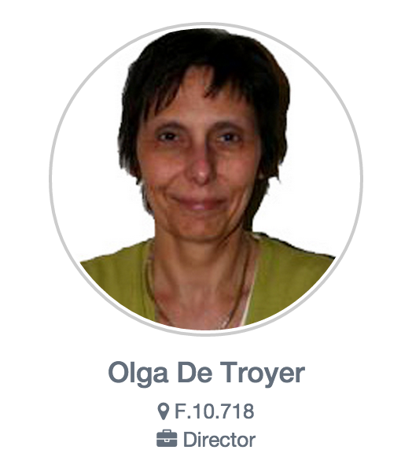
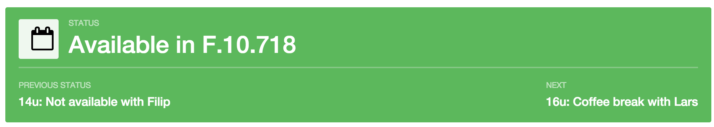
Zaterdag 27 december 2014 - 14:15
0 Back
Show:
1 Current status
2 Member schedule
3 Office on map

Slide 3
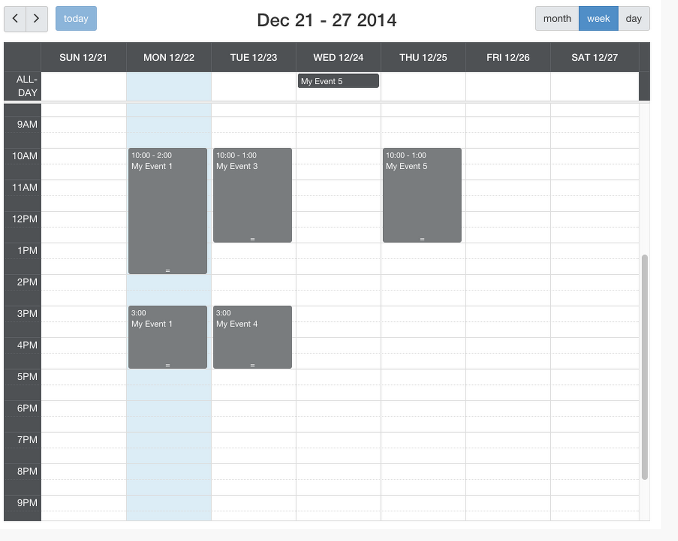
Zaterdag 27 december 2014 - 14:15
0 Back
Show:
1 Current status
2 Member schedule
3 Office on map

Slide 4
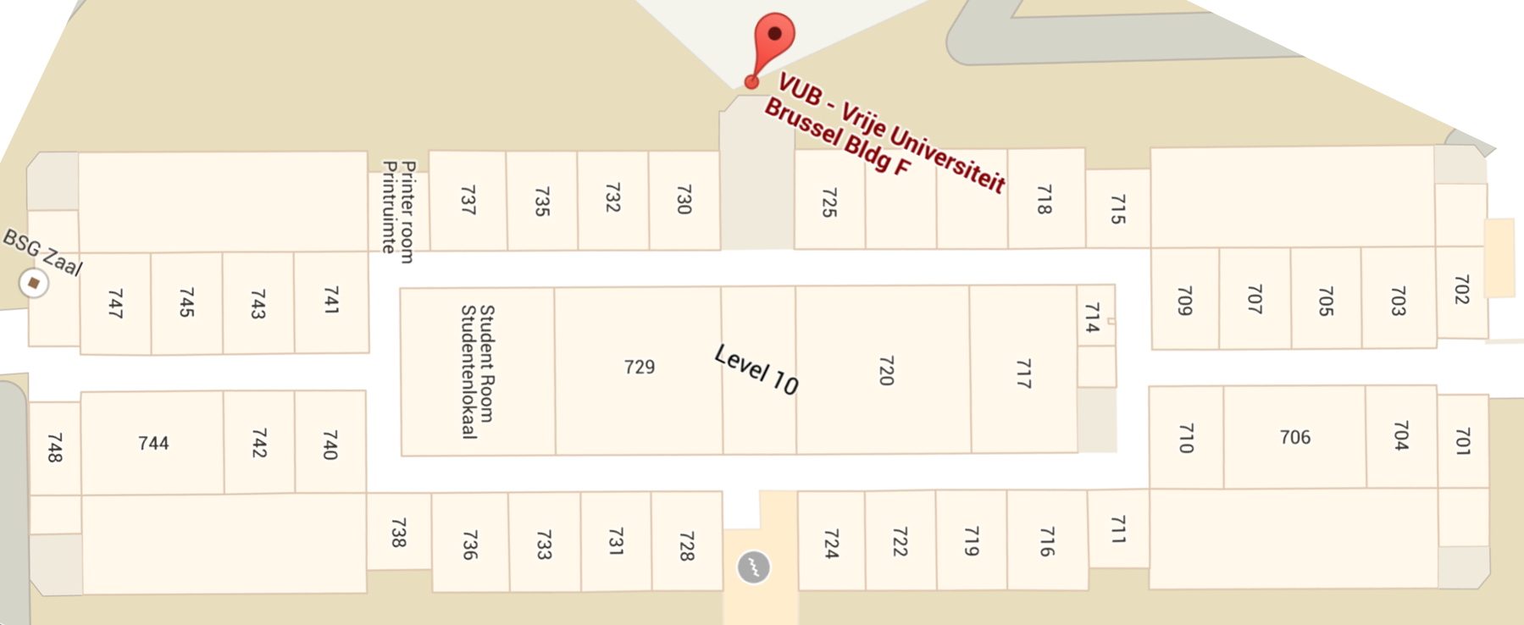
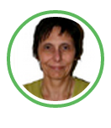
Zaterdag 27 december 2014 - 14:15
0 Back
Show:
1 Current status
2 Member schedule
3 Office on map
Building F Office F.10.718

Slide 5
Zaterdag 27 december 2014 - 14:15
0 Show availabilities
1 Show map
2 Search member
Building:
3 F Building
4 G Building

Slide 6
Zaterdag 27 december 2014 - 14:15
0 Back
Building F - Office F.10.747

Slide 7
Zaterdag 27 december 2014 - 14:15
0 Back
Show:
1 Current status
2 Member schedule
3 Office on map

Slide 8
Zaterdag 27 december 2014 - 14:15
0 Back
Show:
1 Current status
2 Member schedule
3 Office on map

Slide 9
Zaterdag 27 december 2014 - 14:15
0 Show availabilities
1 Show map
2 Search member
Search

Slide 10
Zaterdag 27 december 2014 - 14:15
0 Show availabilities
1 Show map
2 Search member
Search
Tim W

Slide 11
Zaterdag 27 december 2014 - 14:15
0 Back
Show:
1 Current status
2 Member schedule
3 Office on map

Slide 12
Zaterdag 27 december 2014 - 14:15
0 Back
Show:
1 Current status
2 Member schedule
3 Office on map

