Slide 1

Duty Report
Chris Z.
2021.03.31

Slide 2
Before we start

Slide 3
Content
News
Topic
Questions

Slide 4
News (Domestic)
When I searched for news in China, almost all pieces of news are about Xinjiang, US, South China Sea etc…
But not this one.

Slide 5
News (Domestic)
Tecent played down the impact of Beijing’s heightening scrutiny over China’s biggest internet firms, saying a potential revamp of its $120 billion fintech wing should have little impact on its business. Its shares sank the most in two months.
President Martin Lau acknowledged founder Pony Ma called on regulators recently but said that it was voluntary and part of a series of regular meetings. Executives reiterated that the company has always been cautious and compliant with fintech regulations and it will stick with its normal practice of acquiring minority stakes in Chinese startups, while regulators pore over past deals.
Source: Bloomberg

Slide 6
News (Internetional)
A fuel tank at an oil facility in Saudi Arabia caught fire after being struck in an attack by Yemen’s Houthi rebels, officials said Friday, an attack that came on the sixth anniversary of the kingdom’s entry into Yemen’s years-long civil war.
The kingdom has faced an increasing number of such assaults and the tempo hasn’t slowed since it offered a cease-fire deal to the Houthis on Monday.
Source: AP News

Slide 7
Topic
Just Guess!

Slide 8
Topic
Today’s topic is about one person and his stories.
Classical music

Slide 9
Topic
Let Albert guess the question!

Slide 10
Story 1

Slide 11
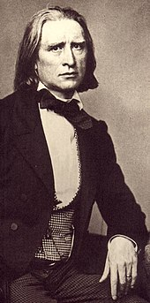
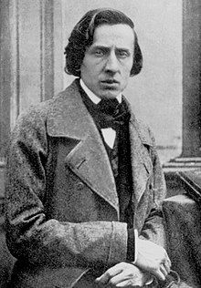
Story 1
19th century
Poland & Hungary
Two musicians

Slide 12
Chopin & Liszt

Slide 13
Chopin
Frédéric François Chopin (01/03/1810 – 17/10/1849)

Slide 14
Liszt
Franz Liszt (22/10/1811 – 31/07/1886)

Slide 15
Liszt
12 Etudes d’execution transcendante
Eg. No.12 Chasse Neige

Slide 16
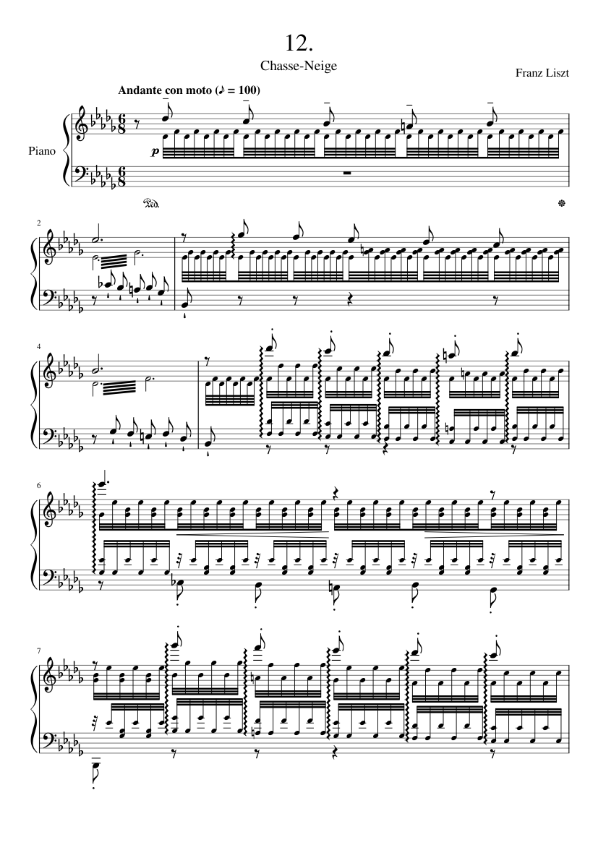
Liszt
12 Etudes d’execution transcendante
Eg. No.12 Chasse Neige

Slide 17
Question -1

Slide 18
Question -1
What’s the background music?

Slide 19

Question -1
What’s the song playing when I’m doing the duty report?
La Campanella by Liszt

Slide 20
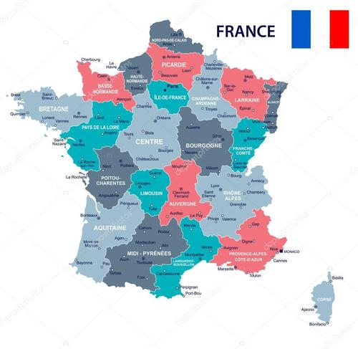
Here comes the story
where the story took place

Slide 21
They met in Paris.
After listening to Chopin’s music, Liszt thought much of Chopin.

Slide 22
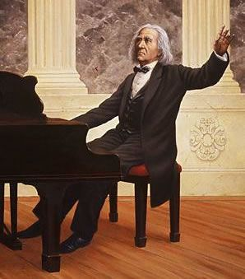
Concert of Liszt
(Applause)

Slide 24
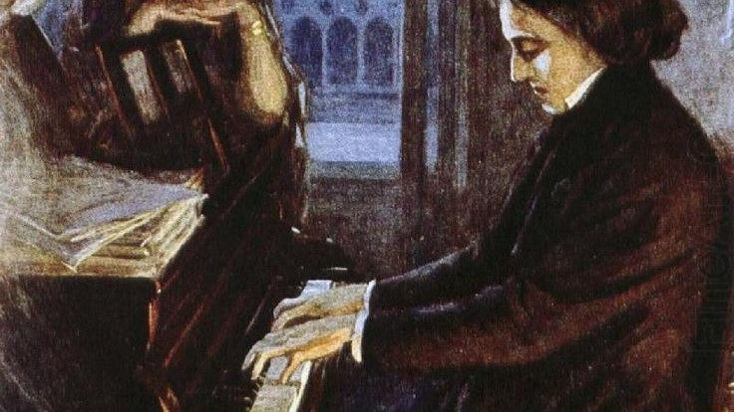
(Louder
Applause)

Slide 25
Question 0
Analyze the two applauds in the story. (3’)

Slide 26
Question 0
Analyze the two rounds of applause in the story.
The first round of applause was for Liszt, because Liszt was a famous pianist then. (1’)
The second round applause was for Chopin’s talent and the fantastic music (1’) and people admire Liszt for what he had done. (2’)

Slide 27
Story 2
Something not that important…

Slide 28
No Title
Liszt used to like travel very much before he broke up with his first wife Mary.
And he eloped with Caroline in the same year.
Caroline disliked travelling, so he then began to stay with her at home more often instead of travelling around Europe.

Slide 29
Story 3 Not only about music
Faust Goethe
Matepa Hugo
Hamlet Shakespeare
Divine Comedy Dante

Slide 30
Question 1
Which company did I mentioned in the domestic news?

Slide 31
Question 2
Who lived longer? Chopin or Liszt? And what was their nationality?

Slide 32
Question 2
Who lived longer? Chopin or Liszt? And what was their nationality?
Liszt lived longer. Chopin is Polish, and Liszt is Hungarian.

Slide 33
Question 3
What’s the relationship between literature and music in your opinion?

Slide 35
Thanks

