Slide 1
Team EchoLogia
Challenge: Turn Audio into Intelligence
Given intercepted audio, let’s decipher the true meaning of the content. Think about the difficulties an operator faces in practice: noisy sound abbreviated language, codewords. Uncover the true meaning of the conversation and correlate with the side information at hand. For example, match the conversation content with the emotion of the speakers (e.g. the stress level), estimate the hierarchy of the speakers, or analyze the background noises (e.g. environmental noises or vehicle types) for situational awareness. Generate an executive summary of the intelligence at hand.

Slide 2
Context:
Intercepted audio does not only contain a conversation, but also important meta information.Not only, we want to know what people are talking about, but e.g. also how and where they talk.
AI can help operators in SIGINT and EW to extract hidden or side information out of audio recordings. This way,we get a holistic view on conversations, merging all information sources at hand.
Expectations:
1. Minimum requirements:
We would love to see a prototype of your idea.
Combine the latest audio AI and large language models to an intelligence pipeline.
Also think about ways to handle noisy, imperfect intercepted data.
Let your creativity go wild and present extensions in a processing diagram.
2. Optional extensions:
Think about a backend structure, how to store and correlate the intercepted information. Database?
How can we integrate other intelligence sources, e.g. weather or location information?
You may even go into Agentic AI here, combining your modules e.g. using MCP servers.
3. Technologies:
You will likely use a Python backend for the AI models (e.g. using transformers, vllm, orpure pytorch/tensorflow), but for some eye candy think about a frontend visualizing your idea (e.g. using Vue or Angular).

Slide 3
Data & resources:
Available data: Intercepted data is usually quite sensitive.
We recommend using public data sets or recording your own data to showcase your ideas.
MAD Dataset: Military Audio Dataset(https://www.kaggle.com/datasets/junewookim/mad-dataset-military-audio-dataset)
Military Helicopter Data Set(https://www.kaggle.com/datasets/crsuthikshnkumar/military-helicopter-data-set
Military - Signal Identification Wiki(https://www.sigidwiki.com/wiki/Category:Military)
APIs: TO-DISCUSS
Tools & Software: Feel free to use the tools you like.
Access: TO-DISCUSS
Operational Scenario:
"The intercepted conversation seems to be between a commander and his troop. They claim to be located at the coast, however, the background noises suggest they are in a city."

Slide 4
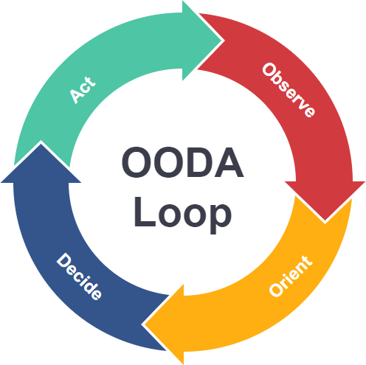
MIL context
“Echologia enhances NATO’s ISTAR framework by delivering tactical-level auditory intelligence converting ambient and conversational sound into situational context that supports rapid, informed decision-making.”

Slide 5
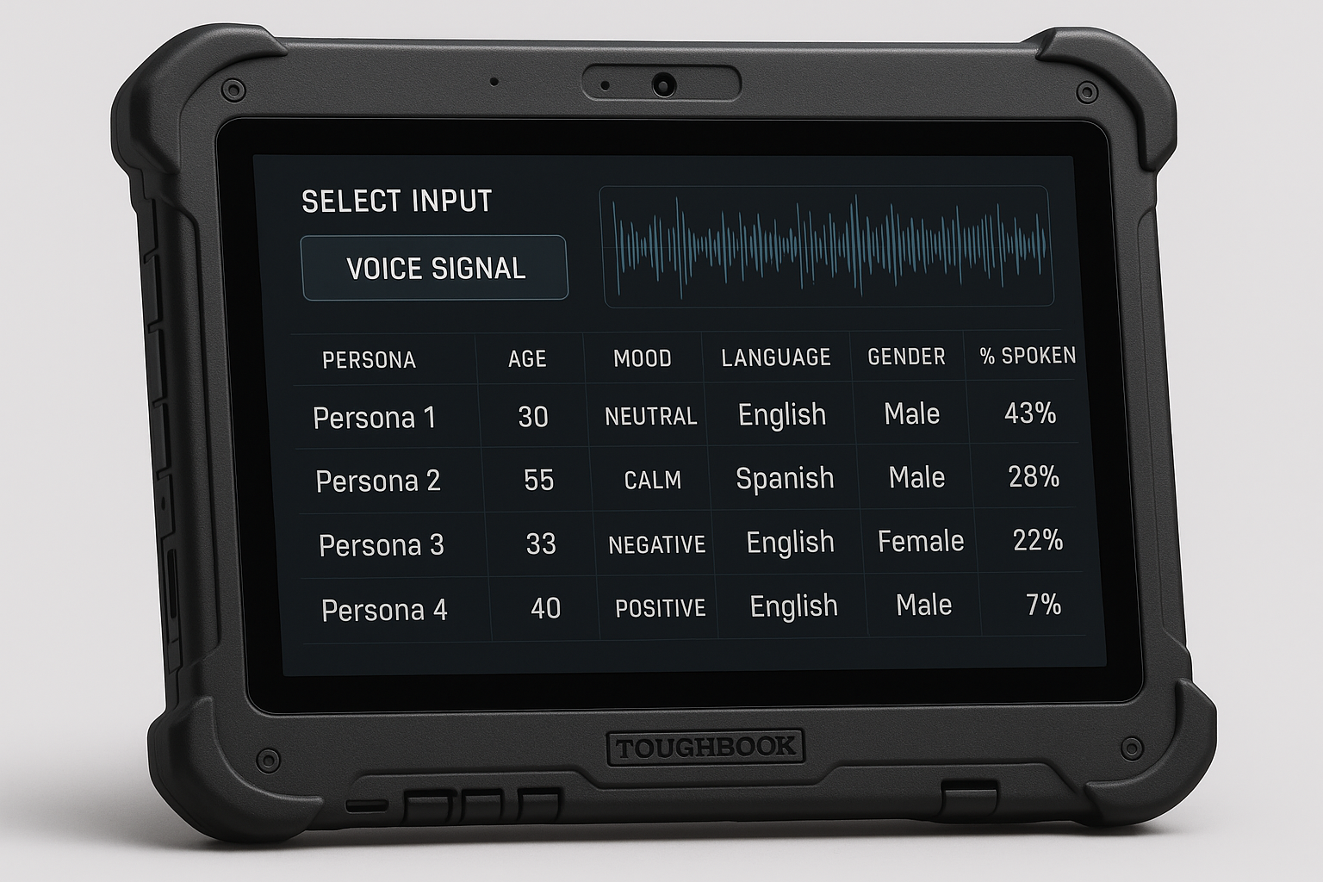

Slide 7
EcoLogia
Turning Audio into Intelligence

Slide 8
The Team
Who are we?

Slide 9
The Problem
Intercepted audio is rich but underutilized.
Operators face noise, codewords, and incomplete context.
Current SIGINT tools focus on what is said, not how or where.
Lack of automation slows tactical decision-making in fast-changing environments.

Slide 10
The Solution: EcoLogia
EcoLogia turns intercepted audio into multi-layered intelligence by:
Extracting speech content, emotion, and hierarchy of speakers.
Analyzing background sound (environment, vehicle, stress cues).
Merging audio with contextual data (weather, location, mission metadata).
Producing an executive summary for operators and analysts.

Slide 11
Technical Approach
AI Pipeline Diagram :
Input: Raw intercepted audio (noisy, partial)
Preprocessing: Noise reduction, segmentation
AI Models:
Whisper or wav2vec for speech-to-text
Emotion/speaker recognition model
Sound classification (open source transformers)
Fusion Layer: Correlates linguistic + acoustic + contextual data
LLM Module: Generates summarized intelligence
Frontend: Visual dashboard for situational awareness

Slide 12
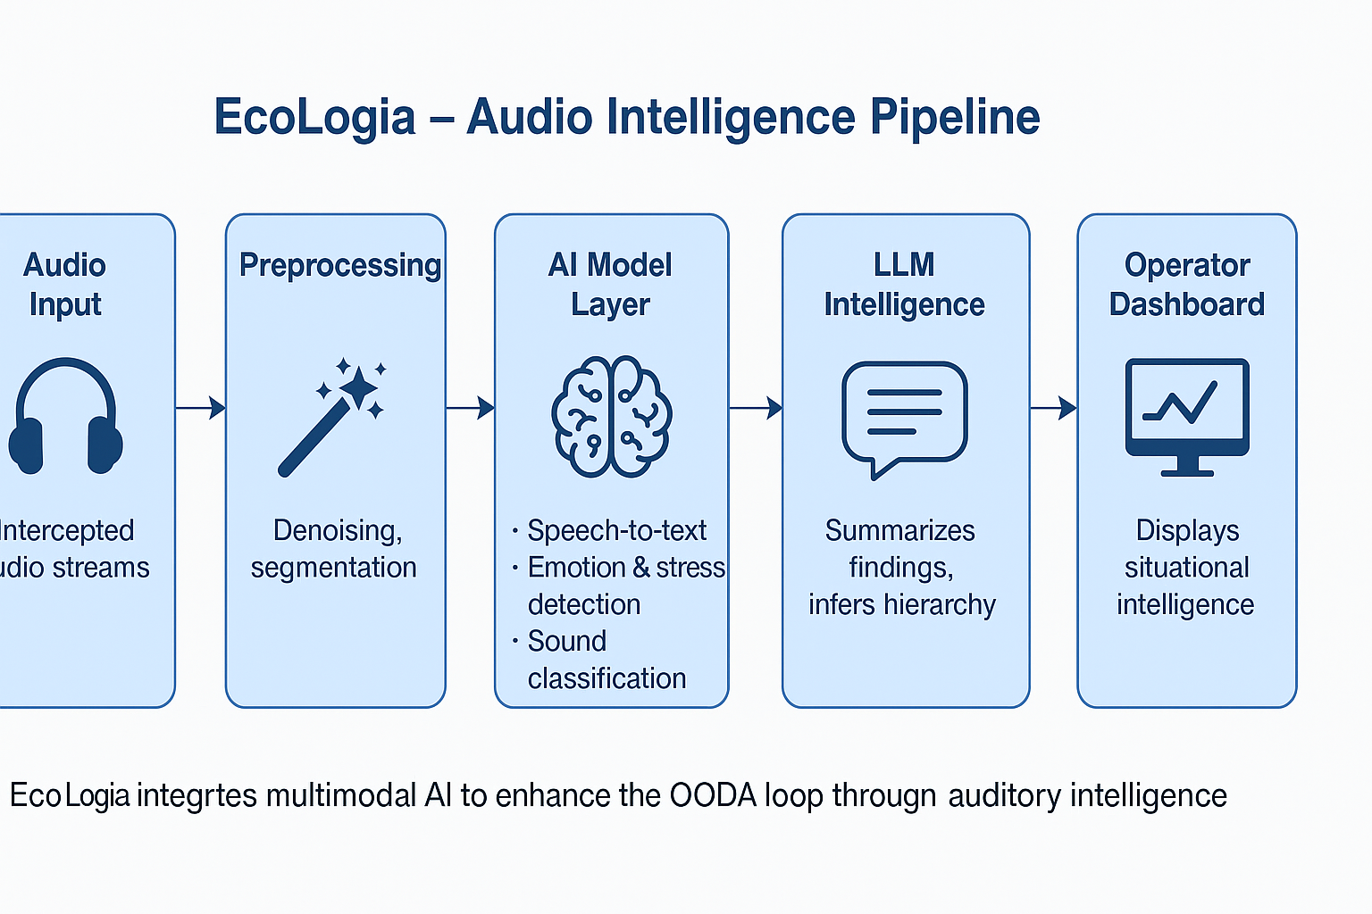

Slide 13
Technology Stack
Layer | Tools
Speech Processing | Whisper, wav2vec2.0
Emotion / Speaker ID | pyAudioAnalysis, transformers
Background Sound | VGGish, YAMNet
LLM Intelligence | GPT / Llama for reasoning
Visualization | Vue.js / Angular frontend
Backend | Python (FastAPI), Postgres / MongoDB

Slide 14
Deployment & Manufacturing
Runs on field-deployable devices (e.g., Panasonic Toughbook).
Modular backend for integration into NATO ISTAR or civilian emergency systems.
Scalable cloud / edge architecture.
Designed for secure environments (air-gapped or encrypted networks).

Slide 15
Hackathon Achievements
Prototype built integrating Whisper + LLM for multi-layered audio intelligence.
Demo scenario: “Commander–troop communication with environmental mismatch (city noise vs claimed coastal location).”
Visual concept mock-up + backend logic diagram.
Team collaboration on multimodal AI integration.

Slide 16
Impact & Future Vision
Enhances NATO OODA (Observe–Orient–Decide–Act) loop.
Potential for dual-use: defense, disaster response, intelligence fusion.
Next steps: expand dataset, fine-tune models, deploy pilot system.

Slide 17
Use Cases
911 calls

