Slide 1
Appium
Equipo QA
Luis Ramírez
Jorge Martínez

Slide 2
APPIUM / Selenium - Java
** Open source automation testing tool **
Supported Platforms
·iOS
·Android
·Firefox OS
Scripts can be developed in Java, C#, Javascript, Python, Ruby.
ECLIPSE IDE

Slide 3
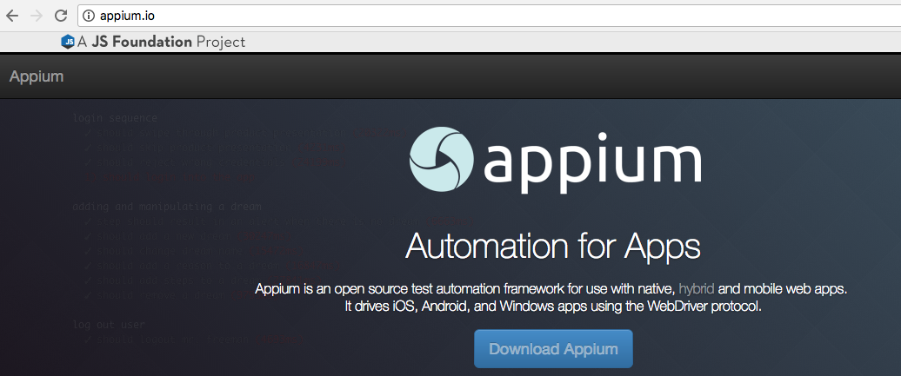

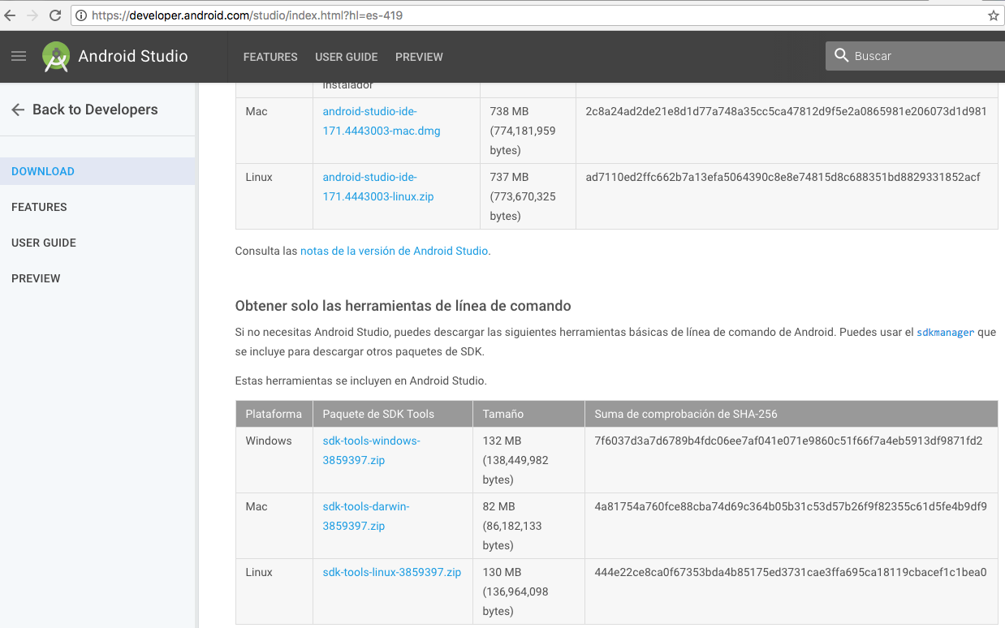
Install Software
Download Appium from the oficial page.
EclipseIDE
SDK Android.

Slide 4
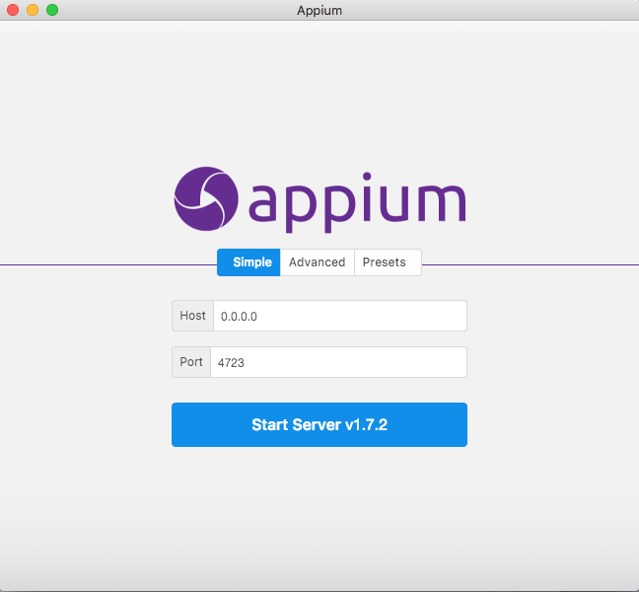
ARCHITECHTURE of APIUM
Start APPIUM server before start running the program otherwise you can’t run the test program.
You need CAPABILITIES, they will help you to handle your commands
localhost

Slide 5

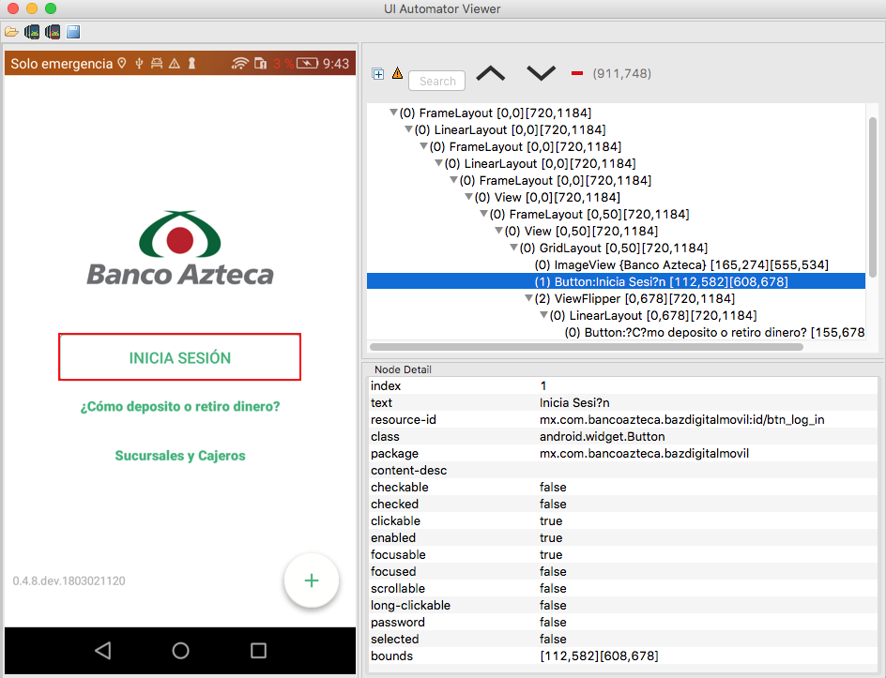
UIAutomatorViewer
Command line : uiautomatorviewer
1. Take Screenshot
2. Select any object: button, field, link etc.
3. Attributes/Details

Slide 6
Core Attributes
Package, class, resource-id, text, index
How to generate a Xpath from automatorviewer
This will help you to identify any object on the screen.
1.- Select something - it has details
2.- From the details - You can identify only by Core attributes
3.- Syntax is : //tagName[@attribute='value']
4.- tagName is : class attributes
Ex. androidDriver.findElementByXPath("//android.widget.Button[@text=‘Iniciar Sesi?n']");

