Slide 1


Module 4:
Selenium WebDriver
by Uladzimir Zviartouski
FEBRUARY 3, 2017

Slide 2


Module 4:
Selenium WebDriver
Lecture 3: Actions, JS Executor, Remote WebDriver
FEBRUARY 3, 2017

Slide 3





FEW WORDS ABOUT ME
6+ years with EPAM
ULADZIMIR ZVIARTOUSKI
Lead Software Testing Engineer

Slide 4
MODULE 4 : AGENDA
1
2
3
Lecture 1
Lecture 2
Lecture 3
Overview: what is WebDriver?
How it works?
Web DevTools
Locators
RegEx basics
Q&A from Lecture 1
Page Object Pattern
Page Factory Pattern
Q&A from Lecture 2
Actions
JavaScript executor
Remote Execution
Selenuim Grid
Extras

Slide 5
Part 1
Selenium WebDriver.
WHAT IS Page object
NOT A MISTAKE ☺ - JUST A SUMMARY FROM THE PREVIOUS SESSION

Slide 6

SELENIUM WEBDRIVER. LECTURE 2. SUMMARY
Design patterns are worth to be used. Design patterns represent the best practices used by experienced object-oriented software developers.
Design patterns are solutions to general problems that software developers faced during software development.
Page Object pattern provides a good solution to separate test logic and web page/area description and build a well structured project.
Page Object can have custom implementation via almost pure Java /basic WebDriver means or by native dedicated support from WebDriver side via specific annotations (@FindBy, @CacheLookup end etc.) and PageFactory methods.
Page Factory provides a solution to manage/create/init page elements in a convenient way.
PO
Page Class (Screen)
WebElements
Methods

Slide 7
Part 2
Selenium WebDriver.
ACTIONS

Slide 8


ACTIONS
The user-facing API for emulating complex user gestures
(interactions with a keyboard and mouse)
Root principle - single action (Action)
click-and-hold
double-click
drag-and-drop
drag-and-drop-by
key-down
key-up
move-by-offset
move-to-element
release

Slide 9
NATIVE EVENTS VS SYNTHETIC
Browser | OS | Native | Synthetic
Firefox | Linux | Supported | Supported
Firefox | Windows | Supported | Supported
Internet Explorer | Windows | Supported | Not supported
Chrome | Linux / Windows | Supported * | Not supported
Opera | Linux / Windows | Supported | Not supported
HtmlUnit | Linux / Windows | Supported | Not supported
FirefoxProfile profile = new FirefoxProfile(); profile.setEnableNativeEvents(true); FirefoxDriver driver = new FirefoxDriver(profile);
Notes:
https://github.com/SeleniumHQ/selenium/wiki/Advanced-User-Interactions
In WebDriver advanced user interactions are provided by either simulating the Javascript events directly (i.e. synthetic events) or by letting the browser generate the Javascript events (i.e. native events). Native events simulate the user interactions better whereas synthetic events are platform independent, which can be important in Linux when alternative window managers are used, see native events on Linux. Native events should be used whenever it is possible.
ChromeDriver provides two modes of supporting native events called WebKit events and raw events. In the WebKit events the ChromeDriver calls the WebKit functions which trigger Javascript events, in the raw events mode operating systems events are used.
In the FirefoxDriver, native events can be turned on and off in the FirefoxProfile.
FirefoxProfile profile = new FirefoxProfile();
profile.setEnableNativeEvents(true);
FirefoxDriver driver = new FirefoxDriver(profile);
Examples
These are some examples where native events behave different to synthetic events:
With synthetic events it is possible to click on elements which are hidden behind other elements. With native events the browser sends the click event to the top most element at the given location, as it would happen when the user clicks on the specific location.
When a user presses the 'tab' key the focus jumps from the current element to the next element. This is done by the browser. With synthetic events the browser does not know that the 'tab' key is pressed and therefore won't change the focus. With native events the browser will behave as expected.

Slide 10
ACTIONS
Common way to run a chain:
new Actions(driver).{<method1>…<methodN>}.build().perform();
build() – routine for “compiling” actions chain;
perform() – routine for executing built chain;

Slide 11
ACTIONS. CLICK, CONTEXT CLICK
click() – mouse click at the current cursor location
click(WebElement onElement) – click at the center of particular WebElement
//Click current position
new Actions(driver).click().build().perform();
//Click web element
WebElement button = driver.findElement(By.id("button"));
new Actions(driver).click(button).build().perform();
contextClick() – invoke context menu at the current cursor location
contextClick(WebElement onElement) – right click at particular WebElement in order to invoke context menu
WebElement accordionSection = driver.findElement(By.linkText(“Section"));
new Actions(driver).contextClick(accordionSection).build().perform();

Slide 12
ACTIONS. CLICK & HOLD, DOUBLE CLICK
clickAndHold() – click without releasing left mouse button;
clickAndHold(WebElement onElement) – click without releasing left mouse button at the center of particular WebElement
//Click current position (without releasing left mouse button)
new Actions(driver).clickAndHold().build().perform();
//Click web element (without releasing left mouse button)
WebElement button = driver.findElement(By.id("button"));
new Actions(driver).clickAndHold(button).build().perform();
doubleClick() – double click at the current cursor position
doubleClick(WebElement onElement) – double click at the particular WebElement
//Double click current position
new Actions(driver).doubleClick().build().perform();
//Double web element
WebElement button = driver.findElement(By.id("button"));
new Actions(driver).doubleClick(button).build().perform();

Slide 13
ACTIONS. RELEASE
release() – release left mouse button in case it was pressed before;
release(WebElement onElement) – release left mouse button in case we’ve pressed it on particular WebElement.
//Click current position (without releasing left mouse button)
new Actions(driver).clickAndHold().build().perform();
//ANY CHECKS OR ACTIONS HERE
new Actions(driver).release().build().perform();
//Click web element (without releasing left mouse button)
WebElement button = driver.findElement(By.id("button"));
new Actions(driver).clickAndHold(button).build().perform();
//ANY CHECKS OR ACTIONS HERE
new Actions(driver).release(button).build().perform();

Slide 14
ACTIONS. MOVE TO ELEMENT, DRAG & DROP
moveToElement(WebElement toElement) – move mouse cursor to the center of particular WebElement
moveToElement(WebElement toElement, int xOffset, int yOffset) – move mouse cursor with respect to location (xOffset; yOffset) from up left corner of toElement
WebElement draggable = driver.findElement(By.id(“draggable”));
new Actions(driver).moveToElement(draggable).build().perform();
new Actions(driver).moveToElement(draggable, 120, 120).build().perform();
dragAndDrop(WebElement source, WebElement target) – drag source WebElement at the target position («press» - «move» - «release»)
dragAndDrop(WebElement source, int xOffset, int yOffset) – drag source element at the (xOffset; yOffset) position
WebElement draggable = driver.findElement(By.id(“draggable”));
WebElement drappable = driver.findElement(By.id(“drappable”));
new Actions(driver).dragAndDrop(draggable, droppable).build().perform();
new Actions(driver). dragAndDrop(draggable, 120, 120).build().perform();

Slide 15
ACTIONS. SEND KEYS
sendKeys( java.Lang.CharSequence … keysToSend) – type text to active element
sendKeys(WebElement element, java.Lang.CharSequence … keysToSend) – type text into particular webElement
new Actions(driver).sendKeys(“Example text”).build().perform();
======================================================================
WebElement input = driver.findElement(By.id(“input"));
new Actions(driver).sendKeys(input, “Example text”).build().perform();
======================================================================
WebElement input = driver.findElement(By.id(“input"));
new Actions(driver).sendKeys(input, Keys.RETURN).build().perform();
======================================================================
Enum Keys - representations of pressable keys that aren't text.
These are stored in the Unicode PUA (Private Use Area) code points, 0xE000-0xF8FF.

Slide 16
DEMO

Slide 17
Part 3
Selenium WebDriver.
Extras

Slide 18
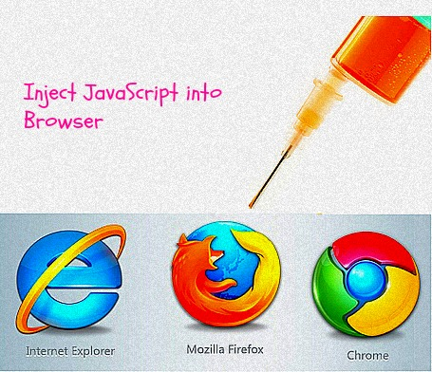
JAVASCRIPT EXECUTOR
JavaScript Executor is an interface, that provides mechanism to execute JavaScript through WebDriver.
executeScript(java.lang.String script, java.lang.Object... args)
executeAsyncScript(java.lang.String script, java.lang.Object... args)

Slide 19
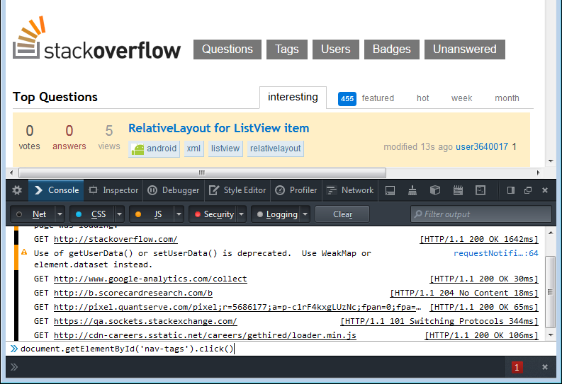
JAVASCRIPT EXECUTOR. CLICK
@Test
public void oneCanViewStackoverflow()
{
WebDriver driver = new FirefoxDriver();
driver.get("http://www.stackoverflow.com/");
System.out.println(driver.getTitle());
JavascriptExecutor jsExec = (JavascriptExecutor) driver;
jsExec.executeScript("document.getElementById('nav-tags').click()");
System.out.println(driver.getTitle());
driver.quit();
}

Slide 20
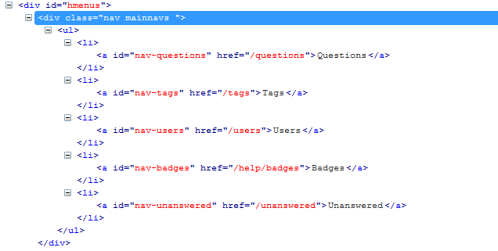
JAVASCRIPT EXECUTOR. RETURN LIST<WEBELEMENT>
@Test
public void oneCanViewStackoverflow()
{
WebDriver driver = new FirefoxDriver();
driver.get("http://www.stackoverflow.com/");
JavascriptExecutor jsExec = (JavascriptExecutor) driver;
Object response = jsExec.executeScript("var elements = document.querySelectorAll('div.mainnavs li a'); return elements;");
int searchLinksCount = ((ArrayList<?>) response).size();
System.out.println(String.valueOf(searchLinksCount));
driver.quit();
}

Slide 21
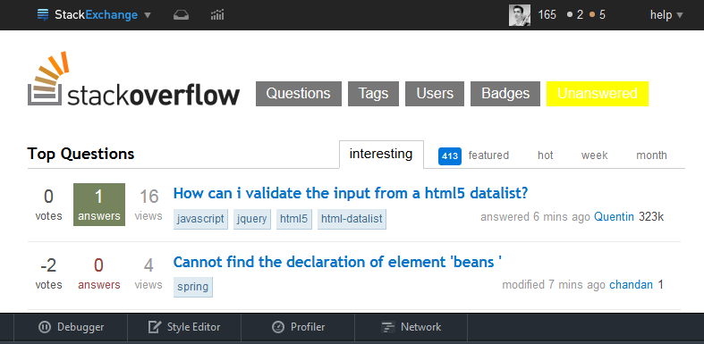
JAVASCRIPT EXECUTOR. HIGHLIGHTING
Pure JavaScript:
document.getElementById('nav-unanswered').style.backgroundColor = "yellow"
Java code:
public void highlightElement(WebDriver driver, WebElement element)
{
String bg = element.getCssValue("backgroundColor");
JavascriptExecutor js = ((JavascriptExecutor) driver);
js.executeScript("arguments[0].style.backgroundColor = '" + "yellow" + "'", element);
// take screenshot here
js.executeScript("arguments[0].style.backgroundColor = '" + bg + "'", element);
}

Slide 22
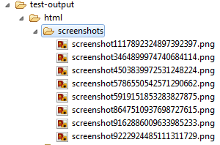
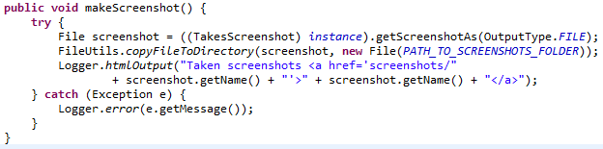
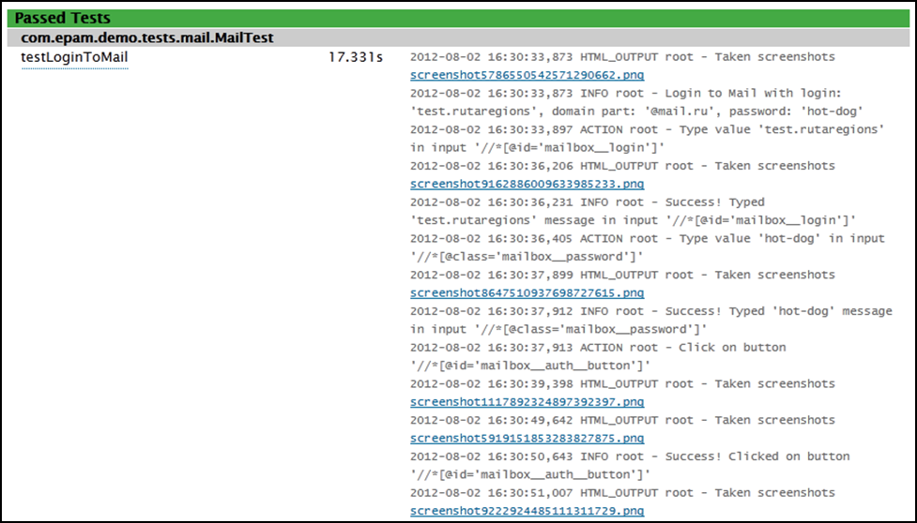
SCREENSHOTS

Slide 23
SELENIUM GRID
Desired Capabilities
Selenium Grid
Selenium Tests
Selenium Hub
Application Under Test
Browser
Browser
Browser

Slide 24
SELENIUM SERVER LAUNCH
role
node or hub
hub
hub for node (http://localhost:4444/grid/register)
port
4444 by default for hub, 5555 by default for node
browser
browserName=firefox, version=21.0, maxInstances=7, platform=WINDOWS
maxSession
number of parallel tests on node (5 by default)
nodeTimeout
300 s by default, 0 – disable option

Slide 25
DESIRED CAPABILITIES
DesiredCapabilities capabilities = new DesiredCapabilities();
driver = new RemoteWebDriver(new URL("http://localhost:4444/wd/hub"), capabilities);
DesiredCapabilities
setPlatform()
setVersion()
setBrowserName()
setCapability()
setJavaScriptEnabled()
android(), chrome(),firefox(), etc…
Notes:
https://github.com/SeleniumHQ/selenium/wiki/Grid2
The hub will then assign the test to a matching node.
A node matches if all the requested capabilities are met. To request specific capabilities on the grid, specify them before passing it into the WebDriver object.
capability.setBrowserName();
capability.setPlatform();
capability.setVersion()
capability.setCapability();
Example:
A node registered with the setting:
-browser browserName=firefox,version=3.6,platform=LINUX will be a match for:
capability.setBrowserName(“firefox” );
capability.setPlatform(“LINUX”);
capability.setVersion(“3.6”);
and would also be a match for
capability.setBrowserName(“firefox” );
capability.setVersion(“3.6”);
The capabilities that are not specified will be ignored. If you specify capabilities that do not exist on your grid (for example, your test specifies Firefox version 4.0, but have no Firefox 4 instance) then there will be no match and the test will fail to run.

Slide 26

SELENIUM GRID LAUNCH - new as from WebDriver 3.0
How to get started with Selenium Grid:
Download Selenium Standalone Server from the official download page. http://www.seleniumhq.org/download/
Download driver binaries. Starting from WebDriver 3.0 for all common browsers (IE, Chrome, Firefox) you will need additional downloads and configuration – please see description below, NOT official selenium wiki-page/description (it is not updated yet) .
Firefox: https://github.com/mozilla/geckodriver/releases
Chrome: https://sites.google.com/a/chromium.org/chromedriver/
IE: http://selenium-release.storage.googleapis.com/3.0/IEDriverServer_Win32_3.0.0.zip /don’t be surprised, this is the latest for now/
EDGE (Windows 10): https://developer.microsoft.com/en-us/microsoft-edge/tools/webdriver/

Slide 27
SELENIUM GRID LAUNCH
Start hub instance (via batch file or pure command-line).
java -jar selenium-server-standalone-3.0.1.jar -role hub
Start node instance (via batch file or pure command-line)
!!Driver binary path (set your system path) should be specified via cmd-line parameter for each browser type
IE:
java -Dwebdriver.ie.driver= d:\_webdriver\iedriver\IEDriverServer.exe -jar selenium-server-standalone-3.0.1.jar -role webdriver -browser "browserName=internet explorer,version=11,maxinstance=1,platform=WINDOWS" -hub http://localhost:4444/grid/register -port 5556

Slide 28
SELENIUM GRID LAUNCH - new as from WebDriver 3.0
Chrome:
java -Dwebdriver.chrome.driver=d:\_webdriver\chromedriver\chromedriver.exe -jar selenium-server-standalone-3.0.1.jar -role node -hub http://localhost:4444/grid/register -browser “browserName=chrome,platform=WINDOWS” -port 5557
Firefox:
java -Dwebdriver.gecko.driver=d:\_webdriver\geckodriver_ff\geckodriver.exe -jar selenium-server-standalone-3.0.1.jar -role node -hub http://localhost:4444/grid/register -browser “browserName=firefox,platform=WINDOWS” -port 5558

Slide 29
SELENIUM GRID LAUNCH - Configuring nodes by JSON
java -jar selenium-server-standalone.jar -role node -nodeConfig nodeconfig.json
{
"capabilities":
[
{
"browserName": "firefox",
"maxInstances": 5,
"seleniumProtocol": "WebDriver"
},
{
"browserName": "chrome",
"maxInstances": 5,
"seleniumProtocol": "WebDriver"
},
{
"browserName": "internet explorer",
"maxInstances": 1,
"seleniumProtocol": "WebDriver"
}
],
...
A sample nodeconfig file for server version 3.x.x (>= beta4) can be seen at https://github.com/SeleniumHQ/selenium/blob/master/java/server/src/org/openqa/grid/common/defaults/DefaultNodeWebDriver.json
A sample nodeconfig file for server version 2.x.x can be seen at https://github.com/SeleniumHQ/selenium/blob/selenium-2.53.0/java/server/src/org/openqa/grid/common/defaults/DefaultNode.json
Note: the configuration { ... } object in version 2.x.x has been flattened in version 3.x.x (>= beta4)

Slide 30
SELENIUM GRID LAUNCH - Configuring hub by JSON
java -jar selenium-server-standalone.jar -role hub -hubConfig hubconfig.json
A sample hubconfig.json file can be seen at https://github.com/SeleniumHQ/selenium/blob/master/java/server/src/org/openqa/grid/common/defaults/DefaultHub.json
{
"port": 4444,
"newSessionWaitTimeout": -1,
"servlets" : [],
"withoutServlets": [],
"custom": {},
"capabilityMatcher": "org.openqa.grid.internal.utils.DefaultCapabilityMatcher",
"throwOnCapabilityNotPresent": true,
"cleanUpCycle": 5000,
"role": "hub",
"debug": false,
"browserTimeout": 0,
"timeout": 1800
}

Slide 31
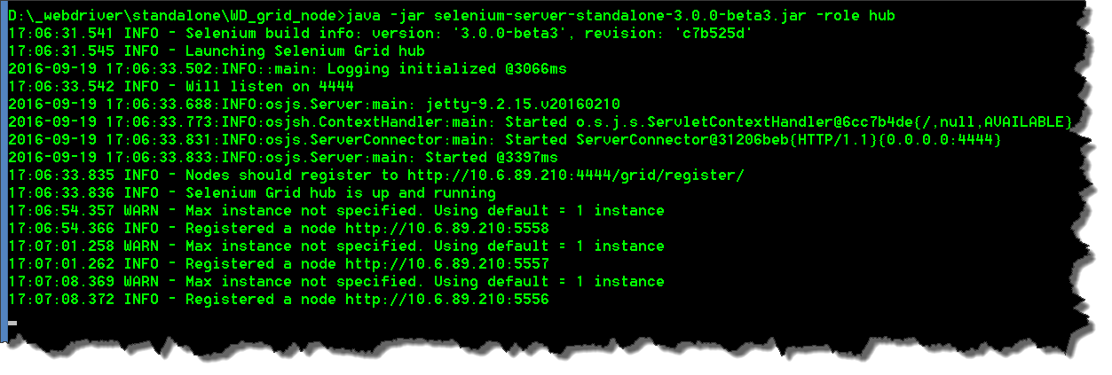
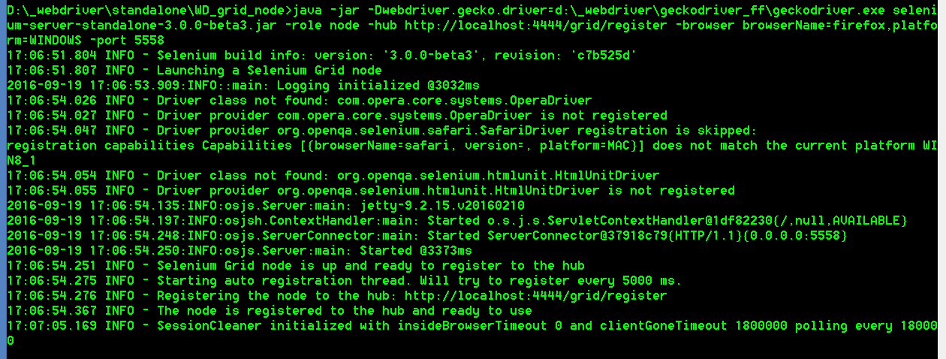
SELENIUM GRID SERVER LAUNCH
Check the grid state via OS console output
NODE
HUB

Slide 32
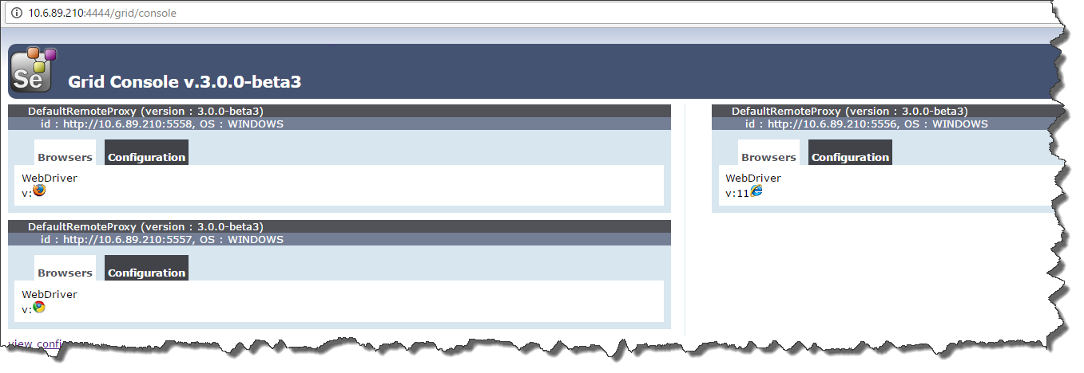
SELENIUM GRID SERVER LAUNCH
Check the grid state via grid console http://localhost:4444/grid/console .

Slide 33
SELENIUM GRID LAUNCH - new as from WebDriver 3.0
Add Java code snippet to your project for instantiating the WebDriver as a RemoteWebDriver.
private WebDriver driver;
@BeforeClass(description = "Start browser")
public void startBrowser() {
// init Webdriver
DesiredCapabilities capabilities = DesiredCapabilities.firefox();
capabilities.setPlatform(Platform.WINDOWS);
try {
driver = new RemoteWebDriver(new URL("http://localhost:4444/wd/hub"), capabilities);
} catch (MalformedURLException e) {
e.printStackTrace();
}
}
Firefox:

Slide 34
SELENIUM GRID SERVER LAUNCH
Add Java code snippet to your project for instantiating the WebDriver as a RemoteWebDriver.
private WebDriver driver;
@BeforeClass(description = "Start browser")
public void startBrowser() {
// init Webdriver
DesiredCapabilities capabilities = DesiredCapabilities.chrome();
capabilities.setPlatform(Platform.WINDOWS);
try {
driver = new RemoteWebDriver(new URL("http://localhost:4444/wd/hub"), capabilities);
} catch (MalformedURLException e) {
e.printStackTrace();
}
}
Chrome:

Slide 35
SELENIUM GRID SERVER LAUNCH
Add Java code snippet to your project for instantiating the WebDriver as a RemoteWebDriver.
private WebDriver driver;
@BeforeClass(description = "Start browser")
public void startBrowser() {
// init Webdriver
DesiredCapabilities capabilities = DesiredCapabilities.internetExplorer();
driver = new InternetExplorerDriver(capabilities);
capabilities.setPlatform(Platform.WINDOWS);
try {
driver = new RemoteWebDriver(new URL("http://localhost:4444/wd/hub"), capabilities);
} catch (MalformedURLException e) {
e.printStackTrace();
}
}
IE:

Slide 36
RESOURCES ABOUT JS, ACTIONS, GRID
Official WebDriver definition:
http://www.seleniumhq.org/docs/04_webdriver_advanced.jsp
https://selenium.googlecode.com/git/docs/api/java/org/openqa/selenium/remote/RemoteWebDriver.html
https://github.com/SeleniumHQ/selenium/wiki/Grid2 – partly obsolete for now
Parallel test execution via Grid*:
https://www.packtpub.com/sites/default/files/downloads/Distributed_Testing_with_Selenium_Grid.pdf
http://www.tothenew.com/blog/parallel-execution-with-selenium-grid/
http://blog.wedoqa.com/2013/07/how-to-run-parallel-tests-with-selenium-webdriver-and-testng-2/
Other resources – latest CLI changes for Grid setup:
https://github.com/SeleniumHQ/selenium/issues/2571
https://github.com/SeleniumHQ/selenium/issues/2566 .

Slide 37
DEMO

Slide 38
Part 3
Selenium WebDriver.
Extras - 2

Slide 39




AutoItDriverServer
Open source solution
for Selenium WebDriver blind spots in OS GUI

Slide 40

Problem to be solved:
Selenium WebDriver doesn’t handle user events outside the browser window, i.e.:
OS file upload dialogs
OS popups
Calls to OS/Desktop software GUI
org.openqa.selenium.NoAlertPresentException: No alert is present (WARNING: The server
did not provide any stacktrace information)
Command duration or timeout: 2.25 seconds
Build info: version: '2.23.0', revision: '17137', time: '2012-06-07 15:43:04'
System info: os.name: 'Windows 7', os.arch: 'x86', os.version: '6.1',
java.version: '1.7.0_17'
Driver info: driver.version: RemoteWebDriver
Session ID: 0c684096-46e6-4f00-8434-af866eb29746
at org.openqa.selenium.remote.RemoteWebDriver.execute(RemoteWebDriver.java:458)
at org.openqa.selenium.remote.RemoteWebDriver.execute(RemoteWebDriver.java:462)
at org.openqa.selenium.remote.RemoteWebDriver$RemoteTargetLocator.alert(RemoteWebDriver.java:733)

Slide 41
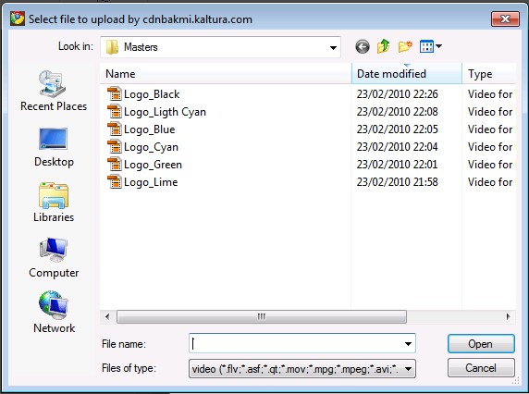
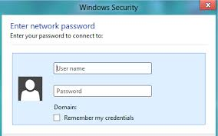
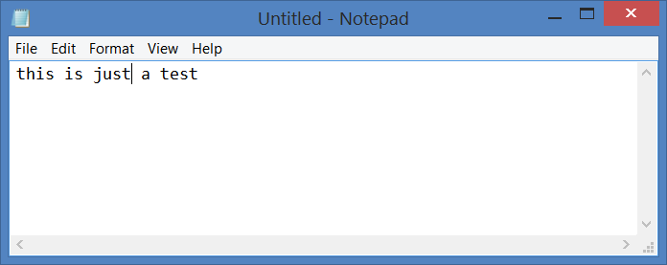
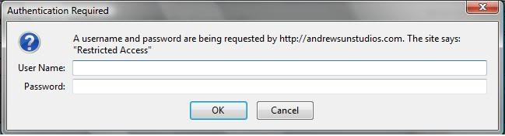
GUI items to be handled:

Slide 42

Points to be covered by all-in-one solution:
Java API
WebDriver-like code style
Run on any host/different automation infrastructure

Slide 43
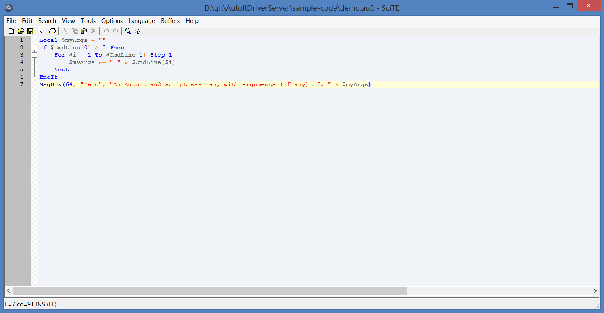
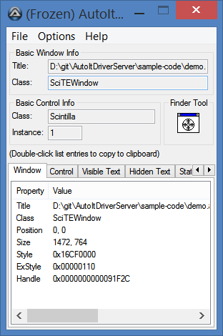
Approach #1: Execute AutoIt compiled binary from Java code
Autoit Script:
WinWaitActive("Authentication Required","","120")
If WinExists("Authentication Required") Then
Send("username{TAB}")
Send("password{Enter}")
EndIf
Java Code:
Runtime.getRuntime().exec("C:\\NewAutoIT.exe");
not convenient, additional IDE is required;
need to compile code to run the same .exe from eclipse;
running on the same host, where code is build

Slide 44
Approach #2: Install Java binding/API and call AutoIt methods from Java code
You should use library AutoItX4Java, it allows to execute AutoIt commands in Java.
You need to install AutoIt and use the library Java COM Bridge, then you can program directly in Java.
Here is a simple example:
File file = new File("lib", "jacob-1.15-M4-x64.dll"); //path to the jacob dll
System.setProperty(LibraryLoader.JACOB_DLL_PATH, file.getAbsolutePath());
AutoItX x = new AutoItX();
String notepad = "Untitled - Notepad";
String testString = "this is a test.";
x.run("notepad.exe");
x.winActivate(notepad);
x.winWaitActive(notepad);
x.send(testString);
Assert.assertTrue(x.winExists(notepad, testString));
x.winClose(notepad, testString);
x.winWaitActive("Notepad");
x.send("{ALT}n");
Assert.assertFalse(x.winExists(notepad, testString));
More convenient than approach #1, but still running on the same host, where code is build

Slide 45
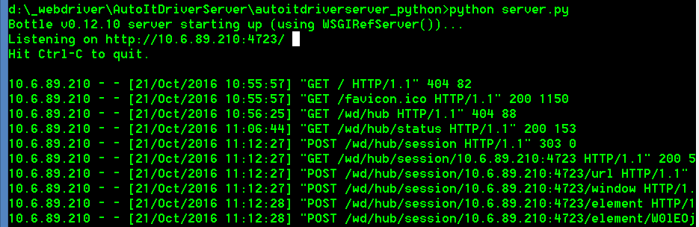
Approach #3: setup AutoItDriverServer and call AutoIt methods from Java code in WebDriver API style
//autoit actions for remote executions via AutoItDriverServer
CustomRemoteWebDriver autoitDriver = Browser.getAutoitDriver();
autoitDriver.switchTo().window("Open");
new Actions(autoitDriver).sendKeys(userFile).build().perform();
DelayHelper.waitFor( 2 );
autoitDriver.findElement(By.linkText( "&Open")).click();
Browser.getBrowser().getWebDriver().switchTo().defaultContent();
Can be run on any remote/local host and managed from Java code in WebDriver API style

Slide 46
AutoItDriverServer use. Landscape setup
Mind compatibility between x86/x64 versions for Python, AutoIt dlls and programming language libs
(for x64 support select x64 mode run option when installing AutoIt dlls)
To be installed apart from Java on the host
Python 3.5.2 x64
Pywin32 x64 build220
AutoIt version: v3.3.14.2 (select x64 mode)
Add “requirements” (mind network topics like proxy and etc.).
Can be done via batch file in a “single” click
Next steps to use for project needs:
Start the server via python from cmd/batch
Call AutoItDriverServer in Selenium-like manner from Java

Slide 47


AutoItDriverServer use. Java code.
Add code snippet to framework for regular use
public static synchronized CustomRemoteWebDriver getAutoitDriver() {
// code snippet below is required to get host ip where webdriver is running
// just in case webdriver host ip is not set explicitly by some env parameter
/*
* String sessionId = ( ( CustomRemoteWebDriver ) webDriver ).getSessionId().toString(); String nodeHost =
* GridInfoExtracter.getHostNameAndPort( seleniumHost, Integer.parseInt( seleniumPort ), sessionId )[0];
*/
if( autoitDriver != null ) {
return autoitDriver;
} else {
String nodeHost = seleniumHost;
logger.info( "Extracted selenium hostname for AutoIt server bind: " + nodeHost );
DesiredCapabilities autoItCapabilities = new DesiredCapabilities();
autoItCapabilities.setCapability( "browserName", "AutoIt" );
try {
autoitDriver =
new CustomRemoteWebDriver( new URL( "http://" + nodeHost + ":4723/wd/hub" ), autoItCapabilities );
} catch( MalformedURLException e ) {
e.printStackTrace();
}
}
return autoitDriver;
}
Start the server via python from cmd/batch
Call AutoItDriverServer in Selenium-like manner from Java
//autoit actions for remote executions via AutoItDriverServer
CustomRemoteWebDriver autoitDriver = Browser.getAutoitDriver();
autoitDriver.switchTo().window("Open");
new Actions(autoitDriver).sendKeys(userFile).build().perform();
DelayHelper.waitFor( 2 );
autoitDriver.findElement(By.linkText( "&Open")).click();
Browser.getBrowser().getWebDriver().switchTo().defaultContent();

Slide 48

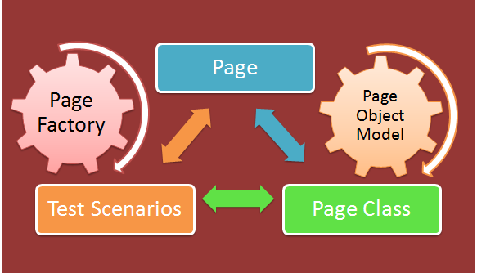
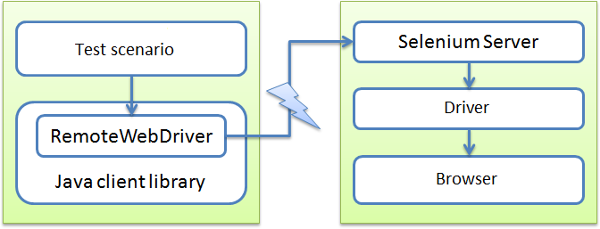
HOME TASK
Selenium Webdriver –
JS, Actions, Remote, Grid - hometask #3.
add actions, js-executor and remote webdriver (grid) stuff to the project from the previous session.
Parallel execution via grid can be done as optional task
Play around autoit stuff can be done as optional task

Slide 49
DEMO

Slide 50
Thanks for attention.
Questions?

