Slide 1

BeppoFresh
Alexander Liebald, Niclas Hülsmann, Leonard Goldstein

Slide 2
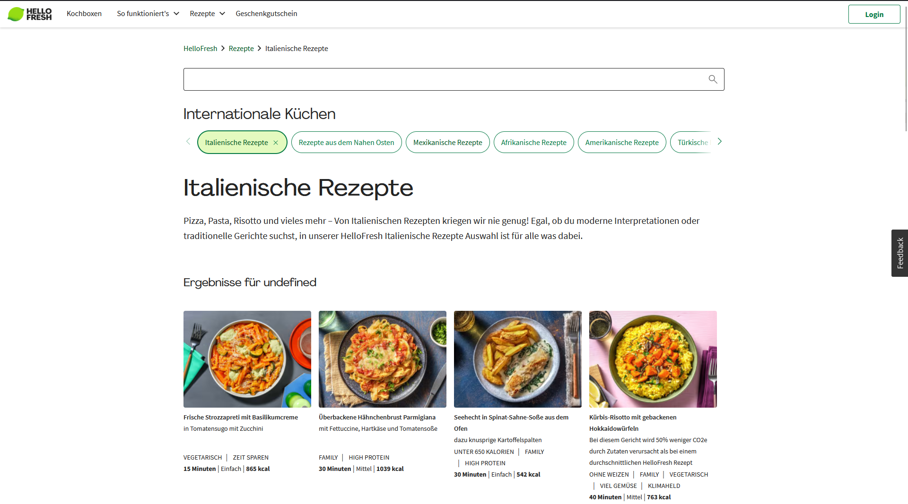
The current website has few options to show user specific recommendations

Slide 3
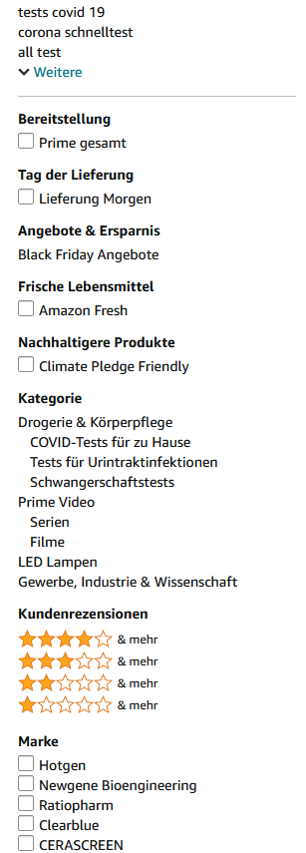
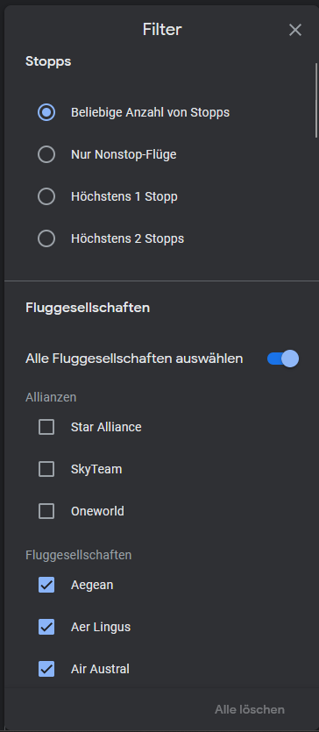
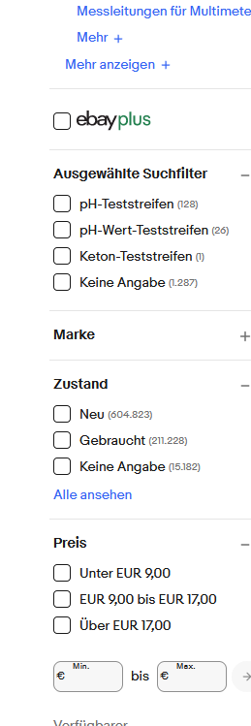
But we also don‘t want complex filters…

Slide 4

Meet Beppo Fresh!

