Slide 1

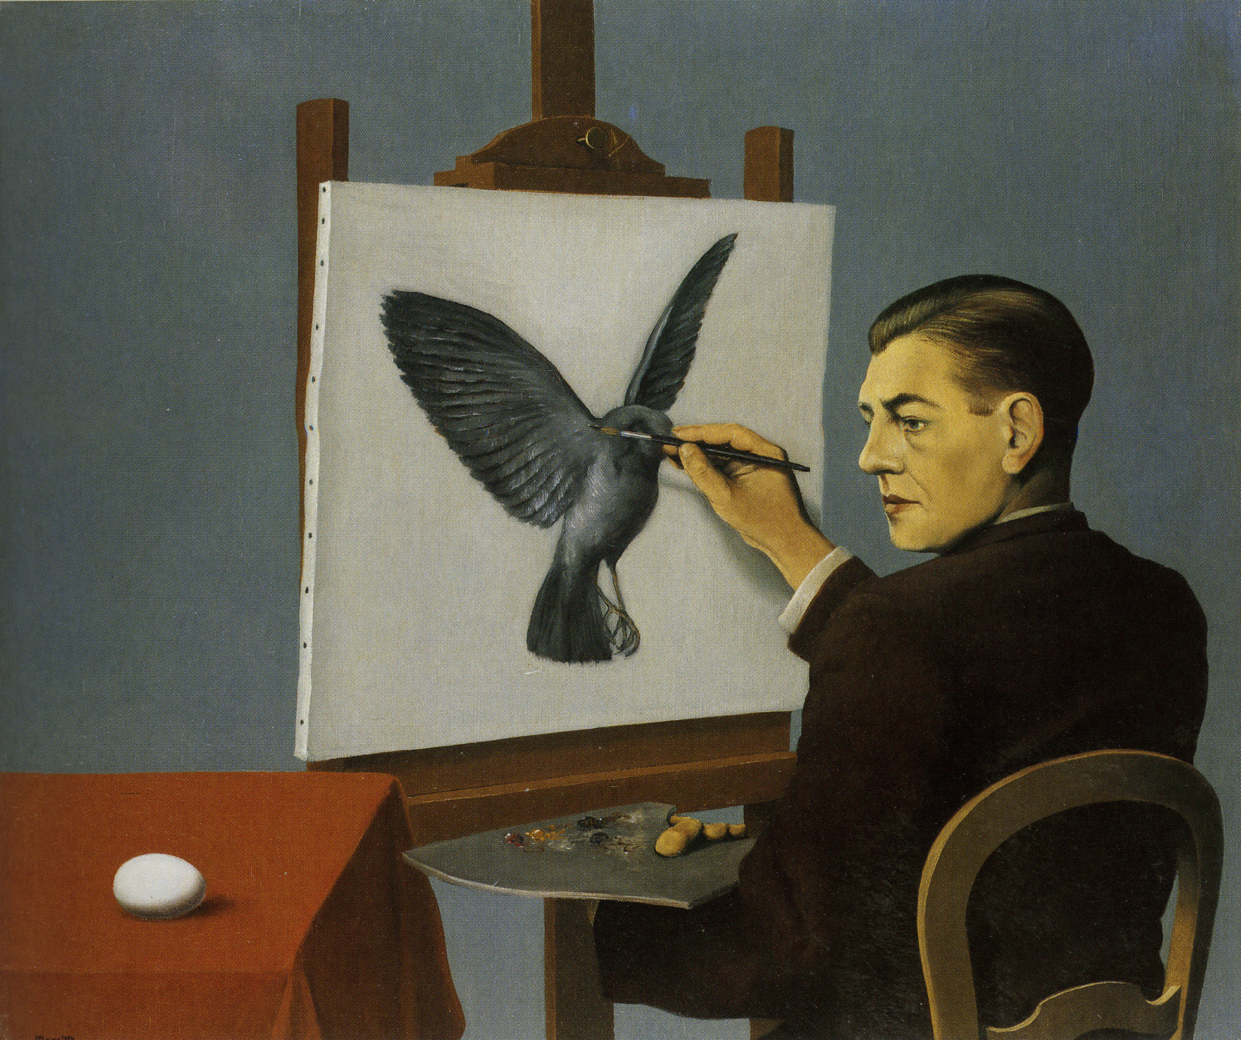
TOWARDS TRUSTWORTHY AI IN HEALTHCARE: CALIBRATION, EVIDENCE-BASED EVALUATION, AND THE CLINICAL UTILITY OF THE ADNEX MODEL.
Doctoral Thesis
Lasai Barreñada
PhD Supervisor
Prof. Ben Van Calster
Leuven, August 2026

Slide 2


