Slide 1
Gender Wage gap
Presented by:
Imandi
Lasal
Malitha
Maryam

Slide 2
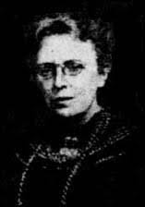





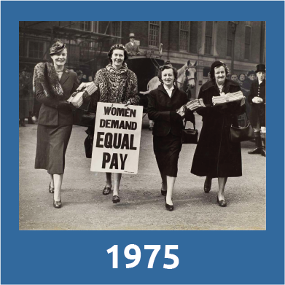
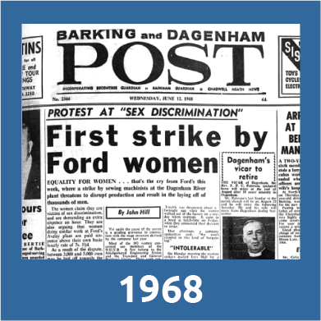

History of Gender Wage Gap

