Slide 1
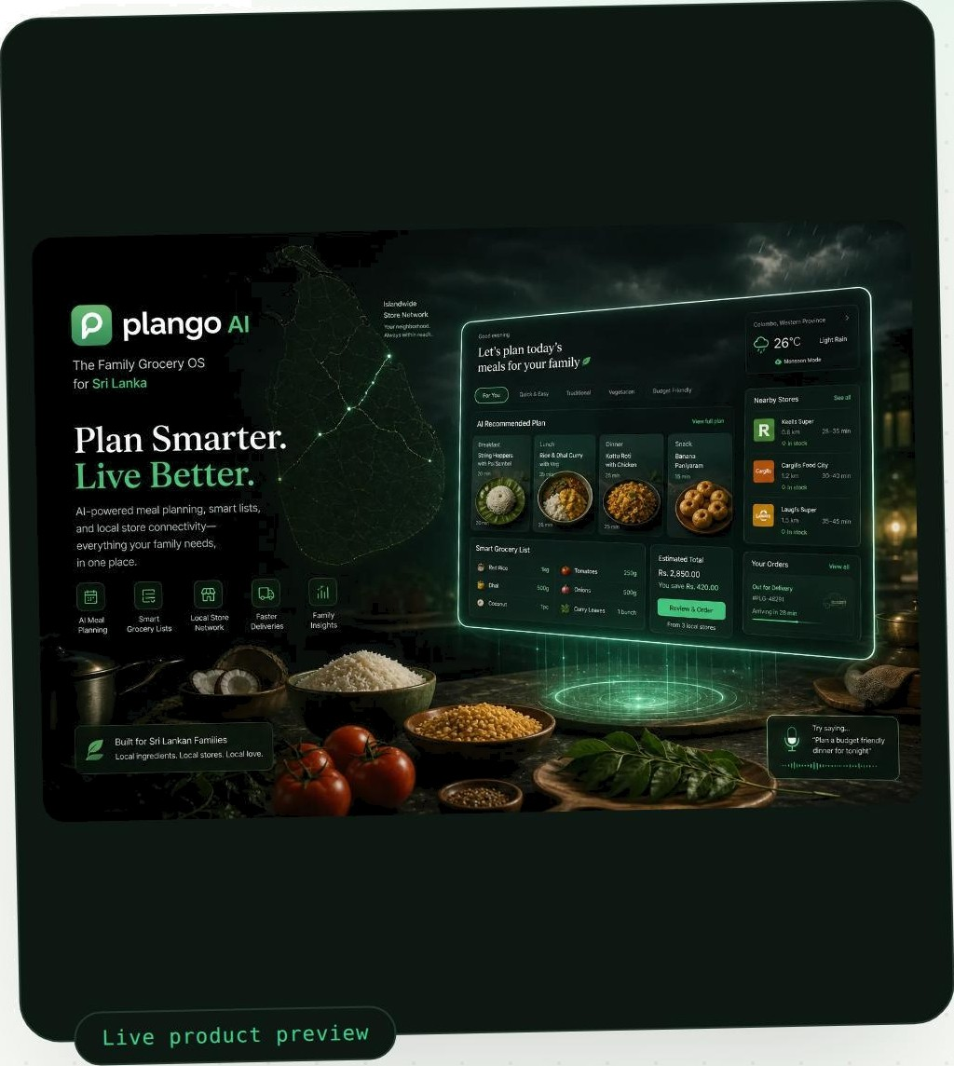
Idle b a pp + Go a g\ e G emi ni
P a n t ry
melt a ry
+ \ i v e c anI e x I
plango
AI
Sri Lanka's family grocery assistant — remembers what's at home, respects diets, compares prices, and plans meals around weather and daily life.

Slide 2

What we'll cover
T A B L E 0 F C 0 N T E N T S
Problem & product vision
Solution & how it's built
0
AI architecture & integration
% Software engineering & code quality
Optimization & reliability
p Demo & wrap-up

Slide 3

p tang o AI
TH E PR0 B LED
8 1 — PRO B L EH 6 VI S10 XI
Family grocery planning is harder than it should be
=35%
of household food bought ends up wasted
20—30%
in savings missed from unplanned, un-compared buying
Hours /wk
of extra stress spent juggling lists, prices and diets
A FA8I LI AR TUESDAY EYENING
Forget rice 7 Buy fish someone cant eat 7 Tomatoes spoil 7 Hit traffic 7 Empty pantry in a storm
03 / 22

Slide 4
One conversation
0 2 - S 0 L U T 1 0 N
a full grocery plan
Understands
Reads a plain-language ask the way a
family member would.
Plans
Builds meals and a shopping list around what's already home.
Optimizes
Compares prices and routes across nearby stores.
Explains
Shows why a plan looks the way it does, with sources.

Slide 5
How we built it
0 2 — S 0 L U T 1 0 N
App
A sim ale web app youi family ovens like any website- chat on one side cfashGoard on the othei.
AI
Google Genml reacts each request and helps wi ite meal ideas, sunJmai”ies. anal bill scans.
Data
Sripahase renJemhers pantry, family members and diet i”uIes. safely. oei
Live helpers
Small conilectecl sei vices check weather. neai”Gy stoi”es. oi”ices and i”ecipes in real time.

Slide 6
AI Architecture & Integration

Slide 7
p tang o AI
A I A RC H I T E C TU R E
8 3 — SYS T E łt AR C HI T E C T URE
The system, end to end
Chat UI / Dashboard
Orchestrator
Vertex Gemini
+ Embeddings
Supabase *
Wave 2 Sequential
pgvector RAG + Memory
plango
Agents each do one j ob
õ7 / 22

Slide 8
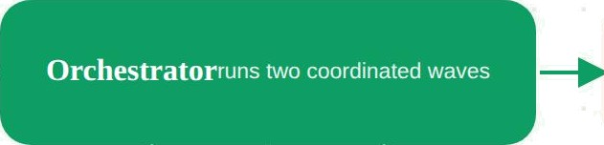
How a request flows
A I A R C H I T E C T U R E
0 3 - S Y S T E H AR C H I T E C T U RE
You ask
Plan API
—
Meal plan + shopping list
Gemini
language & meal ideas
Pantry memory
Supabase + pgvector
Live helpers
weather, maps, prices + backups
FEEDS EVERY WAVE THE ORCHESTRATOR RUNS
08 / 22

Slide 9
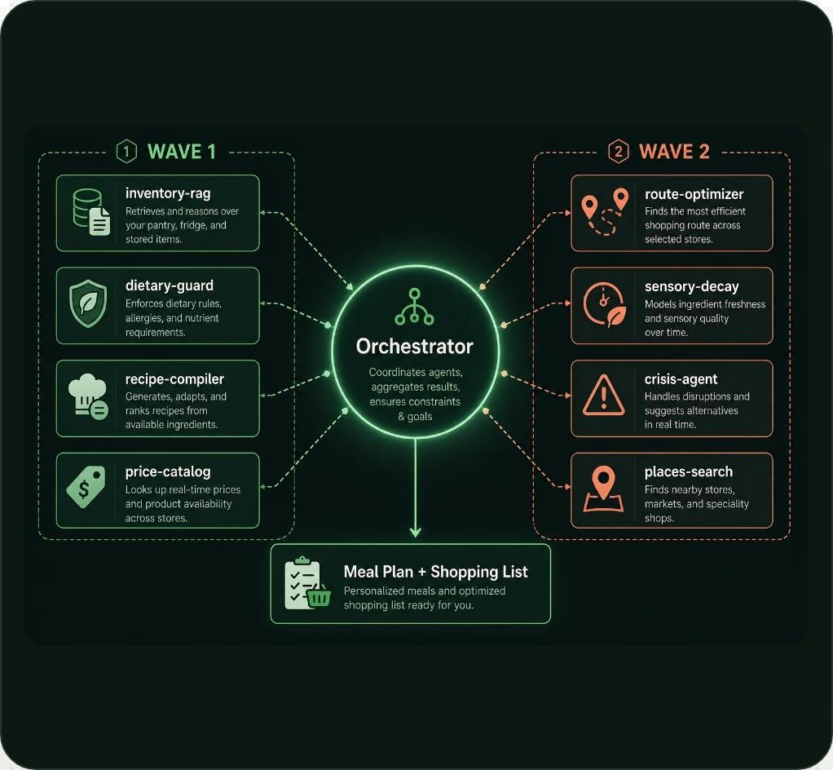

Agent swarm
03 - SYSTEM ARCNIT ECTURE
orchest rat or
Coordinales every other agent and shapes lhe final plan
1nvento ry- rag
Looks up whars already in your pantry and fridge
recipe - compile r
Turns available ingredienls into recipes your family lJkes
d1eta ry- gua rd
Checks meals against allergies and diet rules first
p r1ce- catalog
Compares prices across nearby stores in real lime
route-optimizer
Plansthe mOsteMcentstOp-by-stopshOppngrOuCe
sensory- decay
Tracks freshness so nothing spoils unnoticed
c ris is - agent
Adjusts the plan when weather or supply gets disrupted
places - sea rch
FndsnearbystOres, markelsandspecattyshOps

Slide 10

How planning works
03 - SYSTEM ARCNIT ECTURE
Ask
Unde rsta nd
Answer
Only the right helpers run
Each askisscopedsoOnythe agens‹ acuattyneeds getcatled.
Quick paih for simple asks
"What s for dinner tonight*" doesn t need the full nine-agent swarm.
Answer shape matches the ask
A shopping list looks like a list; a weekly plan looks like a
plan.

Slide 11
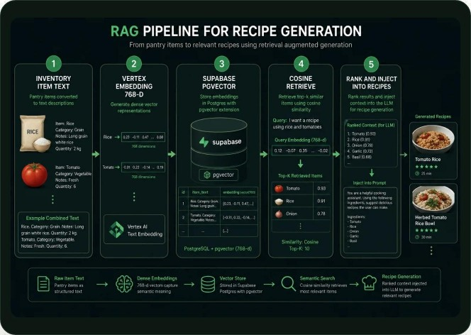

How pantry memory works
03 - PANTR¥ MEMOR¥
Remember
Every pantry item you add becomes something the system can recall
later.
Find
When you ask for a recipe, it retrieves only the ingredients that maher.
Learn
The more your family uses it, the sharper suggestions get.
“
p
Why it matters
No more meal ideas that ignore what's already in your kitchen.

Slide 12
Where Gemini helps
03 - SYSTEM ARCNIT ECTURE
and doesn't
G E NI NI H E L P S WI T H
Understanding your ask in plain language
D 0 E S N ’ T D E C I D E A L 0 N E
o|o Price math — pulled from real store data, not guessed
Q Allergy & diet safety — rule checks run first, AI explains after
Suggesting meal ideas from what's on hand
Reading bill photos to update the pantry
Writing a clear, readable plan summary

Slide 13
Software Engineering & Code
Quality

Slide 14

p tan g o AI
E N G I N E E R I N G
0 4 — 10D E 0UA LI TY
Built in clear layers
e1 cooRozfisToR
Orchestcator
Decides which agents run, in what order, and merges the results.
Nine specialists
Each agent owns one job end-to-end, independently testable.
Weather, maps, prices, recipes
Swappable connections behind a common interface, each with a backup.
Supabase + pgvector
One private, isolated data space per family.
14 / 22

Slide 15
plango AI
ENGINEERING
0 4 — 10 D E 0 UA L I TY
Good engineering habits
Rules before AI
Oiet and safety checks run in code, not in a prompt.
Backups when APIs fail
Cached and local fallbacks keep answers flowing.
Private by default
Each family's data is isolated at the database level.
Visible progress
Every agent step is logged and shown, not hidden.
Heatth check
One endpoint reports the status of every connected service.
Repo hygiene
Typed, linted and documented — built to be handed off.
15 / 22

Slide 16
Optimization & Reliability

Slide 17
p tan g o AI
RE L I A B I L I T Y
0 5 — 0 P T I H I ZAT 10N 6 R E L IAB I LI TY
Built to stay useful when AI struggles
I
AI SYSTEM CONSTRAINTS
°° • ° °
Gemini
Cite sources
17 / 22

Slide 18


Keeping AI focused and affordable
R E L I A B I L I T Y
0 5 - 0 P T I II I Z A T 10 N 6 R E L I A B I L I T Y
Family cap
Token budget capped per household, per request.
Short history
Only recent context is replayed, not the whole conversation.
Shoct answers
Responses sized to the question, not padded.
Templates firsi
Common asks reuse approved templates instead of new generation.
Simple asks siay simple
Easy questions skip the full agent swarm.
Fasi paniry retrieval
Vector search narrows context before it reaches Gemini.
18 / 22

Slide 19


Keeping answers honest
0 5 - 0 P T I M I Z A T 1 0 N & R E L I A B I L I T Y
No invented family members
The plan only knows who you've actually told it about.
Only approved meals recommended
Suggestions are checked against a vetted recipe set.
Map-grounded dine-out
Restaurant picks come from real places, not guesses.
Local-friendly recipes
Ideas built around ingredients you can actually find.
Diet rules before AI wording
Safety checks run first; AI only e xplains the result.
Sources shown
Every key claim links back to where it came from.

Slide 20
If something fails, planning continues
0 5 - 0 P T I M I Z A T 1 0 N & R E L I A B I L I T Y
Gemini is down
Cached templates generate a basic plan instanlly
Reply isn't valid
Automatic retry with a stricter tormat prompt
Pant ry memo ry of ft ine
Falls back to the last known pantry snapshol
P rice lookup fall s
Shows last verified prices, flagged as possibly ouldated
No nea rby p\aces found
One agent fails
Search radius widens aulomalically
Orchestrator continues with the remaining agents

Slide 21
Demo surfaces
D E M 0 6‹ U RA P - U P
0 6 - D E f'I0 & IN R A P - U P
Chat planner
Ask in plain language, get a full plan back.
Agents console
Watch every agent run in real time.
Inventory + biTt scan
Snap a receipt, pantry updates itself.
Memory view
See exactly what the system remembers about your home.
Scenario sim
Test how the plan reacts to a storm or price spike.
Health check
One glance at the status of every connected service.
2 L / 22

Slide 22
plango AI
p tan g o AI
CLOSING
A multi-agent grocery assistant that remembers your home, respects your family, and keeps planning useful even when five data fails.
Questions
TEAM TE RRABYT E S
welcome
A GEN TRI X 2 0 2 6
22 / 22

