Slide 1
AI Bootcamp Project 1: Name of Project Lonnie Aldredge, Giselle Gomez, & Chelsey Hay

Slide 2
AGENDA
Executive Summary
Team Approach
Data Analysis & Visualizations
Future Considerations
Resources

Slide 3
Executive Summary

Slide 4
Executive Summary
We reviewed the correlation between annual global temperature changes and greenhouse gas emissions without land use or forestry
We did an initial review of the data and decided to choose one greenhouse gas category out of ten available
This choice led is to conclude that greenhouse gas emissions without land use or forestry does not impact global temperature changes
We utilized data from

Slide 5
Team Approach

Slide 6
Approach
Is there a relationship between greenhouse emissions without land use or forestry impacts and global temperature rise?
We

Slide 7
Data Analysis & Visualizations

Slide 8
Data Visualizations & Analysis
ABC

Slide 9
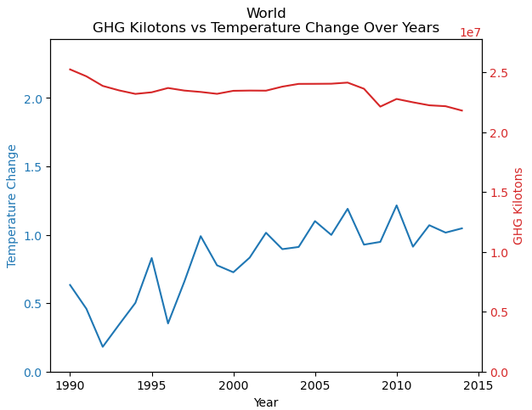
Global Temperature Change & Greenhouse Gas emissions
ABC

Slide 10
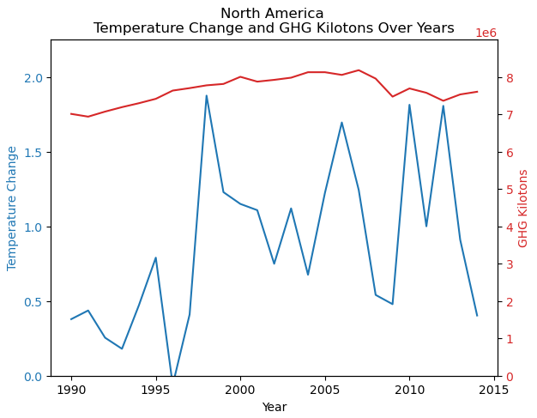
North American Temperature Change & Greenhouse Gas emissions
ABC

Slide 11
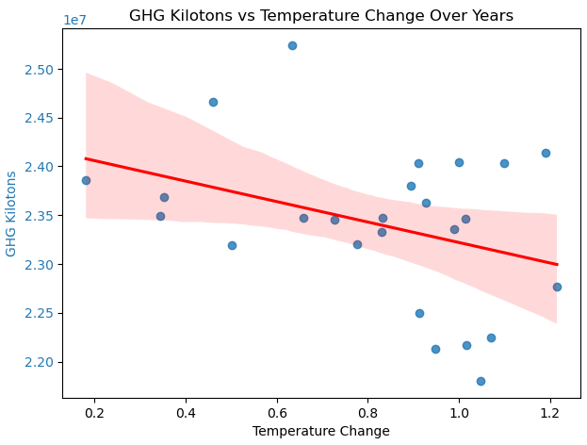
Negative Correlation between Greenhouse Gas & Temperature Change
As the temperature change increases, the greenhouse gas emissions without land use or forestry tend to decrease
The chart suggests a potential negative correlation between temperature change and greenhouse gas emissions without land use or forestry impacts over the years
The confidence interval indicates that there is some uncertainty in the trend, with a slight pattern
This chart is useful for understanding the relationship between temperature changes and GHG emissions, which can be crucial for studies on climate change and its impact on GHG emission levels.

Slide 12
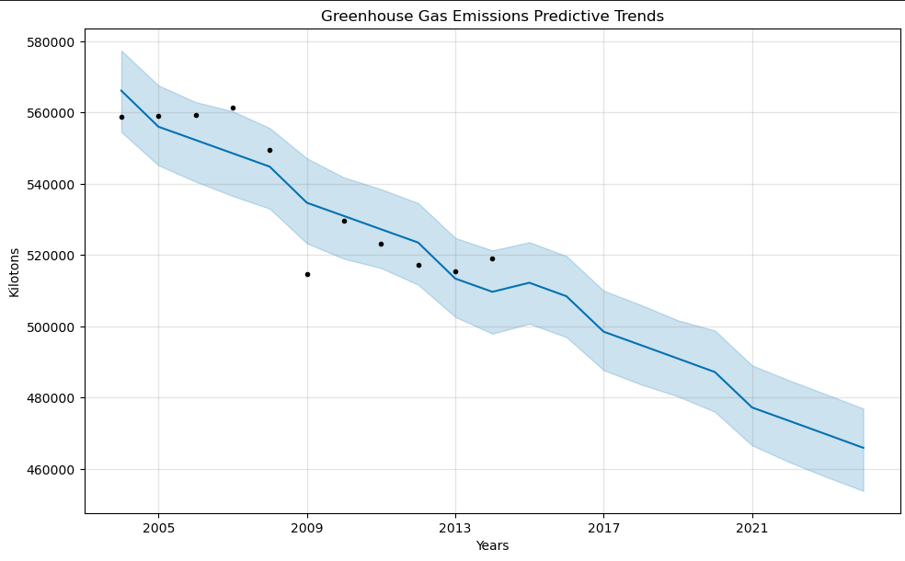
Trends of the “Future”
Our greenhouse gas emission data only went to 2013
We chose one category to analyze - greenhouse emissions without land use or forestry impacts
Using Prophet – we were able to view the “future” global data for this one category
Overall, this data is accurate but does not tell the entire story
In reality, greenhouse gas emissions are increasing annually which leads us to suggest that current greenhouse gas emissions are largely impacted by land use and forestry

Slide 13
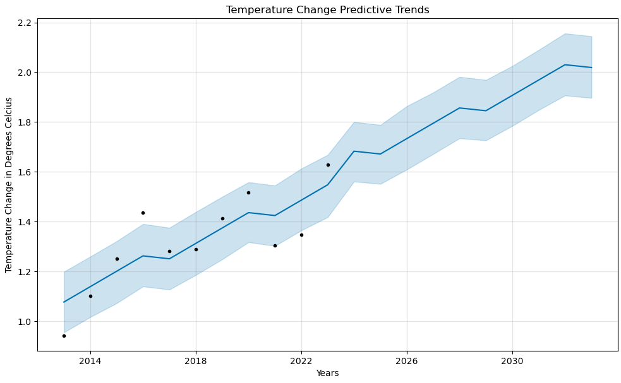
Trends of the Future
Our

Slide 14
Future Considerations

Slide 15
Future Considerations
Questions that arose or areas we did not explore:
How is the total greenhouse gas emissions data correlated to the global temperature change?
What does this data look like cut differently – e.g. by country, economic indicators, etc.

Slide 16
Resources
ABC
ABC
ABC
ABC

Slide 17
THANK YOU
Lonnie Aldredge, Giselle Gomez, & Chelsey Hay

