Slide 1
AI Bootcamp Project 1: Name of Project Lonnie Aldredge, Giselle Gomez, & Chelsey Hay

Slide 2
AGENDA
Executive Summary
Approach
Data Analysis & Visualizations
Future Considerations
Resources

Slide 3
Executive Summary

Slide 4
Executive Summary
We reviewed the correlation between annual global temperature changes and greenhouse gas emissions without land use or forestry
We did an initial review of the data and decided to choose one greenhouse gas category out of ten available and chose greenhouse gas emissions without land use or forestry
This choice led is to conclude that greenhouse gas emissions without land use or forestry had minimal or negative correlations to global temperature changes

Slide 5
Approach

Slide 6
Approach
Is there a relationship between greenhouse emissions without land use or forestry impacts and global temperature rise?
We analyzed the relationship between greenhouse gas emissions without land use or forestry and temperature changes globally
We accessed, cleaned, and merged datasets focused on emissions and temperature change
We then visualized the data to further analyze the relationships between the datasets
We utilized data from:
FAO
United Nations International Greenhouse Gas Emissions via Kaggle
UNdata

Slide 7
Data Analysis & Visualizations

Slide 8
Methodology
Data Cleaning: Handle missing values and convert data types as necessary.
Data Transformation: Pivot temperature change data to align with the structure of the greenhouse gas inventory data.
Data Merging: Merge the datasets on common keys (country and year).
Exploratory Data Analysis: Perform EDA to identify trends and patterns in the data.
Visualization: Create visualizations to illustrate the relationship between greenhouse gas emissions and temperature changes

Slide 9
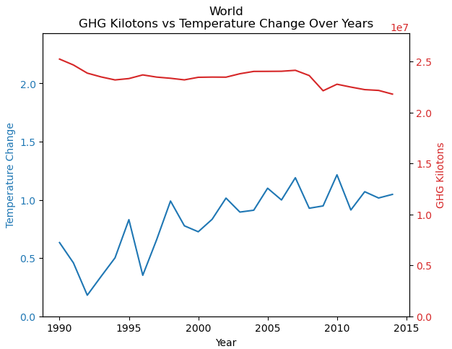
Global Temperature Change & Greenhouse Gas emissions
The chart displays two scales on the y axis: left y displays Temperature Change in Celsius; right y displays greenhouse gas emissions without land use or forestry in kilotons to allow for the data to be overlayed
The chart suggests a potential correlation between the rise in greenhouse gas emissions without land use or forestry and an increase in temperature change over the years
The upward trend in the blue line indicates that temperature change has been increasing over the years.
The upward trend in the red line indicates that GHG emissions have also been increasing over the years, with some fluctuations.

Slide 10
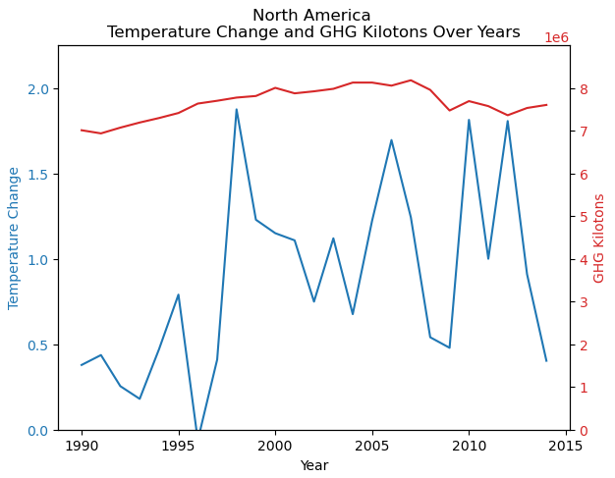
North American Temperature Change & Greenhouse Gas emissions
The chart displays two scales on the y axis: left y displays Temperature Change in Celsius; right y displays greenhouse gas emissions without land use or forestry in kilotons to allow for the data to be overlayed
This chart suggests a potential correlation between the rise in greenhouse gas emissions without land use or forestry and an increase in temperature change over time for North America, though throughout the years it has been inconsistently linked

Slide 11
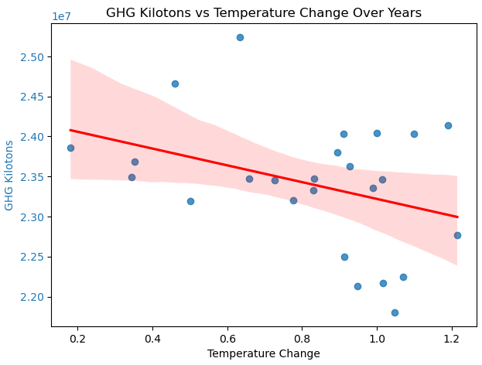
Potential Negative Correlation between Greenhouse Gas & Temperature Change
As the temperature change increases, the greenhouse gas emissions without land use or forestry tend to decrease
The chart suggests a potential negative correlation between temperature change and greenhouse gas emissions without land use or forestry impacts over the years
The confidence interval indicates that there is some uncertainty in the trend, with a slight pattern
This chart is useful for understanding the relationship between temperature changes and GHG emissions, which can be crucial for studies on climate change and its impact on GHG emission levels.

Slide 12
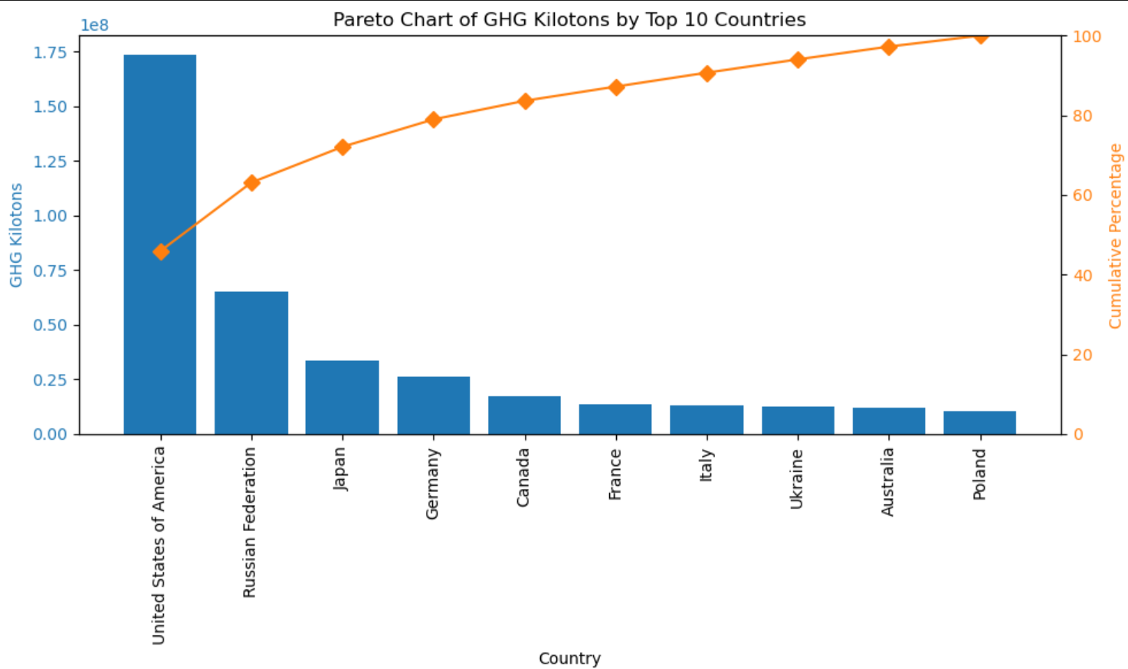
Pareto Chart by Top 10 Countries
The chart highlights the disproportionate contributions of different countries to greenhouse gas emissions without land use or forestry
The United States is the largest emitter among the top 10 countries
The cumulative percentage line shows that a few countries contribute to a large portion of the total greenhouse gas emissions without land use or forestry
Note: China & India did not have data in the emissions dataset we utilized

Slide 13
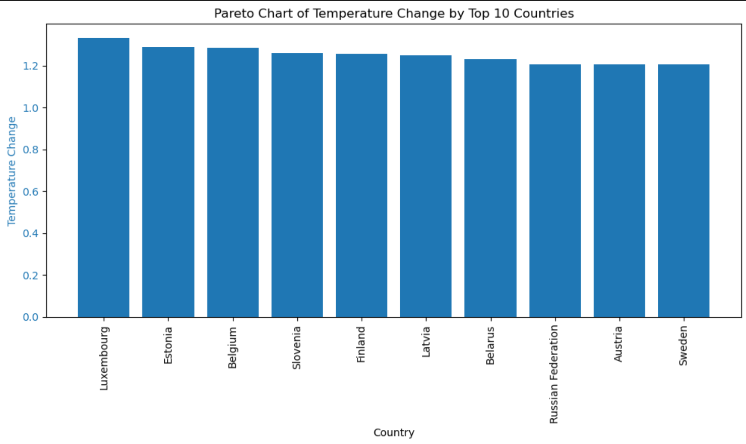
Pareto Chart showing top 10 Countries with largest Temperature Change
This chart highlights the fact that the countries most impacted by temperature changes are not the biggest offenders of emissions
This chart is anecdotal in nature but tells the larger global picture

Slide 14
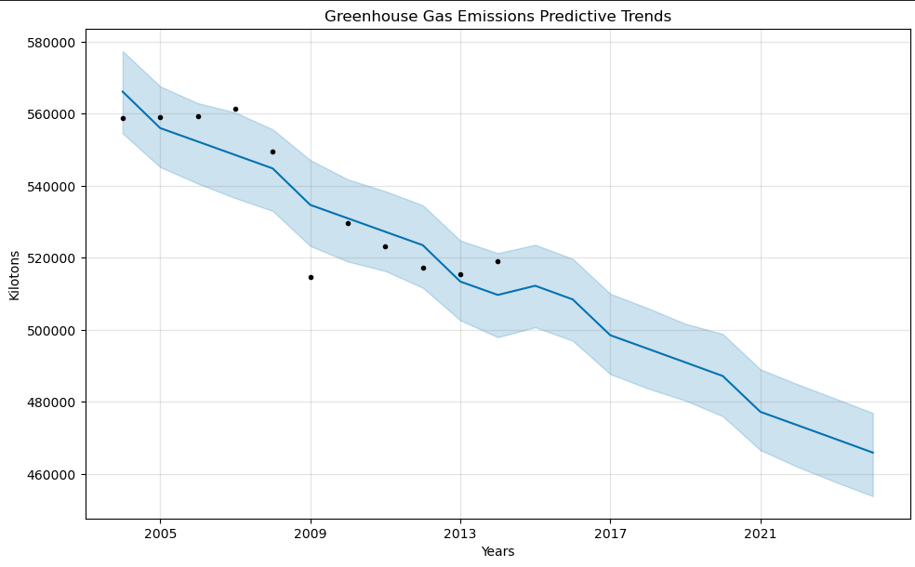
Trends of the “Future”
Our greenhouse gas emission data only went to 2013
We chose one category to analyze - greenhouse emissions without land use or forestry impacts
Using Prophet – we were able to view the “future” global data for this one category
Overall, this data is accurate but does not tell the entire story
In reality, greenhouse gas emissions are increasing annually which leads us to suggest that current greenhouse gas emissions are largely impacted by land use and forestry

Slide 15
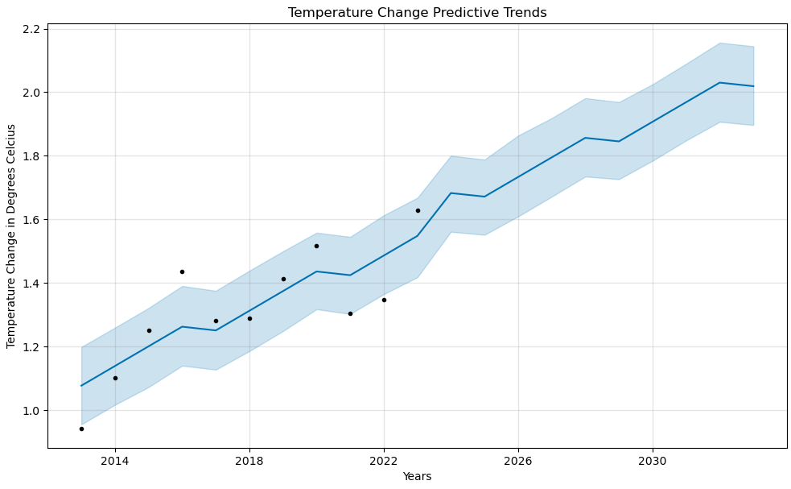
Trends of the Future
The chart suggests that the temperature is predicted to increase over the years, with the central trend line showing a steady upward trajectory
This aligns with the historic data (the black dots on the chart)

Slide 16
Future Considerations

Slide 17
Future Considerations
Questions that arose or areas we did not explore:
How is the total greenhouse gas emissions data correlated to the global temperature change?
What does this data look like cut differently – e.g. by continent, economic indicators, etc.
What additional analysis can we do on this data with a longer time span?

Slide 18
Resources
FAO Temperature Change Data
Kaggle International Greenhouse Gas Emissions
UNdata Explorer

Slide 19
THANK YOU
Lonnie Aldredge, Giselle Gomez, & Chelsey Hay
https://github.com/LaserLon/EDA

