Slide 1

Predicting Online Gaming Behavior
Mike Saunders
Lonnie Aldredge

Slide 2
Agenda
Data Set Review
Project Objectives
Models To Evaluate
Model Results
Lessons Learned

Slide 3
Online Gaming Behavior Dataset
Source: https://www.kaggle.com/datasets/rabieelkharoua/predict-online-gaming-behavior-dataset/data
Features:
PlayerID: Unique identifier for each player.
Age: Age of the player.
Gender: Gender of the player.
Location: Geographic location of the player.
GameGenre: Genre of the game the player is engaged in.
PlayTimeHours: Average hours spent playing per session.
InGamePurchases: Indicates whether the player makes in-game purchases (0 = No, 1 = Yes).
GameDifficulty: Difficulty level of the game.
SessionsPerWeek: Number of gaming sessions per week.
AvgSessionDurationMinutes: Average duration of each gaming session in minutes.
PlayerLevel: Current level of the player in the game.
AchievementsUnlocked: Number of achievements unlocked by the player.
EngagementLevel: Categorized engagement level reflecting player retention ('High', 'Medium', 'Low’).
File size: 2.85MB, 40034 Entries

Slide 4
Project Objectives
Build multiple models and compare accuracy
Fit each model with training data and evaluate them using test data
Optimize the best models to improve performance
Build an additional dataset representing Mike & Lonnie’s online profile
Predict their engagement level

Slide 5
Models Evaluated
KNN
Logistic Regression
SVM
Decision Tree
Random Forest
Gradient Boosting
Adaboost

Slide 6
Models With Highest Scores (Before Optimization)
Random Forest
Gradient Boosting
Description | knn | lr | svm | dt | rf | gb | ab
train_acc | 0.830741 | 0.825079 | 0.826211 | 0.825079 | 1 | 0.913439 | 0.809359
test_acc | 0.741732 | 0.820861 | 0.818763 | 0.820861 | 0.894795 | 0.903887 | 0.805375
diff | 0.089009 | 0.004218 | 0.007448 | 0.004218 | 0.105205 | 0.009552 | 0.003984
r2 | 0.19593 | 0.49583 | 0.49149 | 0.49583 | 0.65323 | 0.69244 | 0.39225
mse | 0.5553 | 0.3482 | 0.3512 | 0.3482 | 0.2395 | 0.2124 | 0.4197
rmse | 0.7452 | 0.5901 | 0.5926 | 0.5901 | 0.4894 | 0.4609 | 0.6478

Slide 7
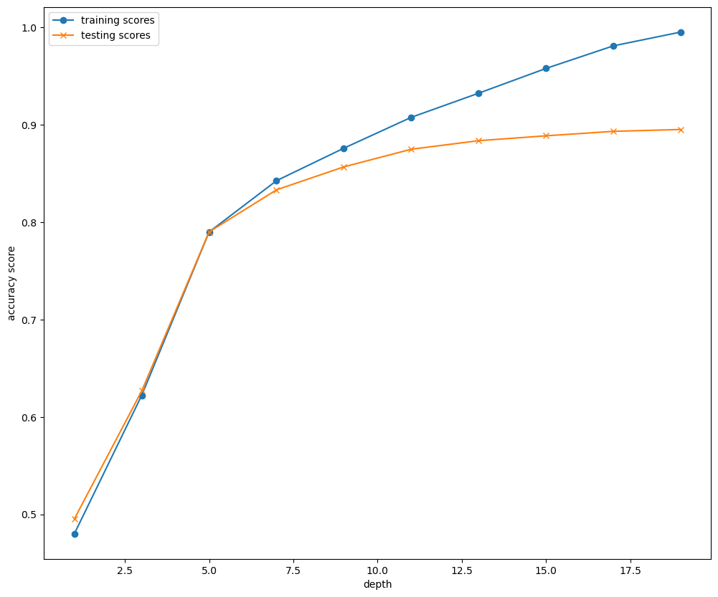
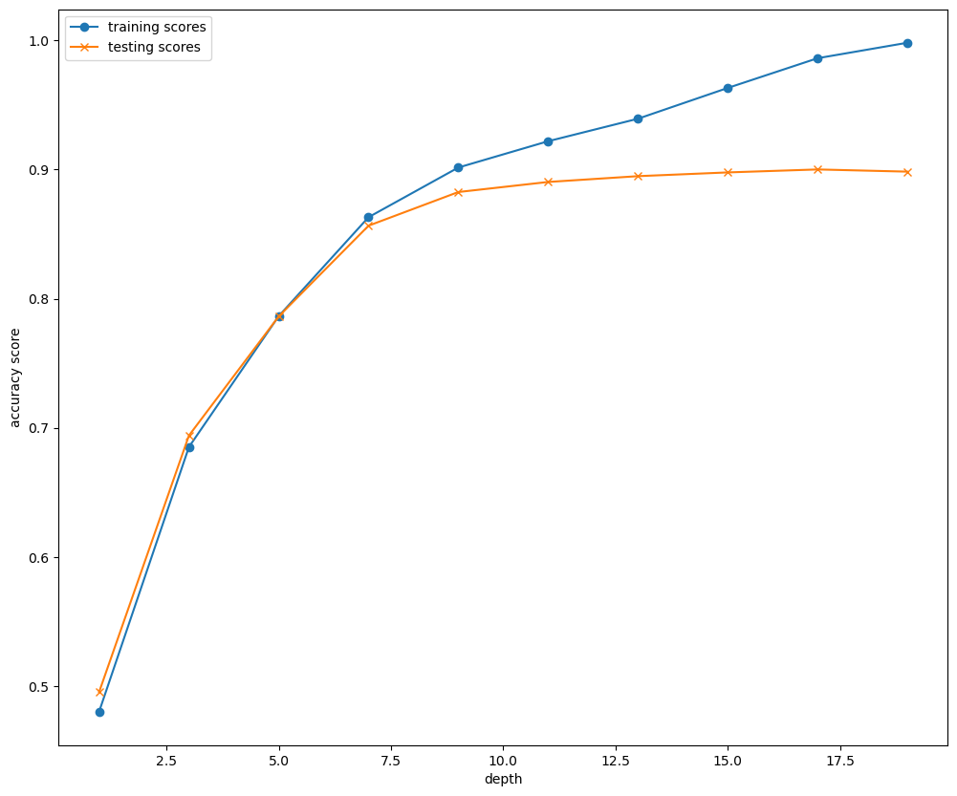
Random Forest Optimization
Random Forest Knee Plot
Random Forest Knee Plot
11 Looks Optimal
Criterion = ‘entropy’, 11 still looks optimal
*Other criterial evaluated log_loss & gini

Slide 8
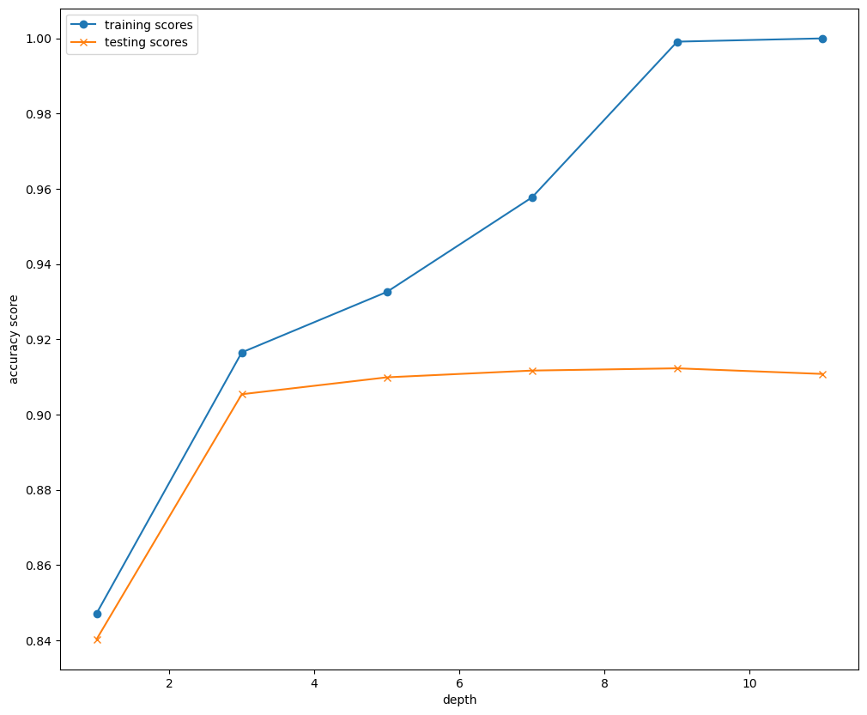
Gradient Boosting Optimization
Gradient Boosting Knee Plot
3 Looks Optimal

Slide 9
Models With Highest Scores (After Optimization)
Random Forest
n_estimators=128, max_depth=11, criterion=‘entropy’
Gradient Boosting
max_depth=3, n_estimators=128
Description | knn | lr | svm | dt | rf | gb | ab
train_acc | 0.82358 | 0.825079 | 0.826211 | 0.825079 | 0.921965 | 0.916503 | 0.809359
test_acc | 0.810071 | 0.820861 | 0.818763 | 0.820861 | 0.890399 | 0.905385 | 0.805375
diff | 0.013509 | 0.004218 | 0.007448 | 0.004218 | 0.031566 | 0.011118 | 0.003984
r2 | 0.44245 | 0.49583 | 0.49149 | 0.49583 | 0.63949 | 0.69634 | 0.39225
mse | 0.3851 | 0.3482 | 0.3512 | 0.3482 | 0.249 | 0.2097 | 0.4197
rmse | 0.6206 | 0.5901 | 0.5926 | 0.5901 | 0.499 | 0.4579 | 0.6478

Slide 10
Evaluating Models Using Mike & Lonnie’s Profiles
 | Age | Gender | Location | GameGenre | PlayTimeHours | InGamePurchases | GameDifficulty | SessionsPerWeek | AvgSessionDurationMinutes | PlayerLevel | AchievementsUnlocked
0 | 57 | Male | USA | Action | 1.5 | 0 | Medium | 5 | 30 | 10 | 8
1 | 49 | Male | USA | RPG | 6 | 0 | Medium | 5 | 180 | 20 | 50
Model | Mike | Lonnie
KNN | Low | Medium
LR | Low | Medium
SMV | Low | Medium
DT | Low | Medium
RF | Low | Medium
GB | Low | Medium
AB | Medium | Medium

Slide 11
Problems Encountered When Running Mike & Lonnie
First pass at creating categorial variables for features used get_dummies
Our profiles did not have all features in dataset, and thus resulting dataset was missing columns
Could not use to predict values
Solution was to use OneHotEncoder. This gave us the ability to create categorial indicators with all the needed columns

