Slide 1
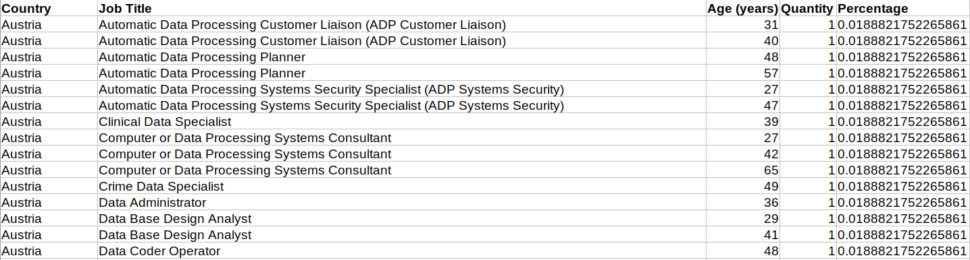
Project module_1
Ironhack_Madrid
Lucia Jiménez_Víctor
What the script does:
- Import all the tables as dataframes from a database and export each one into a .csv file.
- Merge the tables from the database as an unique dataframe.
- Get jobs information from the API of DATA AT WORK and converts it in a dataframe.
- Scrap the Eurostat website to get country codes information as a dictionary.
- Merge all the information to get this table:

Slide 2
Ironhack_Madrid
Lucia Jiménez_Víctor
Tools:
- Jupyter notebooks:
- First approach to data (database, API and web scraping).
- Get, clean and process the data.
- The easy way to have an overview of all the code running at one time
- PyCharm:
- Generate pipelines.
- Structured code.
- Final script main_script.py to execute the code.
- Python libraries:
- Pandas.
- Requests.
- Itertools.
- Regex
- Sqlalchemy
- Beautiful Soup 4
- Argparse

Slide 3
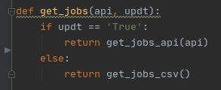
Ironhack_Madrid
Lucia Jiménez_Víctor
Time conflict:
The request to the API takes too much time to execute.
Solution: Argument updt (“-u”, “--updt”)
If python main_script.py -up True the code gets the jobs information from the API, exports the dataframe created as a .csv file and uses the requested information to run the code.
Time to run the code 2’05’’
If python main_script.py the code gets the jobs information from the previously exported .csv.
Time to run the code 05’’

