Slide 1
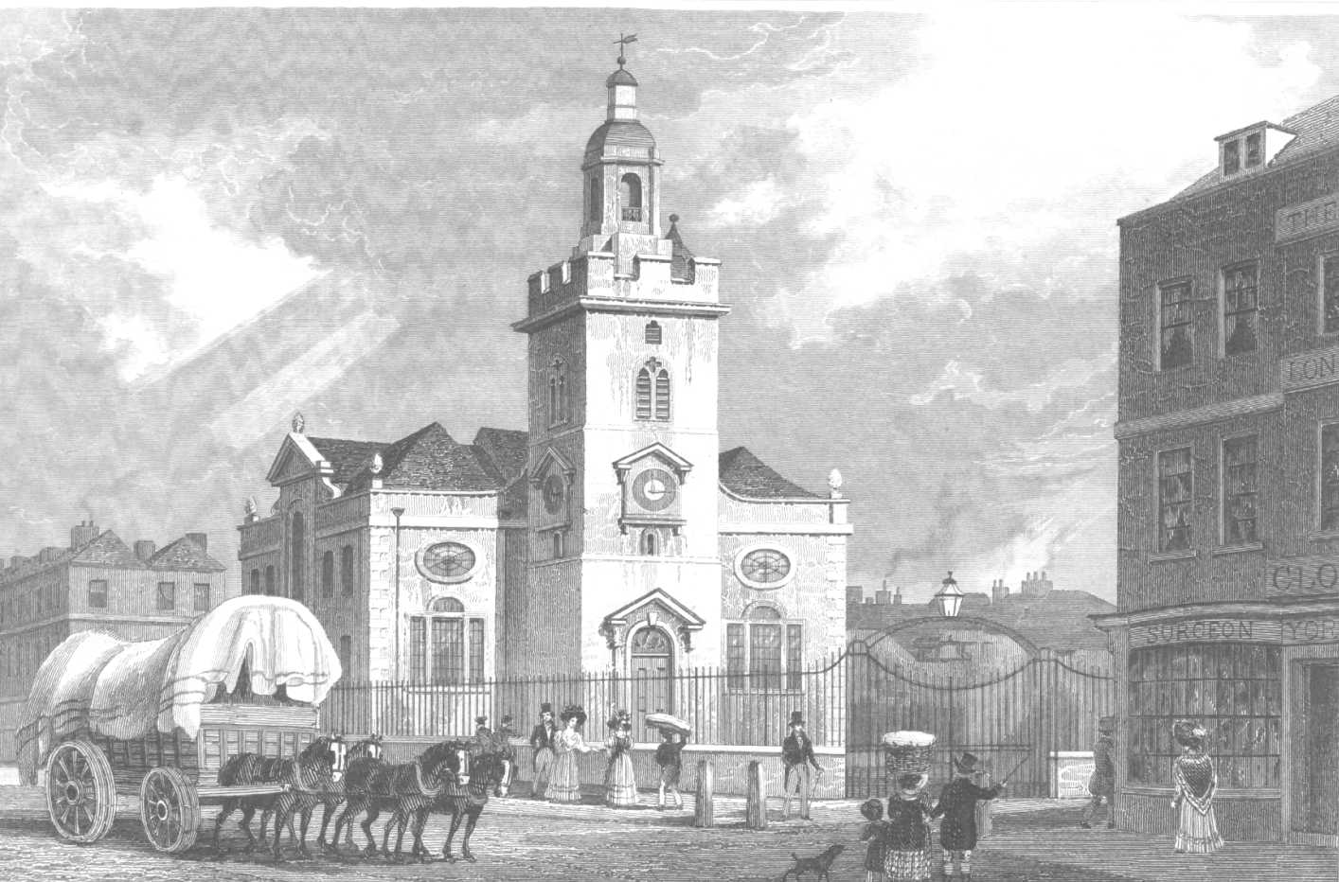
WHITECHAPEL

Slide 2
What is Whitechapel?
Whitechapel is a district in the East End of London, England.
It has been a popular place for immigrants and the working class.
Whitechapel is a significant settlement for the British Bangladeshi community now.

Slide 3
History
Whitechapel is named after a small chapel of ease dedicated to St. Mary in 1338.
In the Victorian era people are particularly Irish and Jewish.
Whitechapel has been home to Rudolf Rocker and Charles Lahr.

Slide 4
Jack the Ripper
The Jack the Ripper is a legendary Whitechapel Murderer.
It is generally believed that there were five victims of Jack the Ripper.

Slide 5
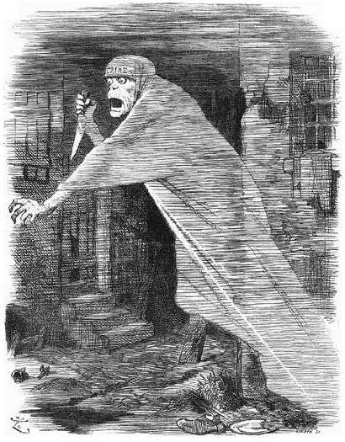
Jack the Ripper

Slide 6
Tourist attraction
The Whitechapel Gallery
The Whitechapel Bell Foundry

Slide 7
The Whitechapel Gallery
The Whitechapel Gallery is a public art gallery on the north side of Whitechapel High Street.
It was founded in 1901.

Slide 8
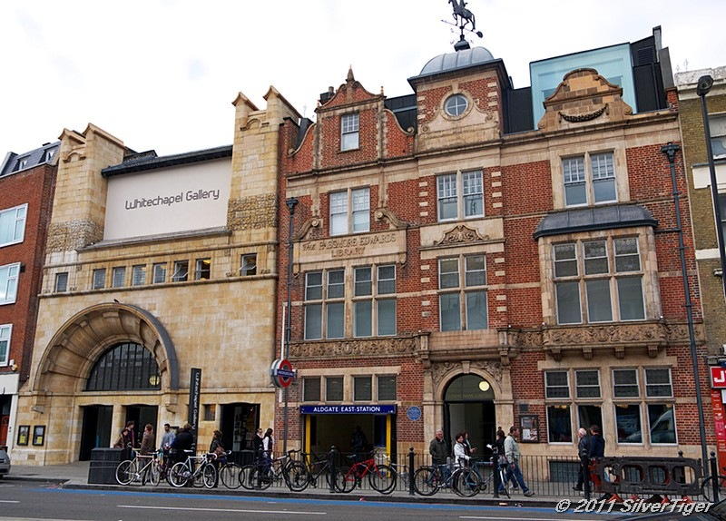
Whitechapel gallery

Slide 9
The Whitechapel Bell Foundry
The Whitechapel Bell Foundry is the oldest manufacturing company in Great Britain.
That unique building was founded in 1570 and since then had never stopped producing bells.

Slide 10
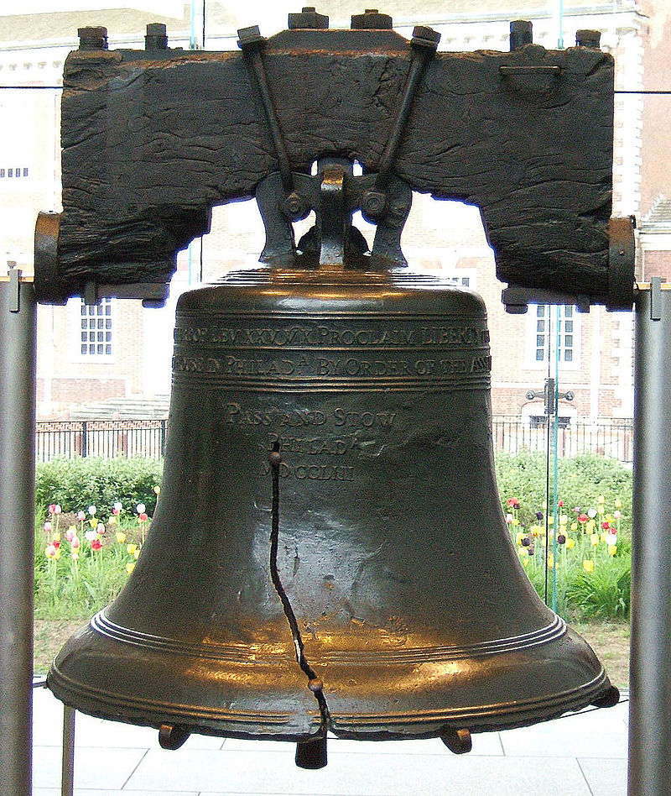
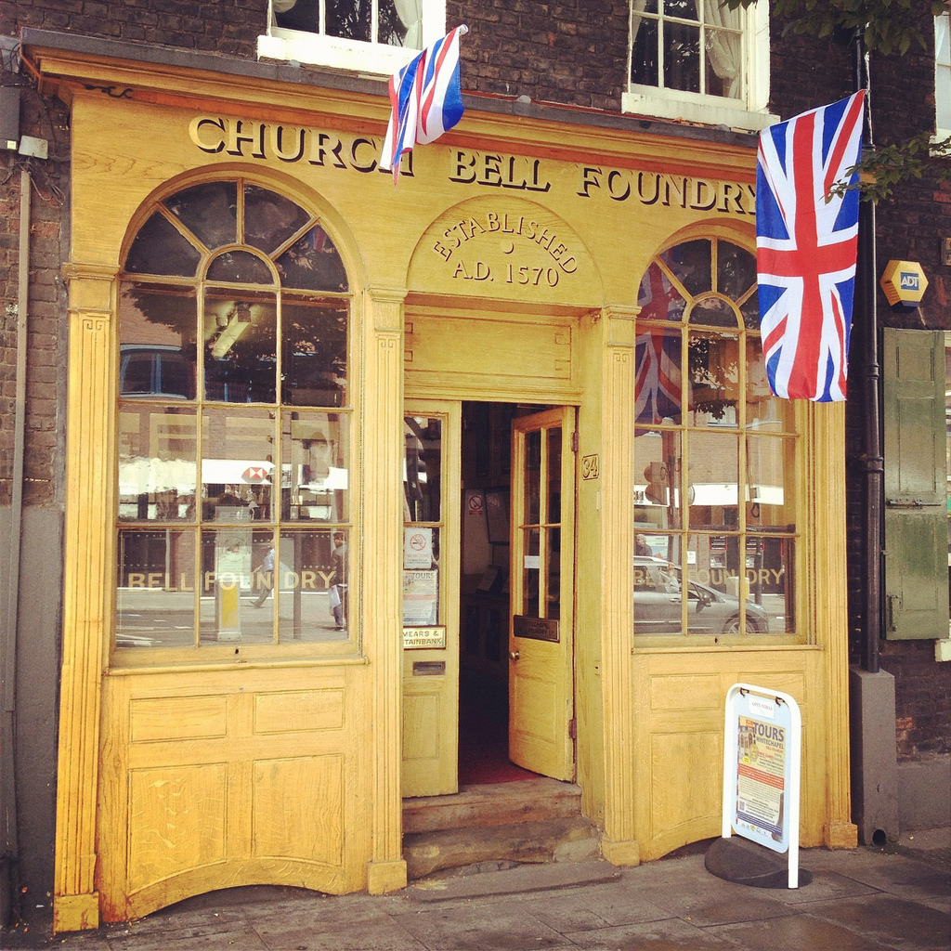
Liberty Bell Whitechapel Bell Foundry

