Slide 1
Programming with C++ LSEG Technology 22nd August 2024

Slide 2
What you will need today?
Install Visual Studio if you are using Windows https://visualstudio.microsoft.com/vs/community/
Or you can setup visual studio code(as editor) + a c++ compiler
Or use an online compiler https://godbolt.org/
C++ compiler support
https://en.cppreference.com/w/cpp/compiler_support

Slide 3
Agenda
History of C++
Why C++
Hello World !!
The Tools
Stages of Compilation
Optimization Levels
Data Types and Operators
Control Structures
Functions
Pointers

Slide 4
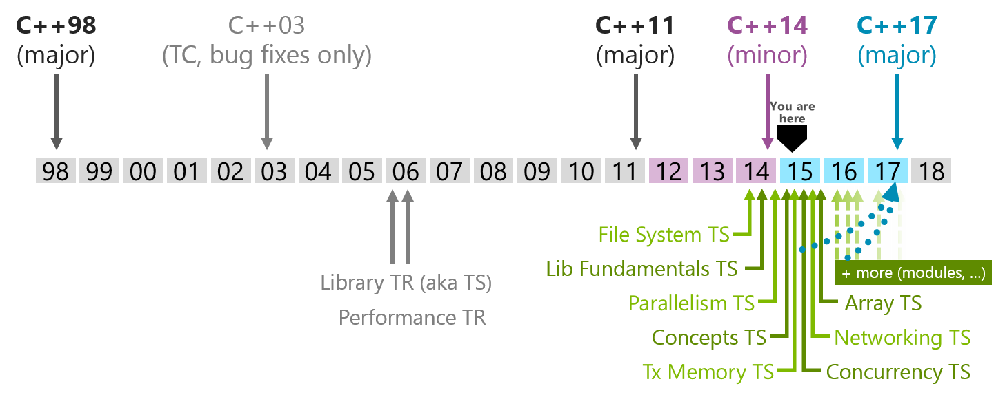
History of C++
1980 : C with Classes by Bjarne Stroustrup.
1983 : C with Classes redesigned and called C++
1989 : C++ 2.0
1998 : The first official ISO standard (C++98)
Source: http://herbsutter.com/2013/10/03/trip-report-fall-iso-c-standards-meeting/

Slide 5
Why C++
When you need to write code that
Runs fast
Touches memory level directly
Can handle complexity
C++ rules in
Gaming industry
Financial applications
Image processing
Embedded systems
Telco applications etc
3rd most popular language after Python and Java (IEEE Spectrum)

Slide 6
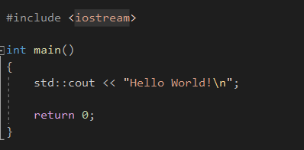
Hello World!
Preprocessor directive
Why return 0?
Main function in C++ has an integer return type.
0 traditionally indicates that the program ran successfully.
Not mandatory for main function only
Iostream – for std::cout
The global objects std::cout and std::wcout control output to a stream buffer of implementation-defined type (derived from std::streambuf), associated with the standard C output stream stdout.
<< → operator overloading

Slide 7
Stages of Compilation
Pre-processor
Pre-processor directives start with ‘#’
e.g. #include replaces that line with the contents of the “included” file
Compiler
Compiles the “pre-processed” file and generates “assembly code”
Assembler
Converts the assembly code in to “object code”
Linker
Combines “object files” with necessary system and user libraries to create “executables”
“g++ -E <input file> -o <output file>” will stop after pre-process stage and store the result in <output file>
“g++ -S <input file> -o <output file>” will stop after compilation stage and store the result in <output file>
“g++ -c <input file> -o <output file>” will stop after assembler. At this point, <output file> contains the “object code”. These files are called “object files”

Slide 8
Code: #include <iostream> #define GREETING "Hello, World!" int main() { std::cout << GREETING << std::endl; return 0; } Then try below in the cmd: Pre-processor: >>g++ -E example.cpp -o preprocessed_example.cpp Compiler: >>g++ -S preprocessed_example.cpp -o assembly_example.s Assembler: >>g++ -c assembly_example.s -o object_example.o Linker: >>g++ -o example_executable object_example.o Pre-processor (g++ -E): Processes example.cpp and creates preprocessed_example.cpp. Compiler (g++ -S): Compiles preprocessed_example.cpp into assembly_example.s. Assembler (g++ -c): Assembles assembly_example.s into object_example.o. Linker (g++ -o): Links object_example.o to create example_executable.

Slide 9
Preprocessor Directives
#define #elif #else #endif
#error #if #ifdef #ifndef
#import #include #line
#pragma #undef #using
Shows paths to clear up code for pre-processer!!
To define code paths for different conditions/platforms
To define definitions to replace in code
To include files
To shows error messages during compilations
…

Slide 10
Optimization Levels
Different optimization levels O0 to O3, Os
-O0 : No optimizations. Default. All debug information present. Less compilation time
-O1 :A set of optimizations applied. Take more time to compile.
-O2 : Recommended. Used in linux kernel too. More opmitized. nearly all supported optimizations that do not involve a space-speed tradeoff
-O3 : Not much recommended
-Os : Optimize for space
-Ofast : Optimize for speed. All O3 optimizations + some subtle differences. Not recommended
Higher optimization → Higher Compiler Time → Faster Code, Less Debug information
Lesser optimization level → Lesser Compiler Timer → Enough Debug information
https://gcc.gnu.org/onlinedocs/gcc/Optimize-Options.html

Slide 11
1. g++ -O0 -S example.cpp -o example_O0.s 2. g++ -O1 -S example.cpp -o example_O1.s 3. g++ -O2 -S example.cpp -o example_O2.s 4. g++ -O3 -S example.cpp -o example_O3.s 5. g++ -Ofast -S example.cpp -o example_Ofast.s -O0: The assembly code will be straightforward and closely related to the original C++ code, including explicit loop constructs and function calls. -O1: The code might start to eliminate some redundant operations and simplify certain constructs. -O2: The code will likely have more aggressive optimizations, such as loop unrolling, inline functions, and dead code elimination. -O3: Expect more complex optimizations, including aggressive inlining, vectorization, and additional performance-enhancing transformations. -Ofast: The code might use non-standard optimizations for faster execution, potentially sacrificing precision or compliance with standards.

Slide 12
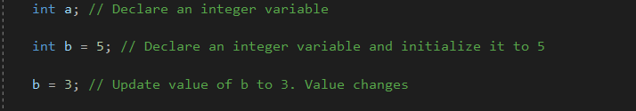
Variables
Variables are names to pieces of memory
How to manipulate values that will change in our code

Slide 13
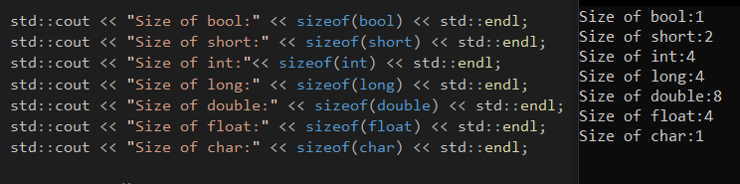
Data Types
Tells what type of and size of data will be stored in a variable
Category | Types | Meaning | Example | Notes
boolean | bool | true or false | true
character | char, wchar_t, char16_t, char32_t | a single ASCII character | ‘c’ | char16_t, char32_t are C++11 only
floating point | float, double, long double | a number with a decimal | 3.14159
integer | short, int, long, long long | a whole number | 64 | long long is C99/C++11 only
void | no type | void | n/a

Slide 14
Operators
Category | Operator(s) | Example | Notes
Assignment | = | x = 5; x = y = 10;
Arithmetic | +, -, *, /, % | x = 11 % 3 | x gets value ‘2’
Compound assignment | +=, -=, *=, /= | x += 5; | Same as x = x + 5;
Increment and decrement | ++, -- | x++ --x | Has suffix and prefix forms
Comparison | ==, !=, <, >, <=, >=
Logical | !, &&, || | if ((a > 5) && (b < 10))
Bitwise | &, |, ^, ~, <<, >>
Operator precedence: https://en.cppreference.com/w/cpp/language/operator_precedence
Parentheses when you need an order
Operator associativity
Operator overloading

Slide 15
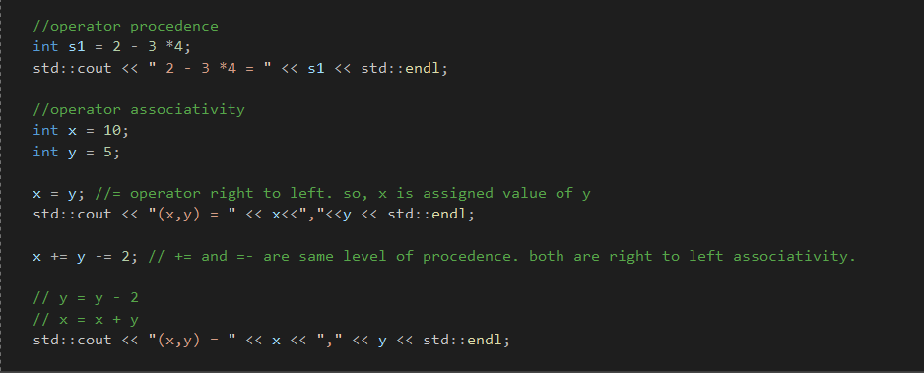
Operators

Slide 16
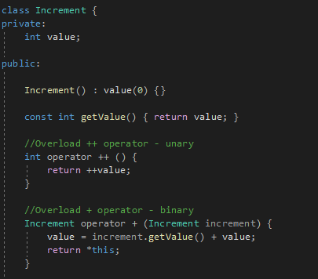
Operator overloading
Operators that cannot be overloaded:
Scope operator ::
Ternary operator ?:
Member access . ->
Pointer to member .* ->*
Two operators = and & are already overloaded by default in C++.
No change in precedence or associativity with operator overloading

Slide 17
Control Flow
Three logical constructs
Sequence, Selection, Repetition
Selection
if, if…else, if… else if… else
switch
Repetition
for (int i = 0; i < n; i++) { … }
while (true) { … }
do { … } while (true)
C++20 likely unlikely
std::cin >>n;
if (n > 1) [[unlikely]]
return 9;
else [[likely]]
return 1;

Slide 18
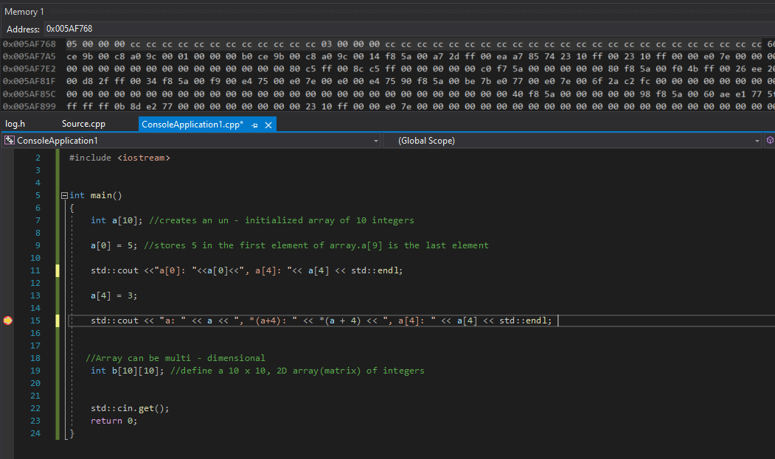
Arrays
An array is a collection of variables of the same type
It’s a convenient way to access multiple variables with a single name and an index value. Array indexes are zero-based (i.e. start at zero)
Need an exercise?
Write a program to generate the multiplication tables up to 12 x 12.

Slide 19
Functions
Function signature
Function declaration vs. definition
Function parameters
Pass by value, pass by reference
Recursion
Need an exercise?
Write a program to calculate the factorial of a given integer number

Slide 20

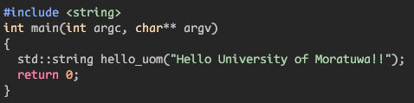
C++ Pointers
1FA0
What is stack
HEAP
3F40
3F48
Store local variables
3F50
Store function parameters
3F58
pointer
3F60
Store container meta data
3F68
&begin &end
3F70
Close to the CPU -> fast access
3F78
3F80
Limited resource
3F88
Automatic deallocation
3F90
3F98
Virtual Memory + Mem Controllers .. blah blah blah
Just another variable holding address
What is heap
hello_uom
We can program without pointers
Store dynamic variables
So, why use pointers?
Handling dynamic memory
Handling dynamic polymorphism
Without pointers? Stack Overflow !!
Slower than stack
Manual de-allocation
begin end length
type_info
L3
L2
Syntax
Example
L1
CPU

Slide 21
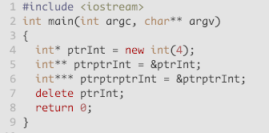
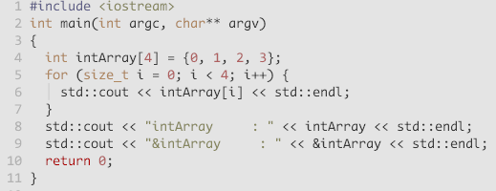
C++ pointers cntd..
Pointer to pointer
Arrays as Pointers
Heap
4
ptrInt
intArray
0
intArray + 1
1
2
intArray + 2
3
ptrptrInt
intArray + 3
ptrptrptrInt
Notes:
Here the custom constructor initializes object’s internal variables with 10 and 20. Example memory representation for that object is shown here.
Note that the Object is allocated in a separate place (in 1000 and 1001 addresses) and the pointer pCN1 has the value as the address of the object’s starting memory address.
C++ run time manages object sizes internally, so when we have a pointer to the start of the object, accessing its internal variables or calling member functions is handled transparently to the programmer.

Slide 22
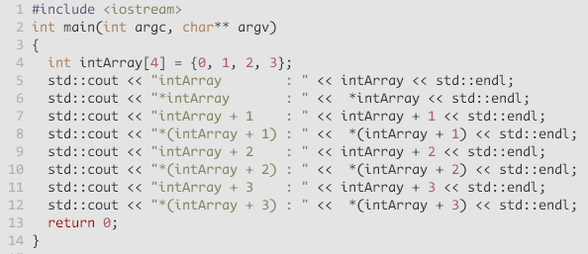
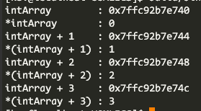
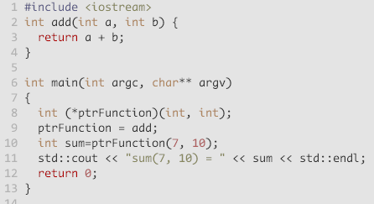

Pointer arithmetic
Function pointers
Variables pointing to address of functions
Syntax
return type ( * Name ) ( arg_types…. )
Usage
Function indirection
Virtual tables
A topic for self study

Slide 23
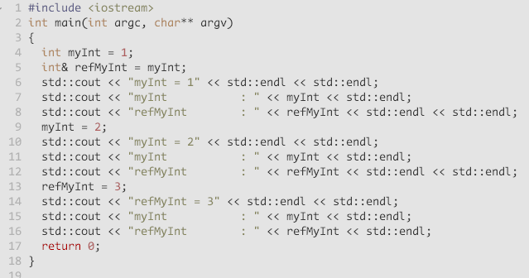
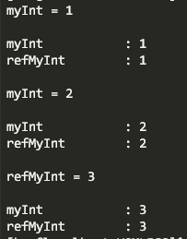
C++ references
An alias to an existing object
Must initialized at creation
Cannot change the object after creation
Never NULL

Slide 24
C++ data alignment
Variable
Self Study Topics
C++ custom align using #pragma pack
In MSVC, C++ custom align using __declspec(align(xx))
Use assert(alignof(xx)) with custom alignment for verification
Pros and Cons of custom alignment
Create a sample program to show mis-use of custom align
Value
Address
CPU read/write most efficient when data is naturally aligned
Address % 1 = 0
Address % 2 = 0 Address % 4 = 0
Address % 8 = 0
12FEEC (1244908)
Memory
Mis-aligned
64bit CPU
Ref 00
Memory
Aligned
64bit CPU
Ref 00
Missed
Unrelated
Notes:
A variable has two properties, value and address
Address of a variable is evenly divisible by 1, 2, 4 or 8
Data object can have 1-byte, 2-byte, 4-byte or 8-byte alignment or any power of 2 !!
Memory is byte addressable, arranged in 1 byte
Find CPU cache width using $ lshw command (linux)
In a 32bit architecture, data is aligned when data is stored in four consecutive bytes on a 4 byte boundary
In a 64bit architecture, data is aligned when data is stored in eight consecutive bytes on a 8 byte boundary
A memory address is N-bytes aligned when address is a multiple of N (where N is a power of 2)

Slide 25
C++ categories of computations
Runtime computations
Constexpr computations
Heterogeneous computations
Type level computations
Notes:
Runtime computation
standard library
dynamic memory management

Slide 26
References
What every programmer should know about memory – Ulrich Drepper
What every programmer should know about floating point – David Goldberg
CppCon
LearnCpp.com
CPlusPlus.com Tutorial
Tutorialspoint.com
The Cherno

