Slide 1
Products Demand
Demand Forecasting on Retail (web e-tailer chain) products

Slide 2
Overview and Summary :
Data is about a large web e-tailer chain which sells different types of products nationally. It has shipping services via different modes/types of transportation. It keeps track of order details, shipping details, discounts provided to the customer, profit earned etc .
Problem Statement: To find out a optimum Marketing strategy to asses what is the current state of the portfolio in terms of product mix, demand trends across categories and products and understand if there are any regional variations.
The main aim is to estimate the demand of different type of products based on the sales history using predictive analysis.
Expected Analysis: Current patterns via Exploratory Data Analysis, descriptive analysis and build models.

Slide 3
Data preparation:
Primary Data shape was 9994*21.
Missing values were handled
Data was made in the same format in each column.
Finding out the outliers and analysing them.
Dropping a few columns which had no significance in further analysis.
Final Data Shape was 9994*19
Handling Missing Values:
A few columns had missing values which were treated. For example, the Region – a relation with state is found and were sorted by the state and filled in by the previous value. Similarly using one or more relational columns missing values were imputed. The columns with missing values were:
Segment
Shipment Mode
Region

Slide 4
Product Line Analysis
Category and Sub-category Analysis
There are 3 categories:
Furniture
Office Supplies
Technology
Within each of those categories there are certain number of subcategories as well.
Diving deep into the product line we will provide category wise and sub-category wise analysis.
YOY Analysis of Sales and Profit
Category with Highest Sales and Profit
Product with Highest offered Discount in each category

Slide 5
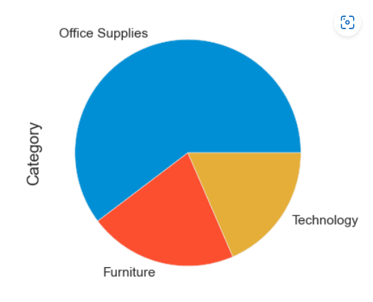
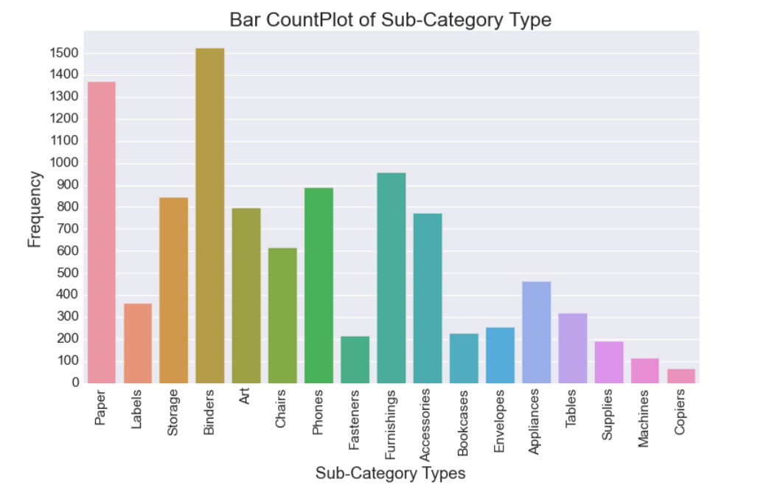
Category and Subcategory
Percentage of Orders per Category
Orders per Subcategory
Among the categories the most orders (More than 60%) were placed from Office Supplies and least was from Technologies.
Binders, paper and Furnishings are the top most ordered Sub-Categories of each category whereas, Copiers being the least sold Sub-Category.

Slide 6
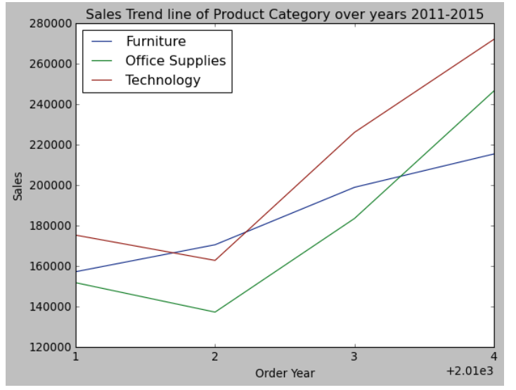
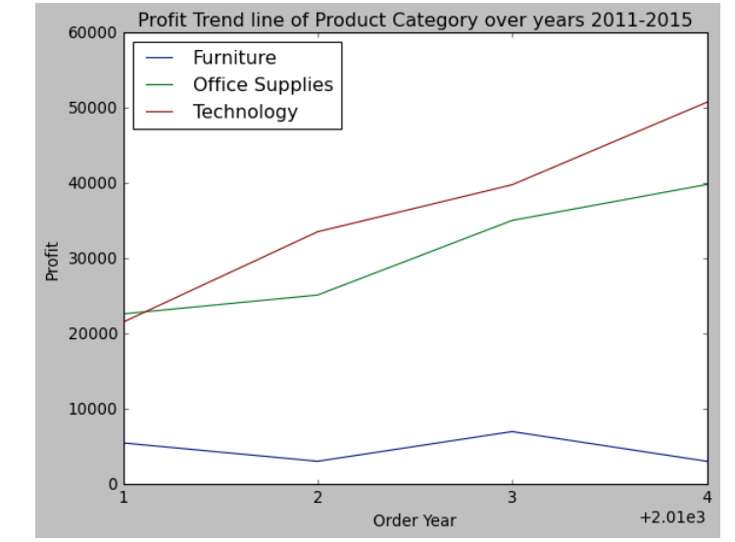
YOY Sales of Each Category
YOY Profit of Each Category
The Sales values Furniture had a steady increase over the years, whereas in Office supplies and technology the sales growth was unstable
Technology and office supplies has a significant increase in profit levels whereas Furniture has fluctuating trends in profit

Slide 7
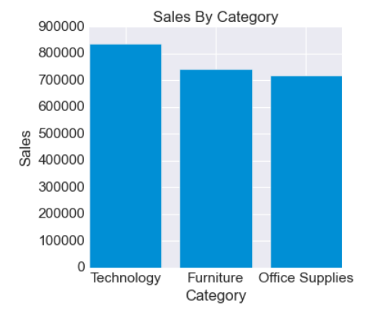
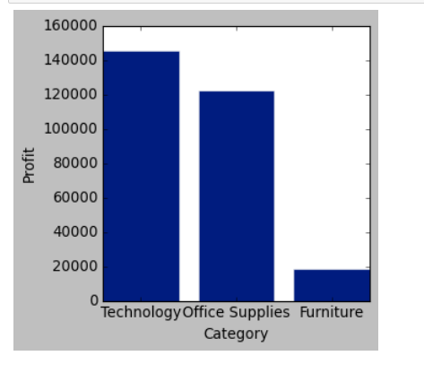
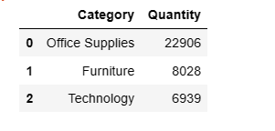
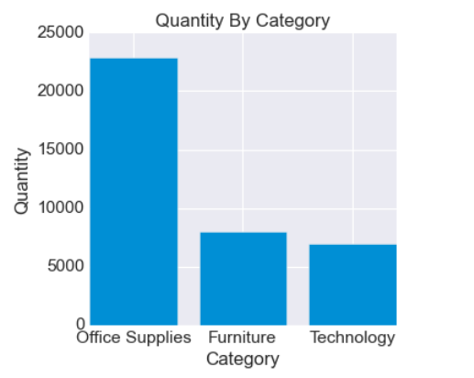
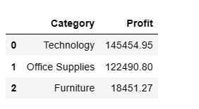
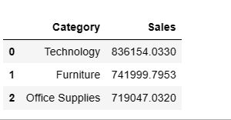
Sales Per Category
Quantity Sold per Category
Profit per Category
Technology field yields the highest sales among all. Furniture and Office supplies also have subsequent good sales value.
Technology field yields the highest profit among all. Furniture on the other hand has given the least amount profit
Office Supplies field has the highest quantity sold among all. Furniture and technology has quite lesser no of quantity sold

Slide 8
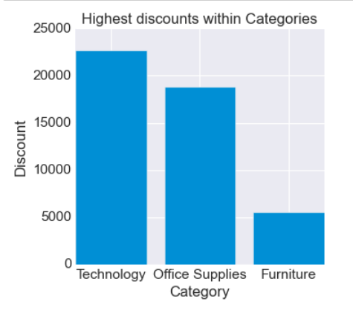
Category of the product with highest offered discount
Technology offers the highest average discount and furniture with the least.

Slide 9
Customer Segment Analysis
The three segments in the data defines the type of customer associated to the order. There is a one to many relationship between the customer and the segment
The 3 segments are as follows:
Consumer
Corporate
Home office
Profit with highest demand in each segment
Shipment methods
Segment yielding highest profit
Most Valuable Customer

Slide 10
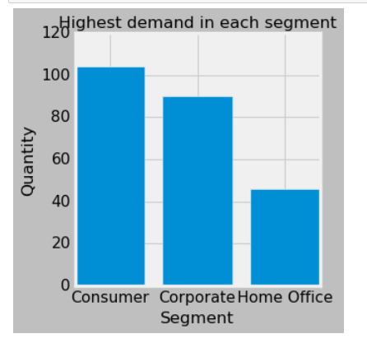
Product with highest demand in each segment
Staple Envelope in the consumer segment has the highest demand on an overall basis. Staples emerge out as a product with leading demand in the Corporate segment and Easy Staple Paper leads in Home Office segment.

Slide 11
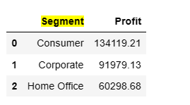
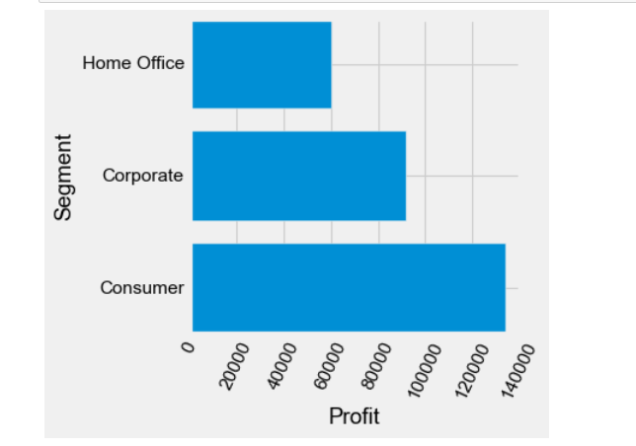
Segment yielding highest profit
Consumer Segment is providing highest Profit, followed by Corporate and Home Office segment.

Slide 12
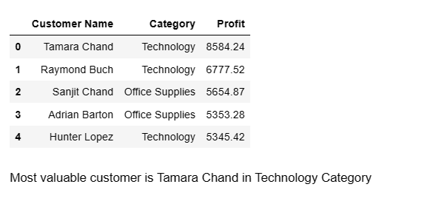
Most Valuable customer
To a company the most valuable customer is one who gives a good profit value also providing a considerable amount of Sales.

Slide 13
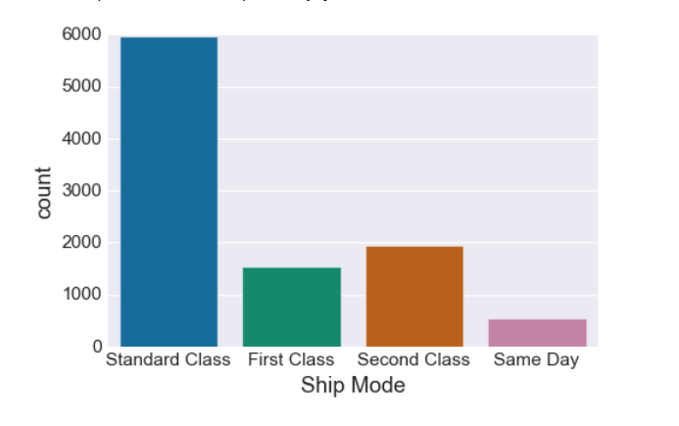
Shipment Methods
Here the Standard Class was preferred by more than 60% of the customers. Same day ship mode is least preferred maybe due to more cost associated with its shipment.

Slide 14
Geographic Analysis
Region wise Analysis
The company is located in the country ‘united States’ and is compromised of 49 states having total 531 cities which all are spread across 4 regions namely East, West, South and Central
State-Wise Analysis
City Wise Analysis
Top N and Buttom N Analysis

Slide 15
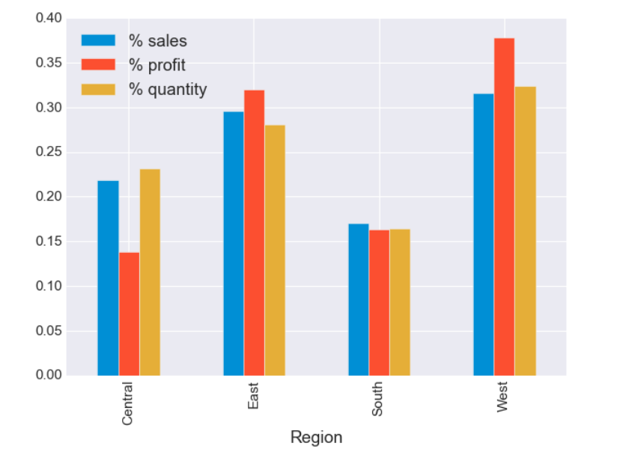
Region–wise Analysis
West Region has the highest Profit, Sales and Quantity percentage share followed by East region while central & South Region has least percentage share
It can be noted that despite greater sales and quantity percentage share of central region than south region it has lesser profit percentage share than south region

Slide 16
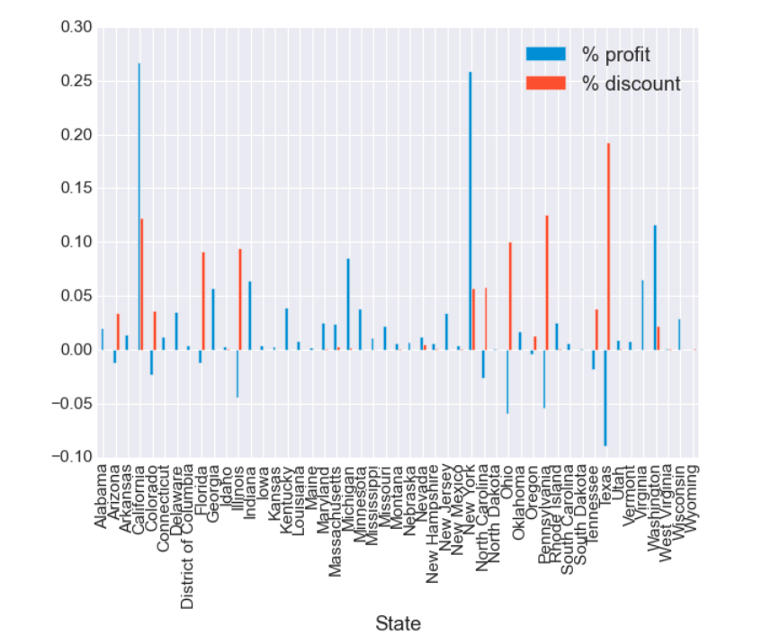
State-wise Analysis
It is noticed that states giving high discount rates are incurring drastic losses on average, whereas states giving no discounts incur moderate high profit.

Slide 17
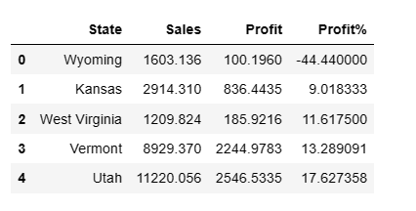
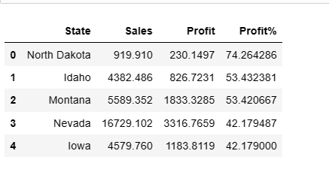
Profit and Loss Percentages (State-wise)
Top 5
Bottom 5

Slide 18
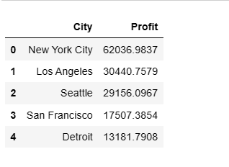
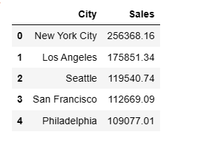
City-wise Analysis
Top 5 cities based on Profit
Top 5 cities based on Sales
From both the City-wise Sales and the Profit table it is quite visible that New York City is the best performing city in the United States

Slide 19
Algorithms used:
As the data contains various metrics related to sales like orders, categories, sub categories, sales etc. and the quantity is a continuous metric, In this scenario we are taking the quantity as the target variable and predict it using various features. This is clearly a regression problem as the target variable is continuous. We are using numerous features and those features are correlated to the target variable quantity. So we are using two most used regression models namely XGBoost and Random Forest
Random Forest Regression Model:
With the aid of several decision trees and a method known as Bootstrap and Aggregation, also ref erred to as bagging, Random Forest is an ensemble methodology capable of handling both regression and classification tasks. This method's fundamental principle is to integrate several decision trees to get the final result rather than depending solely on one decision tree.
Random Forest is utilized for tasks like classification and regression. To increase accuracy and lessen overfitting of the model, this ensemble learning technique integrates several decision trees. Each tree in a Random Forest model is trained using a unique subset of the training data and a randomly selected subset of the features. Combining all of the trees' projections yields the final conclusion. The advantages of Random Forest are its high accuracy, resilience, and capacity for handling highly dimensional data with numerous attributes. It is extensively employed in many different industries, including banking, healthcare, and image analysis.
For the prediction on test data set, we mapped True values with prediction with linear vs random forest regression. Mape for Random Forest regression model is ~0.064. and which mean the accuracy is 93.54%

Slide 20
Algorithms used:
XGBoost Model:
Extreme Gradient Boosting (XGBoost), a potent machine learning algorithm, is a member of the ensemble learning methodology family. This tree-based model combines numerous weak learners into a single strong learner using boosting. XGBoost is a well-liked option for a variety of applications, including data mining, natural language processing, and image recognition, because to its speed and scalability. Additionally, a variety of hyperparameters are provided, which can be adjusted to enhance model performance.
Being able to manage missing data and outliers, which can frequently be an issue for other machine learning algorithms, is one of XGBoost's primary advantages. It is also quite adaptable and may be used for both classification and regression problems.
In our scenario, the mapping between the predicted and actual quantities are matching with each other with a MAPE of 0.47 which means the accuracy is 1-MAPE i.e 53%

Slide 21
Predictive Analysis
The main aim is to estimate the demand of different type of products based on the sales history using predictive analysis.
As the data contains various metrics related to sales like orders, categories, sub categories, sales etc. and the quantity is a continuous metric, In this scenario we are taking the quantity as the target variable and predict it using various features. This is clearly a regression problem as the target variable is continuous. We are using numerous features and those features are correlated to the target variable quantity. So we are using two most used regression models namely XGBoost and Random Forest
For XGBOOST: In our scenario, the mapping between the predicted and actual quantities are matching with each other with a MAPE of 0.32 which means the accuracy is 1-MAPE i.e 68%
For Random Forest: In our scenario, the mapping between the predicted and actual quantities are matching with each other with a MAPE of 0.49 which means the accuracy is 1-MAPE i.e 51%
This shows that the random forest model is performing with a MAPE of 0.49 and the accuracy is 51%
We can see a slight difference in accuracies obtained from XGBoost and Random Forest models, whereas XGBoost performs better with an accuracy of 68%.
These models can further be improved by tuning the hyper parameters using grid search CV with helps in finding the optimal parameters and getting the best accuracies.¶

Slide 22
Findings and Conclusions
Findings
Discusses about the plan of action and possible actionable strategies that could be implemented depending upon the various results and references.
Possible Strategies and conclusion

Slide 23
Results and Findings
Product Line:
Office Supplies is the most ordered.
1. Progressive Profit and Sales Growth.
2. Moderate sales and profit value.
Technology is the least ordered.
1. Increasing Sales and profit over the years.
Furniture has made huge losses despite having good sales.
Customer Segment:
Consumer yield the highest profit, quantity sold is also most.
Office supplies are the products with highest demand in each segment
Most valuable customers are from technology and office supplies
Standard as shipment is chosen over any other modes by all segments.
Geographical:
West – High quantities, High profit.
South- least sales but, good profit.
East shows several fluctuations, Central incurred losses.
States with highest profit percentage and loss percentages are in East.
New York city is the best performing city
1. Corporate
2. Consumer
3. Home Office

Slide 24
Strategy
It is obvious that Wyoming, is the state with Sales. BUT, Vermont is producing highest Profit.
Looking at the Profit Percentage table we see states like Columbia, Minnesota coming up, although sales is low.
Hence the expansion plan should be based on these states maybe by changing different strategies as applicable for the different states keeping customer satisfaction in mind.
Technology products have more competitors, therefore proper advertisement and marketing strategy to be implemented in the regions rather states where its incurring losses, for example: Otherwise technology seems to a cash cow in the product category bringing good revenue and thus good profits.
From the Past Trends of the sales data, it was observed that a minimum of 15% increase in sales is to be met in coming year to have a smooth marketing growth
Office Supplies is definitely a dark horse category to be looked out for as they are regular used products.
Furniture needs to check upon its discount rates i.e. not only boosting up sales but also keeping Profit in mind and thus need to work upon Pricing Strategy so as to get an edge over the competitive market.
Discount can be pertained when the customer is more regular or the product is more popular yielding profit, beside generating Sales.

