Slide 1
Chapter 7
Assembly Language

Slide 2
Human-Readable Machine Language
Computers like ones and zeros…
Humans like symbols…
Assembler is a program that turns symbols into
machine instructions.
  ISA-specific:
  close correspondence between symbols and instruction set
    mnemonics for opcodes
    labels for memory locations
  additional operations for allocating storage and initializing data
0001110010000110
ADD R6,R2,R6 ; increment index reg.
7-<number>

Slide 3
An Assembly Language Program
;
; Program to multiply a number by the constant 6
;
.ORIG x3050
LD R1, SIX
LD R2, NUMBER
AND R3, R3, #0 ; Clear R3. It will
; contain the product.
; The inner loop
;
AGAIN ADD R3, R3, R2
ADD R1, R1, #-1 ; R1 keeps track of
BRp AGAIN ; the iteration.
;
HALT
;
NUMBER .BLKW 1
SIX .FILL x0006
;
.END
7-<number>

Slide 4
LC-3 Assembly Language Syntax
Each line of a program is one of the following:
  an instruction
  an assember directive (or pseudo-op)
  a comment
Whitespace (between symbols) and case are ignored.
Comments (beginning with “;”) are also ignored.
An instruction has the following format:
LABEL OPCODE OPERANDS ; COMMENTS
optional
mandatory
7-<number>

Slide 5
Opcodes and Operands
Opcodes
  reserved symbols that correspond to LC-3 instructions
  listed in Appendix A
    ex: ADD, AND, LD, LDR, …
Operands
  registers -- specified by Rn, where n is the register number
  numbers -- indicated by # (decimal) or x (hex)
  label -- symbolic name of memory location
  separated by comma
  number, order, and type correspond to instruction format
    ex:
    ADD R1,R1,R3
    ADD R1,R1,#3
    LD R6,NUMBER
    BRz LOOP
7-<number>

Slide 6
Labels and Comments
Label
  placed at the beginning of the line
  assigns a symbolic name to the address corresponding to line
    ex:
    LOOP ADD R1,R1,#-1
    BRp LOOP
Comment
  anything after a semicolon is a comment
  ignored by assembler
  used by humans to document/understand programs
  tips for useful comments:
    avoid restating the obvious, as “decrement R1”
    provide additional insight, as in “accumulate product in R6”
    use comments to separate pieces of program
7-<number>

Slide 7
Assembler Directives
Pseudo-operations
  do not refer to operations executed by program
  used by assembler
  look like instruction, but “opcode” starts with dot
Opcode | Operand | Meaning
.ORIG | address | starting address of program
.END |  | end of program
.BLKW | n | allocate n words of storage
.FILL | n | allocate one word, initialize with value n
.STRINGZ | n-character string | allocate n+1 locations, initialize w/characters and null terminator
7-<number>

Slide 8
Trap Codes
LC-3 assembler provides “pseudo-instructions” for
each trap code, so you don’t have to remember them.
Code | Equivalent | Description
HALT | TRAP x25 | Halt execution and print message to console.
IN | TRAP x23 | Print prompt on console, read (and echo) one character from keybd. Character stored in R0[7:0].
OUT | TRAP x21 | Write one character (in R0[7:0]) to console.
GETC | TRAP x20 | Read one character from keyboard. Character stored in R0[7:0].
PUTS | TRAP x22 | Write null-terminated string to console. Address of string is in R0.
7-<number>

Slide 9
Style Guidelines
Use the following style guidelines to improve
the readability and understandability of your programs:
  Provide a program header, with author’s name, date, etc.,
  and purpose of program.
  Start labels, opcode, operands, and comments in same column
  for each line. (Unless entire line is a comment.)
  Use comments to explain what each register does.
  Give explanatory comment for most instructions.
  Use meaningful symbolic names.
    Mixed upper and lower case for readability.
    ASCIItoBinary, InputRoutine, SaveR1
  Provide comments between program sections.
  Each line must fit on the page -- no wraparound or truncations.
    Long statements split in aesthetically pleasing manner.
7-<number>

Slide 10
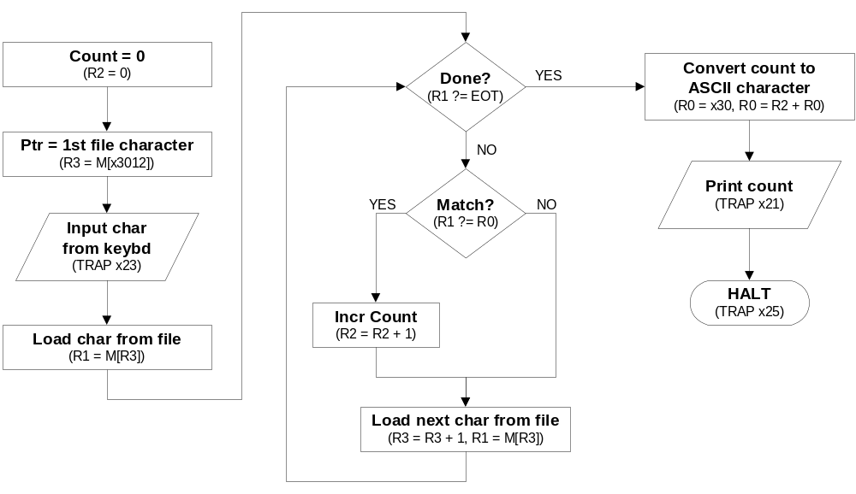
Sample Program
Count the occurrences of a character in a file.
Remember this?
7-<number>

Slide 11
Char Count in Assembly Language (1 of 3)
;
; Program to count occurrences of a character in a file.
; Character to be input from the keyboard.
; Result to be displayed on the monitor.
; Program only works if no more than 9 occurrences are found.
;
;
; Initialization
;
.ORIG x3000
AND R2, R2, #0 ; R2 is counter, initially 0
LD R3, PTR ; R3 is pointer to characters
GETC ; R0 gets character input
LDR R1, R3, #0 ; R1 gets first character
;
; Test character for end of file
;
TEST ADD R4, R1, #-4 ; Test for EOT (ASCII x04)
BRz OUTPUT ; If done, prepare the output
7-<number>

Slide 12
Char Count in Assembly Language (2 of 3)
;
; Test character for match. If a match, increment count.
;
NOT R1, R1
ADD R1, R1, R0 ; If match, R1 = xFFFF
NOT R1, R1 ; If match, R1 = x0000
BRnp GETCHAR ; If no match, do not increment
ADD R2, R2, #1
;
; Get next character from file.
;
GETCHAR ADD R3, R3, #1 ; Point to next character.
LDR R1, R3, #0 ; R1 gets next char to test
BRnzp TEST
;
; Output the count.
;
OUTPUT LD R0, ASCII ; Load the ASCII template
ADD R0, R0, R2 ; Covert binary count to ASCII
OUT ; ASCII code in R0 is displayed.
HALT ; Halt machine
7-<number>

Slide 13
Char Count in Assembly Language (3 of 3)
;
; Storage for pointer and ASCII template
;
ASCII .FILL x0030
PTR .FILL x4000
.END
7-<number>

Slide 14
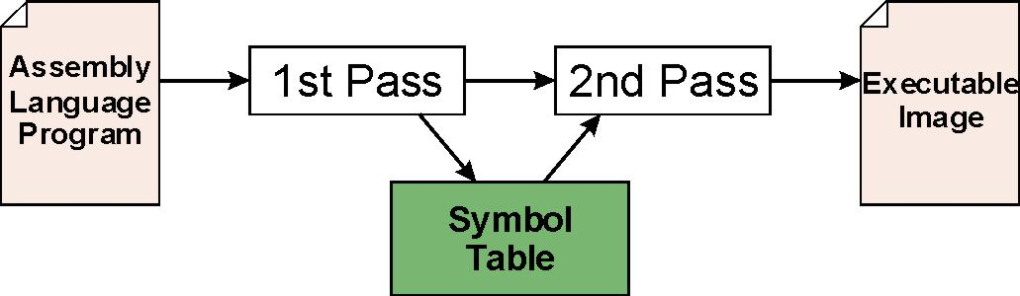
Assembly Process
Convert assembly language file (.asm)
into an executable file (.obj) for the LC-3 simulator.
First Pass:
  scan program file
  find all labels and calculate the corresponding addresses;
  this is called the symbol table
Second Pass:
  convert instructions to machine language,
  using information from symbol table
7-<number>

Slide 15
First Pass: Constructing the Symbol Table
Find the .ORIG statement,
which tells us the address of the first instruction.
  Initialize location counter (LC), which keeps track of the
  current instruction.
For each non-empty line in the program:
  If line contains a label, add label and LC to symbol table.
  Increment LC.
    NOTE: If statement is .BLKW or .STRINGZ,
    increment LC by the number of words allocated.
Stop when .END statement is reached.
NOTE: A line that contains only a comment is considered an empty line.
7-<number>

Slide 16
Second Pass: Generating Machine Language
For each executable assembly language statement,
generate the corresponding machine language instruction.
  If operand is a label,
  look up the address from the symbol table.
Potential problems:
  Improper number or type of arguments
    ex: NOT R1,#7
    ADD R1,R2
    ADD R3,R3,NUMBER
  Immediate argument too large
    ex: ADD R1,R2,#1023
  Address (associated with label) more than 256 from instruction
    can’t use PC-relative addressing mode
7-<number>

Slide 17
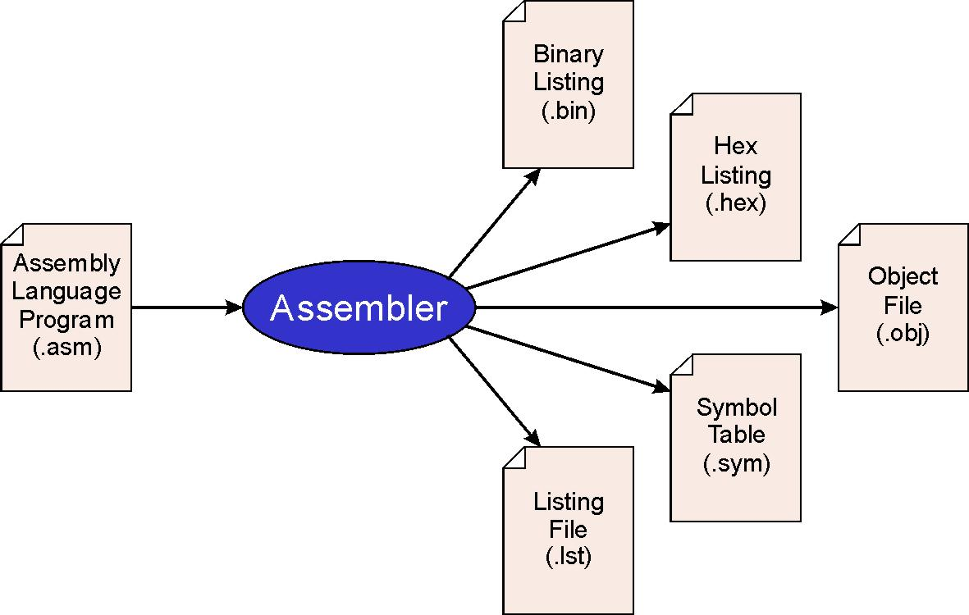
LC-3 Assembler
Using “assemble” (Unix) or LC3Edit (Windows),
generates several different output files.
This one gets
loaded into the
simulator.
7-<number>

Slide 18
Object File Format
LC-3 object file contains
  Starting address (location where program must be loaded),
  followed by…
  Machine instructions
Example
  Beginning of “count character” object file looks like this:
0011000000000000
0101010010100000
0010011000010001
1111000000100011
.
.
.
.ORIG x3000
AND R2, R2, #0
LD R3, PTR
TRAP x23
7-<number>

Slide 19
Multiple Object Files
An object file is not necessarily a complete program.
  system-provided library routines
  code blocks written by multiple developers
For LC-3 simulator,
can load multiple object files into memory,
then start executing at a desired address.
  system routines, such as keyboard input, are loaded automatically
    loaded into “system memory,” below x3000
    user code should be loaded between x3000 and xFDFF
  each object file includes a starting address
  be careful not to load overlapping object files
7-<number>

Slide 20
Linking and Loading
Loading is the process of copying an executable image
into memory.
  more sophisticated loaders are able to relocate images
  to fit into available memory
  must readjust branch targets, load/store addresses
Linking is the process of resolving symbols between
independent object files.
  suppose we define a symbol in one module,
  and want to use it in another
  some notation, such as .EXTERNAL, is used to tell assembler that a symbol is defined in another module
  linker will search symbol tables of other modules to resolve symbols and complete code generation before loading
7-<number>

Slide 21
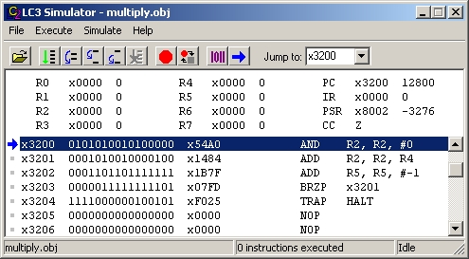
LC-3 Simulator
stop execution,
set breakpoints
execute
instruction
sequences
set/display
registers
and memory
6-<number>

Slide 22
X86 and MIPS
7-<number>

Slide 23
Both MIPS and x86 are regiser based archituecture
Different number of registers
MIPS: 32 registers
X86: More registers with different length
Different name of registers
  MIPS: $a0, $s0, $t0
  X86: EAX, EBX,CS,DS,ESI,EDI
Partial read and write:
  MIPS: can only write 32 bits
  X86: can write to 8, 16, or 32 bits
7-<number>

Slide 24
Both MIPS and x86 use the same basic instruction type
Instruction type: operation, Data movement, control
Different names and instruction length
  MIPS: All instructions are 32 bits
  X86: instruction range from 8 to 32 bytes
Both use ALU flags for branches
X86 supports register <- register + memory
7-<number>

Slide 25
Both MIPS and x86 support byte addressable, 32 bit address space memory
X86 has additional addressing mode
  MIPS: Psodu-direct, register, reg + offset, pc relative
  X86: Direct, register , reg + offset, RIP + offset, Implicit ….
X86 has segmentation, not used by modern systems
7-<number>

Slide 26
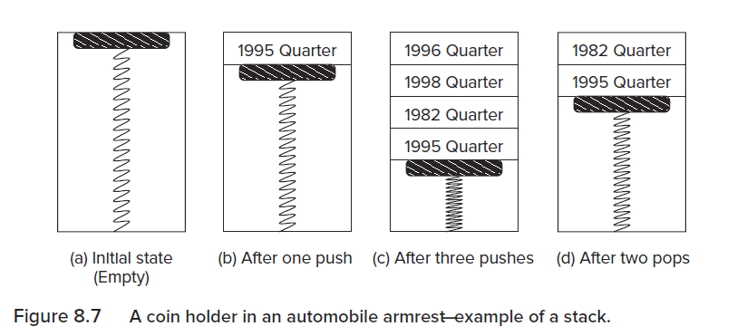
Example: Stack—An Abstract Data Type
Lifo: Last in first out
5-<number>

Slide 27
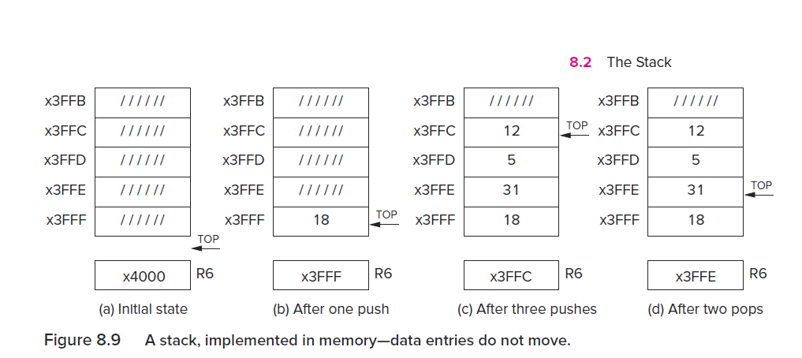
Implementation
5-<number>

Slide 28
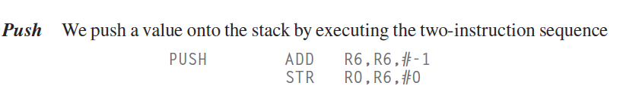
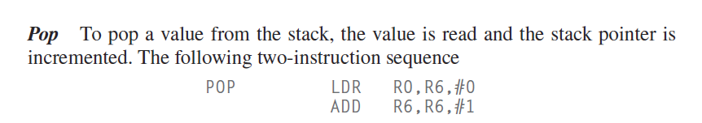
Implementation
5-<number>

Slide 29
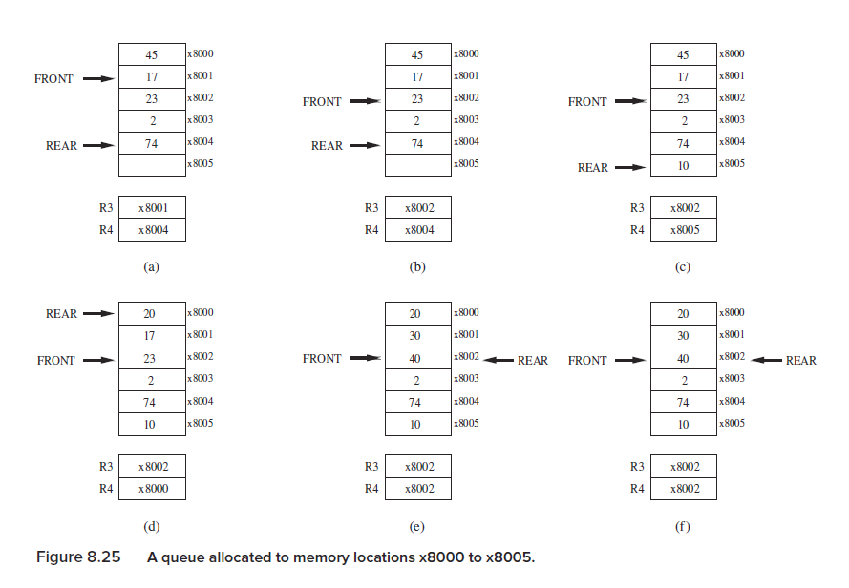
The Queue – First In First out
5-<number>

Slide 30


Aded and remove
Remove
ADD
5-<number>

Slide 31
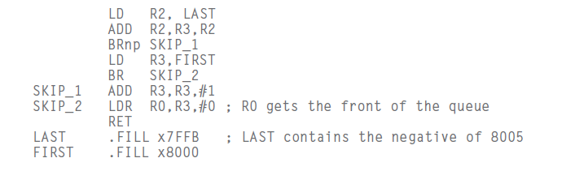
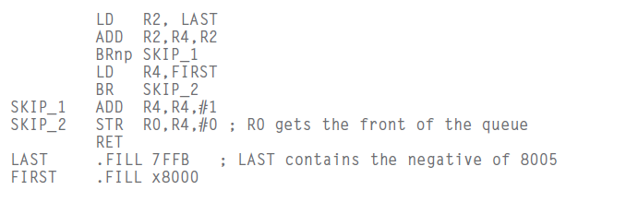
Wrap around
Remove
ADD
5-<number>

Slide 32
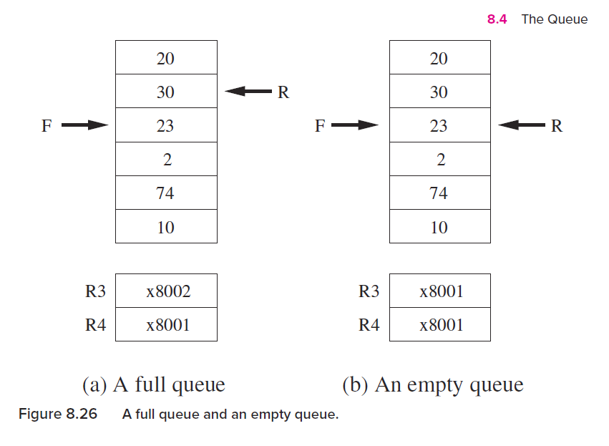
Full and Empty queue
How many elements do we have in the d plots ?
5-<number>

Slide 33
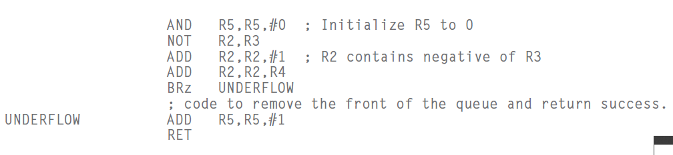
Under Flow
5-<number>

Slide 34
Practice
Construct the symbol table for the program in Figure 7.1
(Slides 7-11 through 7-13).
Symbol | Address
7-<number>

Slide 35
Practice
Using the symbol table constructed earlier,
translate these statements into LC-3 machine language.
Statement | Machine Language
LD R3,PTR
ADD R4,R1,#-4
LDR R1,R3,#0
BRnp GETCHAR
7-<number>

Slide 36
Practice
Write a program (div.asm) to perform positive integer division algorithm. Your program will have two inputs: the dividend and divisor and have two outputs: the quotient and remainder.
Write a program that compares two character strings of the same length. The strings are located at location FIRST, and the SECOND. To initialize the constant string we use the .STRINGZ directive which initializes locations with ASCII value of the character in the sequence. Note that .STRINGZ also null terminates the string. If the strings are the same, the program terminates with the value 1 in R5.
7-<number>

Slide 37
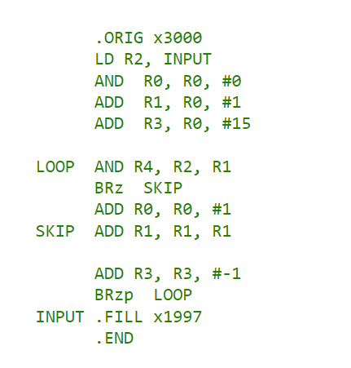
Practice
Consider the following LC-3 assembly language program. What does the program do?
7-<number>

Slide 38
Practice
Write a program to consider over flow in Stack
7-<number>

