Slide 1
Chapter 4, 5, 6,7
Peyman Pahlevani

Slide 2
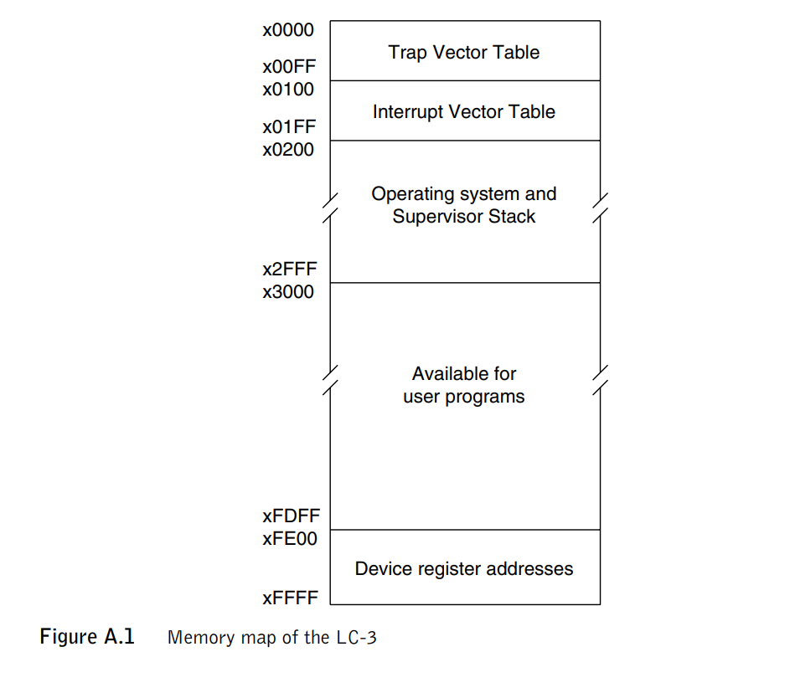
Interrupt and exceptions
Processor status register (PSR)
PSR[15] specifies the privilege mode
PSR[10:8] specifies the priority
PSR[2:0] contains the condition codes. PSR[2] is N, PSR[1] is Z, and PSR[0] is P.
Traps (system calls) is initiated by software
Interrupt events external to the program that
is running can interrupt the processor.
External: eg. I/O
Internal: unused opcode (Exceptions)
Half (128) of these entries, locations x0100 to x017F,
provide the starting addresses of routines that service
events caused by the running program itself (Exceptions)
other half of the entries, locations x0180 to x01FF, provide the starting addresses of routines that service events that are external to the program that is running, such as requests from I/O devices.

Slide 3
Interrupts Processing
An I/O device can interrupt the processor if it wants service
1. The PSR of the interrupted process is saved in TEMP.
2. The processor sets the privilege mode to Supervisor mode (PSR[15]=0).
3. The processor sets the priority level to PL4, the priority level of the interrupting device (PSR[10:8]=100).
4. If the interrupted process is in User mode, R6 is saved in Saved USP and
R6 is loaded with the Supervisor Stack Pointer (SSP).
5. TEMP and the PC of the interrupted process are pushed onto the supervisor
stack.
6. The keyboard supplies its eight-bit interrupt vector, in this case x80.
7. The processor expands that vector to x0180, the corresponding 16-bit
address in the interrupt vector table.
8. The PC is loaded with the contents of memory location x0180, the address
of the first instruction in the keyboard interrupt service routine.

Slide 4
Exceptions
Three exception conditions:
Privilege mode violation (user mode executes RTI instruction)
illegal opcode
Access control violation (ACV). Access privileged memory

Slide 5
A Process
A process is a running program.
Comprising of a process:
Memory (address space)
Instructions
Data section
Registers
Program counter
Stack pointer

Slide 6
Process API
These APIs are available on any modern OS.
Create
Create a new process to run a program
Destroy
Halt a runaway process
Wait
Wait for a process to stop running
Miscellaneous Control
Some kind of method to suspend a process and then resume it
Status
Get some status info about a process

Slide 7
Process Creation
Load a program code into memory, into the address space of the process.
Programs initially reside on disk in executable format.
OS perform the loading process lazily.
Loading pieces of code or data only as they are needed during program execution.
The program’s run-time stack is allocated.
Use the stack for local variables, function parameters, and return address.
Initialize the stack with arguments → argc and the argv array of main() function

Slide 8
Process Creation (Cont.)
The program’s heap is created.
Used for explicitly requested dynamically allocated data.
Program request such space by calling malloc() and free it by calling free().
The OS do some other initialization tasks.
input/output (I/O) setup
Each process by default has three open file descriptors.
Standard input, output and error
Start the program running at the entry point, namely main().
The OS transfers control of the CPU to the newly-created process.

Slide 9
Stack vs Heap
Stack memory will never become fragmented whereas Heap memory can become fragmented as blocks of memory are first allocated and then freed.
Stack accesses local variables only while Heap allows you to access variables globally.
Stack variables can’t be resized whereas Heap variables can be resized.
Stack memory is allocated in a contiguous block whereas Heap memory is allocated in any random order.
Stack doesn’t require to de-allocate variables whereas in Heap de-allocation is needed.
Stack allocation and deallocation are done by compiler instructions whereas Heap allocation and deallocation is done by the programmer.

Slide 10
Loading: From Program To Process
CPU
Memory
code
static data
heap
stack
Process
Loading:
Takes on-disk program
and reads it into the address space of process
code
static data
heap
Program
Disk

Slide 11
Process States
A process can be one of three states.
Running
A process is running on a processor.
Ready
A process is ready to run but for some reason the OS has chosen not to run it at this given moment.
Blocked
A process has performed some kind of operation.
When a process initiates an I/O request to a disk, it becomes blocked and thus some other process can use the processor.

Slide 12
Process State Transition
Running
Ready
Descheduled
Scheduled
I/O: initiate
I/O: done
Blocked

Slide 13
Data structures
The OS has some key data structures that track various relevant pieces of information.
Process list
Ready processes
Blocked processes
Current running process
Register context
PCB(Process Control Block)
A C-structure that contains information about each process.

Slide 14
Example) The xv6 kernel Proc Structure
// the registers xv6 will save and restore
// to stop and subsequently restart a process
struct context {
int eip; // Index pointer register
int esp; // Stack pointer register
int ebx; // Called the base register
int ecx; // Called the counter register
int edx; // Called the data register
int esi; // Source index register
int edi; // Destination index register
int ebp; // Stack base pointer register
};
// the different states a process can be in
enum proc_state { UNUSED, EMBRYO, SLEEPING,
RUNNABLE, RUNNING, ZOMBIE };

Slide 15
Example) The xv6 kernel Proc Structure (Cont.)
// the information xv6 tracks about each process
// including its register context and state
struct proc {
char *mem; // Start of process memory
uint sz; // Size of process memory
char *kstack; // Bottom of kernel stack
// for this process
enum proc_state state; // Process state
int pid; // Process ID
struct proc *parent; // Parent process
void *chan; // If non-zero, sleeping on chan
int killed; // If non-zero, have been killed
struct file *ofile[NOFILE]; // Open files
struct inode *cwd; // Current directory
struct context context; // Switch here to run process
struct trapframe *tf; // Trap frame for the
// current interrupt
};

Slide 16
The fork() System Call
Create a new process
The newly-created process has its own copy of the address space, registers, and PC.
p1.c
#include <stdio.h>
#include <stdlib.h>
#include <unistd.h>
int main(int argc, char *argv[]){
printf("hello world (pid:%d)\n", (int) getpid());
int rc = fork();
if (rc < 0) { // fork failed; exit
fprintf(stderr, "fork failed\n");
exit(1);
} else if (rc == 0) { // child (new process)
printf("hello, I am child (pid:%d)\n", (int) getpid());
} else { // parent goes down this path (main)
printf("hello, I am parent of %d (pid:%d)\n",
rc, (int) getpid());
}
return 0;
}

Slide 17
Calling fork() example (Cont.)
Result (Not deterministic)
prompt> ./p1
hello world (pid:29146)
hello, I am parent of 29147 (pid:29146)
hello, I am child (pid:29147)
prompt>
or
prompt> ./p1
hello world (pid:29146)
hello, I am child (pid:29147)
hello, I am parent of 29147 (pid:29146)
prompt>

Slide 18
The wait() System Call
This system call won’t return until the child has run and exited.
p2.c
#include <stdio.h>
#include <stdlib.h>
#include <unistd.h>
#include <sys/wait.h>
int main(int argc, char *argv[]){
printf("hello world (pid:%d)\n", (int) getpid());
int rc = fork();
if (rc < 0) { // fork failed; exit
fprintf(stderr, "fork failed\n");
exit(1);
} else if (rc == 0) { // child (new process)
printf("hello, I am child (pid:%d)\n", (int) getpid());
} else { // parent goes down this path (main)
int wc = wait(NULL);
printf("hello, I am parent of %d (wc:%d) (pid:%d)\n",
rc, wc, (int) getpid());
}
return 0;
}

Slide 19
The wait() System Call (Cont.)
Result (Deterministic)
prompt> ./p2
hello world (pid:29266)
hello, I am child (pid:29267)
hello, I am parent of 29267 (wc:29267) (pid:29266)
prompt>

Slide 20
The exec() System Call
Run a program that is different from the calling program. It will replace the code with new code
#include <stdio.h>
#include <stdlib.h>
#include <unistd.h>
#include <string.h>
#include <sys/wait.h>
int main(int argc, char *argv[]){
printf("hello world (pid:%d)\n", (int) getpid());
int rc = fork();
if (rc < 0) { // fork failed; exit
fprintf(stderr, "fork failed\n");
exit(1);
} else if (rc == 0) { // child (new process)
printf("hello, I am child (pid:%d)\n", (int) getpid());
char *myargs[3];
myargs[0] = strdup("wc"); // program: "wc" (word count)
myargs[1] = strdup("p3.c"); // argument: file to count
myargs[2] = NULL; // marks end of array
…

Slide 21

The exec() System Call (Cont.)
p3.c (Cont.)
…
execvp(myargs[0], myargs); // runs word count
printf("this shouldn’t print out");
} else { // parent goes down this path (main)
int wc = wait(NULL);
printf("hello, I am parent of %d (wc:%d) (pid:%d)\n",
rc, wc, (int) getpid());
}
return 0;
}
Result
prompt> ./p3
hello world (pid:29383)
hello, I am child (pid:29384)
29 107 1030 p3.c
hello, I am parent of 29384 (wc:29384) (pid:29383)
prompt>

Slide 22
All of the above with redirection
p4.c
#include <stdio.h>
#include <stdlib.h>
#include <unistd.h>
#include <string.h>
#include <fcntl.h>
#include <sys/wait.h>
int
main(int argc, char *argv[]){
int rc = fork();
if (rc < 0) { // fork failed; exit
fprintf(stderr, "fork failed\n");
exit(1);
} else if (rc == 0) { // child: redirect standard output to a file
close(STDOUT_FILENO);
open("./p4.output", O_CREAT|O_WRONLY|O_TRUNC, S_IRWXU);
…

Slide 23
All of the above with redirection (Cont.)
p4.c
…
// now exec "wc"...
char *myargs[3];
myargs[0] = strdup("wc"); // program: "wc" (word count)
myargs[1] = strdup("p4.c"); // argument: file to count
myargs[2] = NULL; // marks end of array
execvp(myargs[0], myargs); // runs word count
} else { // parent goes down this path (main)
int wc = wait(NULL);
}
return 0;
}
Result
prompt> ./p4
prompt> cat p4.output
32 109 846 p4.c
prompt>

Slide 24
How to provide the illusion of many CPUs?
CPU virtualizing
The OS can promote the illusion that many virtual CPUs exist.
Time sharing: Running one process, then stopping it and running another
The potential cost is performance.

Slide 25
How to efficiently virtualize the CPU with control?
The OS needs to share the physical CPU by time sharing.
Issue
Performance: How can we implement virtualization without adding excessive overhead to the system?
Control: How can we run processes efficiently while retaining control over the CPU?

Slide 26
Direct Execution
Just run the program directly on the CPU.
OS | Program
1. Create entry for process list 2. Allocate memory for program 3. Load program into memory 4. Set up stack with argc / argv 5. Clear registers 6. Execute call main() 9. Free memory of process 10. Remove from process list | 7. Run main() 8. Execute return from main()
Without limits on running programs,
the OS wouldn’t be in control of anything and
thus would be “just a library”

Slide 27
Problem 1: Restricted Operation
What if a process wishes to perform some kind of restricted operation such as …
Issuing an I/O request to a disk
Gaining access to more system resources such as CPU or memory
Solution: Using protected control transfer
User mode: Applications do not have full access to hardware resources.
Kernel mode: The OS has access to the full resources of the machine

Slide 28
System Call
Allow the kernel to carefully expose certain key pieces of functionality to user program, such as …
Accessing the file system
Creating and destroying processes
Communicating with other processes
Allocating more memory

Slide 29
System Call (Cont.)
Trap instruction
Jump into the kernel
Raise the privilege level to kernel mode
Return-from-trap instruction
Return into the calling user program
Reduce the privilege level back to user mode

Slide 30
Limited Direction Execution Protocol
OS @ boot
(kernel mode)
Hardware
initialize trap table
remember address of …
syscall handler
OS @ run
(kernel mode)
Hardware
Program
(user mode)
Create entry for process list
Allocate memory for program
Load program into memory
Setup user stack with argv
Fill kernel stack with reg/PC
return-from -trap
restore regs from kernel stack
move to user mode
jump to main
Run main()
…
Call system
trap into OS

Slide 31
Limited Direction Execution Protocol (Cont.)
OS @ run
(kernel mode)
Hardware
Program
(user mode)
(Cont.)
save regs to kernel stack
move to kernel mode
jump to trap handler
Handle trap
Do work of syscall
return-from-trap
restore regs from kernel stack
move to user mode
jump to PC after trap
…
return from main
trap (via exit())
Free memory of process
Remove from process list

Slide 32
Problem 2: Switching Between Processes
How can the OS regain control of the CPU so that it can switch between processes?
A cooperative Approach: Wait for system calls
A Non-Cooperative Approach: The OS takes control

Slide 33
A cooperative Approach: Wait for system calls
Processes periodically give up the CPU by making system calls such as yield.
The OS decides to run some other task.
Application also transfer control to the OS when they do something illegal.
Divide by zero
Try to access memory that it shouldn’t be able to access
Ex) Early versions of the Macintosh OS, The old Xerox Alto system
A process gets stuck in an infinite loop.
→ Reboot the machine

Slide 34
A Non-Cooperative Approach: OS Takes Control
A timer interrupt
During the boot sequence, the OS start the timer.
The timer raise an interrupt every so many milliseconds.
When the interrupt is raised :
The currently running process is halted.
Save enough of the state of the program
A pre-configured interrupt handler in the OS runs.
A timer interrupt gives OS the ability to
run again on a CPU.

Slide 35
Saving and Restoring Context
Scheduler makes a decision:
Whether to continue running the current process, or switch to a different one.
If the decision is made to switch, the OS executes context switch.

Slide 36
Context Switch
A low-level piece of assembly code
Save a few register values for the current process onto its kernel stack
General purpose registers
PC
kernel stack pointer
Restore a few for the soon-to-be-executing process from its kernel stack
Switch to the kernel stack for the soon-to-be-executing process

Slide 37
Limited Direction Execution Protocol (Timer interrupt)
OS @ boot
(kernel mode)
Hardware
initialize trap table
remember address of …
syscall handler
timer handler
start interrupt timer
start timer
interrupt CPU in X ms
OS @ run
(kernel mode)
Hardware
Program
(user mode)
Process A
…
timer interrupt
save regs(A) to k-stack(A)
move to kernel mode
jump to trap handler

Slide 38
Limited Direction Execution Protocol (Timer interrupt)
OS @ run
(kernel mode)
Hardware
Program
(user mode)
(Cont.)
Handle the trap
Call switch() routine
save regs(A) to proc-struct(A)
restore regs(B) from proc-struct(B)
switch to k-stack(B)
return-from-trap (into B)
restore regs(B) from k-stack(B)
move to user mode
jump to B’s PC
Process B
…

Slide 39
The xv6 Context Switch Code
1 # void swtch(struct context **old, struct context *new);
2 #
3 # Save current register context in old
4 # and then load register context from new.
5 .globl swtch
6 swtch:
7 # Save old registers
8 movl 4(%esp), %eax # put old ptr into eax
9 popl 0(%eax) # save the old IP
10 movl %esp, 4(%eax) # and stack
11 movl %ebx, 8(%eax) # and other registers
12 movl %ecx, 12(%eax)
13 movl %edx, 16(%eax)
14 movl %esi, 20(%eax)
15 movl %edi, 24(%eax)
16 movl %ebp, 28(%eax)
17
18 # Load new registers
19 movl 4(%esp), %eax # put new ptr into eax
20 movl 28(%eax), %ebp # restore other registers
21 movl 24(%eax), %edi
22 movl 20(%eax), %esi
23 movl 16(%eax), %edx
24 movl 12(%eax), %ecx
25 movl 8(%eax), %ebx
26 movl 4(%eax), %esp # stack is switched here
27 pushl 0(%eax) # return addr put in place
28 ret # finally return into new ctxt

Slide 40
Worried About Concurrency?
What happens if, during interrupt or trap handling, another interrupt occurs?
OS handles these situations:
Disable interrupts during interrupt processing
Use a number of sophisticate locking schemes to protect concurrent access to internal data structures.

Slide 41
Scheduling: Introduction
Workload assumptions:
Each job runs for the same amount of time.
All jobs arrive at the same time.
All jobs only use the CPU (i.e., they perform no I/O).
The run-time of each job is known.

Slide 42

Scheduling Metrics
Performance metric: Turnaround time
The time at which the job completes minus the time at which the job arrived in the system.
Another metric is fairness.
Performance and fairness are often at odds in scheduling.
$$T_{turnaround}=T_{completion}−T_{arrival}$$

Slide 43

First In, First Out (FIFO)
First Come, First Served (FCFS)
Very simple and easy to implement
Example:
A arrived just before B which arrived just before C.
Each job runs for 10 seconds.
A
B
C
0
20
40
60
80
100
120
Time (Second)
$$Average turnaround time=\frac{10+20+30}{3}=20 sec$$

Slide 44
Why FIFO is not that great? – Convoy effect
Let’s relax assumption 1: Each job no longer runs for the same amount of time.
Example:
A arrived just before B which arrived just before C.
A runs for 100 seconds, B and C run for 10 each.
A
B
C
0
20
40
60
80
100
120
Time (Second)
$$Average turnaround time=\frac{100+110+120}{3}=110 sec$$

Slide 45

Shortest Job First (SJF)
Run the shortest job first, then the next shortest, and so on
Non-preemptive scheduler
Example:
A arrived just before B which arrived just before C.
A runs for 100 seconds, B and C run for 10 each.
B
C
A
0
20
40
60
80
100
120
Time (Second)
$$Average turnaround time=\frac{10+20+120}{3}=50 sec$$

Slide 46
SJF with Late Arrivals from B and C
Let’s relax assumption 2: Jobs can arrive at any time.
Example:
A arrives at t=0 and needs to run for 100 seconds.
B and C arrive at t=10 and each need to run for 10 seconds
[B,C arrive]
A
B
C
0
20
40
60
80
100
120
Time (Second)
$$Average turnaround time=\frac{100+\left(110−10\right)+(120−10)}{3}=103.33 sec$$

Slide 47
Shortest Time-to-Completion First (STCF)
Add preemption to SJF
Also knows as Preemptive Shortest Job First (PSJF)
A new job enters the system:
Determine of the remaining jobs and new job
Schedule the job which has the lest time left

Slide 48
Shortest Time-to-Completion First (STCF)
Example:
A arrives at t=0 and needs to run for 100 seconds.
B and C arrive at t=10 and each need to run for 10 seconds
[B,C arrive]
A
B
C
A
0
20
40
60
80
100
120
Time (Second)
$$Average turnaround time=\frac{(120−0)+\left(20−10\right)+(30−10)}{3}=50 sec$$

Slide 49

New scheduling metric: Response time
The time from when the job arrives to the first time it is scheduled.
STCF and related disciplines are not particularly good for response time.
$$T_{response}=T_{firstrun}−T_{arrival}$$
How can we build a scheduler that is
sensitive to response time?

Slide 50
Round Robin (RR) Scheduling
Time slicing Scheduling
Run a job for a time slice and then switch to the next job in the run queue until the jobs are finished.
Time slice is sometimes called a scheduling quantum.
It repeatedly does so until the jobs are finished.
The length of a time slice must be a multiple of the timer-interrupt period.
RR is fair, but performs poorly on metrics
such as turnaround time

Slide 51


RR Scheduling Example
A, B and C arrive at the same time.
They each wish to run for 5 seconds.
A
B
C
$$T_{average response}=\frac{0+5+10}{3}=5sec$$
0
5
10
15
20
25
30
Time (Second)
SJF (Bad for Response Time)
A
B
A
B
A
B
A
B
A
C
C
C
C
B
C
$$T_{average response}=\frac{0+1+2}{3}=1sec$$
0
5
10
15
20
25
30
Time (Second)
RR with a time-slice of 1sec (Good for Response Time)

Slide 52
The length of the time slice is critical.
The shorter time slice
Better response time
The cost of context switching will dominate overall performance.
The longer time slice
less cost of switching
Worse response time
Deciding on the length of the time slice presents
a trade-off to a system designer

Slide 53
Incorporating I/O
Let’s relax assumption 3: All programs perform I/O
Example:
A and B need 50ms of CPU time each.
A runs for 10ms and then issues an I/O request
I/Os each take 10ms
B simply uses the CPU for 50ms and performs no I/O
The scheduler runs A first, then B after

Slide 54
Incorporating I/O (Cont.)
A
A
A
A
A
B
B
B
B
B
0
20
40
60
80
100
120
140
Time (msec)
Poor Use of Resources
A
B
A
B
A
B
A
B
A
B
Maximize the
CPU utilization
0
20
40
60
80
100
120
140
Time (msec)
Overlap Allows Better Use of Resources

Slide 55
Incorporating I/O (Cont.)
When a job initiates an I/O request.
The job is blocked waiting for I/O completion.
The scheduler should schedule another job on the CPU.
When the I/O completes
An interrupt is raised.
The OS moves the process from blocked back to the ready state.

Slide 56
Questions
Chapter 5 questions
Question 1
Question 2
Question 5
Question 6
Question 7
Question 1, 2,3, 4 from chapter 7
Link to download scheduler:
https://pages.cs.wisc.edu/~remzi/OSTEP/Homework/

