Slide 1





I want to board this plane ?
Hello I am Bob, here are my credentials, please give me a pass
Let me check … yes you are registered for this flight AWX
Today only
You cannot board
Without a pass
Here is your pass, always bring it with you !
Here is my ticket, can I board the plane
Issued by trusted ticket provider ok, please go

Slide 2

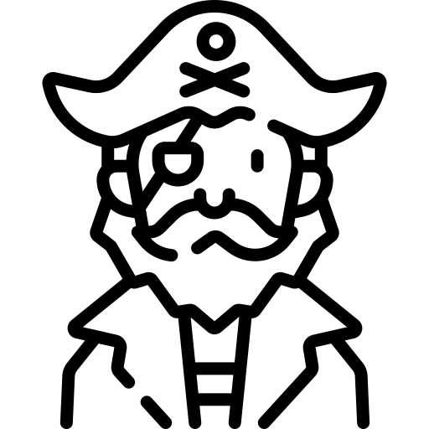




Hello, I am John want to borrow
10 K USD, is that possible
Yes, I am, my balance at
popBank, is always positive
Ok , I will figure it out, give me your
Credentials I will ask them
@pirateLoan,
we have super opportunities
But are you sustainable ?
0
1
Hello I am John … here is my credential
Ah ah , here is the pass
Give me the money !
Ok looks you are John , will give you
access
2
3

Slide 3
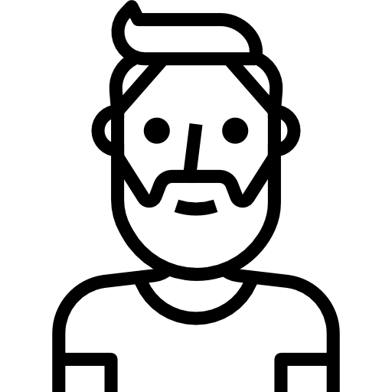



Resource owner
the account owner
Hello I am John, I want to borrow
10 K USD, is that possible
Yes, I am, my balance at
popBank, is always positive
John
I know popBank, I am registered
If you are ok
please go to popBank and grant me access.
Here is a doc, bring me the authorization.
3rd party
who want access
to the resource
@coolLoan,
we have super opportunities
But are you sustainable ?
0
1
coolLoan
Hello, popBank I want to give read access to coolLoan
Here is my credential
(login/pass) and state from CoolLoan
Authorization server
The one who
knows John secret
Ok, CoolLoan is registered to us,
They are allowed
to read your account
if you agree / consent
I am Eddy, Bank client manager
Can you give me your credential ?
Otto
2
3
Token Provider Knows coolLoan & banky
I am ok to grant CoolLoan
Read access
Hey coolLoan,
Here is your doc
And the code for Boris
Boris
Ok, bring that to coolLoan
here its his doc and a
temporary code for Boris
Cool I will ask
Boris
Resource provider
The one who host the account, know Boris
5
4
I am CoolLoan here are my credentials
Along with a proof that Eddy gave me access
Ok I know you @coolLoan,
Your proof is valid
Give you a pass
Boris give me this pass,
Can get account statement of John
It’s a Boris issued pass; I give you
John accounts details
Banky
6
7

Slide 4
Resource owner
the account owner
3rd party
who want access
to the resource
Authorization
The one who
knows John secret
Resource provider
The one who host the account, know Boris
Token Provider Knows coolLoan & banky
John
coolLoan
otto
Boris
Banky
John credential
Login / pass for otto
Cool Loan Reg
clientId , clientSecret
for Boris
CoolLoan Request
OpenId state
Allow to identify callback
Temp Authorization
Authorization code
to grab a ticket
Pass for Access
Access / Refresh token
Provided if code and
coolLoan cred are valid

Slide 5




I am John I would like ,
my TV to access
my YouTube account
I am YouTube App
Google please help !
I am a TV, no keyboard
How can I be authorized
to get John Data ?
No problem,
Here is a code for John,
Here is a code for you
Ask John to go to Locky
123 for john
John check with Locky,
And give him this code
I am john
Here is my tv code
I am Locky , ok code looks ok
Correspond to a request from
John … Are you John ?
123 for john
123
Mean time YouTube keep asking
Here is my credential
Ok so its tv123
Want to access
your profile is it ok ?
I am YouTube App
Is it ok ?
Not yet,
I have to check
its identity
Another try
Yes, John is ok Here is you
Access pass
Enjoy !
Cool let’s watch
cats
I am YouTube App
Is it ok ?

