Slide 1
Corona Virus Analysis with SQL
Deriving Insights from Dataset

Slide 2
Introduction
The COVID-19 pandemic impacted global health, economies, and societies worldwide.
As part of our efforts to understand and respond to this crisis, we have conducted an analysis of a COVID-19 dataset using SQL and data analysis skills.
Purpose of Analysis
The purpose of this analysis is to derive insights from the COVID-19 dataset, by gaining a deeper understanding of the spread and impact of the virus, identify trends, and inform decision-making processes.

Slide 3
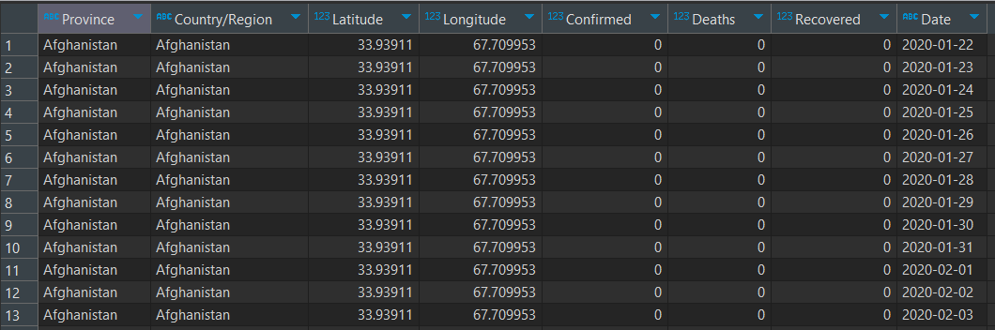
Corona virus dataset
Description of each
column in dataset
Province: Geographic subdivision within a country/region.
Country/Region: Geographic entity where data is recorded.
Latitude: North-south position on Earth's surface.
Longitude: East-west position on Earth's surface.
Date: Recorded date of CORONA VIRUS data.
Confirmed: Number of diagnosed CORONA VIRUS cases.
Deaths: Number of CORONA VIRUS related deaths.
Recovered: Number of recovered CORONA VIRUS cases.

Slide 4
Our analysis comprises 16 tasks aimed at gaining comprehensive insights from the COVID-19 dataset. These tasks include:
Check for NULL values: Identify and handle missing data in the dataset.
Update NULL values to zeros: Address missing values by replacing them with zeros for consistency.
Check total number of rows: Determine the size of the dataset.
Check starting date and end date: Identify the time period covered by the dataset.
Find number of months present in dataset: Determine the temporal scope of the data.
Find monthly average for confirmed, deaths, and recoveries: Analyze average values over time to identify trends.
...

Slide 5
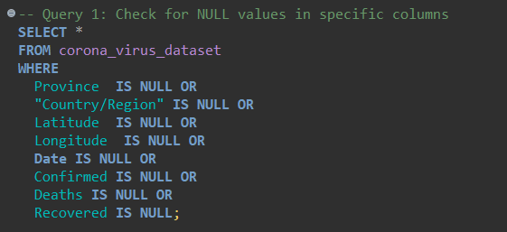
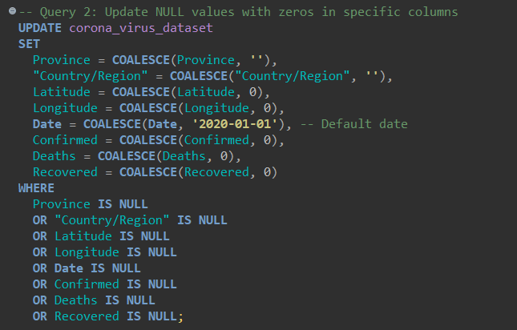
DATA CLEANING
Check for NULL values
Update NULL values to zeros

Slide 6
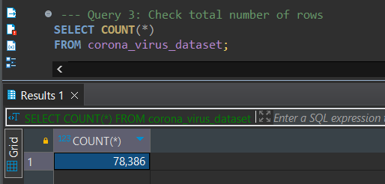
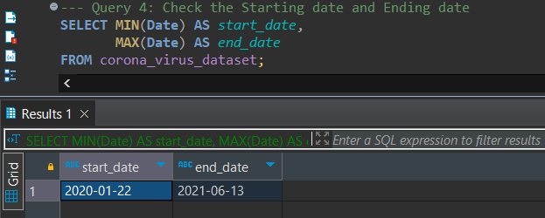
Total number of rows
Start date and end date

Slide 7
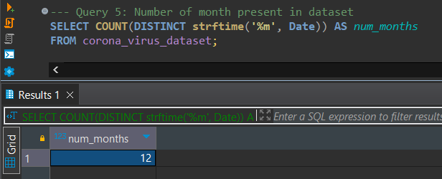
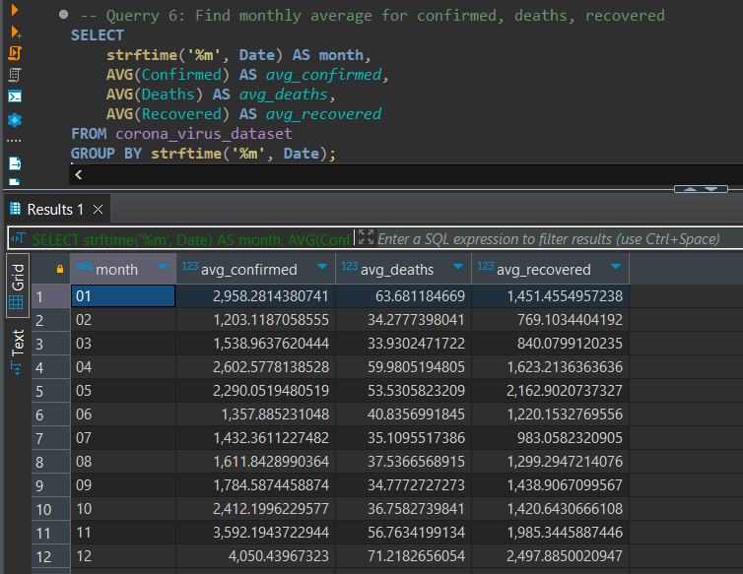
Monthly average for confirmed, deaths, recovered
Number of month present in dataset

Slide 8
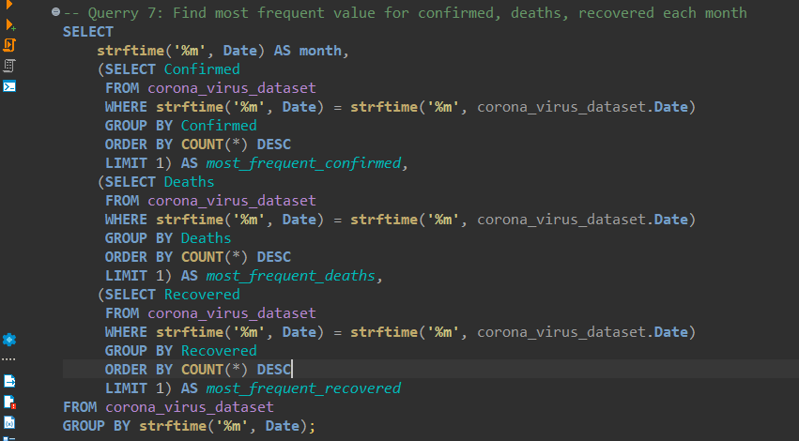
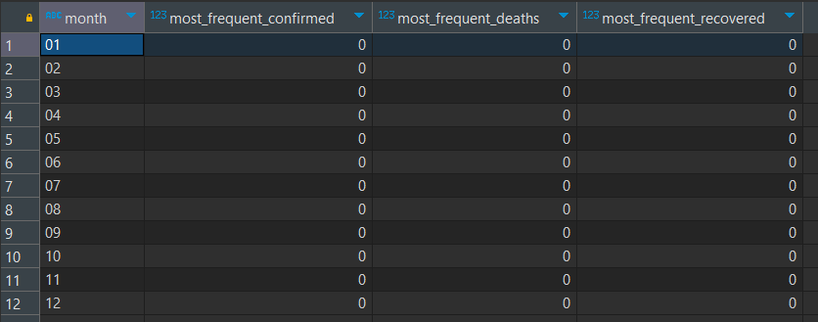
Most frequent value for
confirmed, deaths, recovered
each month

Slide 9
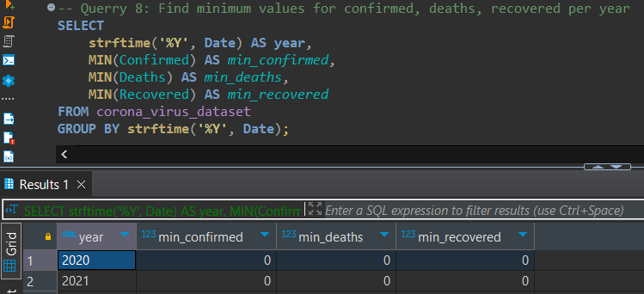
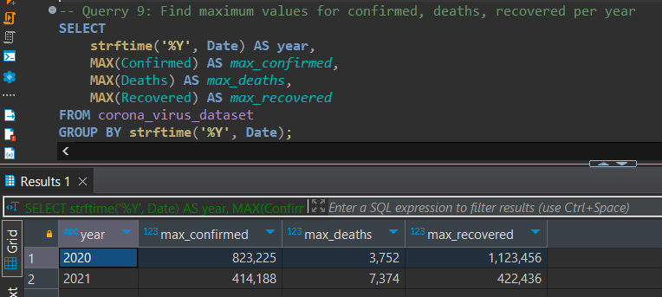
Minimum & Maximum
values for
confirmed, deaths, recovered
per year

Slide 10
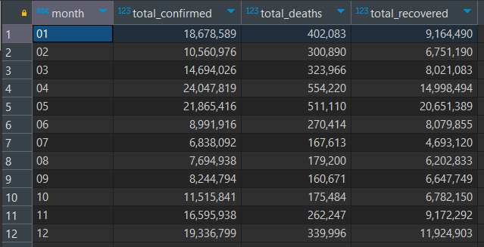
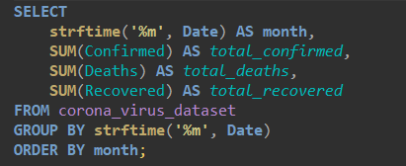
total number of case of confirmed, deaths, recovered each month

Slide 11
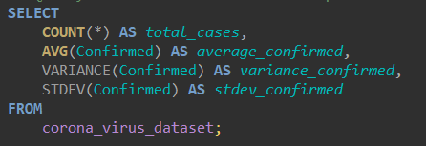
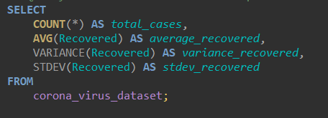
Check how corona virus spread out with respect to confirmed case
CHECK HOW CORONA VIRUS SPREAD OUT WITH RESPECT TO RECOVERED CASE​​

Slide 12
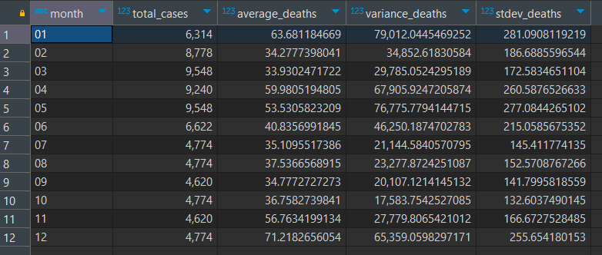
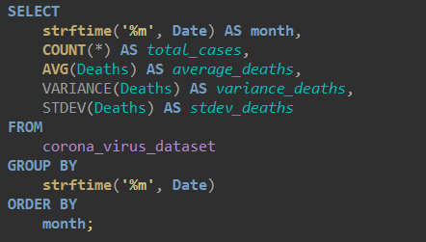
CHECK HOW CORONA VIRUS
SPREAD OUT WITH RESPECT TO DEATH CASE PER MONTH​

Slide 13


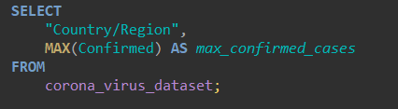
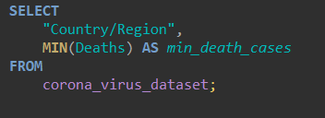
Find Country
having highest number of the Confirmed case
Find Country
having lowest number of the death case​
​

Slide 14
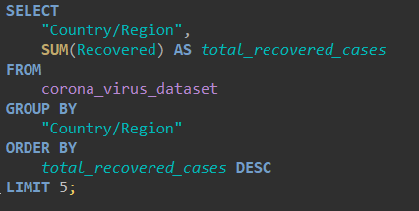
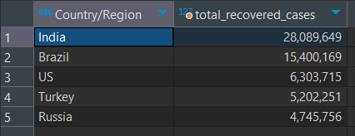
Top 5 countries with the
highest total number of recovered cases

Slide 15
Conclusion
15
Our analysis of the COVID-19 dataset has provided valuable insights into the spread and impact of the virus. We observed significant trends and patterns in the data, including the rise and fall of case counts over time, variations in mortality rates across regions, and disparities in recovery rates among different populations.

Slide 16
Thank You

