Slide 1


TA D3TI 2025/2026 - 18
PENERAPAN ALGORITMA EFFICIENTNETV2 UNTUK KLASIFIKASI
PENYAKIT DAUN PADI (ORIZA SATIVA L) PADA APLIKASI MOBILE

Slide 2




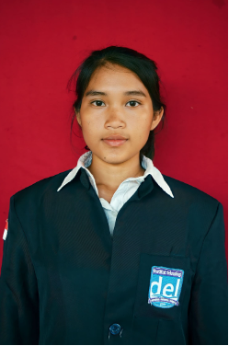
MEET OUR
TEAM MEMBERS
Wika Romauli Siregar
NIM : 11323015
Santo Martogi Simangunsong
NIM : 11323017
Lasro Pesta Natalia Tamba
NIM : 11323052

Slide 3

OUTLINE
1
Background
5
Data Preparation
9
SUGGESTION
2
Objectives
6
Modeling
10
Evaluation
Business Understanding
3
7
Deployment
11
Demo
Data understanding
4
8
CONCLUSION

Slide 4

BACKGROUND
Rice (Oryza sativa L.) is a staple crop essential for food security.
Rice leaf diseases significantly reduce yield and crop quality.
Manual visual identification is subjective and error-prone.
Deep learning enables accurate image-based disease classification.
EfficientNetV2-M provides high accuracy with efficient computation.
This study integrates EfficientNetV2-M into an offline mobile application for early disease detection.

Slide 5
OBJECTIVES
To apply the EfficientNetV2-M algorithm for classifying rice leaf diseases.
To implement the classification model into a mobile application.

Slide 6

Main Problem
Rice farmers still identify rice leaf diseases manually through visual observation, which is prone to errors due to similar symptoms across diseases and limited access to agricultural experts. Misdiagnosis and delayed detection can lead to decreased crop productivity and quality.
BUSINESS UNDERSTANDING
Proposed Solution
A Flutter-based mobile application is developed to classify six rice leaf conditions using digital images and provide disease treatment recommendations, enabling farmers to obtain fast and practical preliminary diagnoses directly in the field.
Key Benefits
The application helps farmers identify rice leaf diseases more quickly and accurately, supports early treatment decision-making, and contributes to maintaining agricultural productivit

Slide 7
DATA ANDERSTANDING
Data Source: Rice leaf image dataset obtained from Kaggle
Data Type: Digital RGB images of rice leaves
Dataset Size: Approximately 6,000 images with balanced class distribution
Data Classes: Six rice leaf conditions (Healthy, Bacterial Leaf Blight, Leaf Blast, Brown Spot, Sheath Blight, Narrow Brown Spot)
Data Characteristics: Variations in color, texture, lesion patterns, severity levels, lighting, and backgrounds
Data Challenges: Similar visual symptoms across diseases and inconsistent image quality

Slide 8
DATA PREPARATION
Data Labeling
Each rice leaf image is manually labeled into one of six classes: Healthy, Bacterial Leaf Blight, Leaf Blast, Brown Spot, Sheath Blight, and Narrow Brown Spot to ensure correct ground truth for model training.
Data Splitting
The dataset is divided into training (80%), validation (10%), and testing (10%) sets to support model learning, performance monitoring, and final evaluation.
Data Augmentation
Image augmentation techniques such as rotation, flipping, zooming, translation, and brightness adjustment are applied to increase data diversity and improve model generalization.
1
Data Labeling
2
Data Splitting
3
Data Augmentation

Slide 9

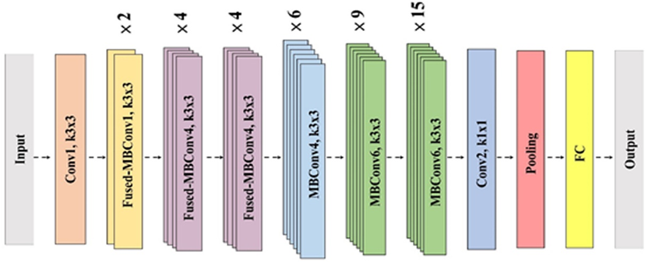
MODELING
Model Selection
EfficientNetV2-M is selected due to its high accuracy, efficient computation, and suitability for mobile deployment.
Transfer Learning
The model uses pre-trained weights from ImageNet to leverage learned visual features and reduce training time.
Feature Extraction
The base EfficientNetV2-M layers are frozen, and a custom classification head is trained to learn rice leaf disease features.
Fine-Tuning
Selected deeper layers are unfrozen and retrained to improve classification performance on rice leaf images.
Training Configuration
The model is trained using the Adam optimizer, categorical cross-entropy loss, and early stopping to prevent overfitting.
Model Output
The final model classifies six rice leaf conditions and is converted to TensorFlow Lite (TFLite) for mobile use.

Slide 10

EVALUATION
The evaluation stage is conducted to assess the performance of the EfficientNetV2-M model in classifying rice leaf diseases and to ensure its generalization capability on unseen data. The evaluation uses the testing dataset, which is not involved in the training or validation process. Model performance is measured using accuracy, precision, recall, and F1-score to evaluate classification effectiveness and balance. In addition, a confusion matrix is used to analyze prediction errors based on true positive, true negative, false positive, and false negative values for each disease class. Further analysis is carried out by comparing training, validation, and testing results to identify potential overfitting. Finally, the model is tested within the mobile application to evaluate prediction latency, model size, and suitability for deployment on resource-limited devices.

Slide 11
The trained EfficientNetV2-M model is converted into TensorFlow Lite (TFLite) format to ensure lightweight and efficient execution on mobile devices and is then integrated into a Flutter-based mobile application. The application allows users to capture or select rice leaf images, perform offline predictions, and display classification results along with disease treatment recommendations stored in a local JSON file. Implementation testing is conducted to ensure model stability, fast prediction time, and overall usability in field conditions.
MODEL DEPLOYMENT

Slide 12

CONCLUSION
A Flutter-based mobile application for rice leaf disease classification was successfully developed using the EfficientNetV2-M model with the CRISP-DM methodology approach. The system was able to classify six rice leaf conditions with excellent performance, demonstrated by a test accuracy of 94.67% and balanced evaluation metrics. The application of transfer learning, data augmentation, and early stopping played a significant role in improving model generalization. The model, converted to TensorFlow Lite format, can be run offline on mobile devices and integrated with local JSON-based disease treatment recommendations, so the application not only performs classification but also provides useful treatment information for users.

Slide 13
SUGGESTION
Adding more diverse field data to improve model generalization and accuracy in real-world situations.
Developing disease severity detection to provide more specific and precise treatment recommendations.
Cloud integration for model and data updates, detection result storage, and centralized analysis to support application scalability.

Slide 14
DEMO

Slide 15
THANK YOU

