Slide 1

t
PROJET
DISNEY +

Slide 2
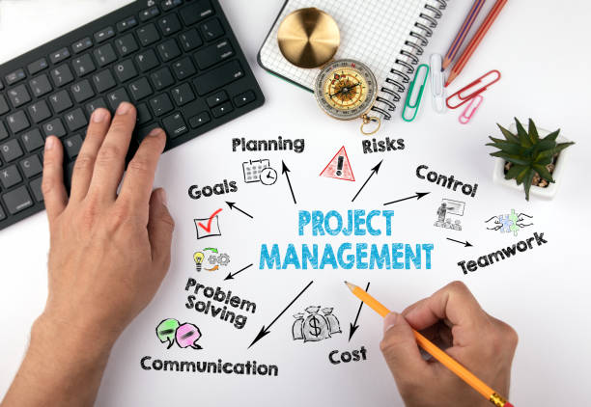
PRESENTATION

Slide 3

BESOIN FONCTIONELS ET TECHNIQUES

Slide 4
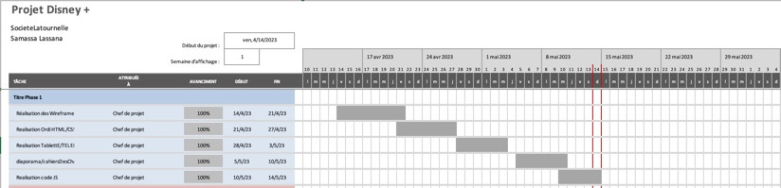
CALENDRIER

Slide 5
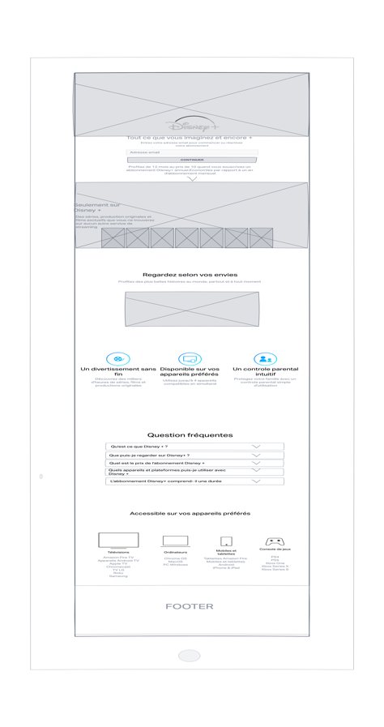
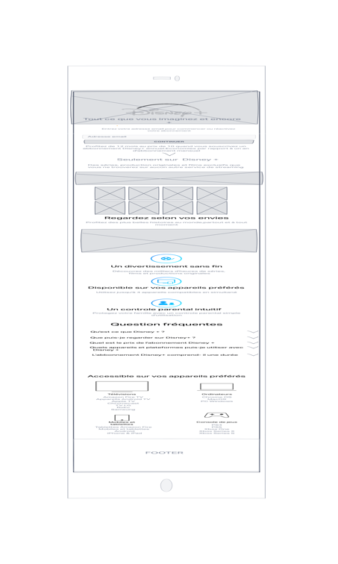
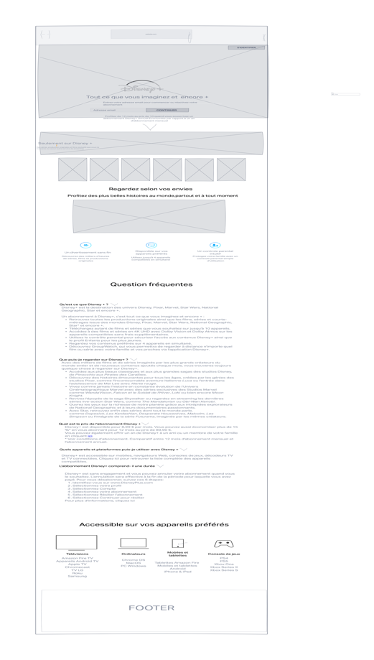
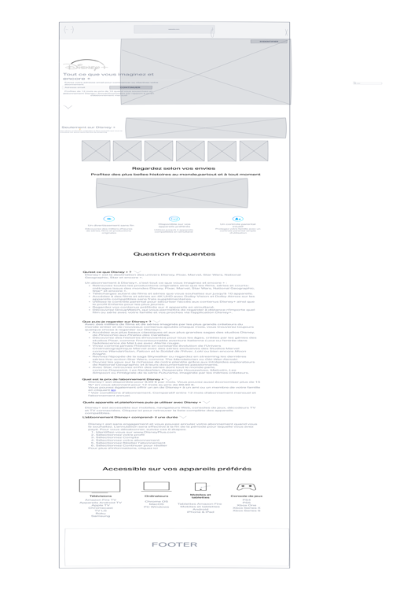
Wireframe

Slide 6
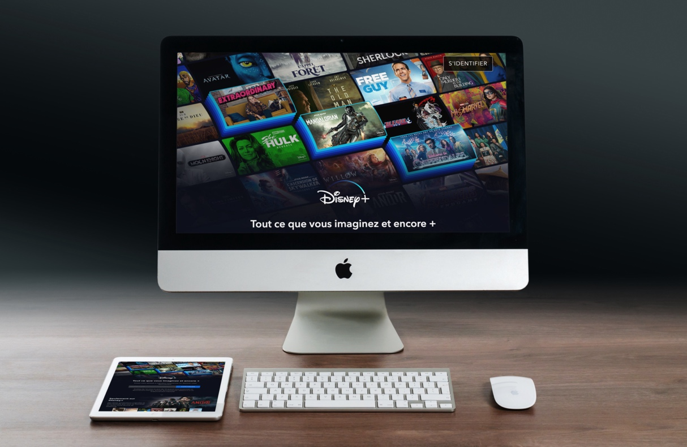
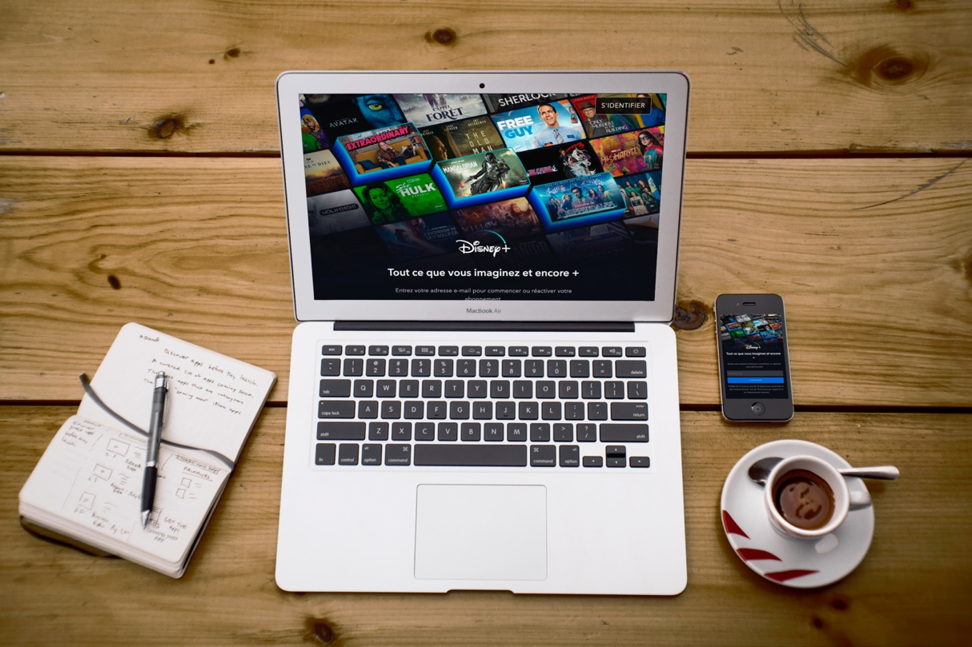
MOCK-UP

Slide 7
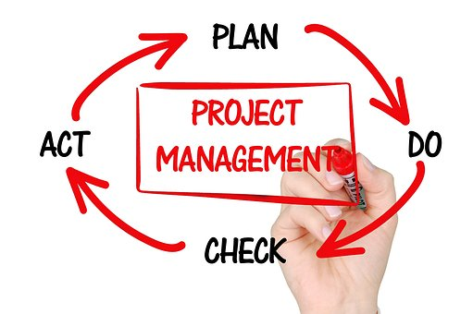
Methodes projets

Slide 8
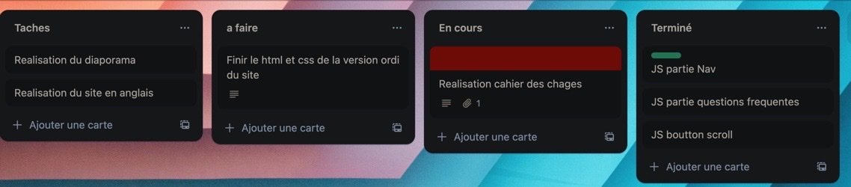
Methode Kanban

Slide 9
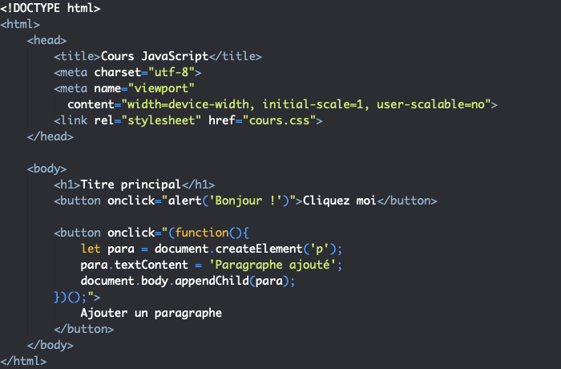
EXPLICATION DU CODE JS

Slide 10
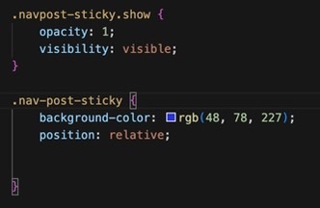
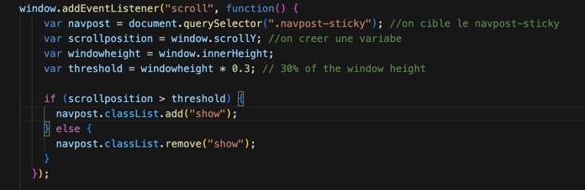
EXPLICATION DU CODE JS

Slide 11
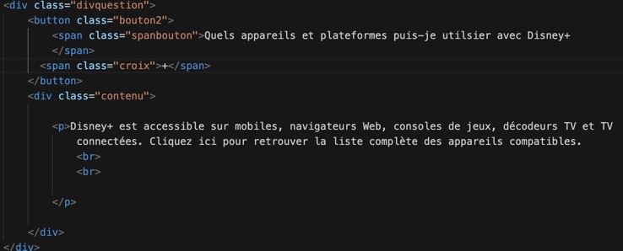
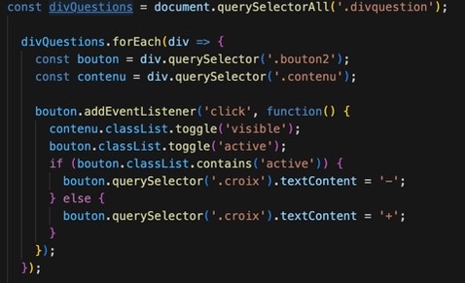
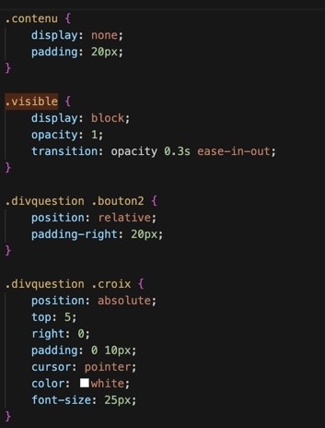
EXPLICATION DU CODE JS

Slide 12
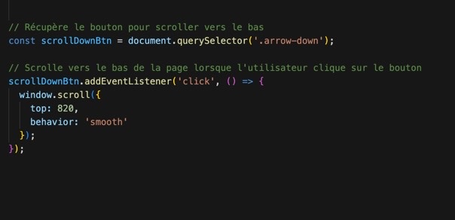
EXPLICATION DU CODE JS
<div class="arrow-down">
<img src="img-disney-plus/arrow.svg" alt="Down Arrow" class="bounce-top"/>
</div>
.arrow-down{
animation: bounce2 2s ease infinite;
}
@keyframes bounce2 {
0%, 20%, 50%, 80%, 100% {transform: translateY(0);}
40% {transform: translateY(-30px);}
60% {transform: translateY(-15px);}
}

Slide 13
t
FIN

