Slide 1
G20 Energy and Sustainability Report
MT412
Submitted to Dr. Mathieu Mercadier
Submitted by: Group 4
Leon Kozak (22108467)
Leonie Röskam (22108483)
Anika Stammen (22108505)
Lasse Willen (22108556)

Slide 2







Assessing the Environmental Footprint: A Deep Dive into G20 Nations' Sustainability Metrics
Introduction
Structured analysis and cleaning of dataset
Key Metrics
Emissions and Pollution
(Renewable) Energy Production and Consumption
Dataset Selection
Dataset collection based on data relevance for current global developments
Selection of reliable data and high-quality set
Temperature: Cooling and heating days
Forestry
Dataset Analysis
Analysis of data by scanning dataset and checking for correlations in the data
Outlier detection
Add columns via DAX Code Column Programming
Relevance of Data
Global Impact of G20 Nations
G20 countries represent world's major economies
Environmental practices have profound impact
Climate Change and CO2 Emissions
Data can help to understand each country's contribution
Enables comparisons between nations and specific metrics
Dataset Visualization
Visualization focused on showcasing most relevant data
Use of interactivity to present “surprising” findings
Health and Quality of Life
Certain Metrics are directly related to public health
Data can be used to evaluate quality of life in different
Trend analysis to assess progress
Analysis of development for positive (e.g. renewable energy) and negative (e.g. Air Pollution) environmental metrics
Use of analysis to determine progress

Slide 3
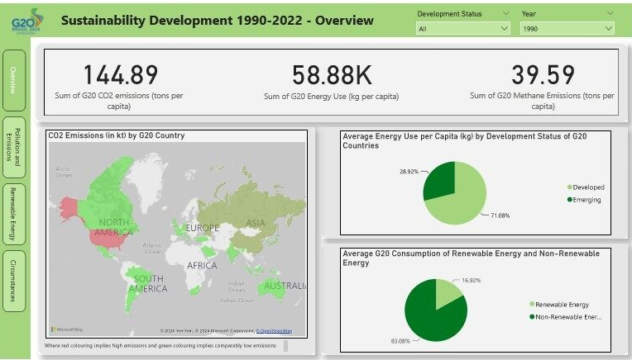

Creation of an interactive report on G20 energy and sustainability data using PowerBI
Data Visualization using PowerBI
Data Visualization
Detailed outlook on data using various interactive visualizations in Power BI
Comparison of G20 countries with metrics shown in introduction

Slide 4
Reflecting on the Data: Insights and Implications from G20 Environmental Metrics
Conclusion
CO₂ emission development
Stagnant per capita emissions since 1990 in G20 states: 144 metric tonnes per capita in 1990 – 148 metric tonnes per capita in 2019
Energy consumption development
Slight rise in energy consumption since 1990, increase of 12% until 2015
OECD Objectives
The 2020 OECD Renewable Energy Consumption Objective have not been accomplished
Renewable energy Consumption
Percentage of Renewable energy consumption has decreased since 1990 for most countries
Renewable Energy
Individual Circumstance
Pollution and Emissions
Sustainablity Development
Emissions per capita vs. Totals
Developed countries account for higher per capita emissions, emerging nations have overall higher emissions → need for targeted climate action
Pollution
Emerging G20 countries have higher pollution rates compared to developed countries
Land Surface Temperature
Countries with extreme average temperatures are more dependent on energy use.
Air Pollution in relation to other factors
Circumstances like forest area and population density have notable influences on air quality.

Slide 5
Sources
World Bank. (2024). Carbon Emissions Statistics [Data set]. World Bank. https://data.worldbank.org/indicator/EN.ATM.CO2E.KT?locations=AR-AU-BR-CA-FR-DE-CN-IN-ID-IT-JP-KR-MX-RU-SA-ZA-TR-US-GB
World Bank. (2024). Environmental Social and Governance (ESG) Data [Data set]. World Bank. https://databank.worldbank.org/source/environment-social-and-governance-(esg)-data#

