Slide 1
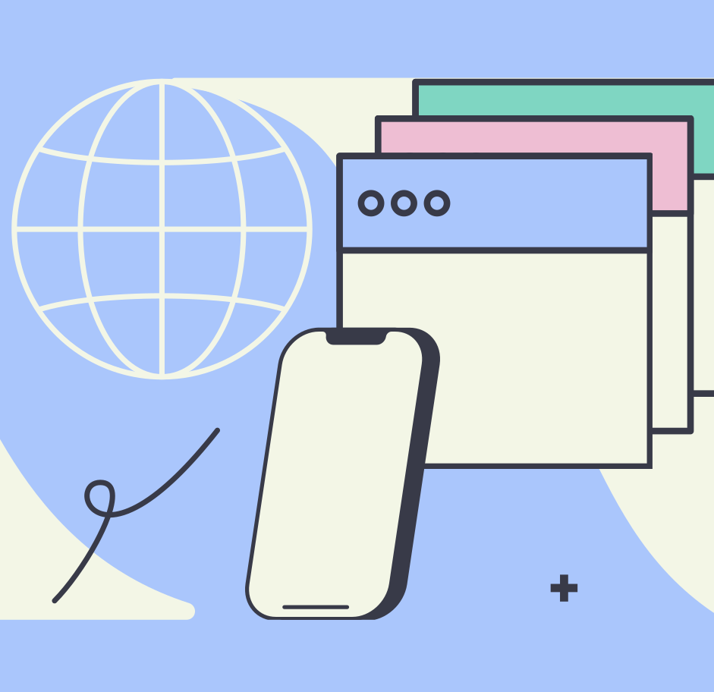
What happens when I Visit a Webpage?

Slide 2
A Quick Question
Could you checkout this website for me?
https://larrylobster.live
What did you do to get to the website?
Well, there was A LOT going on behind the scenes

Slide 3
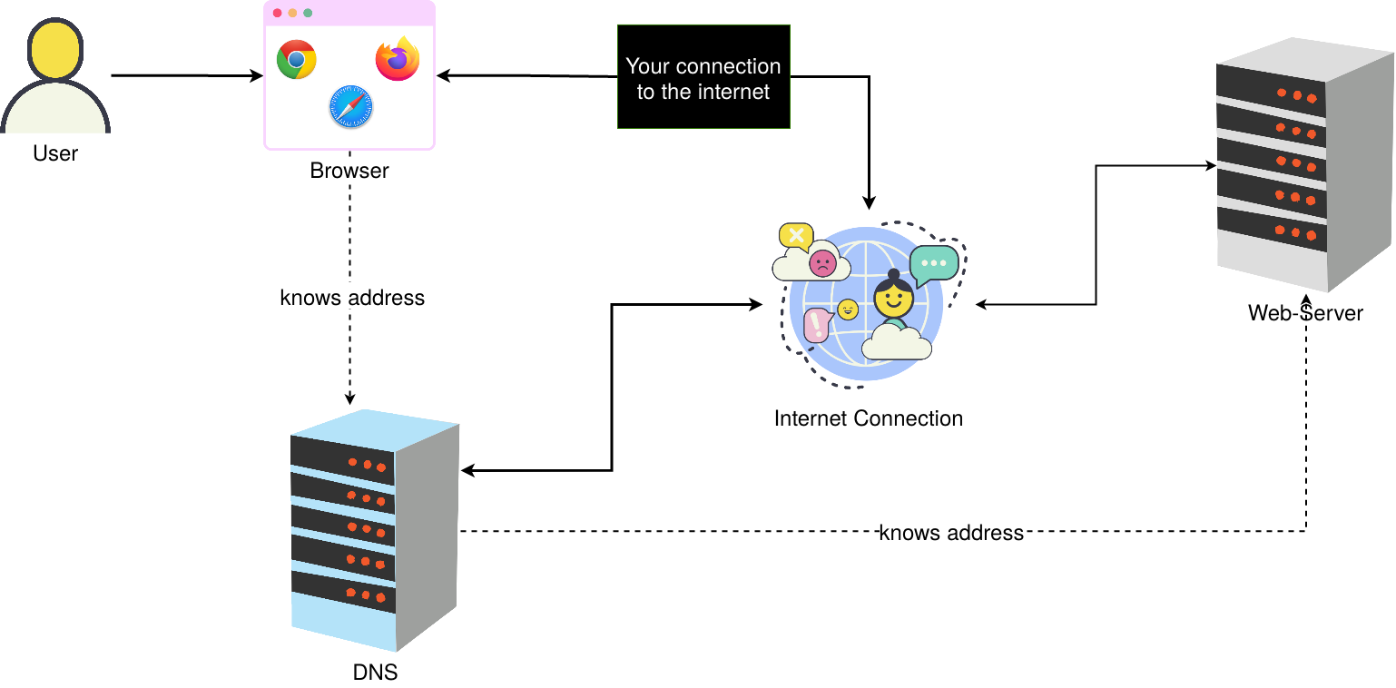
How it works
larrylobster.live
https://larrylobster.live
Illustrations from icon8

Slide 4
How it works
https://larrylobster.live
larrylobster.live
102.20.33.29
Illustrations from icon8

Slide 5
How it works
Give me the main page
102.20.33.29
https://larrylobster.live
Illustrations from icon8

Slide 6
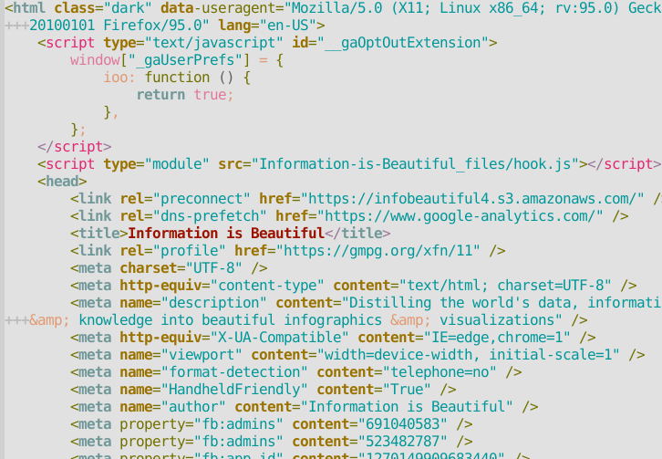
How it works
102.20.33.29
https://larrylobster.live
Give me the main page
Illustrations from icon8

Slide 7
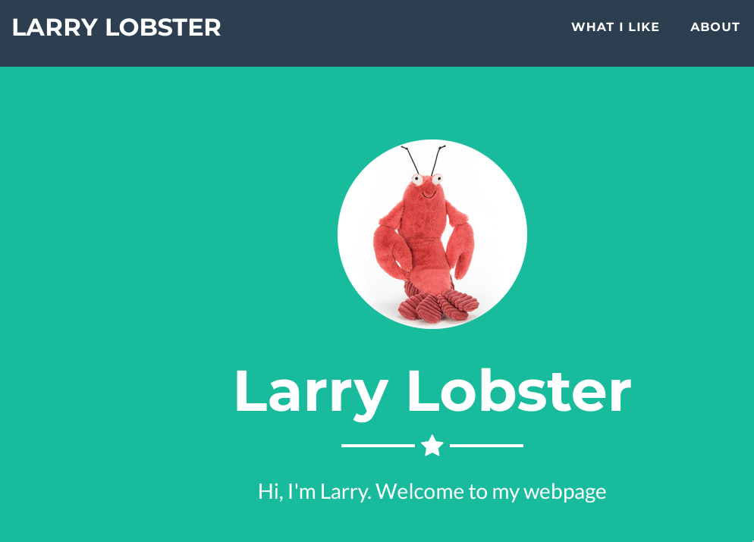
How it works
https://larrylobster.live
Illustrations from icon8

Slide 8
How it works
https://larrylobster.live
Illustrations from icon8

Slide 9
Who are you?
Name
Codename
Brid105
Elephant49
Unicorn357
Tiger123
Zebra98
Illustrations from icon8
Notes:
Explain WHY Codenames
- to hide who is who
- to match the prepared material

Slide 10
Let's Go
Component
Name
Codename
Web-Server
Brid105
User
Elephant49
Internet Conection
Unicorn357
Browser
Tiger123
DNS
Zebra98
Remarks:
The "Wanna know more?"(WKM) - Section is optional
First steps:
Look at your material
Check who you know
Start the task
Illustrations from icon8

