Slide 1
NAC-COLORINGS
SEARCH: COMPLEXITY
AND ALGORITHMS
Petr Laštovička
Dr. techn. Ing. Jan Legerský
FIT CTU in Prague, 2025

Slide 2
NAC-coloring
NAC-coloring is an edge coloring by red and blue such that it is surjective and there are no cycles with exactly one red or blue edge.
It is NP-complete to decide if a graph has a NAC-coloring.
Certifiable in polynomial time.

Slide 3
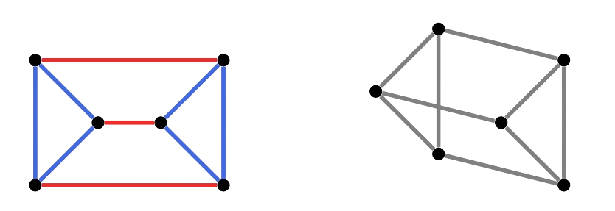
Flexible realizations
Realization of a graph into the space is flexible if it can be deformed while preserving edge lengths, otherwise it is rigid.
Generically rigid graphs may have flexible realizations.
A graph has a flexible
realization iff. there
exist a NAC-coloring
of the graph.

Slide 4
NP-comp. & degree five
It has been already known that it is
NP-complete to decide wether a graph has
a NAC-coloring.
We show that it is NP-complete to decide also for graphs with maximum degree five.
Reduction from 3-SAT.

Slide 5
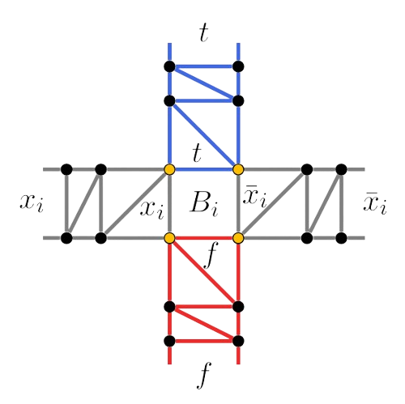
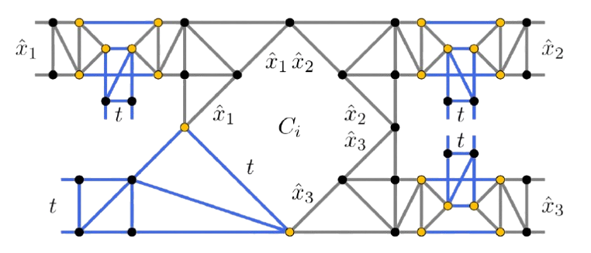
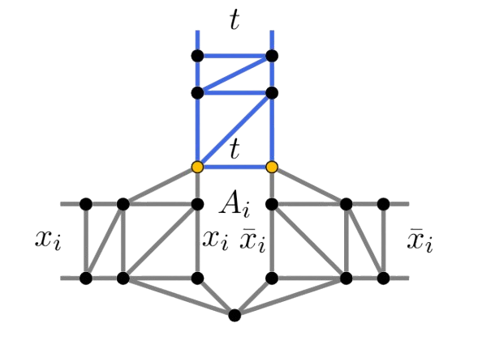
Reduction from 3-SAT

Slide 6
FPT algorithm
Algorithms polynomial in n with a factor f(k).
Algorithm for NAC-coloring counting parametrized by treewidth k.
Treewidth represents similarity of a graph with trees.
Dynamic programming alg. is run on tree decomposition, nodes are bags of vertices.

Slide 7
FPT algorithm
Information about connectivity in bags needs to be preserved→
superexponential complexity in k.
Additional optimizations proposed.
Not implemented, only proved.

Slide 8
Stable cuts
A stable cut is a vertex cut that is also an independent set.
If a stable cut exists, a NAC-coloring also trivially exists.
Algorithm for stable cut search in flexible graphs implemented.

Slide 9
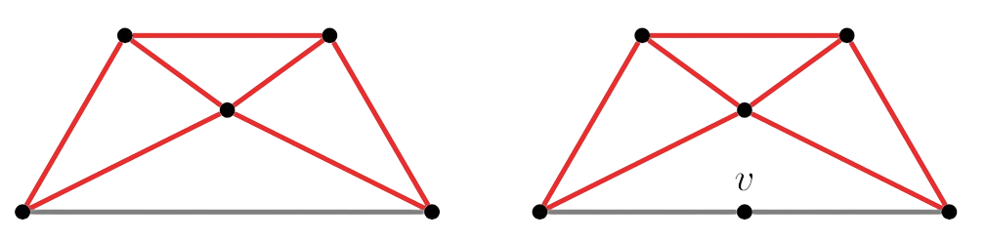
NAC-coloring search
Naive approach tries all the colorings.
Triangle connected components evolved into monochromatic classes.
Quick check for small cycles using bit masks.

Slide 10
NAC-coloring search
Strategy:
  Decompose into smaller subgraphs.
  Find all the NAC-colorings of the subgraphs.
  Choose merge order for the subgraphs.
Multiple heuristics for every stage.

Slide 11
Benchmarks
Flexible vs. minimally rigid vs. globally rigid
Any NAC-coloring vs. all NAC-colorings vs. number of NAC-colorings.

Slide 12
Benchmarks
Improved naive approach wins for flexible graphs for any NAC-coloring case.
Monochromatic classes reduce search space dramatically.
Listing all NAC-colorings runs fast enough for ~25 vertices.
1 second for ~100 vertex graphs with no
NAC-coloring, naive does not finish.

Slide 13
NAC-colorings search
Extension of our paper from VýLeT.
Code contributed to PyRigi.
I am ready for your questions and discussion.

