Slide 1
NAC-COLORINGS
SEARCH: COMPLEXITY
AND ALGORITHMS
Petr Laštovička
Dr. techn. Ing. Jan Legerský
FIT CTU in Prague, 2025

Slide 2
Goals
Study basics of Rigidity theory & flexible realizations.
Show that NAC-coloring existence is NP-complete on graphs with maximum degree five.
Design, implement and evaluate an algorithm and heuristics for NAC-coloring search.

Slide 3
NAC-coloring
NAC-coloring is an edge coloring by red and blue such that it is surjective and there are no cycles with exactly one red or blue edge.
It is NP-complete to decide if a graph has a NAC-coloring.
Certifiable by connected components search.

Slide 4
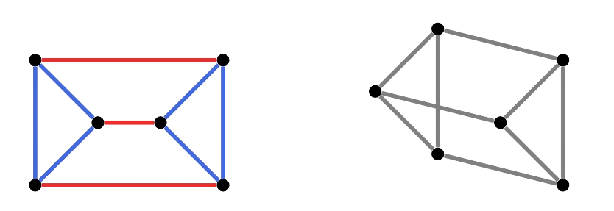
Flexible realizations
Realization of a graph into the space is flexible if it can be transformed while preserving edge lengths, otherwise it is rigid.
Generically rigid graphs may still have some flexible realizations.
A graph has a flexible
realization iff. there
exist a NAC-coloring
of the graph.

Slide 5
NP-comp. & degree five
It has been already known that it is
NP-complete to decide wether a graph has
a NAC-coloring.
We show that it is NP-complete to answer also for graphs with maximum degree five.
Reduction from 3-SAT.

Slide 6
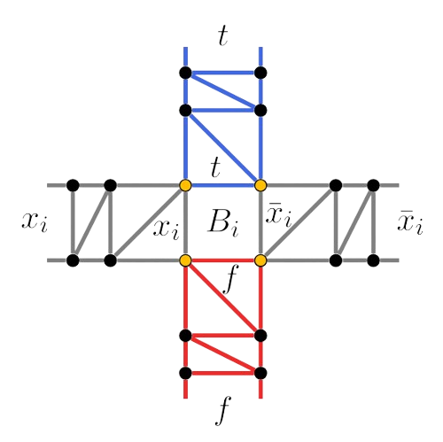
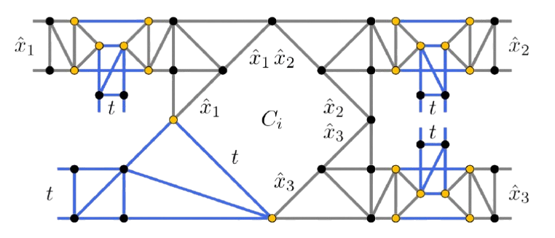
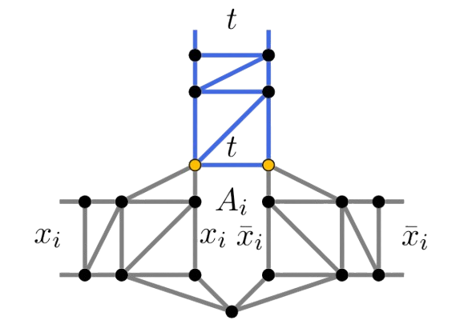
Reduction from 3-SAT

Slide 7
FPT algorithm
Algorithms polynomial in graph size with a factor f(k), where k is a graph parameter.
Algorithm for NAC-coloring counting parametrized by treewidth k.
Treewidth represents kind of a similarity of a graph with trees.
Decomposition tree where nodes are bags of vertices (vertex cuts) of the original graph.
Dynamic programming alg. run on the decomp.

Slide 8
FPT algorithm
Information about connectivity in bags needs to be preserved, hence superexponential complexity in k, linear in graph size.
Recursive definition of the cache function.
Additional optimizations proposed.
Not implemented, only proved.

Slide 9
Stable cuts
A stable cut is a vertex cut that is also an independent set.
If a stable cut exists, a NAC-coloring also trivially exists.
Algorithm for stable cut search in flexible graphs implemented.

Slide 10
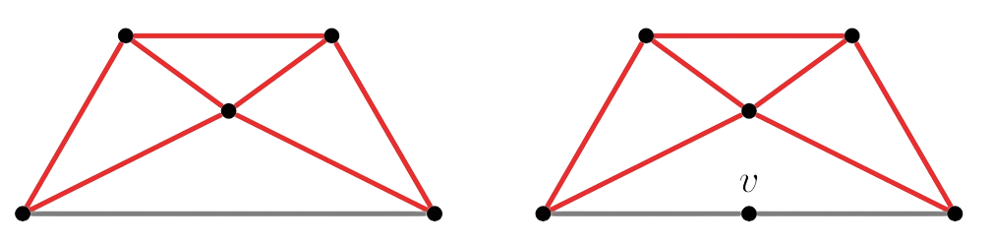
NAC-coloring search
Naive approach tries all the colorings.
Triangle connected components evolved into monochromatic classes.
Quick check for small cycles using bit masks.

Slide 11
NAC-coloring search
Strategy:
  Decompose into smaller subgraphs.
  Find all the NAC-colorings of the subgraphs.
  Choose colorings merge order for the subgraphs.
Multiple heuristics for each stage.

Slide 12
Benchmarks
Flexible vs. minimally rigid vs. globally rigid.
Any NAC-coloring / all NAC-colorings / the number of NAC-colorings.

Slide 13
Benchmarks
Improved naive approach wins for flexible graphs with many NAC-colorings.
Monochromatic classes reduce search space significantly.
Listing all NAC-colorings runs fast enough for ~25 vertices.
1 second for ~100 vertex graphs with no
NAC-coloring, naive does not finish.

Slide 14
Graphs with many NAC-colorings
Improved naive approach is the fastest.
Fast for finding any NAC-coloring on over ~100 vertex graphs.
Listing all NAC-colorings runs fast enough for ~30 vertex graphs.

Slide 15
Graphs with no/few NAC-colorings
Naive search in not feasible.
Monochromatic classes reduce search space significantly (hard to find random hard cases).
Tens of vertices / monochromatic classess run in few seconds.

Slide 16
NAC-colorings search
Extension of our paper from VýLeT.
Code contributed to PyRigi.
I am ready for your questions and discussion.

Slide 17
Reviewer’s question
Is it typically the case that the color classes in a NAC-coloring are balanced with respect to the two colors (especially when the graph has only few NAC-colorings)?
Or does it often happen (in practice) that there exists some NAC-coloring that is largely biased towards one of the two colors?

Slide 18
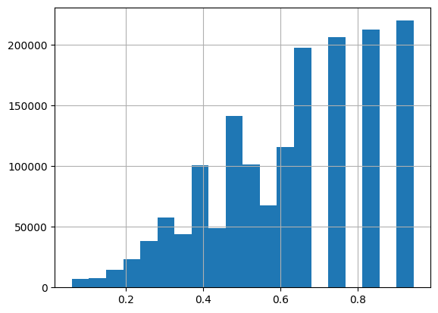
Minimally rigid graphs
sample size | 1000
NAC-colorings | 1602001
weighted mean | 0.60
mean | 0.63
std | 0.21
min | 0.06
25 | 0.46
50 | 0.65
75 | 0.83
max | 0.94
Minimally rigid graphs with 18 to 20 vertices.

Slide 19
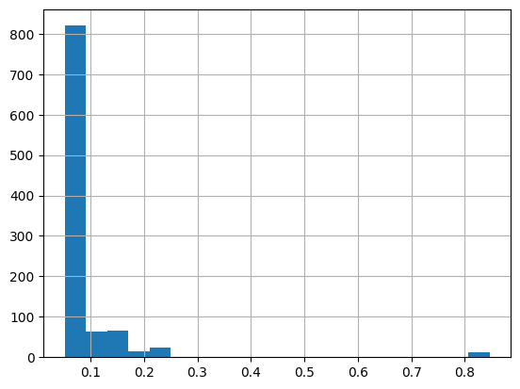
Globally rigid graphs (single)
sample size | 1000
NAC-colorings | 1000
weighted mean | 0.09
mean | 0.09
std | 0.09
min | 0.05
25 | 0.06
50 | 0.07
75 | 0.09
max | 0.85
Globally rigid graphs with 18+ vertices and
one unique NAC-coloring.

Slide 20
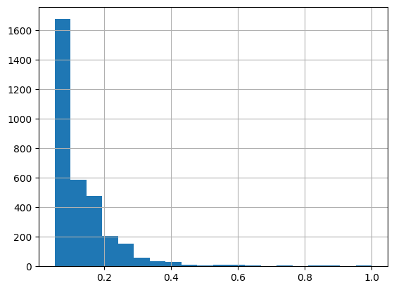
Globally rigid graphs (few)
sample size | 1000
NAC-colorings | 3287
weighted mean | 0.11
mean | 0.13
std | 0.11
min | 0.05
25 | 0.07
50 | 0.10
75 | 0.16
max | 1.00
Globally rigid graphs with 18+ vertices and
at most 10 unique NAC-colorings.

Slide 21
Reasoning
Flexibility opportunities can be caused easily by small local defects while the rest of the graph can be far from having any NAC-coloring.

