Slide 1
Student Enrollment System
Created by: William Chapman

Slide 2
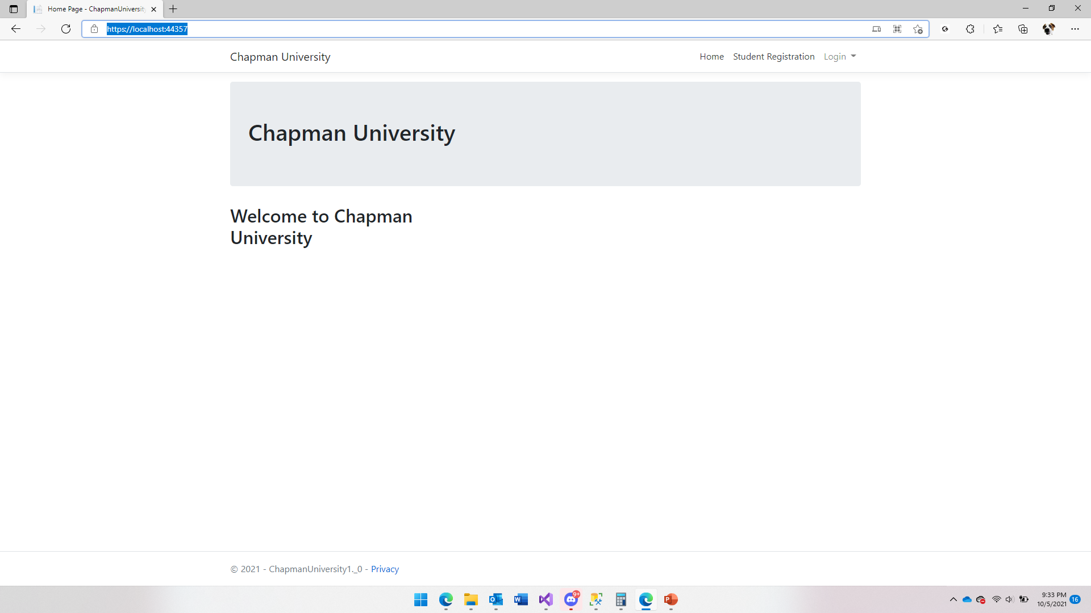
Homepage Index

Slide 3
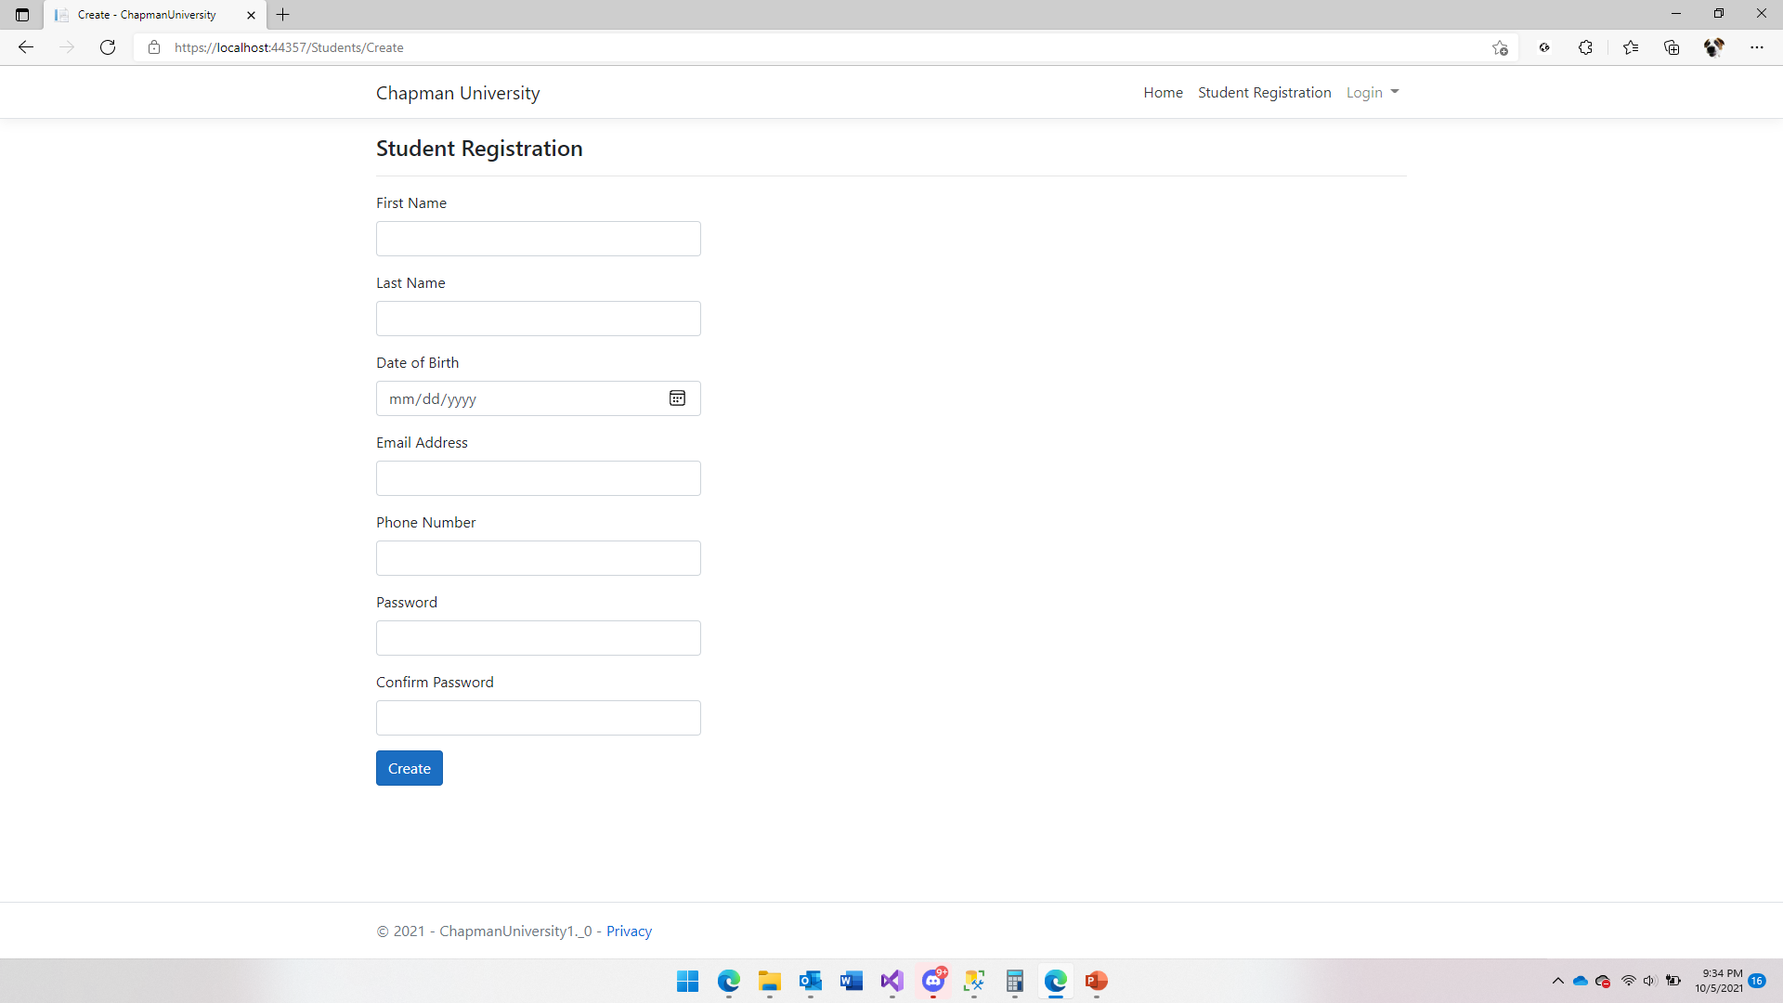
Student Registration Page

Slide 4
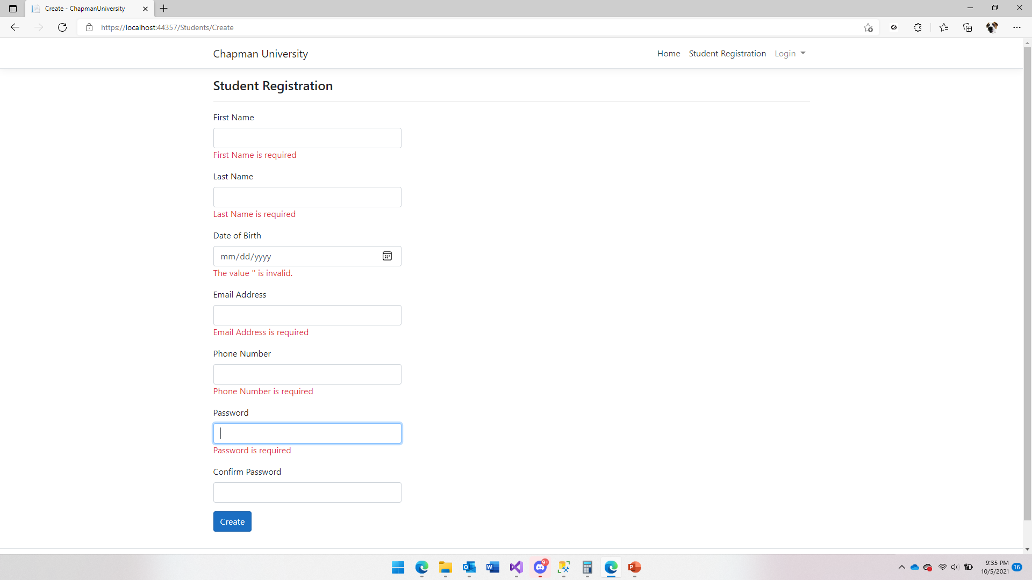
Student Registration Page User Input Validation

Slide 5
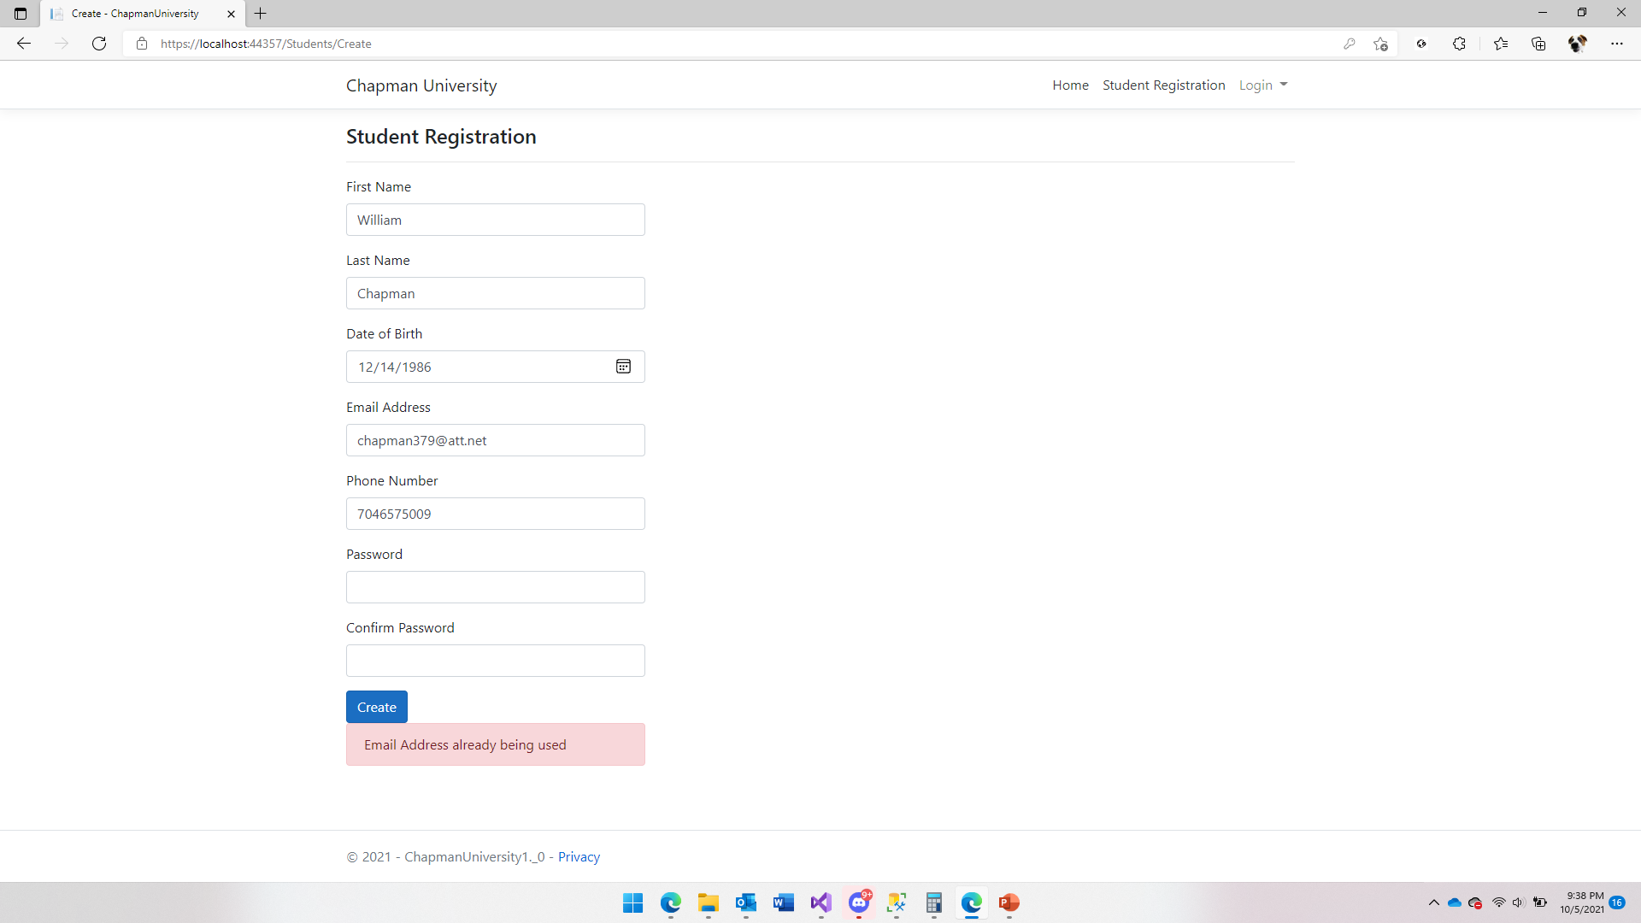
Student Registration Email Validation

Slide 6
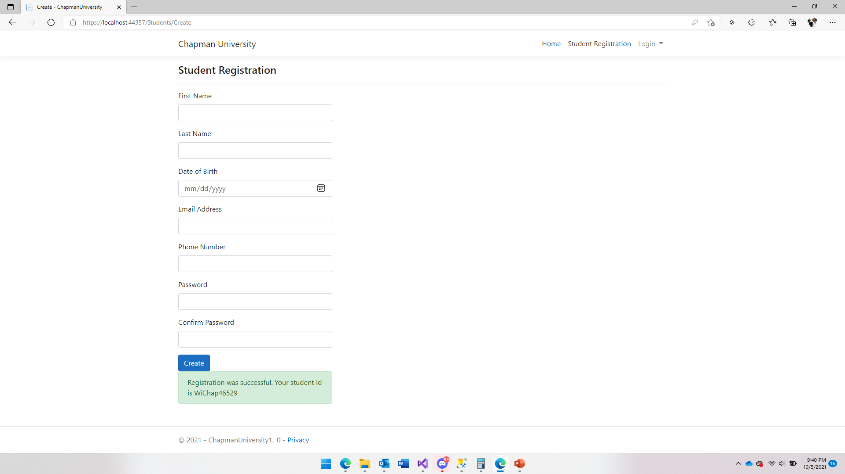
Successful Student Registration

Slide 7
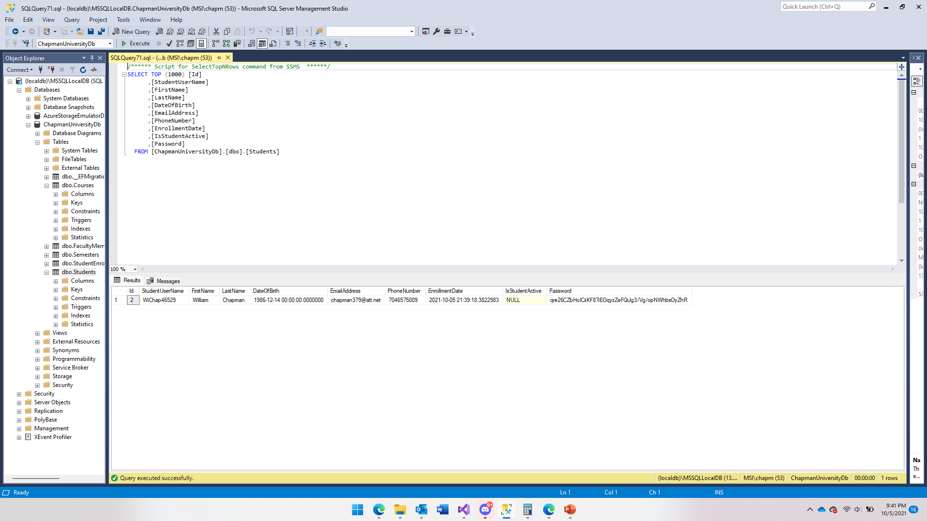
Successful Student Registration Database Entry

Slide 8
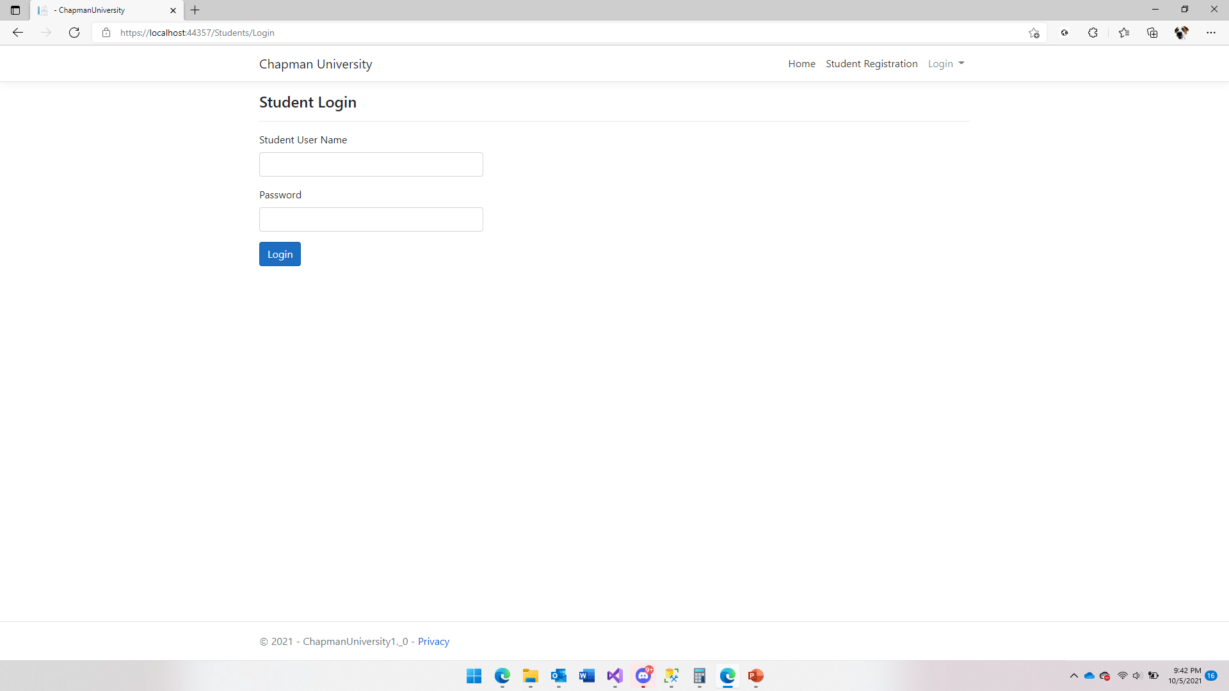
Student Login Page

Slide 9
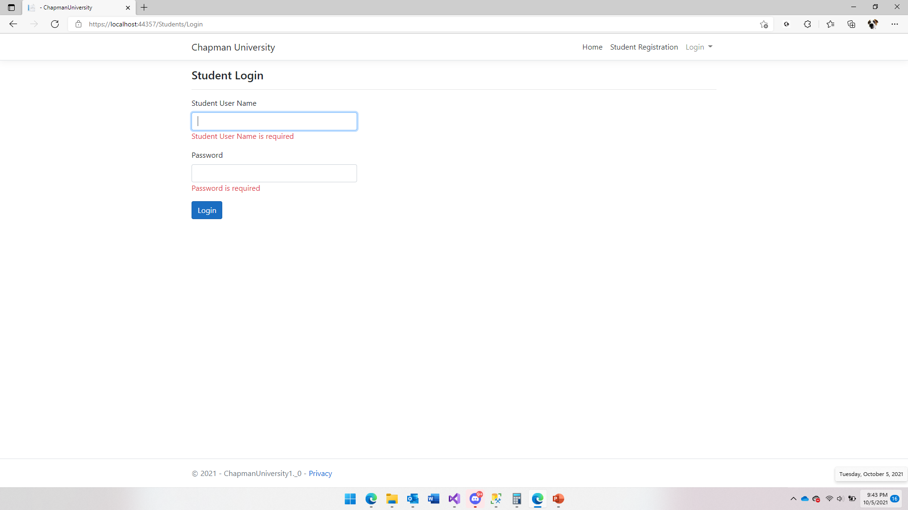
Student Login Input Validation

Slide 10
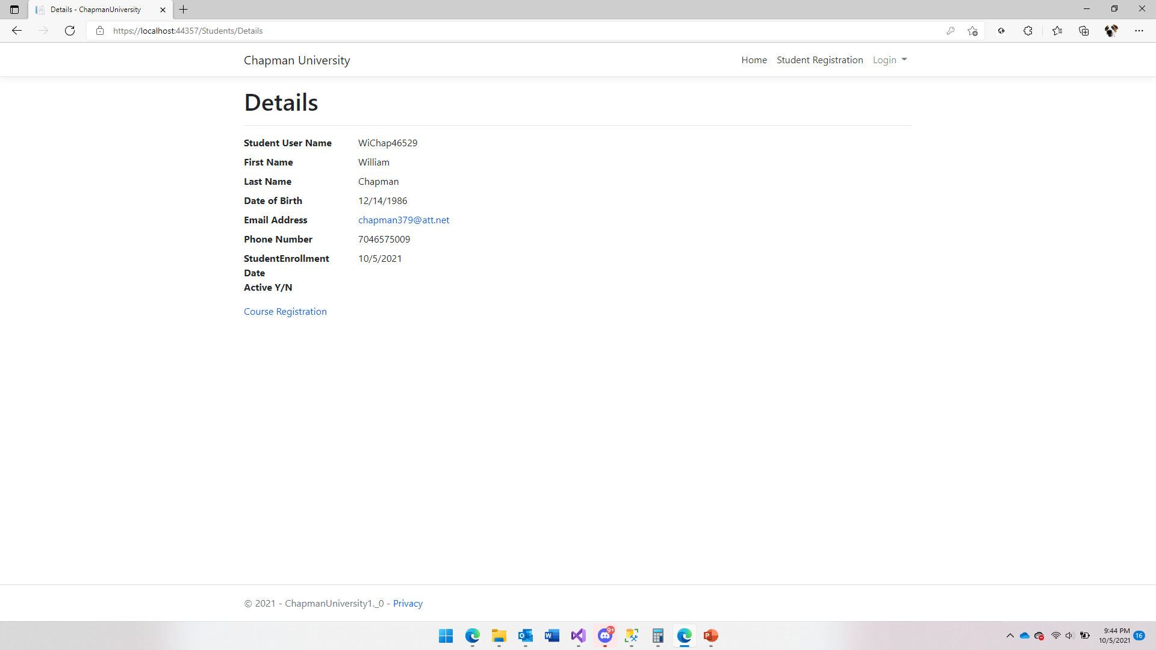
Successful Student Login

Slide 11
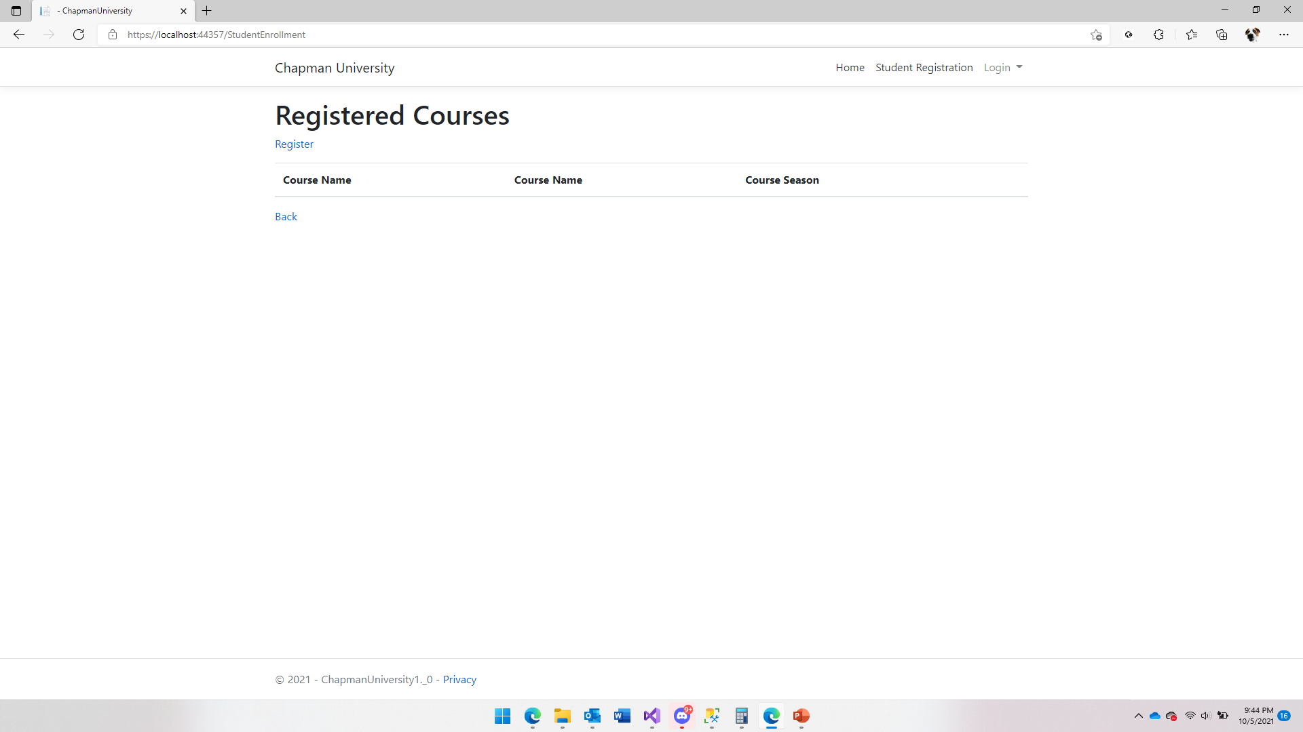
Registered Courses Index Page

Slide 12
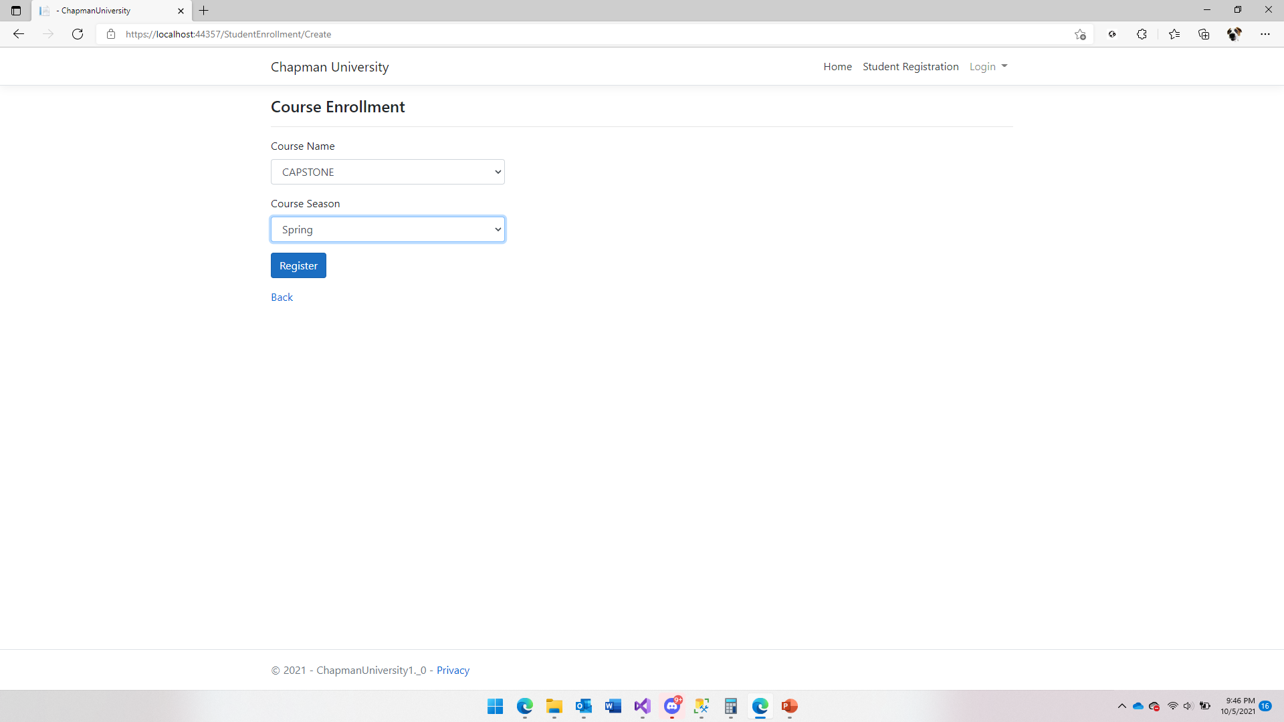
Course Enrollment Screen

Slide 13
Successful Student Login

Slide 14
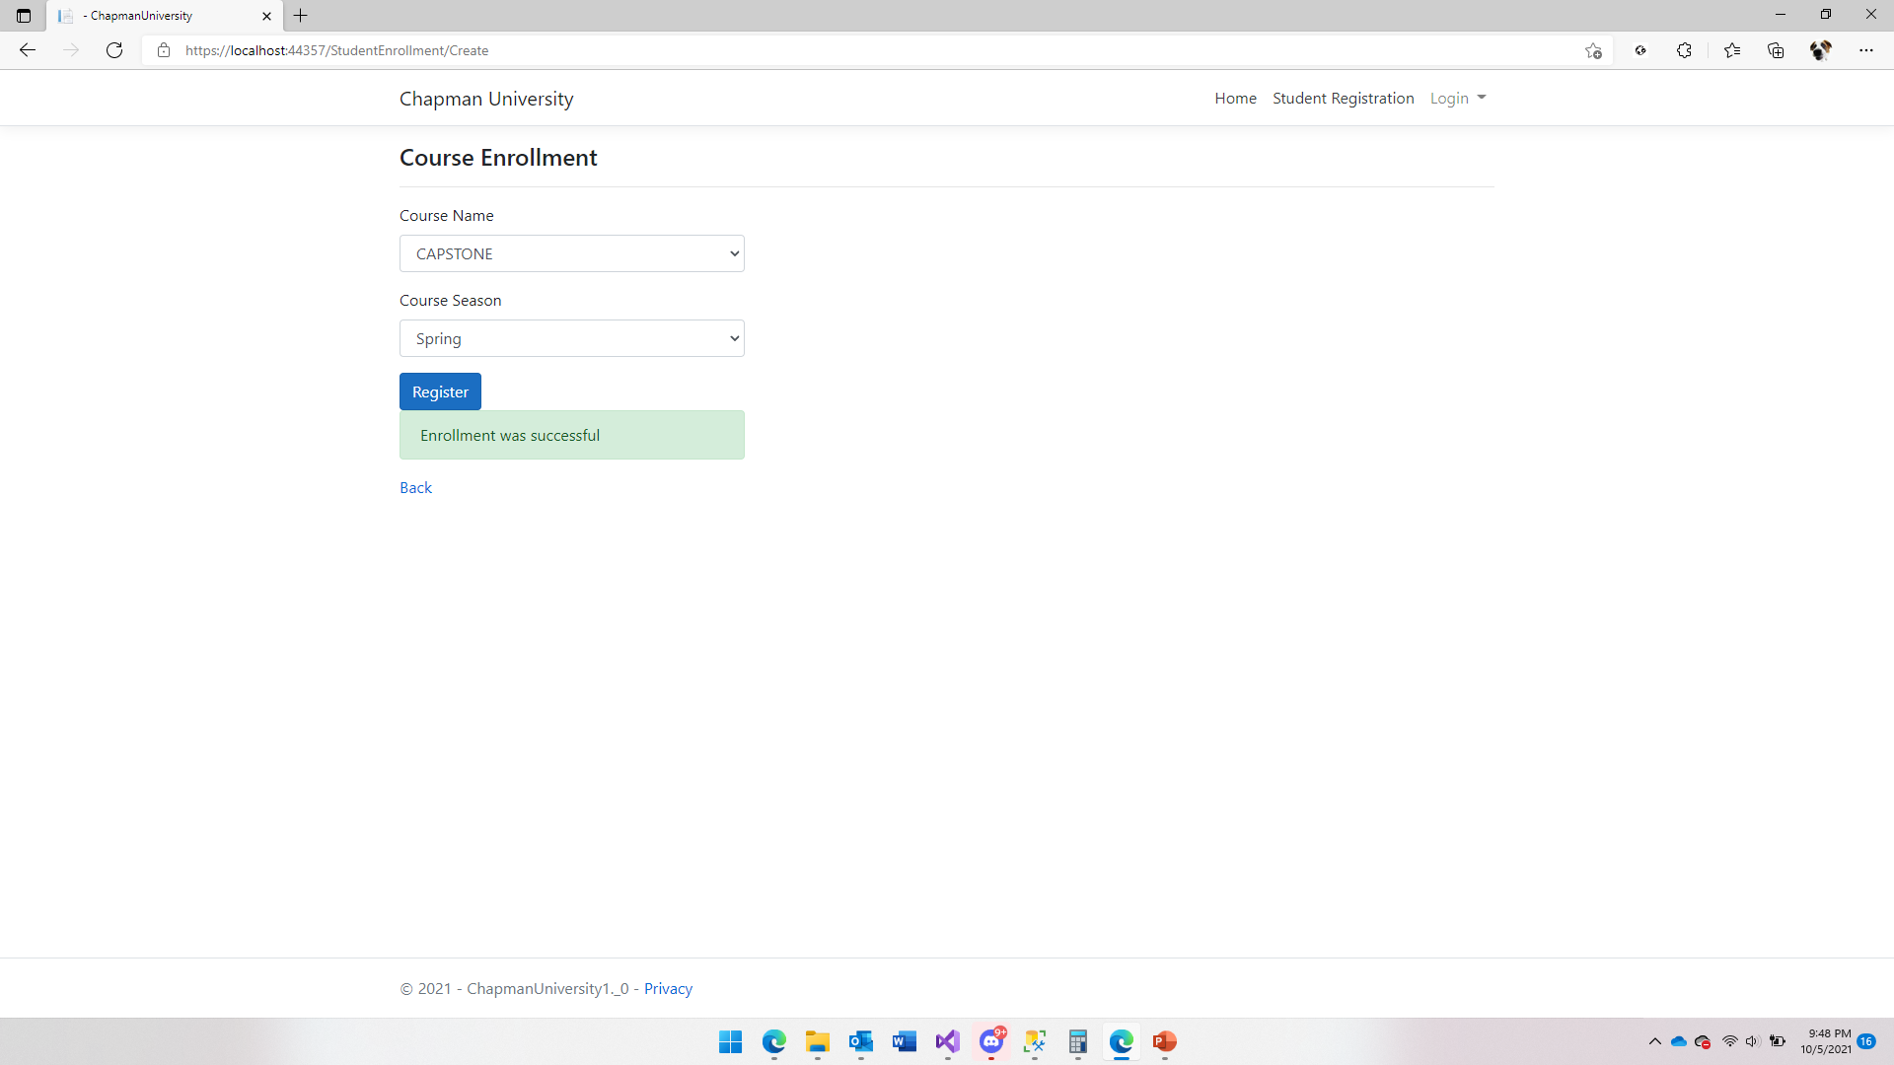
Successful Course Enrollment

Slide 15
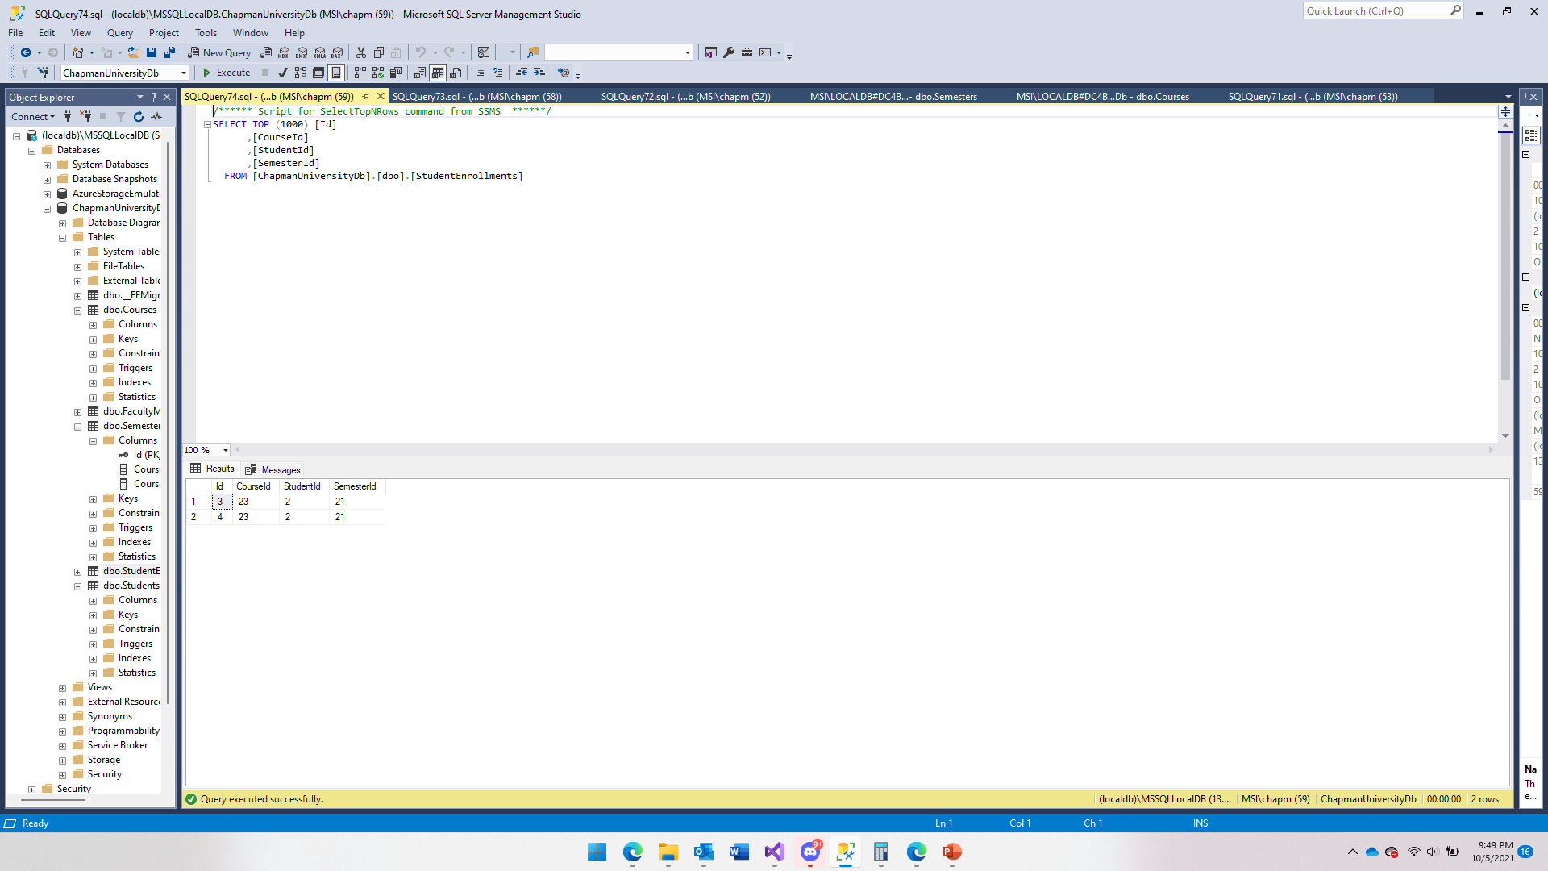
Successful Course Enrollment Database Entry

Slide 16
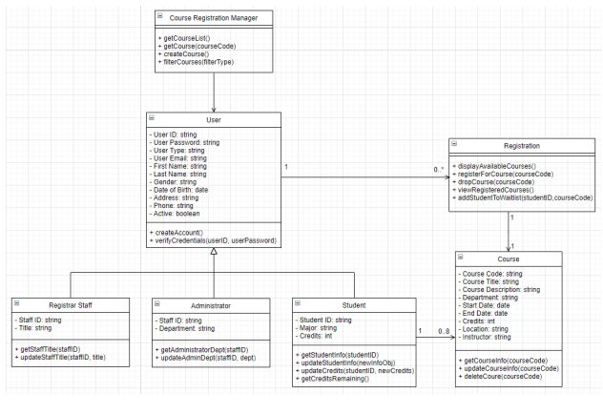
UML

