Slide 1
A Strong Baseline for DNA Sequence Classification
Team: 25
Zheng Shaomian,
Xian Jiesen,
Cao Zhelin

Slide 2
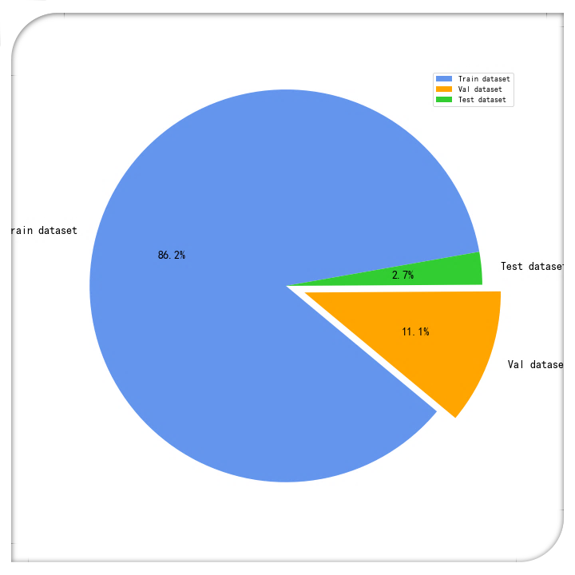
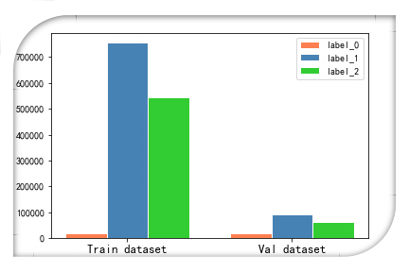
Exploratory Data Analysis (EDA)
Unbalanced data
1

Slide 3

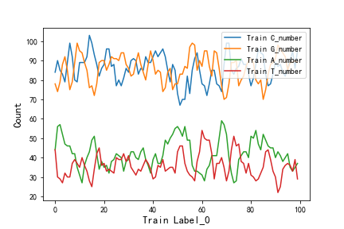
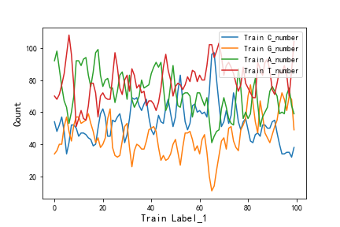
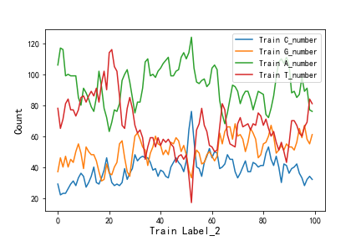
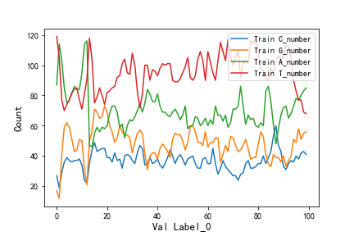
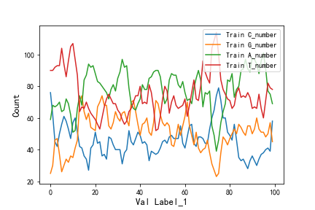
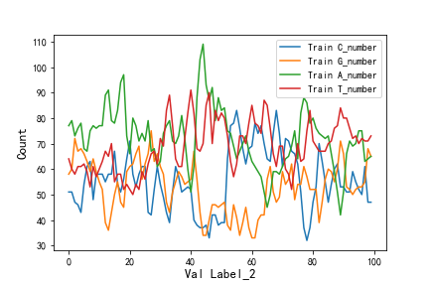
Transfer learning?
2

Slide 4
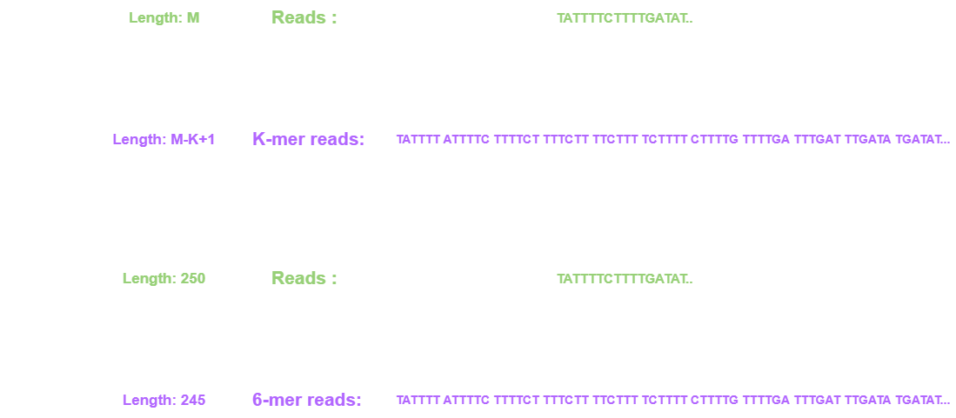
Data Preprocessing
K-mers
1

Slide 5
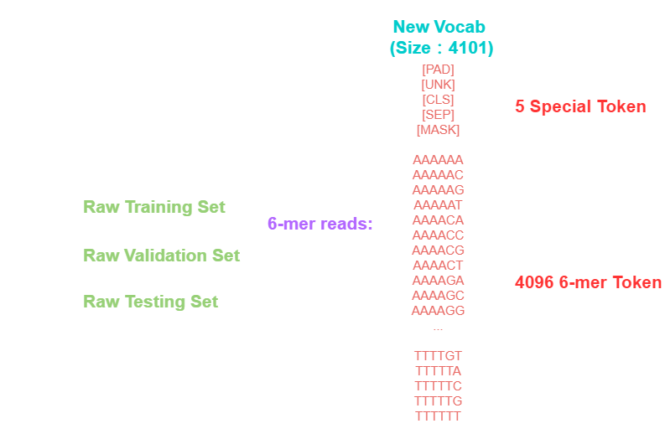
Data Preprocessing
Vocab.txt
1

Slide 6
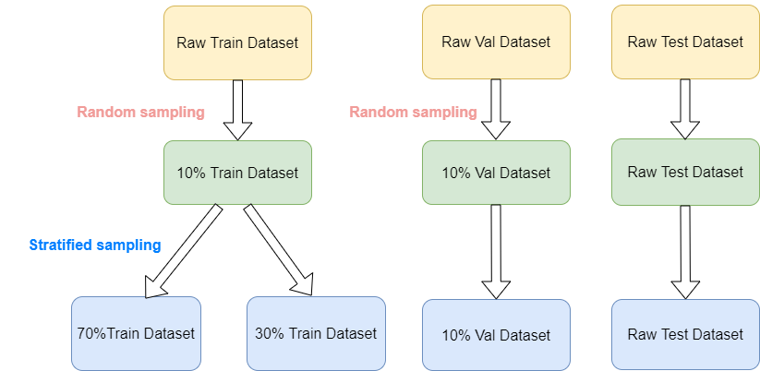
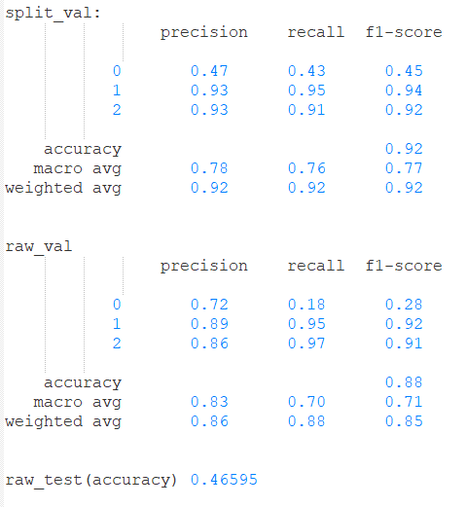
Data Preprocessing
Random sampling & Stratified sampling
1

Slide 7
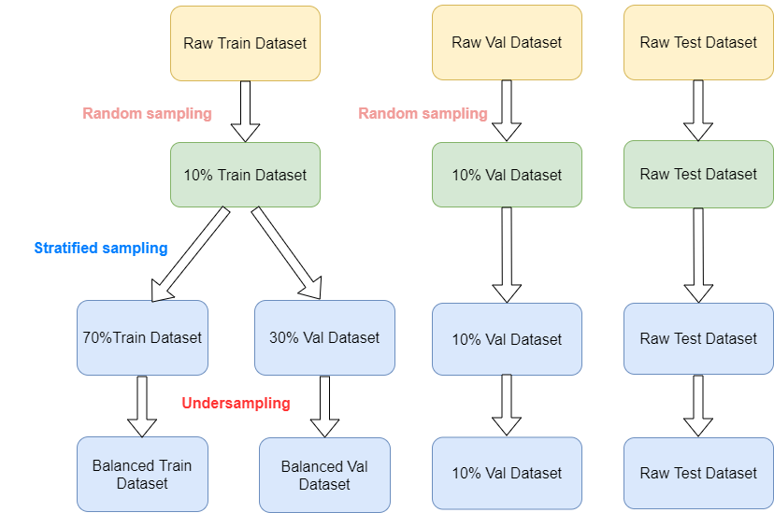
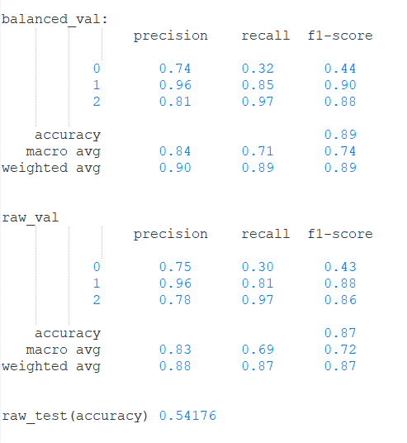
Data Preprocessing
Undersampling
1

Slide 8
Methodology
Bert is all your need
Unlabeled data
Pretrain bert model
New vocab
10% train data
Finetune
10% val data
test data
Probability
Predict
Pseudo-label
3

Slide 9
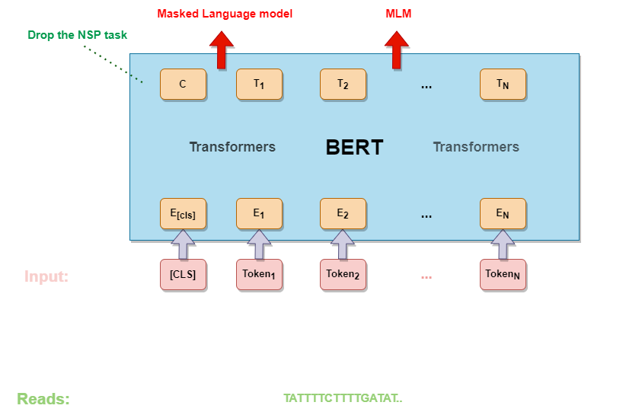
Methodology
Pretrain Model
4

Slide 10
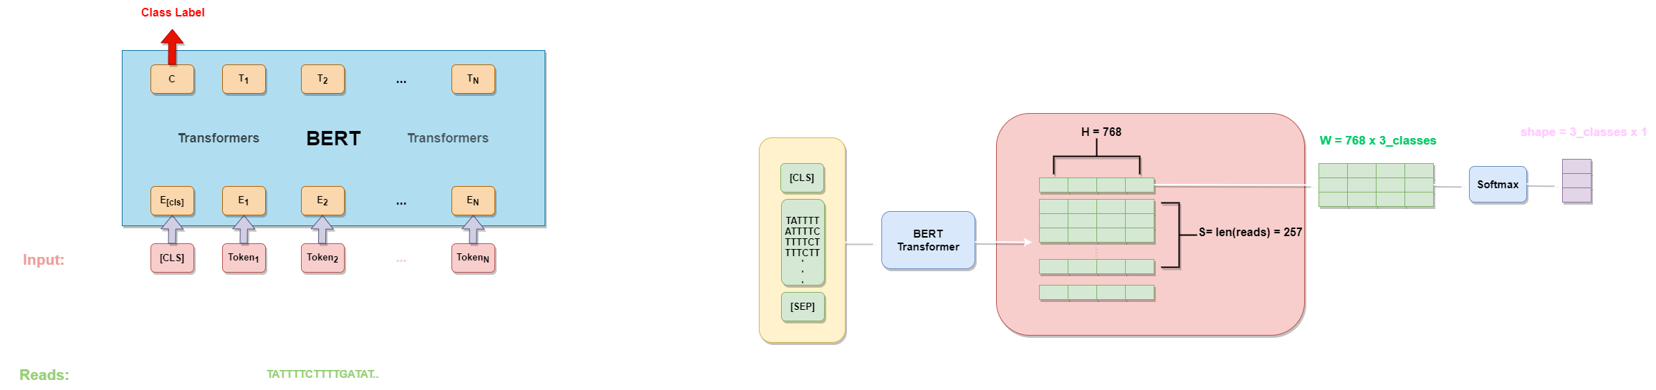
Methodology
Finetune Model
5

Slide 11
Methodology
Finetune details
6

Slide 12
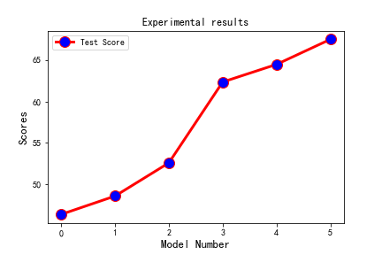
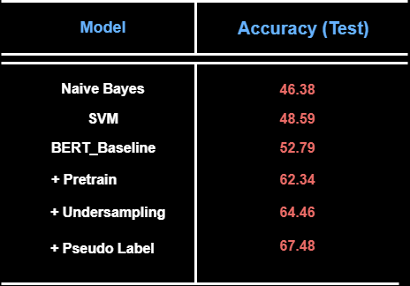
Experimental results
Model performance on Test dataset
7

Slide 13
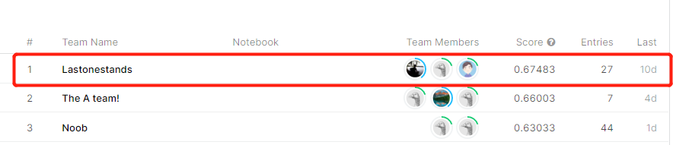
Conclusion and discussion
We trained a general model through the pre-training method, and then finetuned on the domain training set, and achieved quite good results.
(1) By pre-training the unlabeled test set, our model has a good generalization effect.
(2) Through the pseudo-label training method, our model can well cope with the challenges brought by transfer learning.
(3) By comparing the Bert model with Naive Bayes and SVM models, it turns out that our language model has obvious advantages.
(4) We only used a single model and achieved the first place on the Leaderboard.
8

Slide 14
Discussion
How to further improve the performance of the model?
K-fold
Focal loss
Ensemble
Adjust hyperparameter

