Slide 1

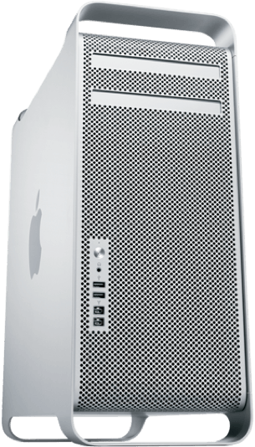
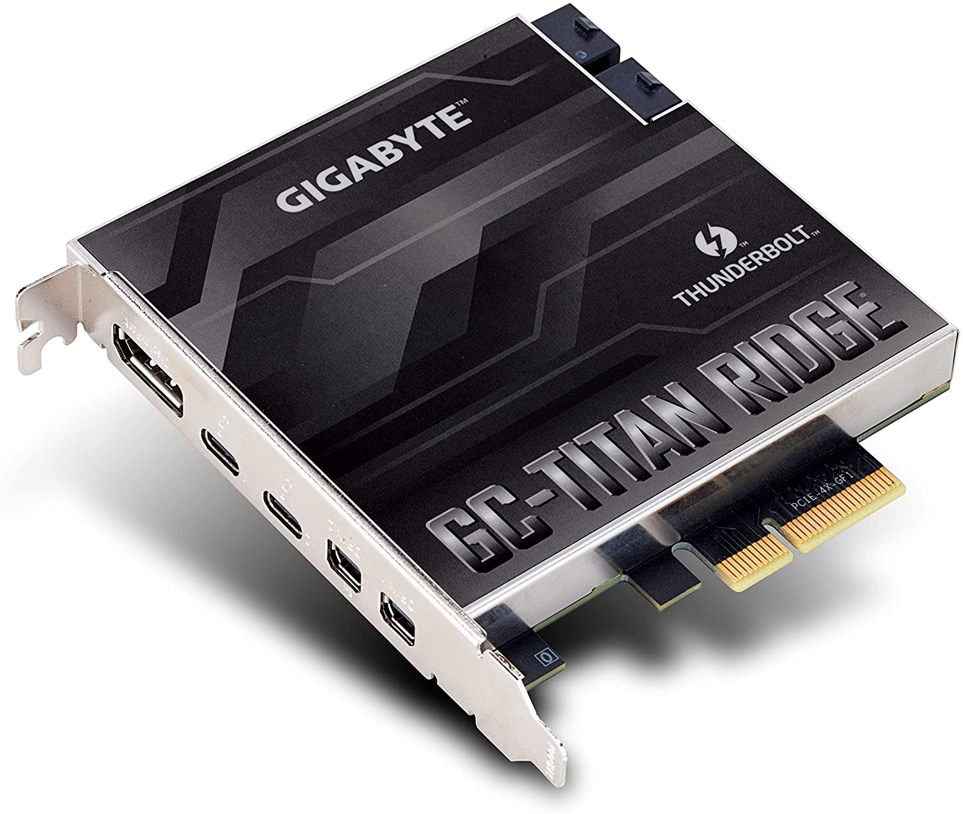
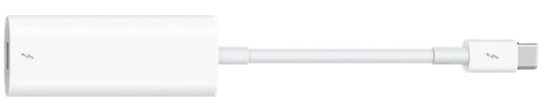
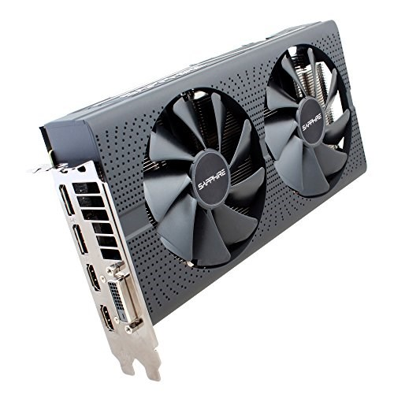
5
4
3
PCI Slot 4
1
2
Connect the output of the graphic cards Display Port to the Mini Display
input port on the GC-Titan Ridge card using the provided cables
3
Connect Thunderbolt 2 to 3 adapter to any of the Thunderbolt ports
on the GC-Titan Ridge card
1
4
Connect the Thunderbolt cable from Apple Thunderbolt Display to the
Thunderbolt adapter
2
5
Connect the cable from the second Thunderbolt Display to first Thunderbolt Display’s Thunderbolt port at the back
PCI Slot 1

Slide 2

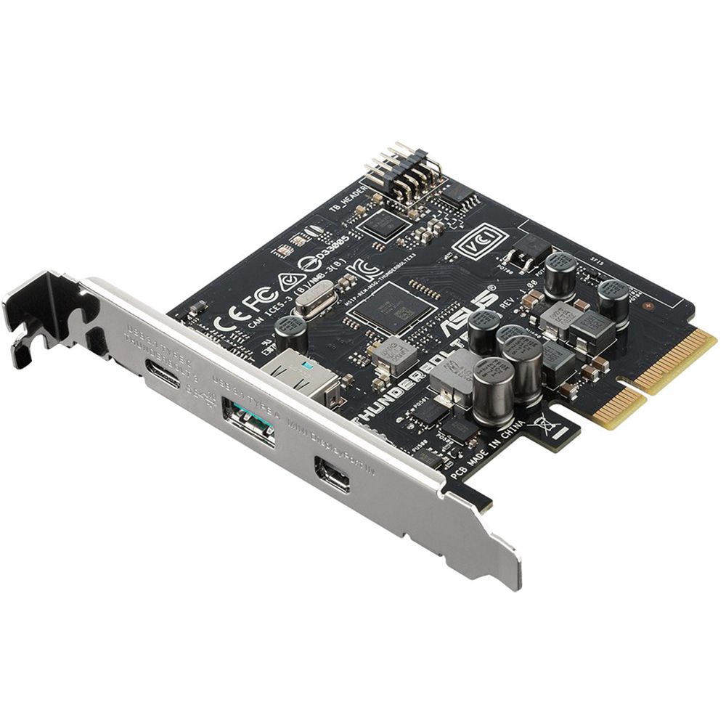
3
2
PCI Slot 3
1
Connect the output of the graphic cards Display Port to the Mini Display
input port on the GC-Titan Ridge card using the provided cables
2
Connect Thunderbolt 2 to 3 adapter to any of the Thunderbolt ports
on the GC-Titan Ridge card
1
3
Connect the Thunderbolt cable from Apple Thunderbolt Display to the
Thunderbolt adapter
PCI Slot 1

